Slide 1
Neural correlates of the LSD experience revealed by multimodal neuroimaging
Carhart-Harris,…, Nutt, PNAS, 2016

Slide 2
Significance
‘first modern neuroimaging study of LSD’

Slide 3
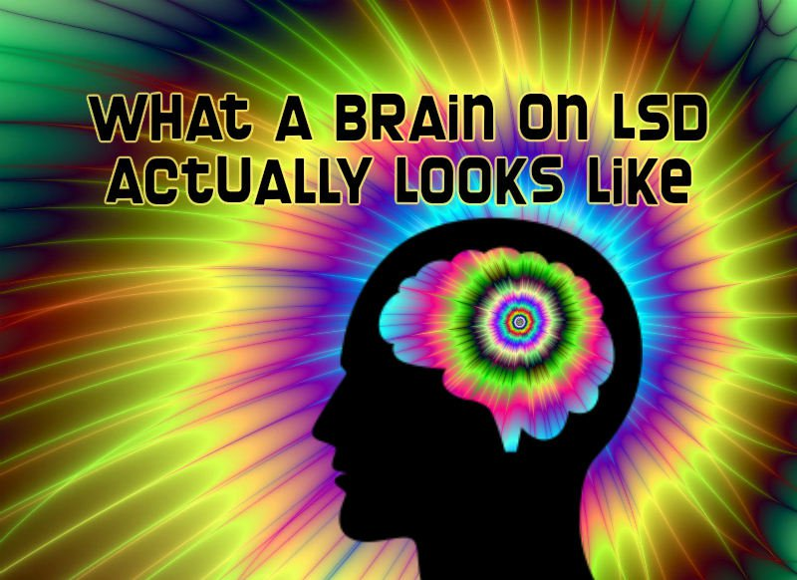

Slide 4
Background
LSD
  ‘psychedelic’
  (cf. ‘psychoactive’; e.g., stimulants, depressants,…)
  serotonergic (5-HT2A agonist; also psilocybin=‘magic mushrooms’)
  characteristic phenomenology
    visual hallucinations
    other perceptual/cognitive changes
History
  1938: synthesized by Hoffman, researching ergoline derivatives (ergot)
  1943: Hoffman accidentally discovers its psychedelic properties
  1947: Sandoz Lab introduces LSD as psychiatric drug
  1950s: CIA research program (on ‘mind control’)
  1960s: counterculture and ‘consciousness expansion’

Slide 5
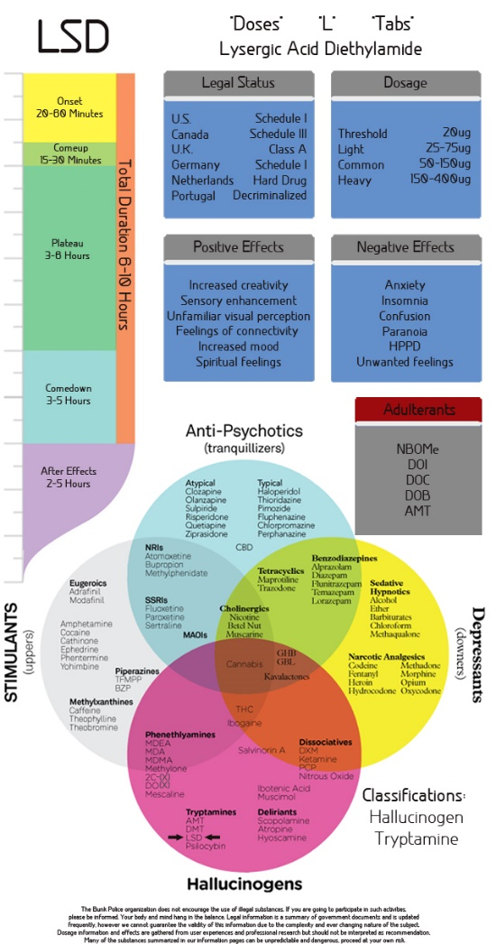

Slide 6
Methods
20 healthy volunteers, 2 sessions each (LSD vs. placebo)
Session
  scanning during ‘resting state’ (eyes closed, task-free)
    fMRI (135 mins post-infusion)
    MEG (225 mins post-infusion)
  questionnaires to measure subjective state

Slide 7
Results: subjective experience

Slide 8
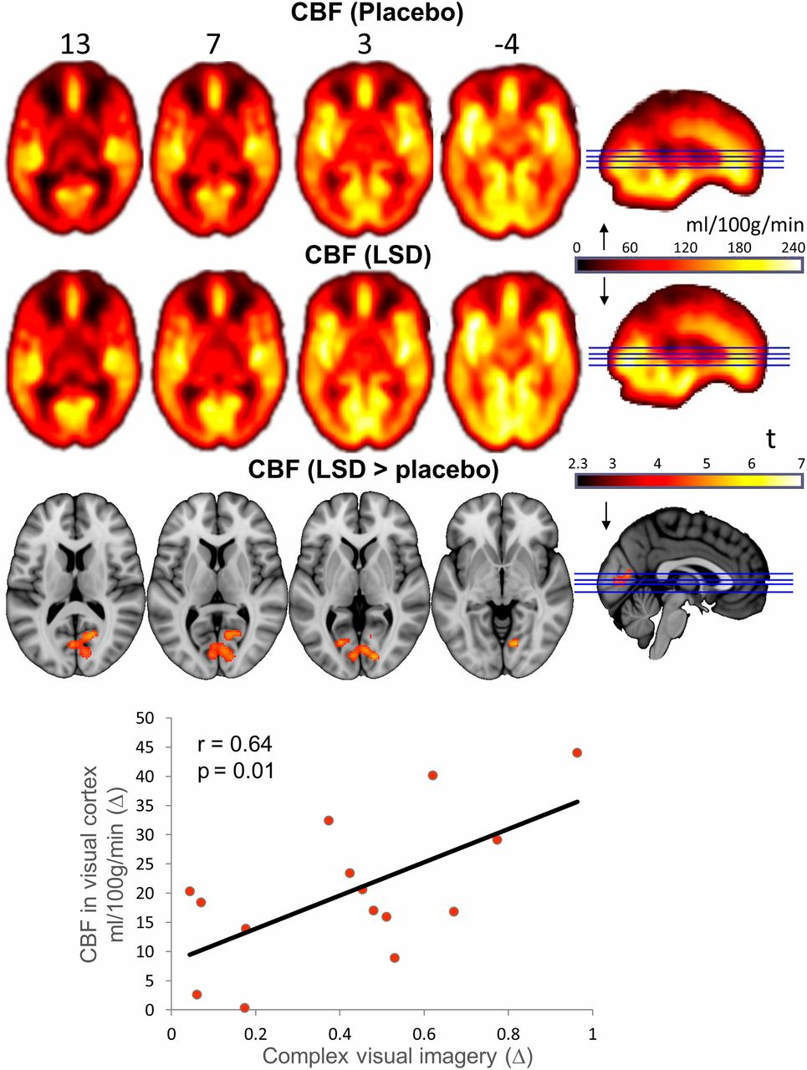
Whole-brain cerebral blood flow maps for the placebo and LSD conditions, plus the difference map (cluster-corrected, P < 0.05; n = 15).
Robin L. Carhart-Harris et al. PNAS 2016;113:4853-4858
©2016 by National Academy of Sciences
Notes:
Whole-brain cerebral blood flow maps for the placebo and LSD conditions, plus the difference map (cluster-corrected, P < 0.05; n = 15).

Slide 9
  ‘seed-based RSFC’
‘resting state’ (RS) fMRI
  ‘evaluate regional interactions that occur when a subject is not performing an explicit task’
‘functional connectivity’ (FC)
  ‘statistical dependence between two or more anatomically distinct time series’
  (resting state networks (RSNs): e.g., the ‘default-mode network’)
‘seed-based analysis’
  regress the time-course of one region over the entire brain

Slide 10
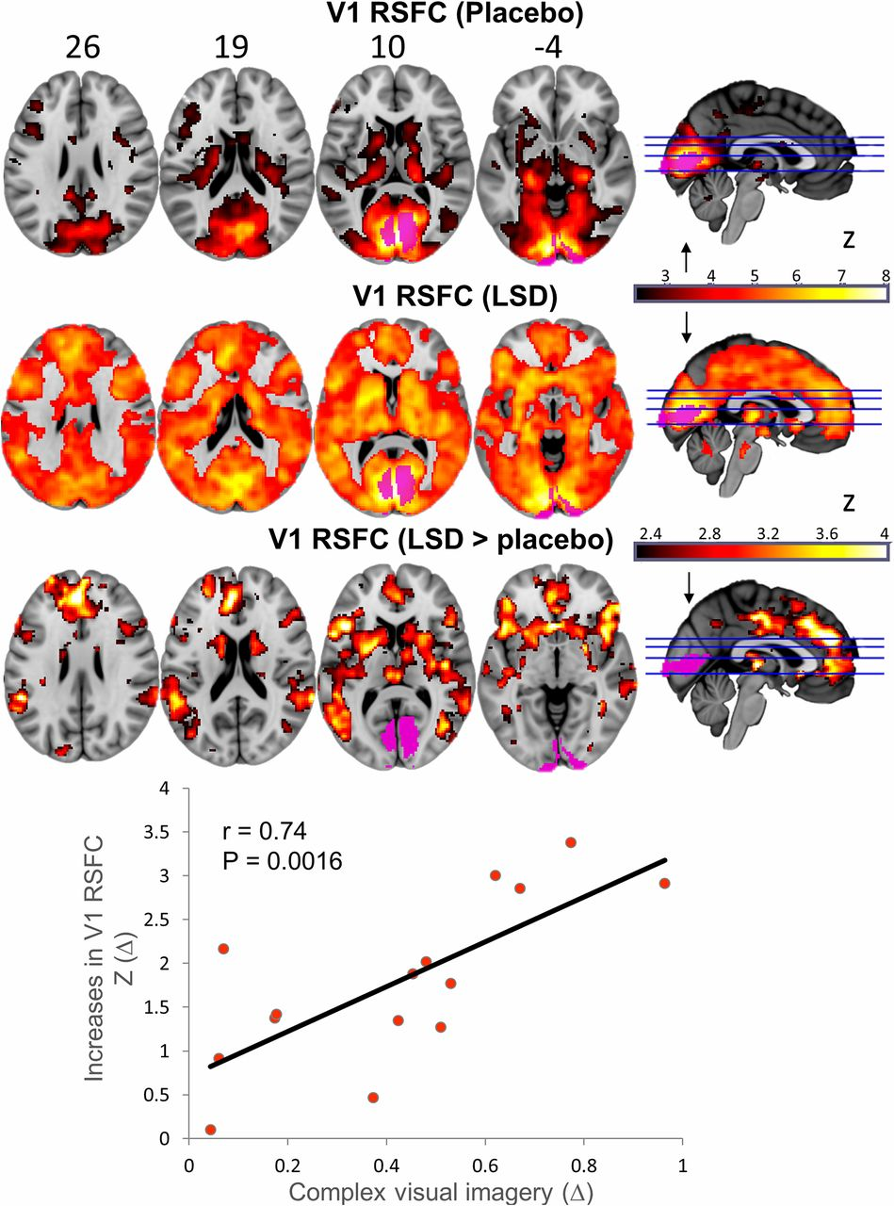
Significant between-condition differences (orange = increases) in RSFC between the V1 seed region (purple) and the rest of the brain.
Robin L. Carhart-Harris et al. PNAS 2016;113:4853-4858
©2016 by National Academy of Sciences
Notes:
Significant between-condition differences (orange = increases) in RSFC between the V1 seed region (purple) and the rest of the brain. Unthresholded maps can be viewed here: neurovault.org/collections/FBVSAVDQ/ (n = 15).

Slide 11
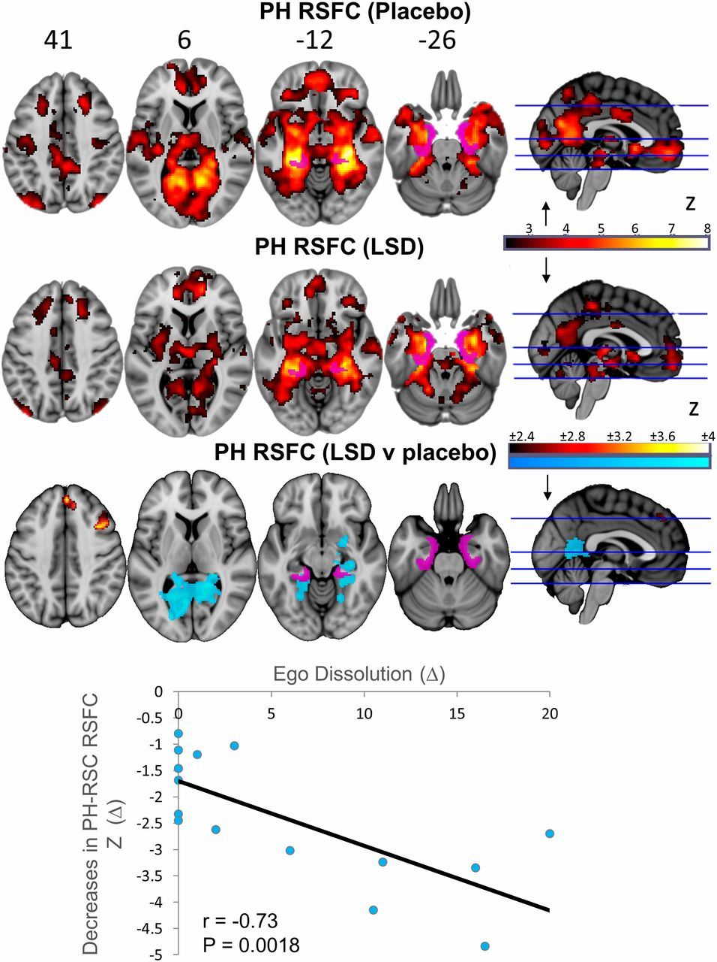
Significant between-condition differences in RSFC between the PH seed and the rest of the brain (orange = increases; blue = decreases).
Robin L. Carhart-Harris et al. PNAS 2016;113:4853-4858
©2016 by National Academy of Sciences
Notes:
Significant between-condition differences in RSFC between the PH seed and the rest of the brain (orange = increases; blue = decreases). Unthresholded maps can be viewed here: neurovault.org/collections/FBVSAVDQ/ (n = 15).

Slide 12
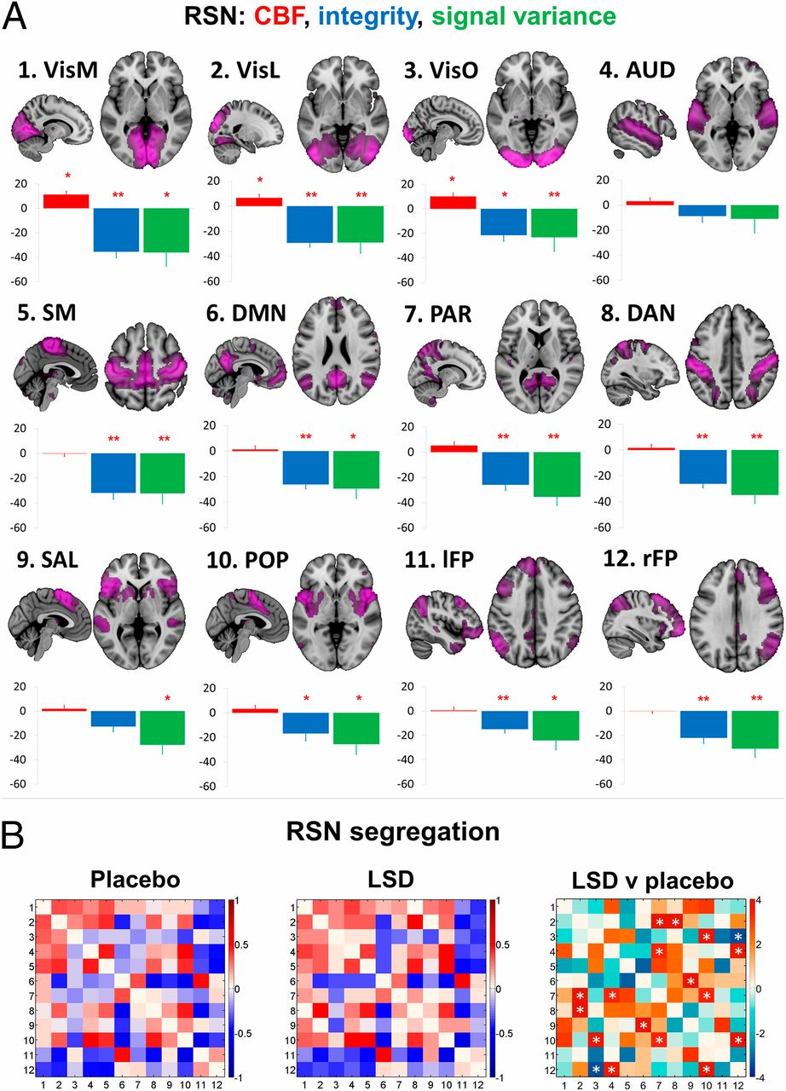
(A) Mean percentage differences (+SEM) in CBF (red), integrity (blue), and signal variance (green) in 12 different RSNs under LSD relative to placebo (red asterisks indicate statistical significance, *P < 0.05; **P < 0.01, Bonferroni corrected).
Robin L. Carhart-Harris et al. PNAS 2016;113:4853-4858
©2016 by National Academy of Sciences
Notes:
(A) Mean percentage differences (+SEM) in CBF (red), integrity (blue), and signal variance (green) in 12 different RSNs under LSD relative to placebo (red asterisks indicate statistical significance, *P < 0.05; **P < 0.01, Bonferroni corrected). (B) Differences in between-RSN RSFC or RSN “segregation” under LSD vs placebo. Each square in the matrix represents the strength of functional connectivity (positive = red, negative = blue) between a pair of different RSNs (parameter estimate values). The matrix on the far right displays the between-condition differences in covariance (t values): red = reduced segregation and blue = increased segregation under LSD. White asterisks represent significant differences (P < 0.05, FDR corrected; n = 15).

Slide 13
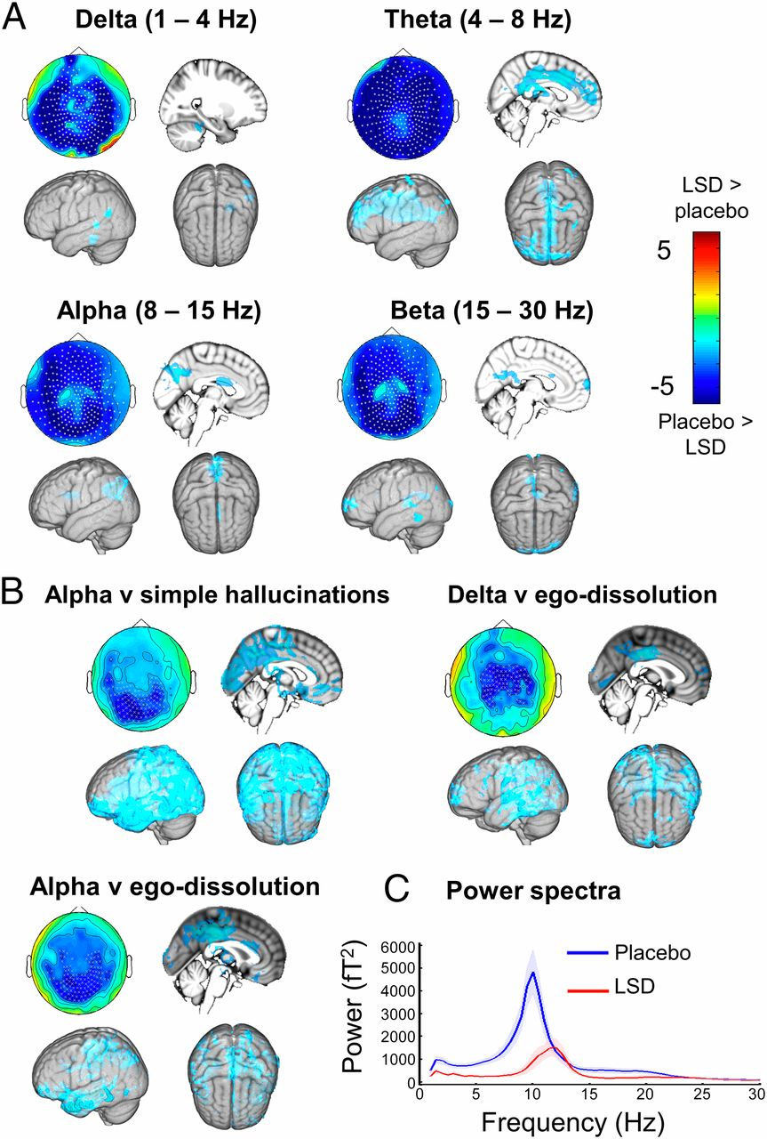
MEG results.
Robin L. Carhart-Harris et al. PNAS 2016;113:4853-4858
©2016 by National Academy of Sciences
Notes:
MEG results. (A) Statistical analysis of planar gradiometer-configured MEG data comparing LSD with placebo in the eyes-closed condition. Blue indicates less power under LSD. Units are t-statistics. Significant sensor clusters are marked such that stars correspond to P < 0.01 and crosses to P < 0.05 (corrected). Source localization results are also displayed. (B) Significant correlations between changes (decreases) in oscillatory power and subjective phenomena. (C) Power spectra for the significant sensor cluster in B (simple hallucinations), with placebo data plotted in blue and LSD in red (n = 14).

Slide 14
Summary
predicting magnitude of visual hallucinations
  increased V1 CBF & RSFC
  decreased alpha power
predicting other changes in consciousness (ego-dissolution)
  decreased PH RSFC
  decreased DMN ‘integrity’
  decreased alpha and delta power

Slide 15
Discussion
causal mechanisms
  e.g., idea that cortical alpha has a general inhibitory function, gating information by suppressing activity in task-irrelevant regions
implications for ‘endogenous’ psychosis (e.g., in schizophrenia)
relevance for therapeutic potential of psychedelics

