Slide 1
Dopamine and schizophrenia
Tea Talk, 15/1/15

Slide 2
“... a psychiatric disorder, falling within the scope of psychotic illnesses, meaning that the patient at some point develops symptoms that lead them to misinterpret reality.”
(Picchioni & Murray, scholarpedia)

Slide 3
History of a concept
Early 1800’s
Belief in a single ‘psychotic’ illness
(‘psychosis’=‘psychic neurosis’; ‘neurosis’: any disease of CNS; psychological manifestations)
Kraepelin: “dementia praecox”
Bleuler: “schizophrenia” (disconnection/splitting of psychic functions)

Slide 4
Presentation
Positive symptoms
hallucinations (esp. auditory; critical, instruction)
delusions (e.g. persecution, passivity, grandiose)
thought disorder (loose associations, tangentiality, etc.)
Negative symptoms
social withdrawal
self-neglect
loss of motivation
emotional blunting
impoverished speech
Cognitive deficits
working memory, executive functions
Clinical subtypes (paranoid, hebephrenic, catatonic, simple)

Slide 5
Epidemiology
low incidence (15.2 per 100,000)
higher prevalence (7.2 per 1000): tendency to start in early adulthood and become chronic
greatest single risk factor = family history: lifetime risk rises from 1% to 6.5% in first-degree relatives of patient; over 40% in monozygotic co-twin
males at moderately greater risk, earlier age of onset, more severe symptoms, poorer prognosis
more common in those born in cities; longer duration living in city, greater risk
more common in migrants (e.g. African and Caribbean people in UK, prevalence 6x native white population)
social adversity: racism, loss of social and family support
patients with schizophrenia more likely to have experienced obstetric complications: premature birth, low birth weight, perinatal hypoxia; intra-uterine viral exposure
substance abuse (e.g. cannabis, even after controlling for self-medication)

Slide 6
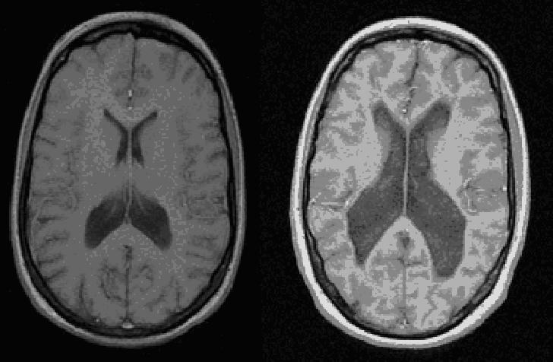
Gross structural changes
decreased cortical volume
particularly hippocampus and PFC
dendritic abnormalities without gliosis (c.f. AD)
Interpretation?
disease progression?
contribution of antipsychotics?
[unaffected (left) and affected (right) MZ twins]

Slide 7
Dopamine hypothesis of schizophrenia: Version I
Excessive dopamine transmission
Early evidence
introduction of first-generation/typical antipsychotics (1950s: chlorpromazine, haloperidol) produced PD-like symptoms
drug-induced psychosis in normals or exacerbation in patients (e.g. L-DOPA, amphetamine, LSD)
neuroleptics accelerated catecholamine metabolism
antipsychotic potency correlates with D2-blockade
elevated densities of D2 receptors in schizophrenia

Slide 8
P. Seeman (1987)

Slide 9
Dopamine hypothesis of schizophrenia: Version II
Shortcomings of version I (Davis et al., 1991)
DA elevation not universally elevated; emerging evidence that different DA receptors have different brain distributions; more regional specificity required
efficacy of clozapine (first atypical antipsychotic, 1970s) in patients refractory to other drugs, in spite of low D2 affinity (controversial)
difficult to exclude confound in postmortem studies of D2 receptors; early PET studies not conclusive

Slide 10
Regional specificity
“Hypofrontality”
PET studies showed reduced cerebral blood flow to frontal cortex, directly correlated with low CSF dopamine metabolite levels
Hypothesis: abnormally low PFC DA leads to excessive subcortical DA
lesions of DA terminals in PFC leads to increase DA and D2 density in striatum
DA agonists in PFC reduces DA metabolites in striatum
frontal hypodopaminergia = negative symptoms
striatal hyperdopaminergia = positive symptoms

Slide 11
Dopamine hypothesis of schizophrenia: Version III
Shortcomings of version II (Howe and Kapur, 2009)
little clear evidence of prefrontal hypodopaminergia has emerged
doesn’t address how dopamine dysregulation produces symptoms
Dopamine as the final common pathway to psychosis; the idea of aberrant salience (Kapur, 2003)

Slide 12
‘Psychosis as a state of aberrant salience’ (Kapur, 2003)
“The clinical hallmark of schizophrenia is psychosis”
“central role of DA is to mediate salience of environmental events and internal representations”
dysregulated, hyperdopaminergic state leads to aberrant attribution of salience to aspects of experience
hallucinations: reflect direct experience of aberrant salience of internal representations
delusions: results of cognitive effort to make sense of experience

Slide 13
More recent evidence (Howe and Kapur, 2009)
robust finding of elevated presynaptic striatal DA synthesis in schizophrenic patients
baseline occupancy of D2 receptors by DA increased in schizophrenia
confirmation of modest elevation of striatal D2/3 receptor density independent of antipsychotic medication; striatal D1 densities unaffected
D1 dysfunction linked to cognitive impairment and negative symptoms in schizophrenia
environmental risk factors: social isolation/subordination, obstetric complications

Slide 14
Inconsistencies and the glutamate hypothesis of schizophrenia
Problems
patients symptomatic for many years can be less responsive to antipsychotics in spite of very high D2 occupancy
antipsychotics less effective in addressing negative symptoms or cognitive impairments (e.g. impaired memory)
Glutamate hypothesis: NMDA receptor hypofunction
ketamine and PCP can induce clinical states indistinguishable from schizophrenia (pos and neg)
probable interactions with DA system
drug development ongoing

Slide 15
So what do we know?
Large amount of evidence that abnormal DA activity plays central role in positive symptoms of schizophrenia
DA-mediated (mis)attribution of incentive salience may explain psychotic symptoms
D2 receptors mediate antipsychotic action: threshold striatal D2 blockade is required for antipsychotic efficacy
Negative symptoms and cognitive deficits perhaps not as well addressed

