Slide 1
Cheap talk in bargaining experiments: lying and threats in ultimatum games
Rachel Croson Terry Boles J. Keith Murnighan
Journal of Economic Behavior & Organization

Slide 2
Cheap Talk: Farrell & Gibbons (1989)
“one might expect that cheap talk could not matter in bargaining, because each side has an obvious incentive to seem unenthusiastic: we think of a bazaar, where the buyer sneers at the seller’s goods, which the latter declares are so precious as to be scarcely for sale.”
“yet casual observation reveals much cheap talk of the opposite kind: people often claim to be “seriously interested” in trading.”
“Imagine that one Saturday evening, two corporate moguls have a chance encounter at their country club. One mogul’s company owns a division that the other mogul’s firm may wish to buy. Serious negotiation, involving binding offers and hordes of lawyers, can take place on Monday morning; all that can happen Saturday night is talk. If, based on this talk, the moguls conclude that there is sufficient prospect of gains from trade, then they will send their lawyers into the fray on Monday morning. Otherwise, Saturday evening will be the end of it. Therefore, each mogul has an incentive not to sneer too much, lest the other choose not to try to do business with one who seems uninterested. The strategy (common in bazaars) of sneering and then returning for serious bargaining is less attractive to the moguls because a sneer may end negotiations.

Slide 3
Ultimatum Game with Outside Options
split $10; no agreement=$0
proposer: average $3-4
responder: typically reject <$3
outside option: give one side sure money if rejection
for proposer, no change to equilibrium
in US reduces offer; in Japan increased offer
imperfect information: how big is the pie?
proposers make; responders accept lower offers
cheap talk: threats; demands; information about pie size

Slide 4
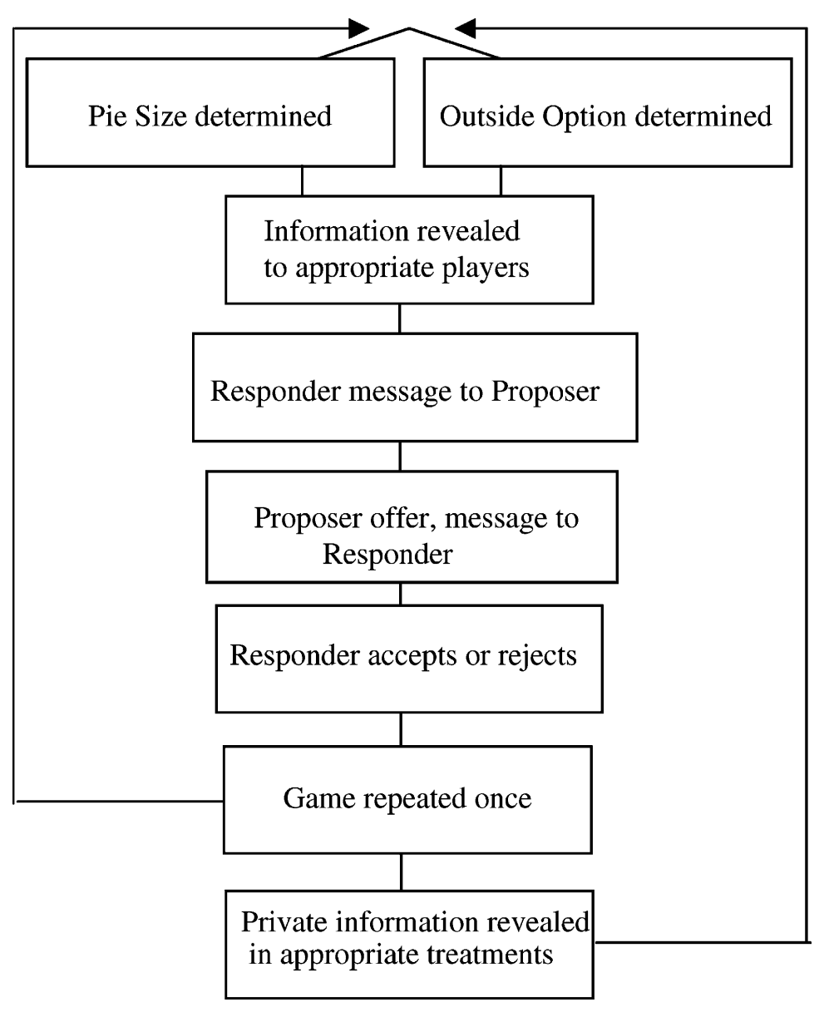
Complex Design
(responder)
known: pie; outside option
unknown:
pie: $10-50
outside: $1-8
after two games – may tell parties whether they have been telling porkies

Slide 5
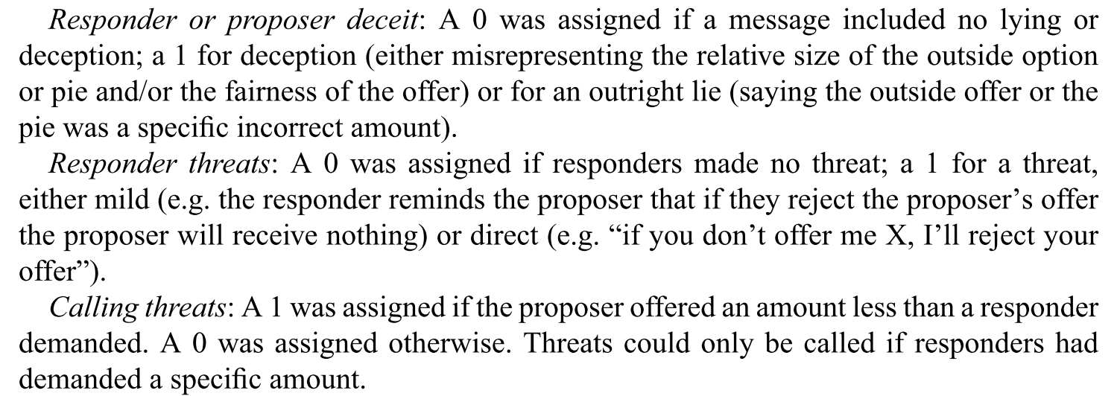
Decoding Cheap Talk

Slide 6
Ideas
equilibrium:
if responder outside is $X, then offer $X+e
if you don’t know: then min(pie/2,$8)
cheap talk:
about private information (‘pie is miserably small’)
about preferences (‘I’m going to be upset if you’re mean’)
but anchoring; penance

Slide 7
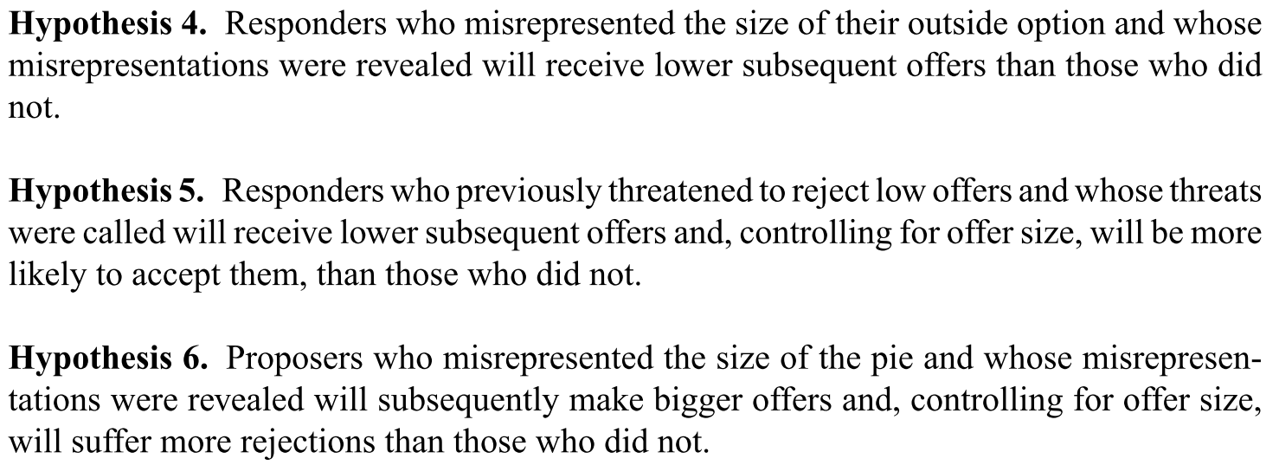
Hypotheses

Slide 8
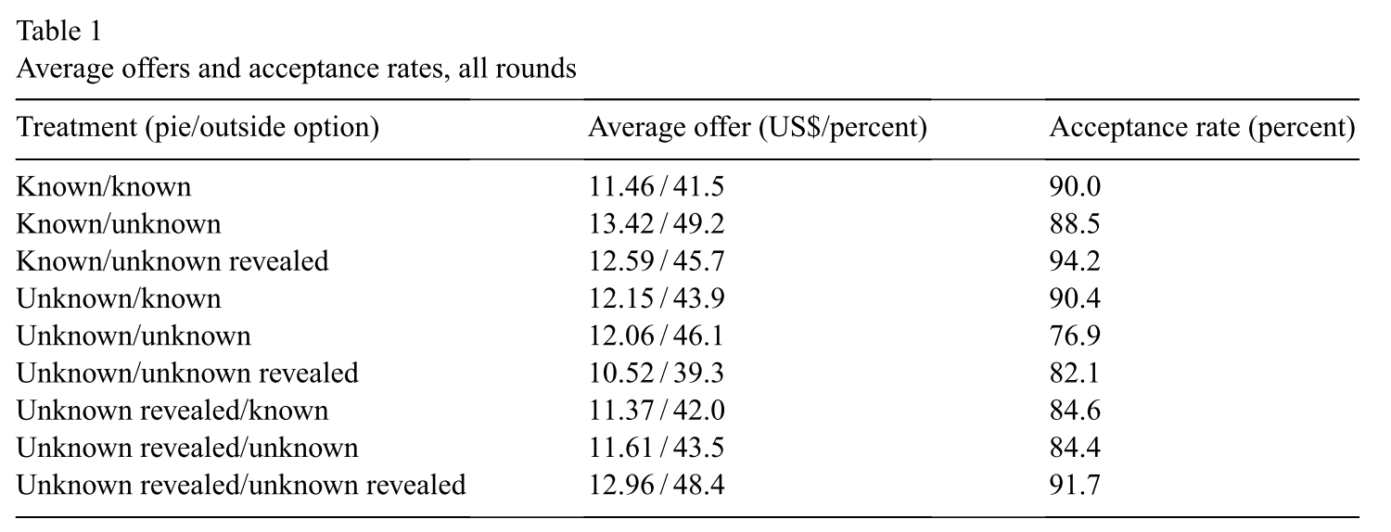
Results
for $ 27, 47 , 25, 13 -> $ 11.22, 19.04, 13.04, 6.54
{1,2}: unknown pie: $14.71; known pie: $16.00
{1,2}: unknown option: $15.44; known option: $14.50

Slide 9
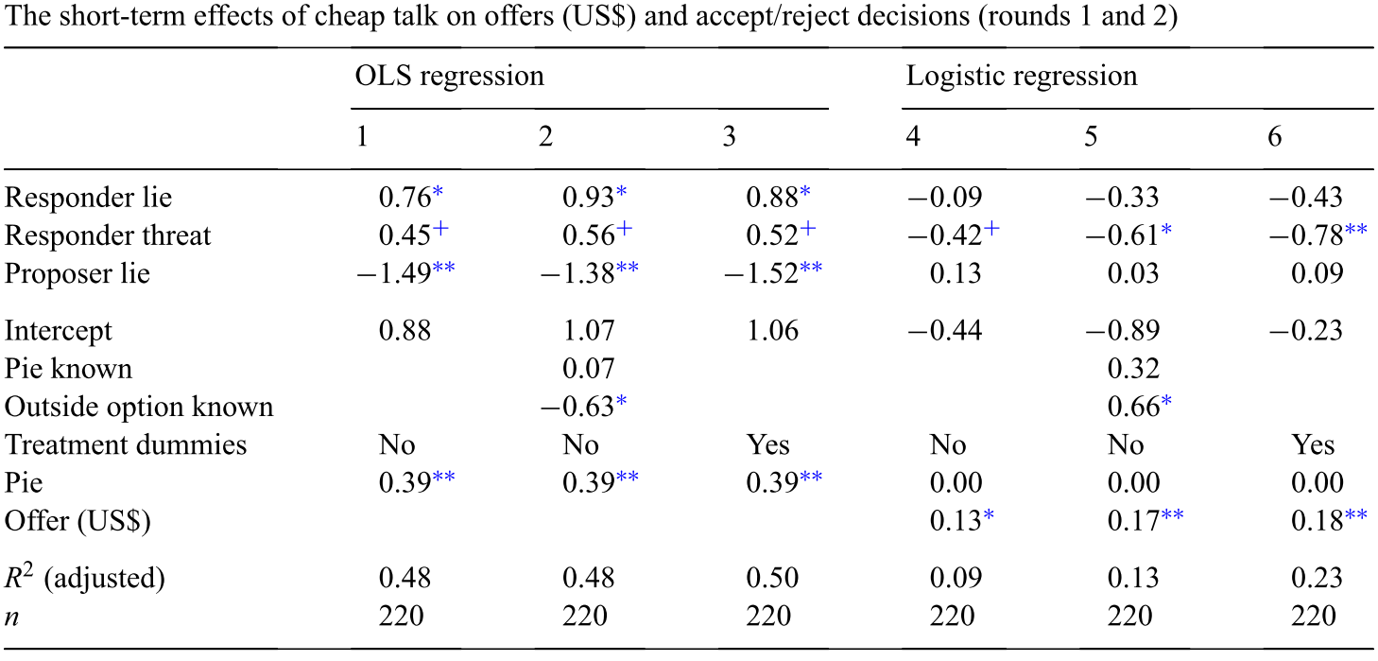
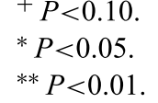
Use Regression to test the Hypotheses
H1: responder lies increase their offers
H2: responder threats marginally increase their offers; decrease acceptance
H3: proposer lies associated with lower offers; and no change in accept

Slide 10
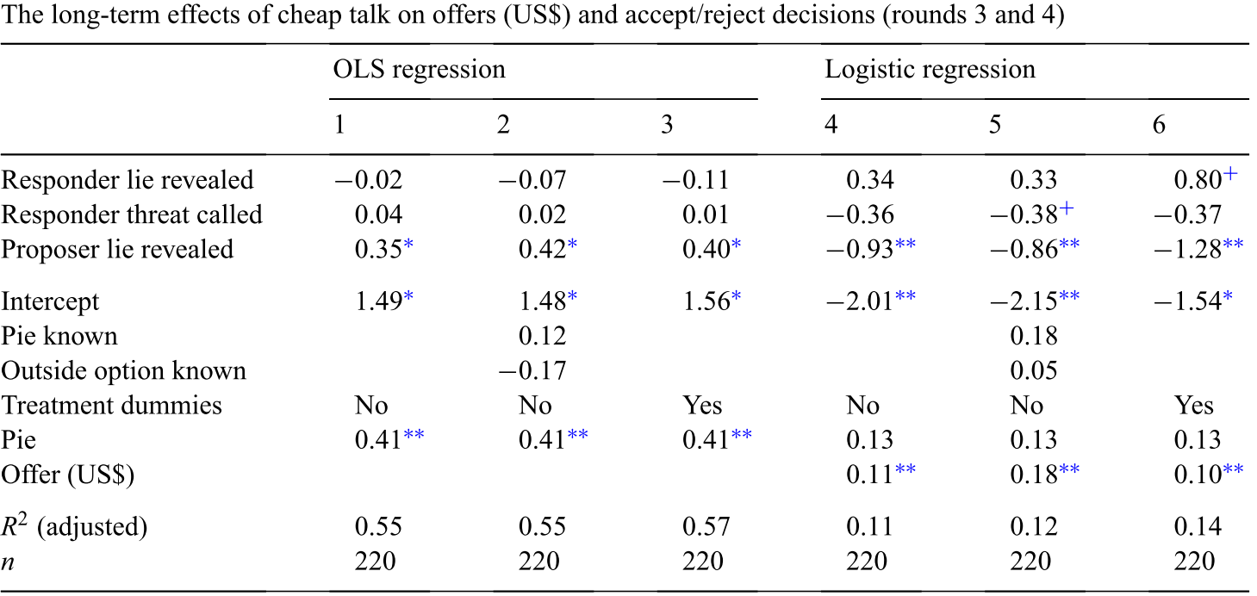
Reputation
H4: responder perfidy associated with marginally smaller offers
H6: proposer perfidy associated with larger offers; decreased acceptances
H5: no real impact of threats that were called

Slide 11
Discussion
short-term effect: misrepresentation works
long-term effect: getting found out is costly
models: talk is cheap; bargainers are influenced
some sequential effects not assessed: threat calling

