Slide 1
Rational Temporal Predictions Can Underlie Apparent Failures to Delay Gratification
Joseph T. McGuire and Joseph W. Kable
Psychological Review 2013

Slide 2
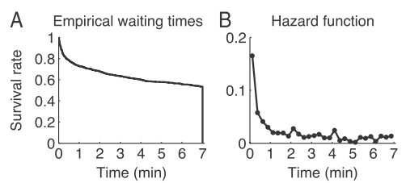
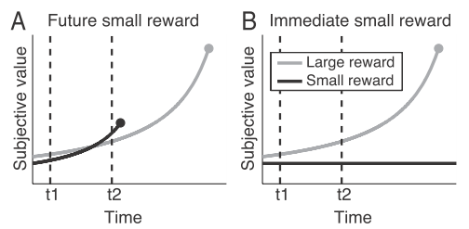
The Marshmallow Test
failure to postpone gratification:
subjects pursuing a large, long-run, outcome
abandon it in favour of a small, short-run alternative
that has always been available
possible explanations:
hot/cool; affective/deliberative; Pavlovian/instrumental
but why abandon late?
depletion of strength of willpower
hyperbolic discounting
but small reward always available

Slide 3
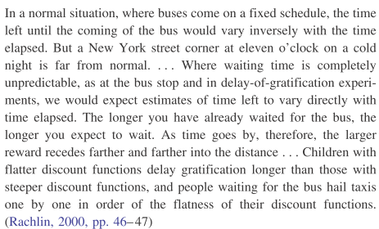
The Instructions
+ Richard Gott’s Copernican Principle

Slide 4
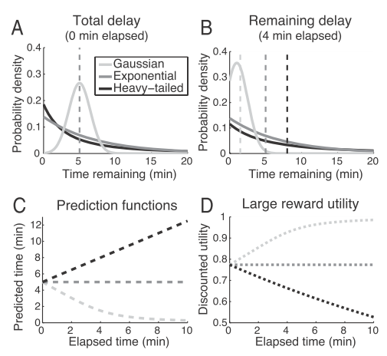
Formally
initial beliefs are cumulative distribution function F(t)
assume decision-making based on the median of the remaining delay
should integrate out uncertainty; worry about temporal uncertainty
also mixture model
Gott: P(t)~1/t

Slide 5
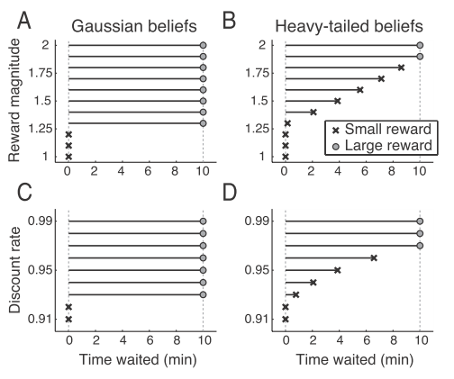
Implying
exponential discounting (0.95 in A;B)
small reward 1
large reward 1.5 in C;D
temporal beliefs
discount factor
reward size

Slide 6
Heavy-Tailed Beliefs
email replies (Barabasi)
successive mentions of a name in a newspaper (Anderson)
hospital admission and discharge (Harrison)
phone call (Griffiths & Tenenbaum)

Slide 7
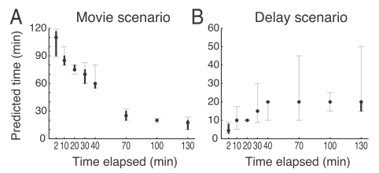
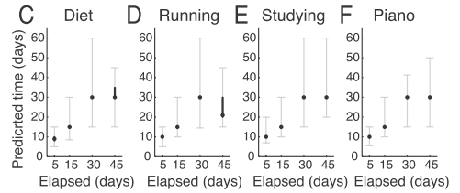
How Long Left
given time elapsed, how much longer
given no discernible progress, how much longer

Slide 8
Marshmallows
simplifications:
thus:
Gaussian prior over m doesn’t work
Gaussian prior over inverse logistic D does

Slide 9
Discussion
calibrating persistence
‘unrequited love’ (Baumeister)
manipulate prior by experience (McGuire)
plus poor test/retest reliabilty in Mischel
distraction changes subjective time?
PhDs: willpower vs stable discounting
risk of non-arrival quite similar
estimation of cost/unit time
no account of binding (Ulysses and the sirens)

