Slide 1
Predicting h-index
Daniel Acuna, Stefano Allesinam and
Konrad Kording
Nature 489:201–202 (13 September 2012)
Tea talk
September 13, 2013

Slide 2
It would be really nice to have an objective measure of
research quality.
Because then it would be easy to judge you (without having
to figure out what you actually do).
Proposals:
- number of papers (or papers/year)
- number of citations (or citations/paper)
- average value of (citations ÷ impact factor)
- h-index
- and a lot more

Slide 3
Why don’t we just count papers or citations?
Counting papers: doesn’t control for quality.
One might think about weighting paper by journal impact
factors, but high profile journals tend to not control for
quality.
Counting citations is better, but it also has problems.

Slide 4
A couple of scenarios.
10,000 citations
one-hit wonder
number of citations
papers ordered by citation number
large number of citations
large number of citations/paper

Slide 5
A couple of scenarios.
many-hit non-wonder
number of citations
1,000 papers
papers ordered by citation number
large number of citations
small number of citations/paper

Slide 6
A couple of scenarios.
normal, productive scientist
number of citations
papers ordered by citation number
reasonably large number of citations
reasonably small number of citations/paper

Slide 7
A couple of scenarios.
number of citations
h-index
papers ordered by citation number
Jorg Hirsch (PNAS 102: 16569-16572 2005)
number of papers, h, with at least h citations
(maximized over h)

Slide 8
A couple of scenarios.
normal, productive scientist
h-index is reasonably large
number of citations
h-index
papers ordered by citation number

Slide 9
A couple of scenarios.
10,000 citations
one-hit wonder
h-index is small
number of citations
h-index
papers ordered by citation number

Slide 10
A couple of scenarios.
many-hit non-wonder
h-index is small
number of citations
1,000 papers
h-index
papers ordered by citation number

Slide 11
αn²
βn^{1/2}
number of citations
h-index
papers ordered by citation number
Although it’s not a bad index, the h-index is far from perfect:
It doesn’t count for author contribution.
It doesn’t take into account self-citations.
It is just one of many possible metrics.
There is probably no good single objective metric.

Slide 12
We’re going to ignore all that and just see if
we can predict the h-index.
Prediction is important, because what we care
about is future productivity.
Never mind that the h-index and future productivity
might not be related …

Slide 13
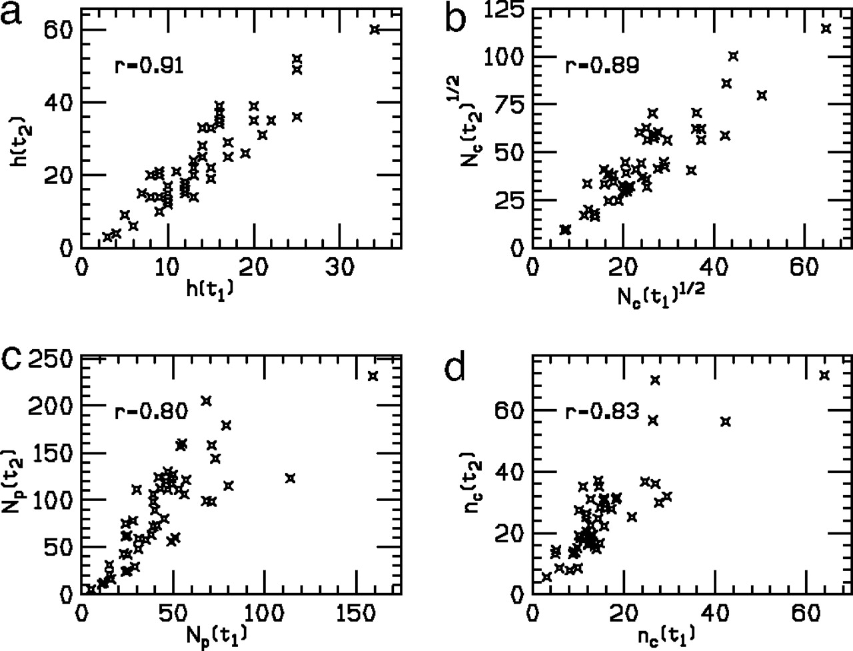
The first question: can h predict itself?
Yes, at least for physics:
12 years later
Database of physicists:
Physical Review B: Condensed Matter and Materials Physics
Hirsch, PNAS 104:19193–19198 (2007)
Notes:
Predictive power of each indicator at time t1 = 12 yr for the value of the same indicator at time t2 = 24 yr for sample PRB80.

Slide 14
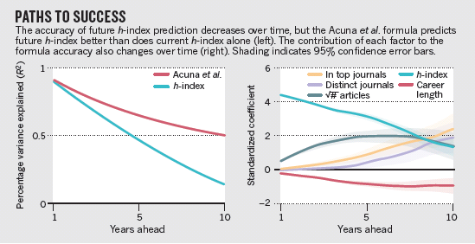
But it’s not such a good predictor for neuroscience
physics

Slide 15
Acuna et al. wanted to get a better prediction of
future h-index.
“To construct a formula to predict future h-index,
we assembled a large data set and analysed it
using machine-learning techniques.”
large data set: 3085 neuroscientists
machine-learning techniques: linear regression
with elastic net
regularization

Slide 16
minimized
n
2
1
∑_{i=1} (h_{i} - β⋅x_{i})² + λ((1-α) ||β||₂/2 + α|β|₁)
2n
with respect to β
i labels scientist
x = set of features
α = 0.2
λ chosen using cross-validation

Slide 17
features (x):
number of articles in top journals: Nature, Science, Nature Neuroscience, PNAS, Neuron
number of articles in theoretical journals
number of years in a postdoctoral position
number of years in graduate school
number of articles with a adviser is a co-author
number of R-type grants
total current yearly cost
h-index divided by career length
mean h-index divided by career length of PhD supervisor
proportion of articles as last author
proportion of articles as first author
total number of citations
total number of articles
average number of co-authors per article
total number of journals
average number of citations per article
number of year since publishing first article
current h-index

Slide 19
approximate formulae:
h₊₁ = 0.76 + 0.97h + 0.37n^{1/2} – 0.07y + 0.02d + 0.03q R²=0.92
h₊₅ = 4.00 + 1.58h + 0.86n^{1/2} – 0.07y + 0.06d + 0.20q R²=0.67
h₊₁₀ = 8.73 + 1.33h + 0.48n^{1/2} – 0.07y + 0.52d + 0.82q R²=0.48
n: number of articles written
h: current h-index
y: years since publishing first article
d: number of distinct journals
q: number of articles in high profile journals:
Nature, Science, Nature Neuroscience, PNAS and Neuron

Slide 20
full model:
http://klab.smpp.northwestern.edu/h-index.html

Slide 21
my neuroscience h-index
55
Richard
Feynman
45
35
h-index
25
15
2006
2010
2015
2020
2024
year

Slide 22
I have one issue and one comment

Slide 23
Issue:
Did they try
h(t) = h₀ + h(t₀) + β(t – t₀)?
In principle yes, because they seem to have done a different regression for each future time period.
But Hirsch found that h-index tended to increase linearly.

Slide 24
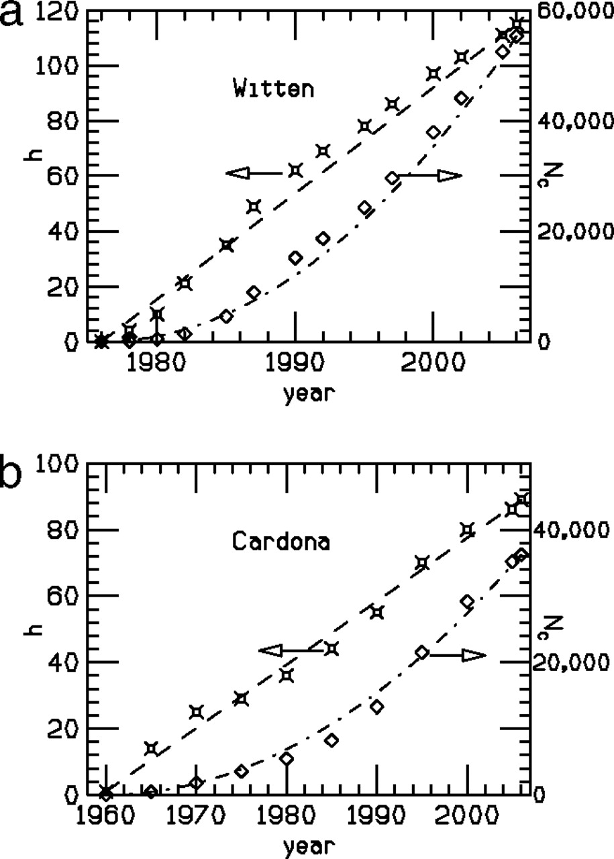
h index vs. time (left scale) and total number of citations (Nc) vs. time (right scale) for E. Witten (theorist) (a) and M. Cardona (experimentalist) (b).
Notes:
h index vs. time (left scale) and total number of citations (Nc) vs. time (right scale) for E. Witten (theorist) (a) and M. Cardona (experimentalist) (b). The dashed and dash-dotted lines show linear and quadratic fits to the h index and Nc, respectively.

Slide 25
Issue:
Did they try
h(t) = h₀ + h(t₀) + β(t – t₀)?
In principle yes, because they seem to have done a different regression for each future time period.
But Hirsch found that h-index tended to increase linearly.
And he found R² = 0.8 12 years in the future (versus about 0.2).

Slide 26
The first question: can h predict itself?
Yes, at least for physics:
12 years later
Database of physicists:
Physical Review B: Condensed Matter and Materials Physics
PNAS 104:19193–19198 (2007)
Notes:
Predictive power of each indicator at time t1 = 12 yr for the value of the same indicator at time t2 = 24 yr for sample PRB80.

Slide 27
Issue:
Did they try
h(t) = h₀ + h(t₀) + β(t – t₀)?
In principle yes, because they seem to have done a different regression for each future time period.
But Hirsch found that h-index tended to increase linearly.
And he found R² = 0.8 out to 12 years (versus about 0.2).
Maybe physicists and neuroscientists are different?

Slide 28
Comment:
h₊₁ = 0.76 + 0.97h + 0.37n^{1/2} – 0.07y + 0.02d + 0.03q R²=0.92
h₊₅ = 4.00 + 1.58h + 0.86n^{1/2} – 0.07y + 0.06d + 0.02q R²=0.67
h₊₁₀ = 8.73 + 1.33h + 0.48n^{1/2} – 0.07y + 0.52d + 0.08q R²=0.48
Why 1/2 power?
Assume number of citations, n_{c}, is drawn from a distribution,
p(n_{c})
Then,
h = n ∫ dn_{c} p(n_{c})
number of papers
with at least h citations
∞
h

Slide 29
∞
h = n ∫ dn_{c} p(n_{c})
h
what does this imply?
suppose that for large n_{c}, p(n_{c}) ~ 1/n_{c}
=> h ~ n h^{1-k}
=> h ~ n^{1/k}
total p(n_{c}), experimental high-energy physicists: k=2.8.
2=2.8 for small 2.8!
k

