Slide 1
Cracking the neural code for sensory perception by combining statistics, intervention, and behavior
Stefano Panzeri, Chris Harvey, Eugenio Piasini, Peter Latham, Tommaso Fellin Neuron 93:491-507 (2017)
Tea talk
April 27, 2017

Slide 2
Flash back to the 1990s, when one of the big questions was:
What aspects of spike trains are important?
In its simplest version, this was a question about bin size.

Slide 3
A typical experiment:
Show a set of stimuli (over and over) while recording from a neuron.
Bin the spike trains at a bin size of Δt.
Compute the information between the stimuli and spike trains versus Δt.
A typical result:
run out of data!!!
info
bin size (Δt)

Slide 4
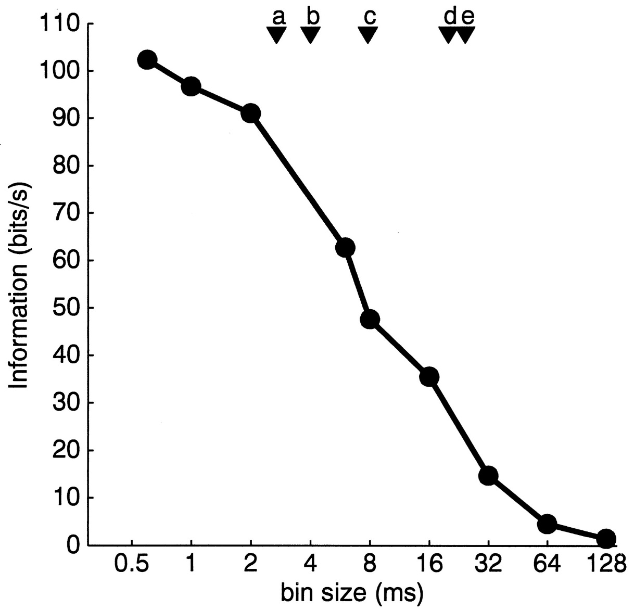
Reinagel, P. et al. J. Neurosci.20:5392-5400 (2000)
anesthetized
Stimulus:
full-field, high-contrast,
new frame every 7.8 ms.

Slide 5
However, just because information is contained in spike timing doesn’t mean the brain uses that information.
The million pound question: does the brain use information at fine timescales?
This paper proposes a methodology for answering that question, except more generally than just bin size.

Slide 6
The idea is to define
intersection information
which is
“the set of neural features carrying sensory
information that is read out to inform a
behavioral choice”.

Slide 7
An example: bin spikes at 0.5 s.
show stimulus
record spikes
r₁ = 4
r₂ = 3
0
0.5
1
time (s)

Slide 8
An example:
But suppose the decoder was based on the total spike count.
r₂
s₁
s₂
r₁

Slide 9
An example:
But suppose the decoder was based on the total spike count.
r₂
s₁
s₂
choice boundary
r₁

Slide 10
An example:
r₂
stimulus boundary
s₁
s₂
choice boundary
r₁
Loosely, the intersection information is zero if the stimulus and choice boundaries are orthogonal.

Slide 11
An example:
r₂
stimulus boundary
s₁
s₂
choice boundary
r₁
Loosely, the intersection information is high if the stimulus and choice boundaries are the same.

Slide 12
An example:
r₂
stimulus boundary
s₁
s₂
choice boundary
r₁
Loosely, the intersection information is in between if the stimulus and choice boundaries partially line up.

Slide 13
It turns out to be hard to come up with a rigorously justified definition of intersection information.
But suppose we use, for now, the degree to which stimulus and choice boundaries line up as a measure of intersection information.
How might we measure it experimentally?

Slide 14
An easy case:
r₂
Visual
Stimulus
r₁

Slide 15
In that case, the decision boundaries tell you everything:
r₂
stimulus boundary
s₁
s₂
choice boundary
r₁

Slide 16
But it’s never that simple.
r₂
Visual
Stimulus
r₁

Slide 17
Two reasons why naively measuring intersection information will give wrong answers.

Slide 18
Reason #1.
true choice boundary
r₂
true stimulus boundary
s₁
s₂
r₁
Actual choice made by the animal depends only on r₁.
You record only from r₂.

Slide 19
Reason #1.
true choice boundary
r₂
true stimulus boundary
s₁
r₂ choice boundary
s₂
r₁
Actual choice made by the animal depends only on r₁.
You record only from r₂.

Slide 20
Reason #1.
true choice boundary
r₂
true stimulus boundary
s₁
r₂ stimulus boundary
r₂ choice boundary
s₂
r₁
Actual choice made by the animal depends only on r₁.
You record only from r₂.
It looks like r₂ has high intersection information!

Slide 21
Reason #2.
r₂
stimulus boundary
s₁
s₂
choice information
r₁
r₁ – r₂
s
r₁ + r₂
choice ~ ar₃ + b(r₁ + r₂)
r₃ carries stimulus information

Slide 22
Reason #2.
choice boundary
r₂
stimulus boundary
s₁
s₂
choice information
r₁
r₁ – r₂
s
r₁ + r₂
choice ~ ar₃ + b(r₁ + r₂)
r₃ carries stimulus information

Slide 23
Intervention is required!

Slide 24
optogenetically perturbing r₂
will have no effect on choice!
true choice boundary
r₂
true stimulus boundary
s₁
s₂
r₁
Actual choice made by the animal depends only on r₁.
You record only from r₂.

Slide 25
optogenetically perturbing r₁ and r₂ in the “stimulus direction” will have no effect on choice!
r₂
stimulus boundary
s₁
s₂
choice boundary
r₁
r₁ – r₂
s
r₁ + r₂
choice ~ ar₃ + b(r₁ + r₂)
r₃ carries stimulus information

Slide 26
The grand conclusion:
It’s difficult, but possible (we believe), to define intersection information.
It can only be measured using neural coding techniques to determine the stimulus-response mapping, and optogenetics to determine causal relationships between activity and choices.
In practice, it’s difficult because more than two neurons are involved!

