Slide 1
Parental olfactory experience influences behaviour
and neural structure in subsequent generations
or
Lamarckism lives!
Brian Dias and Kerry Ressler
Nature Neuroscience, Jan 2014
Tea talk
January 14, 2014

Slide 2
A very brief history of our understanding of evolution

Slide 3
Jean-Baptiste Lamarck (1744 -1829)’s two laws:
First Law: In every animal which has not passed the limit of its development, a more frequent and continuous use of any organ gradually strengthens, develops and enlarges that organ, and gives it a power proportional to the length of time it has been so used; while the permanent disuse of any organ imperceptibly weakens and deteriorates it, and progressively diminishes its functional capacity, until it finally disappears.
Second Law: All the acquisitions or losses wrought by nature on individuals, through the influence of the environment in which their race has long been placed, and hence through the influence of the predominant use or permanent disuse of any organ; all these are preserved by reproduction to the new individuals which arise, provided that the acquired modifications are common to both sexes, or at least to the individuals which produce the young.

Slide 4
Jean-Baptiste Lamarck (1744 -1829)’s two laws:
First Law: In every animal which has not passed the limit of its development, a more frequent and continuous use of any organ gradually strengthens, develops and enlarges that organ, and gives it a power proportional to the length of time it has been so used; while the permanent disuse of any organ imperceptibly weakens and deteriorates it, and progressively diminishes its functional capacity, until it finally disappears.
Second Law: All the acquisitions or losses wrought by nature on individuals, through the influence of the environment in which their race has long been placed, and hence through the influence of the predominant use or permanent disuse of any organ; all these are preserved by reproduction to the new individuals which arise, provided that the acquired modifications are common to both sexes, or at least to the individuals which produce the young.

Slide 5
Jean-Baptiste Lamarck (1744 -1829)’s two laws:
First Law: Use it or lose it.
Second Law: All the acquisitions or losses wrought by nature on individuals, through the influence of the environment in which their race has long been placed, and hence through the influence of the predominant use or permanent disuse of any organ; all these are preserved by reproduction to the new individuals which arise, provided that the acquired modifications are common to both sexes, or at least to the individuals which produce the young.

Slide 6
Jean-Baptiste Lamarck (1744 -1829)’s two laws:
First Law: Use it or lose it.
Second Law: Your kids suffer too.

Slide 7
Jean-Baptiste Lamarck (1744 -1829)’s two laws:
First Law: Use it or lose it.
Second Law: Your kids suffer/benefit too.

Slide 8
For a long time, Lamarckism was considered just plain wrong.
Instead, people held the Darwinian view: random changes at birth that are amplified by natural selection.
And Watson and Crick found a mechanism: DNA.
Jean-Baptiste Lamarck (1744 -1829)
Charles Darwin (1809 -1882)
Lamarck published in: 1802, 1809, 1815-1822 (7 vol)

Slide 9
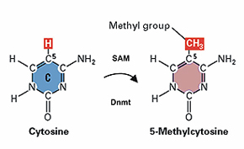
Recently, however, we have seen a revival of Lamarckism via
epigenetics.
A brief reminder: DNA consists of a long string of nucleotides,
guanine, adenine, thymine, and cytosine.
cytosine can be methylated,
more methylation => less transcription
methylation is stable when the cell divides

Slide 10
Do stuff to a pregnant mother (e.g., fear conditioning), and
you will see effects in her offspring.
Mechanism: methylation.

Slide 11
Enter Dias and Ressler.
They did a simple experiment:
an odor and a foot shock were paired in male mice
10 days later the rats mated with naive females
offspring of those females (F1) and the next generation (F2) were studied for sensitivity to the original odor.
The result: offspring were sensitive to the original odor.
there were additional controls (IVF, odor/foot shock in females, cross-rearing), but I won’t have time to talk about them.

Slide 12
Enter Dias and Ressler.
They did a simple experiment:
an odor and a foot shock were paired in male rats
10 days later the rats mated with naive females
offspring of those females (F1) and the next generation (F2) were studied for sensitivity to the original odor.
The result: offspring were sensitive to the original odor.
there were additional controls (IVF, odor/foot shock in females, cross-rearing), but I won’t have time to talk about them.

Slide 13
Enter Dias and Ressler.
They did a simple experiment:
an odor and a foot shock were paired in male rats
10 days later the rats mated with naive females
offspring of those females (F1) and the next generation (F2) were studied for sensitivity to the original odor.
The result: offspring were sensitive to the original odor.
there were additional controls (IVF, odor/foot shock in females, cross-rearing), but I won’t have time to talk about them.

Slide 14
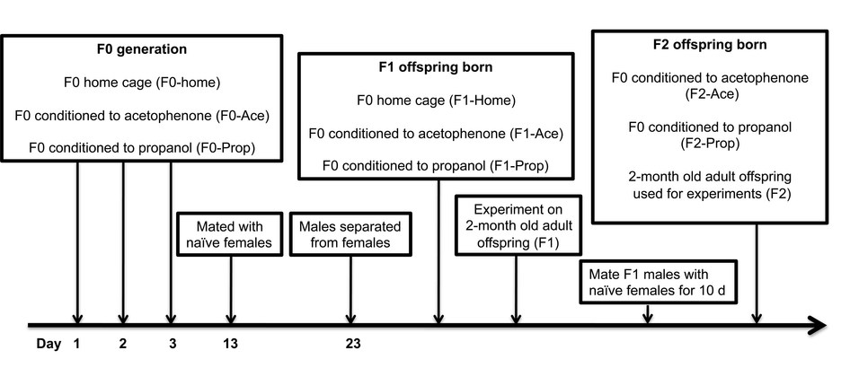
The main experiment in a nutshell

Slide 15
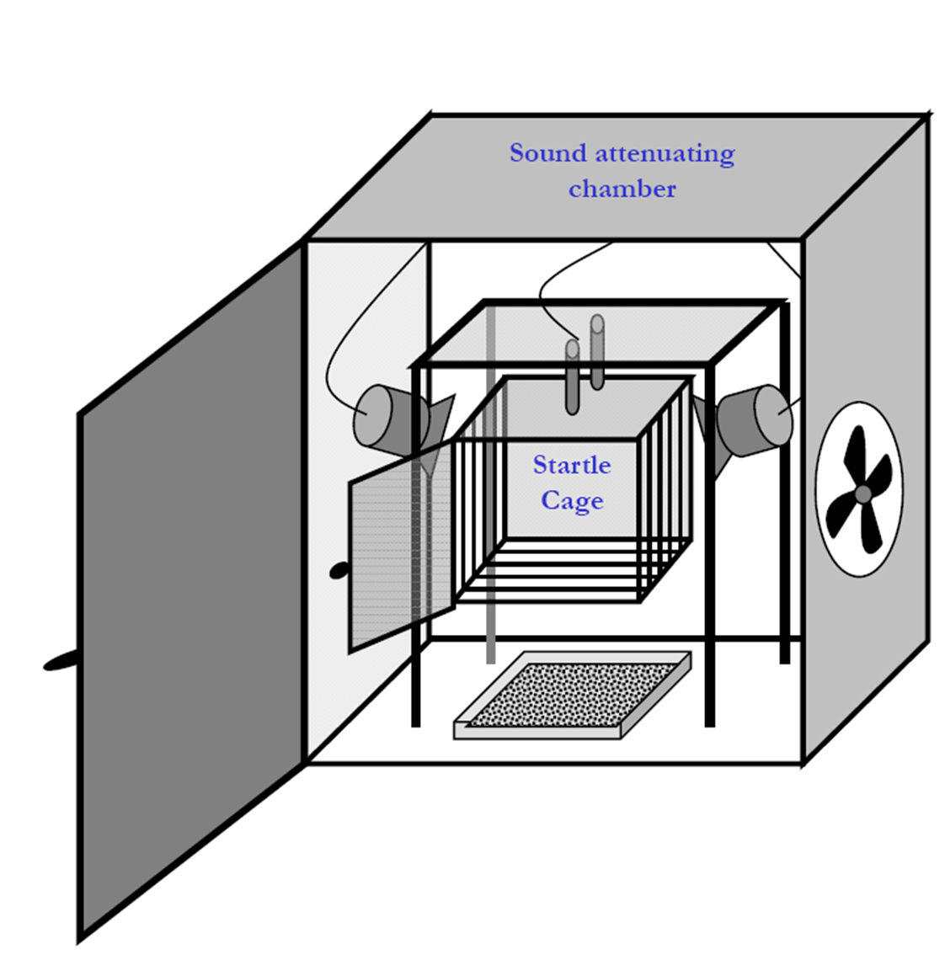
OPS: odor-potentiated startle.
Startle stimulus:
50 ms, 105-dB white noise burst.
Startle amplitude:
peak accelerometer voltage within 100 ms of startle stimulus.

Slide 16
OPS: odor-potentiated startle.
O_{first}
A_{last}
10 of
these
10 s
odor
10 odor + startle
trials interleaved
with startle only
trials.
white
noise
startle
amplitude
A_{last} - O_{first}
OPS = 100 ×
A_{last}
O_{first} - A_{last}
they must have meant
100 ×
A_{last}

Slide 17
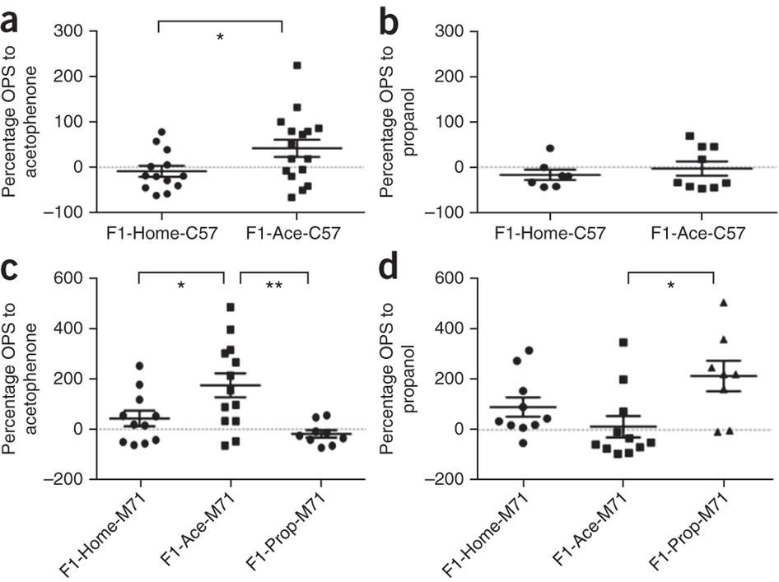
Figure 1

Slide 18
Aversion to odor:
odor tube
empty tube
1
2
3
Explored for 10 minutes.
Aversion index = time in chamber 1 – time in chamber 2 or 3.

Slide 19
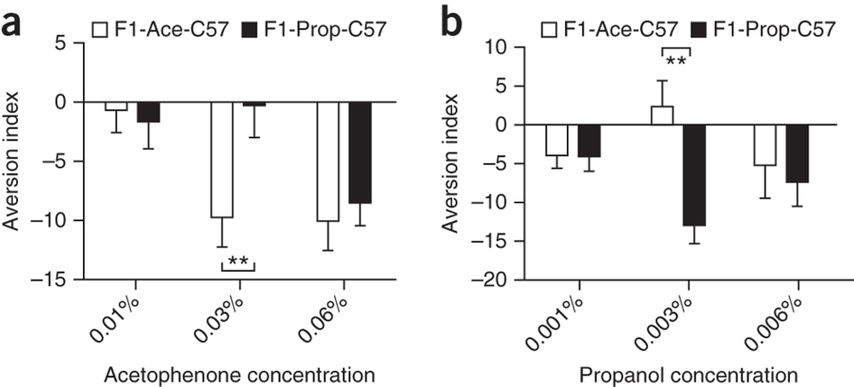
Figure 2

Slide 20
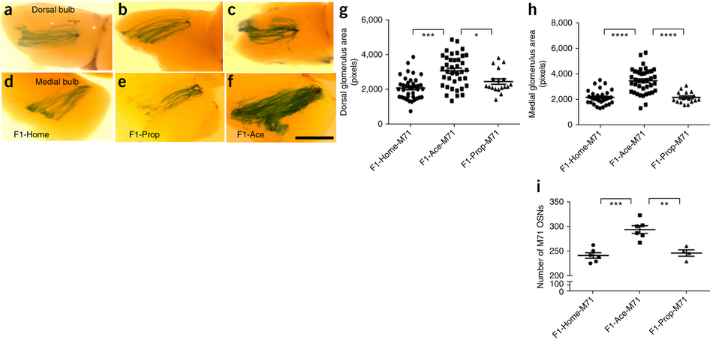
acetophenone responding glomeruli enlarged
in descendants of acetophenone fear conditioned
fathers.
Figure 3

Slide 21
Plus more data.
Effect is even stronger in F2 (second generation) mice!
But what about mechanism?
The Ofr151 gene codes for the M71 odorant receptor,
which detects acetophenone.
They looked for methylation on the Ofr151 gene in sperm cells.

Slide 22
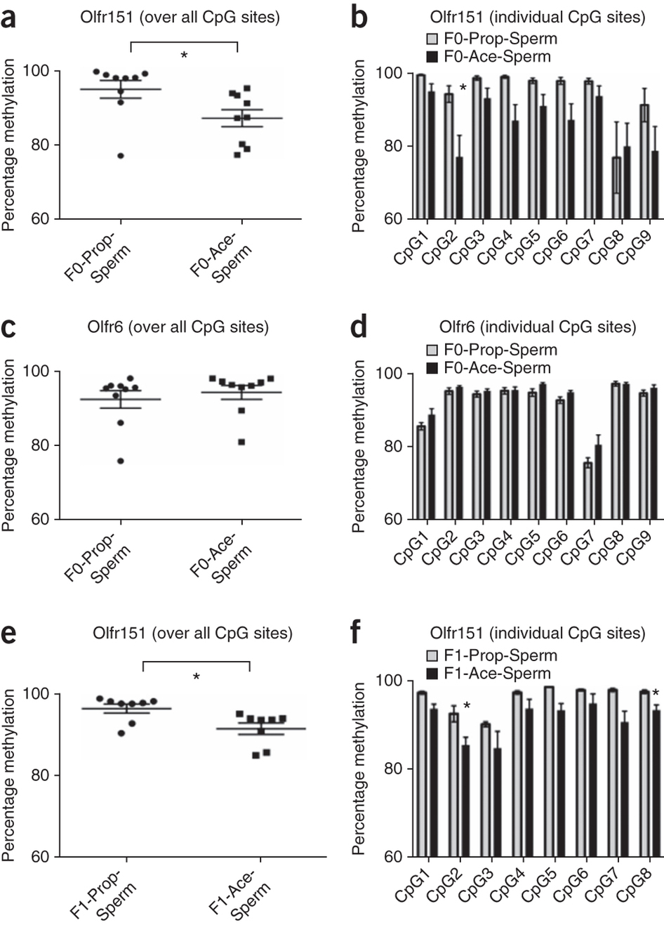
F0
Less methylation => more transcription.
Consistent with enlarged acetophenone responding glomeruli!
F0
F1

Slide 23
However:
“At the level of the main olfactory epithelium [where the odorant receptor neurons live], we did not find any differences in the methylation at the Olfr151 locus of either the F1 or F2 generations.”
In other words: reduced methylation is happening in the sperm, but not in the neurons where it is needed!

Slide 24
And how does methylation get to the sperm?
According to the authors:
“…it is also conceivable that the odorants used in the F0 fear conditioning protocol enter the circulatory stream and activate odorant receptors that are expressed on sperm.”
But there is no evidence.

Slide 25
My take:
A very intriguing result.
I would not be at all surprised if it is not replicated.

Slide 26
confidence
level
prior
1-β = power
(1-β) P(T)
p(T|p<α) =
(1-β) P(T) + α P(F)
Their α, which is the product of the p-values for
lots of independent (we hope) experiments,
was tiny.
But so is the prior.

