Slide 1
A Theory of Cerebral Neocortex
Marr 1970
Proc Roy Soc

Slide 2
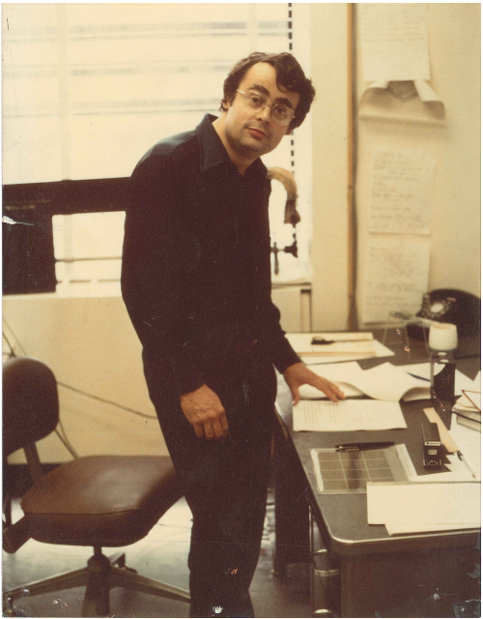
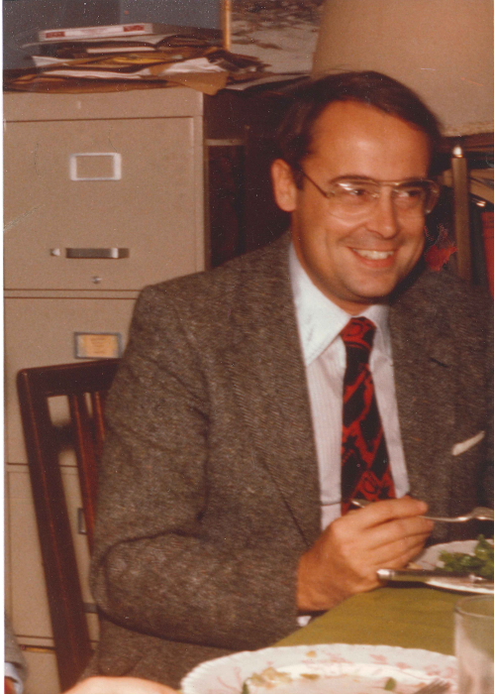
David Marr 1945-1980

Slide 3
Three Key Theories
cerebellum (1969) [2341 citations]
feedforward associative memory
anatomy:
granule cells=codons
climbing fibres as teaching signals
substantial attention to subtractive/divisive inhibition; threshold setting
neocortex (1970) [384 citations]
archicortex (1971) [1594 citations]
recurrent autoassociative memory
offline consolidation process for neocortex
MIT: famously abandoned modelling style -> Vision

Slide 4
Neocortex
general theory
canonical microcircuit
unsupervised learning
what’s the statistical structure?
how can we be sure that this matters?
how do we initialize learning?
umbrella of information theory
realization in terms of clustering
mountains
numerical taxonomy (Jardine & Sibson)
what counts as evidence (codons)
mapping onto the anatomy

Slide 5
Recycling
output cells (P-cells) no fixed meaning
‘some aspect of the structure of information’
codons (granule cells) could support probabilistic classification

Slide 6
Redundancy (1)
redundancy reduction is fine near periphery
‘diversity of specialized coding tricks’
centrally:
(iv)

Slide 7
Redundancy (2)
information storage via probabilistic recoding
no general probabilistic model
but feature-based similarity is common
‘some objects share features’
implies mountains

Slide 8
Five Questions
determining the appropriate features (codons)
finding the mountains (spatial recognition)
diagnosing new input in terms of its associated mountain
interpreting partial input in terms of its associated mountain
justifying the mountain in the first place

Slide 9
Justification
internal biological utility
redundancy
uniformity of processing
external biological utility
extrinsic vs intrinsic properties

Slide 10
$(∞)$ Mixture of Mountains
spatial recognition, diagnosis, interpretation via EM; ML density estimation
but:
what is if $\text{a}$ has never been seen before?
similarity is not the same as frequency:

Slide 11
Marr’s Solution
a bit unconvincing

Slide 12
Discussion
gets to the heart of the problem of unsupervised learning
oddly not self-consistent
‘special’ recoding mechanisms from spatial/temporal contiguity are different?
oddly not ML DE
before EM had been invented
much more to be said: notably recoding; initializing; mountain climbing…

Slide 13
