Slide 1
Not all neurons are the same
Tea talk
December 8, 2015

Slide 2
Diverse coupling of neurons to populations in sensory cortex
Michael Okun, Nicholas A. Steinmetz, Lee Cossell, M. Florencia Iacaruso, Ho Ko, Péter Barthó, Tirin Moore, Sonja B. Hofer, Thomas D. Mrsic-Flogel, Matteo Carandini & Kenneth D. Harris
Nature 521:511–515 (2015)

Slide 3
The bottom line is easy:
Some neurons are highly correlated with background activity.
Some neurons are not.
The degree of correlation seems to be relatively independent of stimulus.

Slide 4
Outline:
I’ll tell you exactly what that means.
I’ll address the question: what does it tell us about how the brain works?

Slide 5
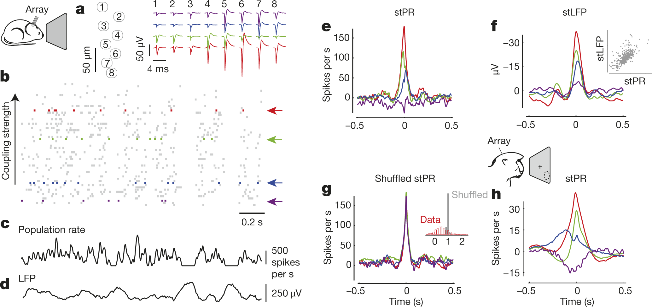
c_{i}(τ)
τ (s)
∫dt (ν_{i}(t+τ) - ν_{i}) ∑_{j≠i} (ν_{j}(t) - ν_{j})
c_{i}(τ) =
average firing rate
∫dt ν_{i}(t)
firing rate smoothed with
a Gaussian kernel
c_{i} = coupling strength ≡ c_{i}(0)

Slide 6
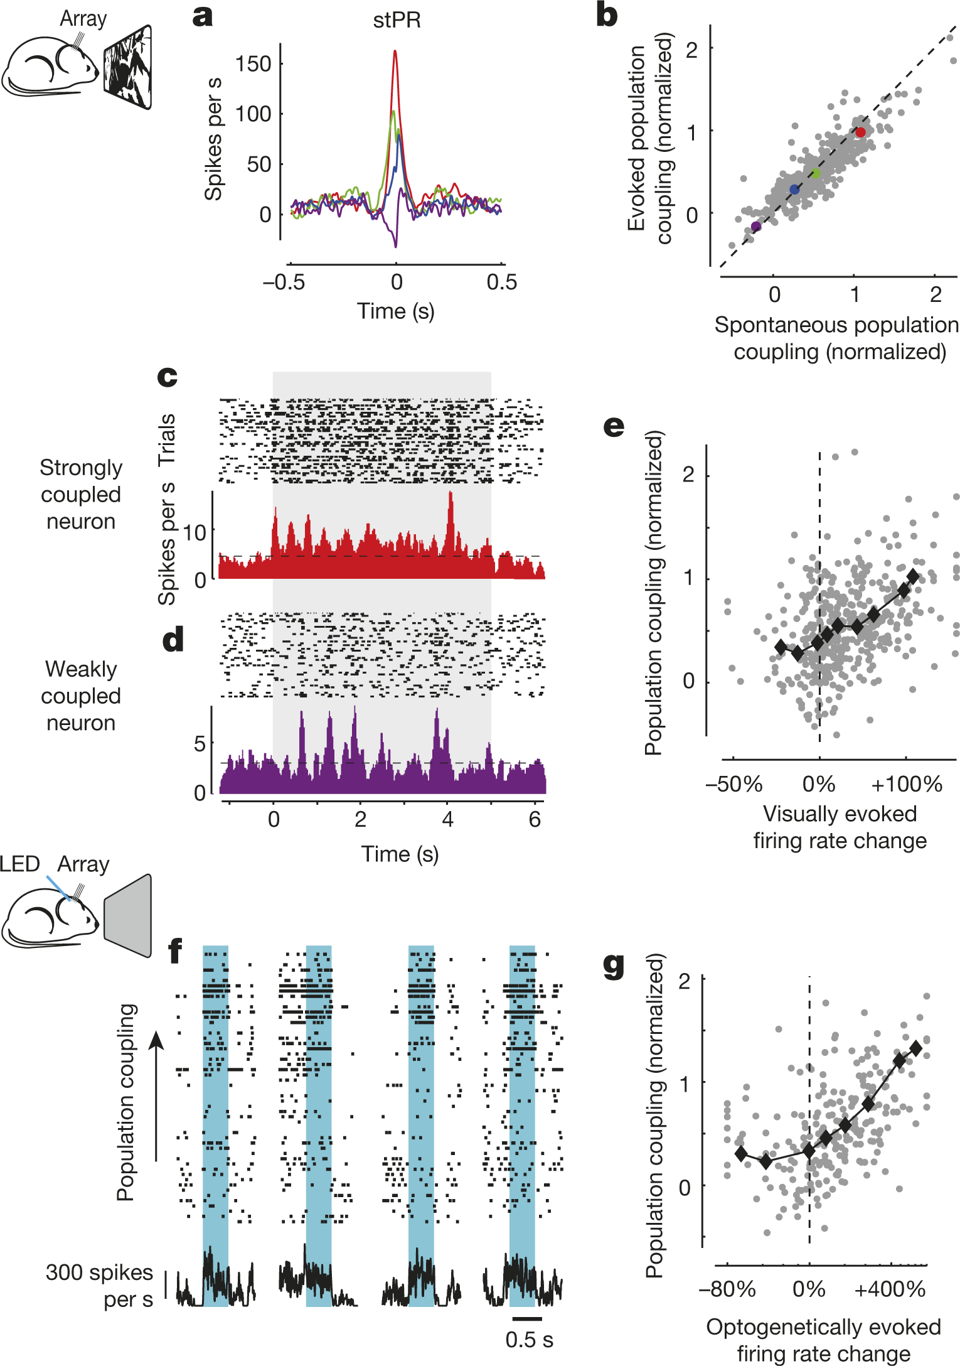
population coupling mainly independent of stimulus.
population coupling correlated with response to stimuli.
population coupling correlated with optogenetic stimulation.

Slide 7
Picture:

Slide 8
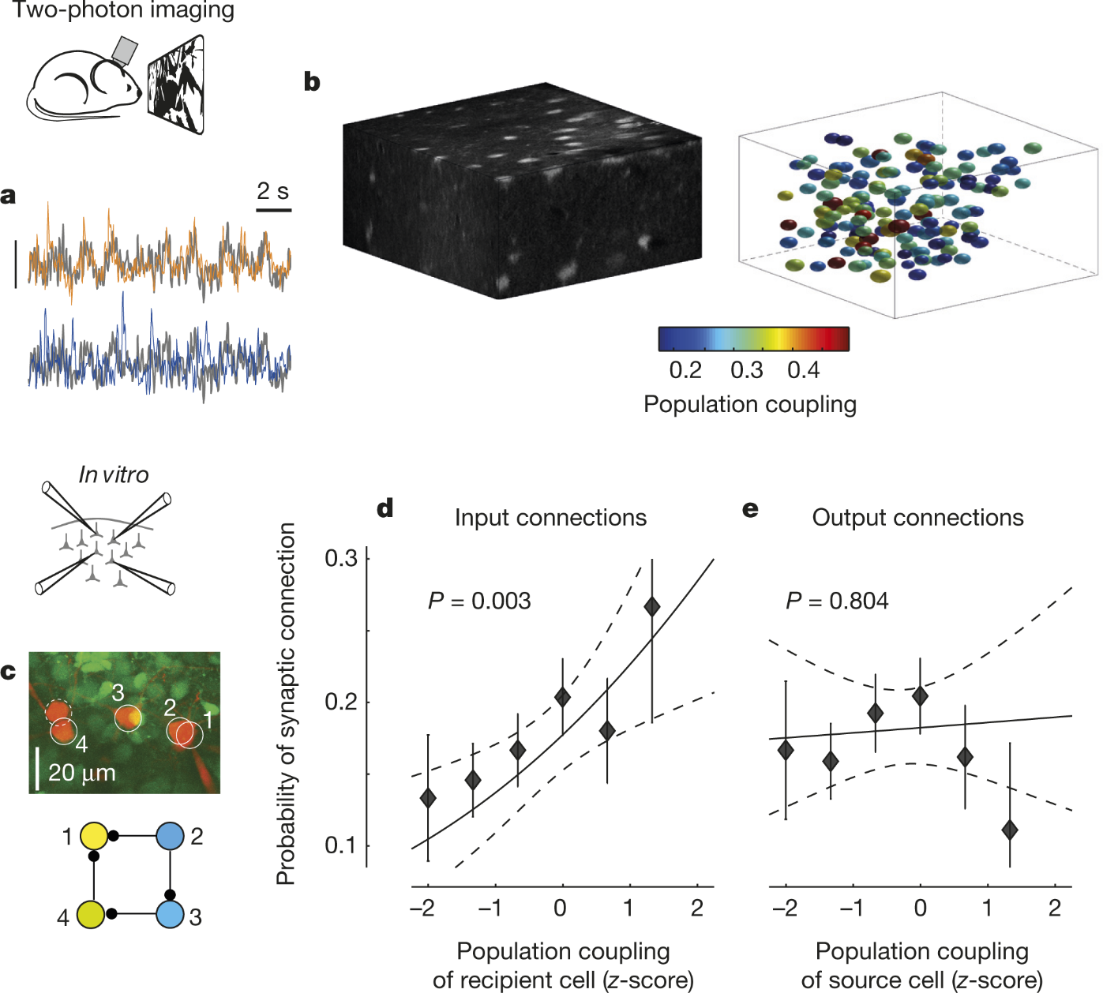
This is broadly consistent with experiments

Slide 9
It’s also broadly consistent with theory
Wilson-Cowan equations:
ν_{E,i} = ϕ_{E}(∑_{j} W_{EE,ij} ν_{E, j} - ∑_{j} W_{EI,ij} ν_{I, j} + X_{E,i})
external input
ν_{I,i} = ϕ_{I}(∑_{j} W_{IE,ij} ν_{E, j} - ∑_{j} W_{II,ij} ν_{I, j} + X_{I,i})
sigmoidal gain functions

Slide 10
It’s also broadly consistent with theory
Wilson-Cowan equations:
ν_{E,i} = ϕ_{E}(∑_{j} W_{EE,ij} ν_{E, j} - ∑_{j} W_{EI,ij} ν_{I, j} + X_{E,i})
ν_{I,i} = ϕ_{I}(∑_{j} W_{IE,ij} ν_{E, j} - ∑_{j} W_{II,ij} ν_{I, j} + X_{I,i})
Very randomly connected:
W_{QR,ij} = W_{QR} + δW_{QR,ij}
∑_{ij} δW_{QR,ij} = 0
∑_{j} W_{QR,ij} ν_{E, j} = N_{R}W_{QR}ν_{R} + ∑_{j} δW_{QR,ij} ν_{R, j}

Slide 11
It’s also broadly consistent with theory
Wilson-Cowan equations:
ν_{E,i} = ϕ_{E}(∑_{j} W_{EE,ij} ν_{E, j} - ∑_{j} W_{EI,ij} ν_{I, j} + X_{E,i})
ν_{I,i} = ϕ_{I}(∑_{j} W_{IE,ij} ν_{E, j} - ∑_{j} W_{II,ij} ν_{I, j} + X_{I,i})
Slightly less randomly connected:
W_{QR,ij} = W_{QR,i} + δW_{QR,ij}
∑_{j} δW_{QR,ij} = 0
∑_{j} W_{QR,ij} ν_{E, j} = N_{R}W_{QR,i}ν_{R} + ∑_{j} δW_{QR,ij} ν_{R, j}

Slide 12
It’s also broadly consistent with theory
Wilson-Cowan equations:
ν_{E,i} = ϕ_{E}(N_{E}W_{EE,i}ν_{E} - N_{I}W_{EI,i}ν_{I} + X_{E})
ν_{I,i} = ϕ_{I}(N_{E}W_{IE,i}ν_{E} - N_{I}W_{II,i}ν_{I} + X_{I})
ν_{E} and ν_{I} determined by nullclines
ν_{I}
ν_{E}

Slide 13
It’s also broadly consistent with theory
Wilson-Cowan equations:
ν_{E,i} = ϕ_{E}(N_{E}W_{EE,i}ν_{E} - N_{I}W_{EI,i}ν_{I} + X_{E})
ν_{I,i} = ϕ_{I}(N_{E}W_{IE,i}ν_{E} - N_{I}W_{II,i}ν_{I} + X_{I})
ν_{E} and ν_{I} determined by nullclines
changes in external input, X_{E} and X_{I}, generally move ν_{E} and ν_{I} up and down together.
ν_{I}
ν_{E}

Slide 14
It’s also broadly consistent with theory
Wilson-Cowan equations:
ν_{E,i} = ϕ_{E}(N_{E}W_{EE,i}ν_{E} - N_{I}W_{EI,i}ν_{I} + X_{E}) ≈ ϕ_{E}([N_{E}W_{EE,i} - N_{I}W_{EI,i}]ν)
ν_{I,i} = ϕ_{I}(N_{E}W_{IE,i}ν_{E} - N_{I}W_{II,i}ν_{I} + X_{I}) ≈ ϕ_{I}([N_{E}W_{IE,i} - N_{I}W_{II,i}]ν)
ν_{E} and ν_{I} determined by nullclines
changes in external input, X_{E} and X_{I}, generally move ν_{E} and ν_{I} up and down together.
ν_{I}
ν_{E}

Slide 15
It’s also broadly consistent with theory
Wilson-Cowan equations:
ν_{E,i} = ϕ_{E}(N_{E}W_{EE,i}ν_{E} - N_{I}W_{EI,i}ν_{I} + X_{E}) ≈ ϕ_{E}([N_{E}W_{EE,i} - N_{I}W_{EI,i}]ν)
ν_{I,i} = ϕ_{I}(N_{E}W_{IE,i}ν_{E} - N_{I}W_{II,i}ν_{I} + X_{I}) ≈ ϕ_{I}([N_{E}W_{IE,i} - N_{I}W_{II,i}]ν)
The size of these terms determiners how correlated a neuron is with the population.
Consistent with simulations of a linear model – see supporting information of the paper.

Slide 16
The bottom line is easy:
Some neurons are highly correlated with background activity.
Some neurons are not.
The degree of correlation seems to be relatively independent of stimulus.

Slide 17
What does this tell us about how the brain works?
It forces us to modify slightly our standard model of randomly connected networks.

Slide 18
Very randomly connected:
W_{QR,ij} = W_{QR} + δW_{QR,ij}
∑_{ij} δW_{QR,ij} = 0
Slightly less randomly connected:
W_{QR,ij} = W_{QR,i} + δW_{QR,ij}
∑_{j} δW_{QR,ij} = 0
I suspect that before we understand how the brain works, there will be a lot more modifications!

