Slide 1
Spontaneous giving and calculated greed
David G. Rand, Joshua D. Greene & Martin A. Nowak
Nature 489: 427 (20/9/12)

Slide 2
Strategic Interactions
instrumental : model-based and model-free
Pavlovian: could depend on either
here ‘intuition’ vs ‘reflection’
how to investigate: RT; stress; rTMS; priming
does model-free make you more or less interested in social effects?
is model-free evaluation pro- or anti-social?
egotistical choice; altrusitic reward/punishment

Slide 3
Games
dictator game
ultimatum game
public good games

Slide 4
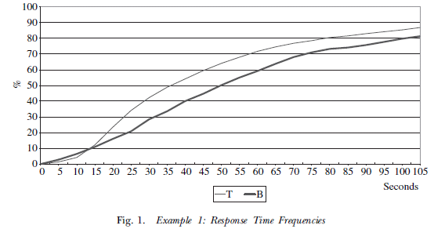
Intuition
reaction times: Rubinstein (2007)
“It is suggested that choices made instinctively, that is, on the basis of an emotional response, require less response time than choices that require the use of cognitive reasoning.”
 | L | R
T | 2,-2 | 0,0
B | 0,0 | 1,-1

Slide 5
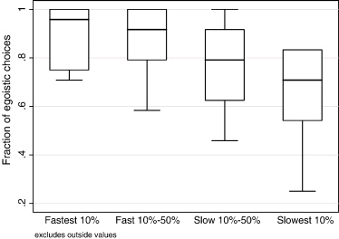
Model-Free less (pro)Social
Piovesan & Wengstrom, 2009 (strange) dictator game –egotistical choices and RTs:
rTMS over dlPFC leads to more acceptance of unfair offers

Slide 6
Model-free more social
faster to reject than accept unfair offers in ultimatum game
time pressure in bargaining leads to fairer outcomes
decisions under pressure are stressful, and stress leads to pro-sociality (UG offer)

Slide 7
Public Goods Games
around 2000 participants via Mechanical Turk
one-shot PGG in groups of 4:
$0.50 to participate
$0.40 to contribute; doubled; quartered
(maximum extra of $1)
Harvard variant:
$5 to show up
$4 to contribute; doubled; quartered
$2 to predict average contribution of rest of group

Slide 8
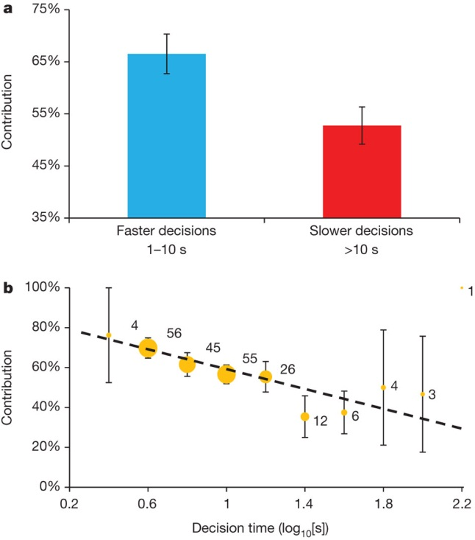
Faster decisions are more cooperative.
Notes:
Subjects who reach their decisions more quickly contribute more in a one-shot PGG (n = 212). This suggests that the intuitive response is to be cooperative. a, Using a median split on decision time, we compare the contribution levels of the faster half versus slower half of decisions. The average contribution is substantially higher for the faster decisions. b, Plotting contribution as a function of log₁₀-transformed decision time shows a negative relationship between decision time and contribution. Dot size is proportional to the number of observations, listed next to each dot. Error bars, mean ± s.e.m. (see Supplementary Information, sections 2 and 3, for statistical analysis and further details).

Slide 9
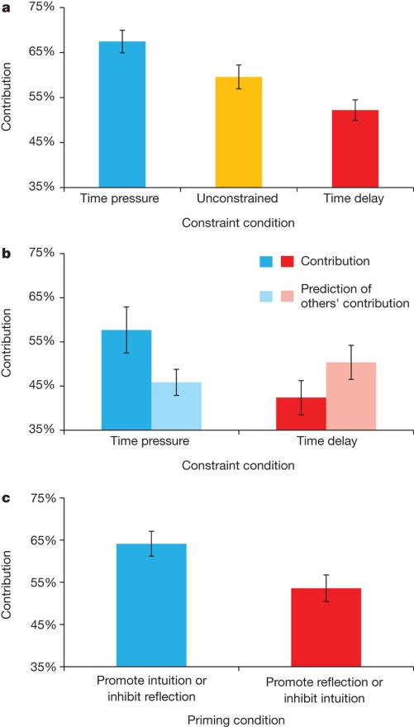
Inducing intuitive thinking promotes cooperation.
within 10s
at least 10s
no difference, so
preferences rather than
beliefs
5c loss for 10c inaccuracy
*10 stakes
write paragraphs
about the benefits or
costs of intuition/reflection
Notes:
a, Forcing subjects to decide quickly (10 s or less) results in higher contributions, whereas forcing subjects to decide slowly (more than 10 s) decreases contributions (n = 680). This demonstrates the causal link between decision time and cooperation suggested by the correlation shown in Fig. 1. b, We replicate the finding that forcing subjects to decide quickly promotes cooperation in a second study run in the physical laboratory with tenfold larger stakes (n = 211). We also find that the time constraint has no significant effect on subjects’ predictions concerning the average contributions of other group members. Thus, the manipulation acts through preferences rather than beliefs. c, Priming intuition (or inhibiting reflection) increases cooperation relative to priming reflection (or inhibiting intuition) (n = 343). This finding provides further evidence for the specific role of intuition versus reflection in motivating cooperation, as suggested by the decision time studies. Error bars, mean ± s.e.m. (see Supplementary Information, sections 5–7, for statistical analysis and further details).

Slide 10
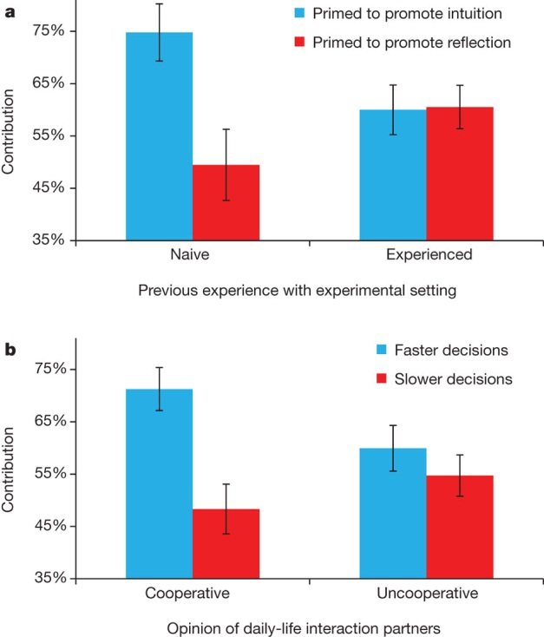
Evidence that cooperative intuitions
from daily lift spill over into the laboratory.
just asked
To what extent do you feel you can trust other people that you interact with in your daily life?” using a
ten-point Likert scale from “1=Very Little” to “10=Very Much – median split
more cooperation!
Notes:
Two experiments validate predictions of our hypothesis that subjects develop their cooperative intuitions in the context of daily life, in which cooperation is advantageous. a, Priming that promotes reliance on intuition increases cooperation relative to priming promoting reflection, but only among naive subjects that report no previous experience with the experimental setting where cooperation is disadvantageous (n = 256). b, Faster decisions are associated with higher contribution levels, but only among subjects who report having cooperative daily-life interaction partners (n = 341). As in Fig. 1a, a median split is carried out on decision times, separating decisions into the faster versus slower half. Error bars, mean ± s.e.m. (see Supplementary Information, sections 9 and 10, for statistical analysis and further details).

Slide 11
Discussion
“the intuitive response is never reliably less cooperative than the reflective response, therefore intuition promotes cooperation”
Pavlovian or cultural (look at young children)?
how to square with UG/DG results?
calculational problems (my stake is doubled)

