Slide 1
Representation of aversive prediction errors in the human periaqueductal gray
Mathieu Roy, Daphna Shohamy, Nathaniel Daw, Marieke Jepma, G Elliott Wimmer & Tor D Wager
Nature Neuroscience
5 October 2014; doi:10.1038/nn.3832

Slide 2
prediction errors
ample evidence for appetitive PEs:
phasic activity of dopamine neurons in mice, rats, monkeys and humans
release of dopamine in rats, humans

Slide 3
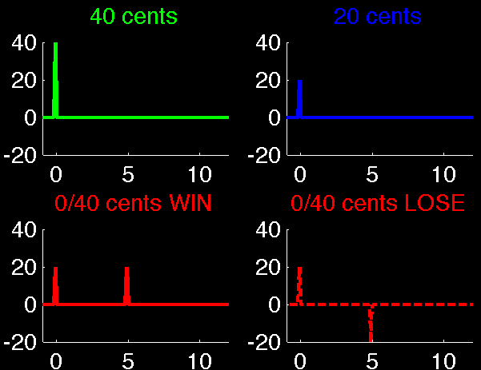
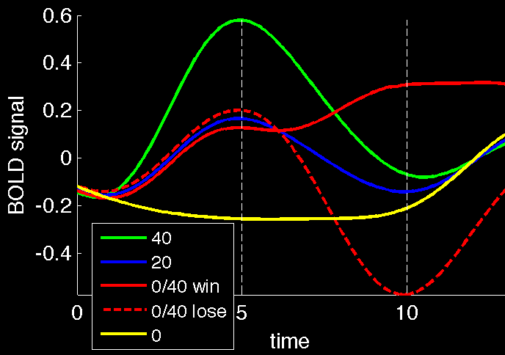
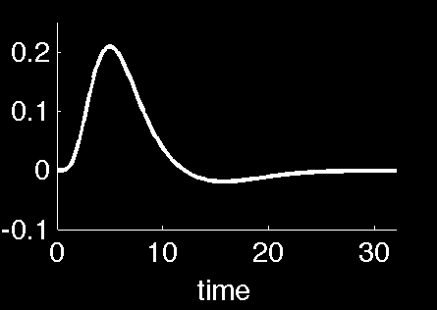
Human Prediction Errors
what would a prediction error look like (in fMRI BOLD)?
You won
40 cents
$$⊗$$
$$=$$
Niv & O’Doherty

Slide 4
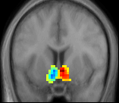
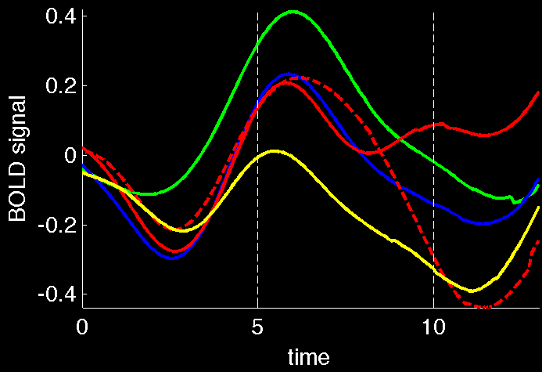
Human Prediction Errors
what would a prediction error look like (in fMRI BOLD)?
You won
40 cents
unbiased anatomical ROI in nucleus accumbens (marked per subject*)
raw BOLD
(avg over all subjects)
Niv & O’Doherty

Slide 5
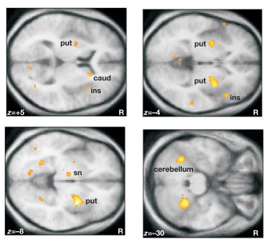
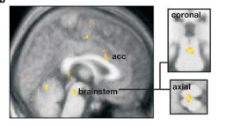
prediction errors
ample evidence for appetitive PEs:
phasic activity of dopamine neurons in mice, rats, monkeys and humans
release of dopamine in rats, humans
but what about aversive Ps; or Ps?

Slide 6
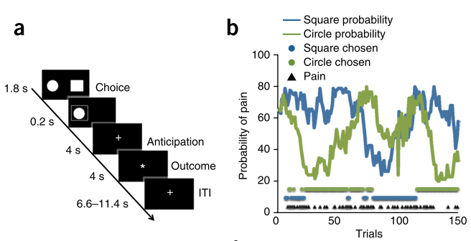
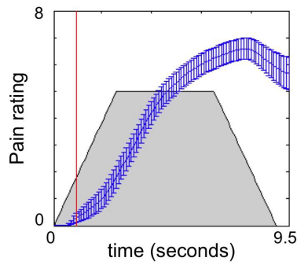
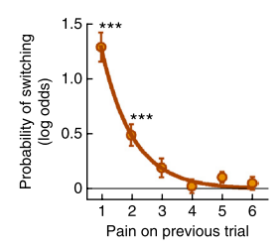
Paradigm

Slide 7
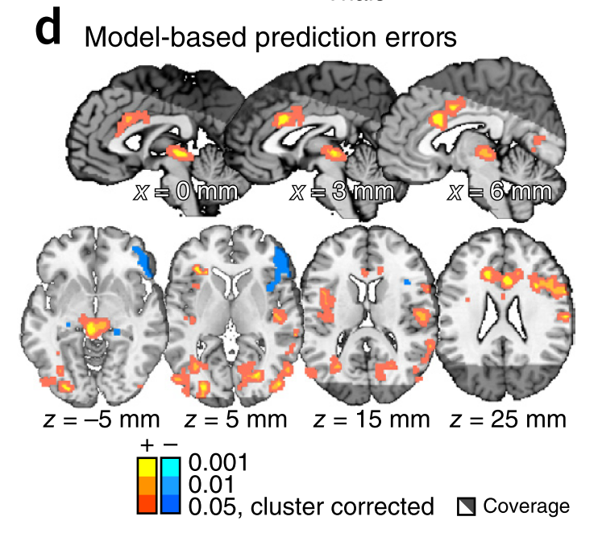
+/- correlation with aversive outcome PEs
left anterior insula
ACC; PCC
dlPFC
midbrain/PAG
EC/HC
rIFG
r lateral thalamus

Slide 8
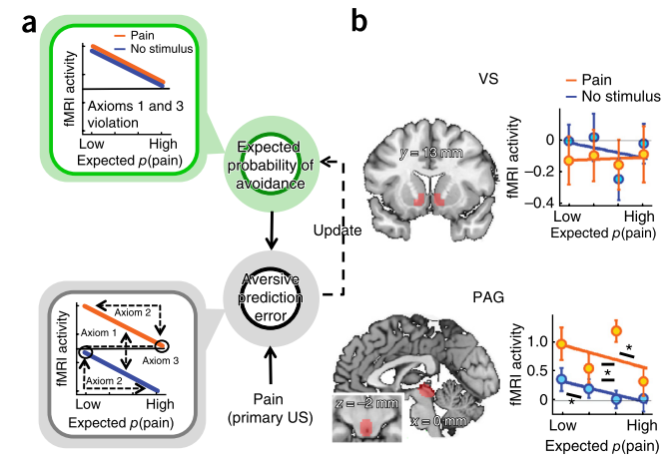
axioms (Caplin; Dean; Rutledge; Glimcher)
activity higher for received than avoided pain
activity should decrease in proportion to the expected pain
activity on expected pain = activity on expected non-pain

Slide 9
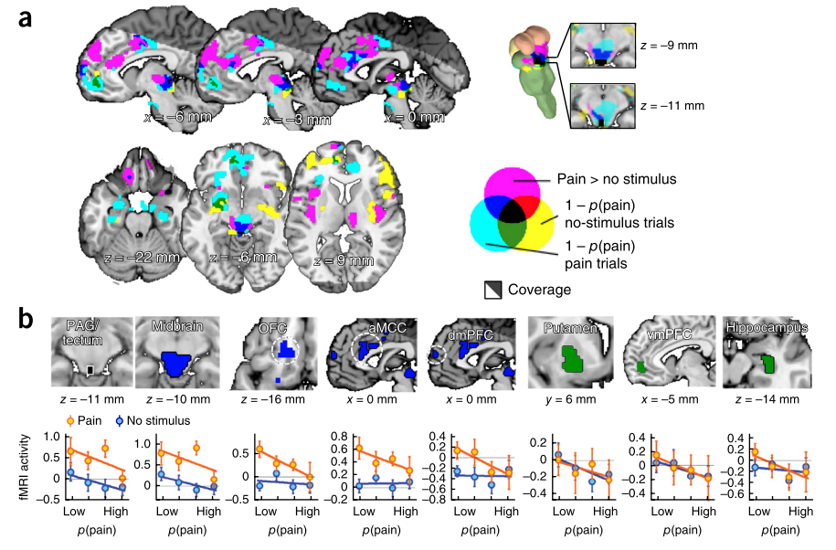
axiomatically restricted to the PAG

Slide 10
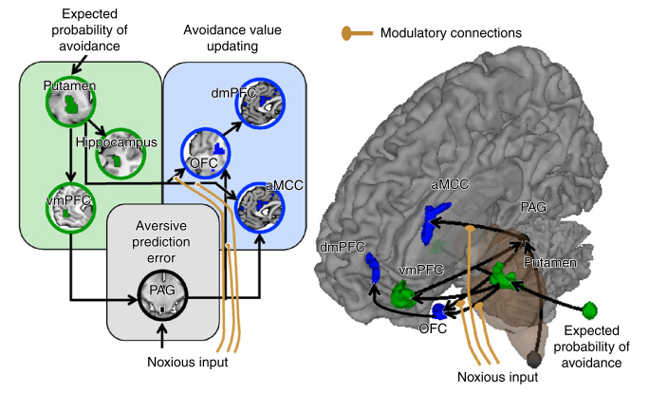
Dubious DCM circuitry

Slide 11
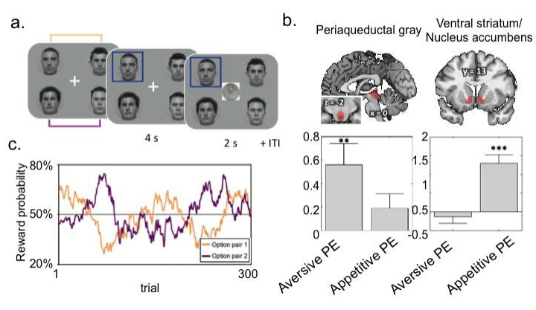
appetitive vs aversive PEs

Slide 12
PAG
good position to represent a PE
associated with Pavlovian responses to aversive outcomes
*not* striatum (Frank)
*not* mesocortical VTA (Brischoux; Lammel)
vmPFC is the key value structure

