Slide 1
Plasticity is even more complicated
than you thought
Tea talk
September 22, 2015

Slide 2
The question for the day:
How do animals learn timing intervals?

Slide 3
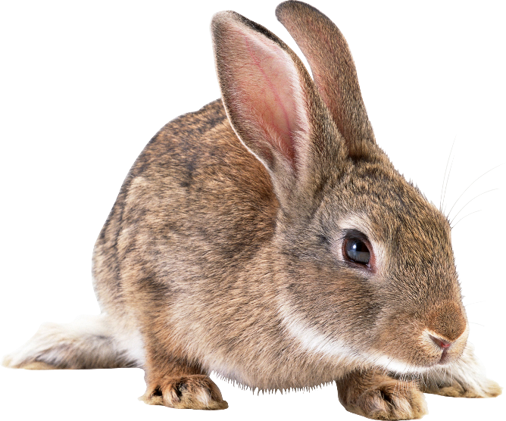
A classic experiment: eyeblink conditioning:
ring bell
300 ms later:
puff air into its eye
repeat enough times and the rabbit will
learn to blink about 300 ms after the bell

Slide 4
A classic experiment: eyeblink conditioning:
ring bell
500 ms later:
puff air into its eye
repeat enough times and the rabbit will
learn to blink about 500 ms after the bell

Slide 5
A classic experiment: eyeblink conditioning:
ring bell
200 ms later:
puff air into its eye
repeat enough times and the rabbit will
learn to blink about 200 ms after the bell

Slide 6
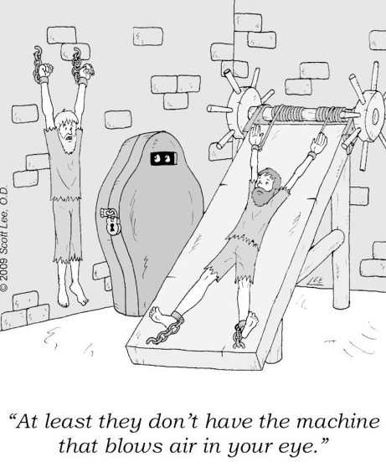

Slide 7
People have been trying to figure out how the brain does this for a long time.
At least for eyeblink conditioning, learning takes place in the cerebellum.
So maybe if we figure out exactly how, we’ll learn something about how the brain works.

Slide 8
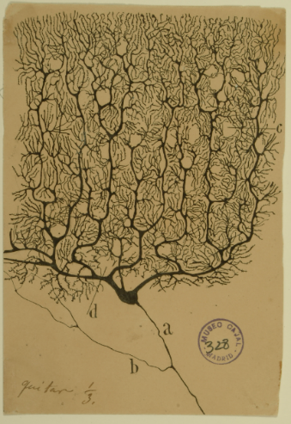
Purkinje cell
excitatory synapses
parallel
fibers
granule
cells
firing rate
climbing
fiber
bell
time
air puff
bell
air puff

Slide 9
Purkinje cell
excitatory synapses
parallel
fibers
granule
cells
firing rate
climbing
fiber
bell
time
bell
air puff

Slide 10
Purkinje cell
excitatory synapses
parallel
fibers
granule
cells
firing rate
climbing
fiber
bell
time
air puff
bell
air puff

Slide 11
standard mechanism:
long term
depression
(pause)
Purkinje cell
excitatory synapses
parallel
fibers
granule
cells
firing rate
climbing
fiber
bell
time
clock
(timing)
bell
air puff
Mauk & Buonomano, Annu. Rev. Neurosci. 27:307-340 (2004)

Slide 12
Enter
Johansson, Jirenhed, Rasmussen, Zucca, Hesslow
(Lund University, Sweden)
Memory trace and timing mechanism localized to cerebellar Purkinje cells
PNAS 111:1 4930-14934 (2014)

Slide 13
directly stimulated
parallel fibers
Purkinje cell
excitatory synapses
parallel
fibers
granule
cells
climbing
fiber
bell
air puff

Slide 14
directly stimulated
parallel fibers
Purkinje cell
excitatory synapses
parallel
fibers
experiments done
in decerebrate
ferrets
stim protocol 1
protocol 2
firing rate
climbing
fiber
pf stim
time
cf stim
directly stimulated
climbing fibers

Slide 15
directly stimulated
parallel fibers
Purkinje cell
excitatory synapses
parallel
fibers
firing rate
climbing
fiber
pf stim
time
directly stimulated
climbing fibers

Slide 16
directly stimulated
parallel fibers
Purkinje cell
excitatory synapses
parallel
fibers
firing rate
climbing
fiber
pf stim
time
cf stim
directly stimulated
climbing fibers

Slide 17
directly stimulated
parallel fibers
Purkinje cell
excitatory synapses
parallel
fibers
firing rate
climbing
fiber
pf stim
time
directly stimulated
climbing fibers

Slide 18
directly stimulated
parallel fibers
Purkinje cell
excitatory synapses
parallel
fibers
firing rate
climbing
fiber
pf stim
time
cf stim
directly stimulated
climbing fibers

Slide 19
directly stimulated
parallel fibers
Purkinje cell
excitatory synapses
parallel
fibers
Inhibitory interneurons could account for this, but the result didn’t go away when they blocked GABA.
firing rate
climbing
fiber
pf stim
time
directly stimulated
climbing fibers

Slide 20
standard mechanism:
long term
depression
(pause)
Purkinje cell
excitatory synapses
parallel
fibers
granule
cells
firing rate
climbing
fiber
pf stim
time
clock
(timing)
cf stim
bell
air puff
Mauk & Buonomano, Annu. Rev. Neurosci. 27:307-340 (2004)

Slide 21
directly stimulated
parallel fibers
Purkinje cell
excitatory synapses
parallel
fibers
the synapses have to do a lot more work!
firing rate
climbing
fiber
pf stim
time
directly stimulated
climbing fibers

Slide 22
Standard model for plasticity:
dV_{i}
τ
= (spike generating mechanism)_{i}
– ∑_{j} w_{ij} g_{j}(t)(V_{i} – E_{j})
dt
5 ms
spike times, neuron j
Traditionally, plasticity modifies synaptic strength, w_{ij}.
For eyeblink conditioning, plasticity must also modify g_{j}(t).

Slide 23
Standard model for plasticity:
dV_{i}
τ
= (spike generating mechanism)_{i}
– ∑_{j} w_{ij} g_{j}(t)(V_{i} – E_{j})
dt
before conditioning
w_{ij} g_{j}(t)
after conditioning
w_{ij} g_{j}(t)

Slide 24
Another possibility:
-80 mV;
inhibitory
dV_{i}
τ
= (spike generating mechanism)_{i}
– ∑_{j} w_{ij} g_{j}(t)(V_{i} – E_{j})
dt
0 mV
K
K
K
– ∑_{j} w_{ij} g_{j} (t)(V_{i} – E_{j} )
GIRK channel (Dutar, Vu and Perkel, Neuropharmacology 38:467-475, 1999, Pages 467-475)

Slide 25
Another possibility:
-80 mV;
inhibitory
dV_{i}
τ
= (spike generating mechanism)_{i}
– ∑_{j} w_{ij} g_{j}(t)(V_{i} – E_{j})
dt
K
K
K
– ∑_{j} w_{ij} g_{j} (t)(V_{i} – E_{j} )
before conditioning
w_{ij} g_{j}(t)
after conditioning
w_{ij} g_{j} (t)
K
K

Slide 26
directly stimulated
parallel fibers
Purkinje cell
excitatory synapses
parallel
fibers
summary:
after eyeblink conditioning,
there are probably changes to the conductance timecourse of these synapses!
this is speculation.
the mechanism is unknown.
firing rate
climbing
fiber
pf stim
time
directly stimulated
climbing fibers

