Slide 1
Empirical estimates suggest most
published medical research is true
Leah R. Jager and Jeffrey T. Leek
arXiv:1301.3718, Jan 2013
Tea talk
July 2, 2013

Slide 2
Possibly a response to:
Why Most Published Research
Findings Are False
John P.A. Ioannidis
PLoS Med 2005 2:e124 2005

Slide 3
Ioannidis asked the question: what is the probability that a
result is true (T) given p < α?
null hypothesis
should be rejected

Slide 4
Ioannidis asked the question: what is the probability that a
result is true (T) given p < α?
1-β = power
P(p<α|T) P(T)
p(T|p<α) =
P(p<α|T) p(T) + P(p<α|F) P(F)
α

Slide 5
Ioannidis asked the question: what is the probability that a
result is true (T) given p < α?
(1-β) P(T)
p(T|p<α) =
(1-β) P(T) + α P(F)

Slide 6
power = 1-β = 1 (big effect)
p=0.001
p=0.01
probability result is true
p=0.05
prior probability

Slide 7
power = 1-β = 0.1 (small effect)
p=0.001
probability result is true
p=0.01
p=0.05
prior probability

Slide 8
Jager and Leek asked a different question:
  Given observations of p-values, how many false positives
  are there?
Null hypothesis is true even
though p<α.
Probability of this happening
is 1 – P(T|p<α).

Slide 9
The idea:
If all results are false positives, the distribution of
p-values should be flat.
P(p)
0
p
0.05

Slide 10
The idea:
If all results are true, the distribution of
p-values should be β(a, b).
micro-array data
P(p)
0
p
0.05

Slide 11
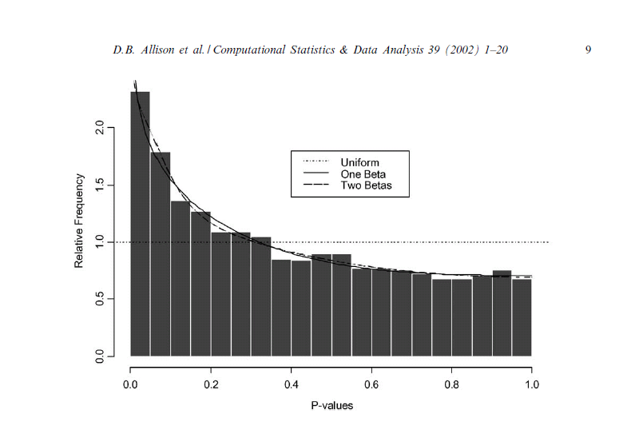

Slide 12
P(p)
log P(p)
p

Slide 13
The approach:
Collect a bunch of p-values, fit a mixture model,
P(p) = π U(p) + (1-π) β(p|a, b)
truncated β [0, 0.05]
uniform [0, 0.05]

Slide 14
The approach:
Collect a bunch of p-values, fit a mixture model,
From 77,430 papers in medical journals (Lancet,
New England Journal of Medicine, …).
Scraped p-values from abstracts only.
5332 papers, 12632 p-values ≤ 0.05.

Slide 15
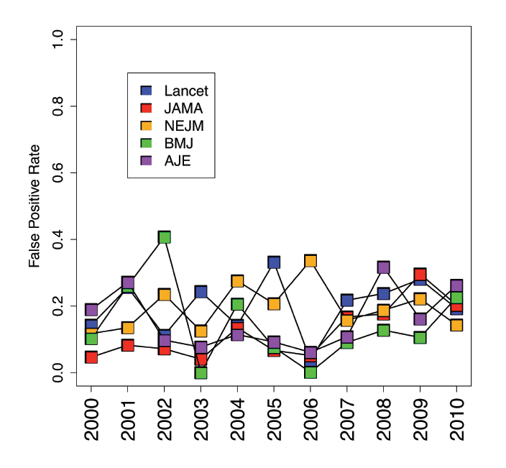
P(p) = π U(p) + (1-π) β(p|a, b)
π
14%

Slide 16
power = 1-β = 0.1 (small effect)
p=0.001
probability result is true
p=0.01
p=0.05
prior probability

Slide 17
power = 1-β = 1 (big effect)
p=0.001
p=0.01
probability result is true
p=0.05
prior probability

Slide 18
figures

Slide 19
my conclusions: something very strange is going on
0.001
0
0.01
P(p)
0
p
0.05

