Slide 1
When Pliers Become Fingers in the Monkey Motor System
M. A. Umiltà, L. Escola, I. Intskirveli, F. Grammont, M. Rochat, F. Caruana, A. Jezzini, V. Gallese, and G. Rizzolati
PNAS, 2008
Tea Talk: Thomas Desautels
29 May 2014

Slide 2
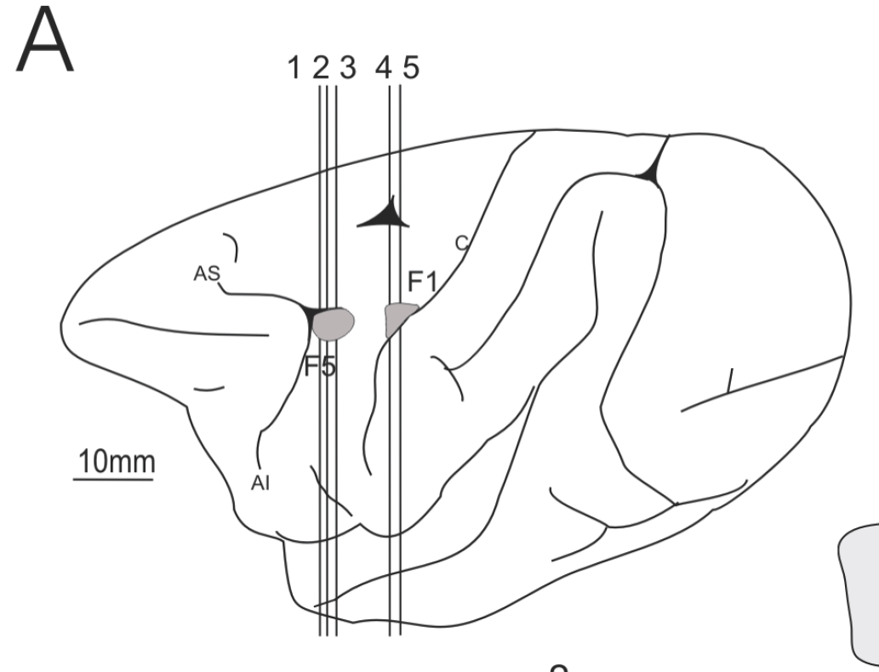
Background
In area F5 of the macaque ventral premotor cortex (PMv), some neurons fire in grasping
Respond to hand actions (e.g., opening, closing, opening and closing)
Some fire selectively for certain grips (precision, whole-hand, and finger-grasp)
Canonical Neurons: fire when the monkey observes an object, even without grasping or pre-grasping activity.
Respond to particular potential grasp types
May represent a potential motor act
Mirror Neurons: fire in grasping, also when observing another individual performing that grasp
See Kandel et al. (5th ed.), Ch 19.

Slide 3
The Basic Idea
These neurons will have some firing pattern if the monkey grasps an object with its hand.
How would the responses change if the monkey grasps an object using a tool (pliers)?
Can these results tell us anything about the way the brain represents motor plans?

Slide 4
Reaching for Food with Pliers
Animals (n = 2, Macaca nemestrina, 1♂, 1♀) trained before recording (6-8 mos.).
Grasp food with pliers: Videos 1 & 2
Plier trials are intermixed with manual grasping trials

Slide 5
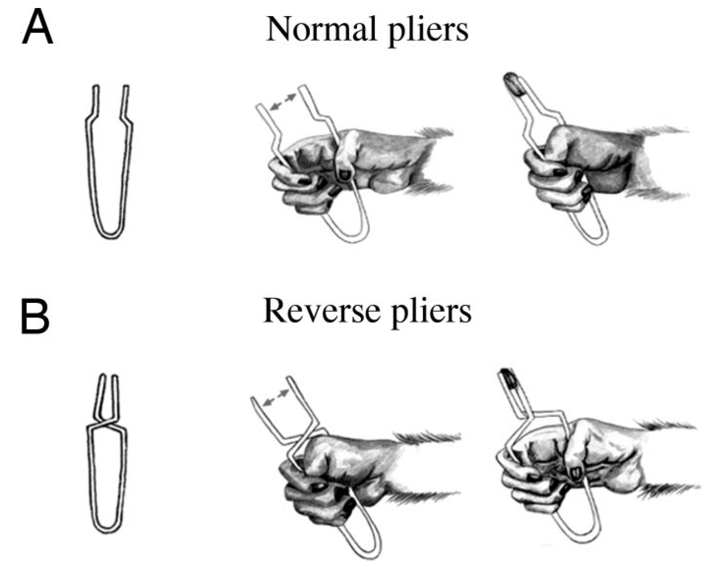
Two Types of Pliers
Normal Pliers:
Hand opens ➔ pliers open
Hand closes ➔ pliers close
Reverse Pliers:
Hand opens ➔ Pliers close
Hand closes ➔ pliers open
Videos 3 & 4
Dissociate hand opening/closing from plier opening/closing

Slide 6
Recordings
Implanted recording chamber → localization of F5 (also related F1 area in primary motor cortex)
Single-unit recordings from these areas
Potentiometer between pliers handles → opening/closing
Springiness → applied force via calibration
Surface EMG in flexor digitorum superficialis (hand closing)

Slide 7
Results
118 neurons (55 from F5, 58 from F1)
Locations defined functionally, confirmed by histology
All of the F5 neurons fired during grasping with both normal and reverse pliers.
4 firing patterns during normal plier use:
Only during opening (2)
Start firing during opening, max at start of closure (18)
Hand closure only (28)
Start during closure and continue through holding (7)
F5 patterns remained the same relative to plier tip opening/closing when using the reverse pliers

Slide 8
Results II
In F1, there were two sub-populations:
F1g (“goal-related”, 26): Similar firing patterns to F5; retained relationship with plier tips
F1m (“movement-related”, 32): Firing pattern related to hand movement, not plier tips.

Slide 9
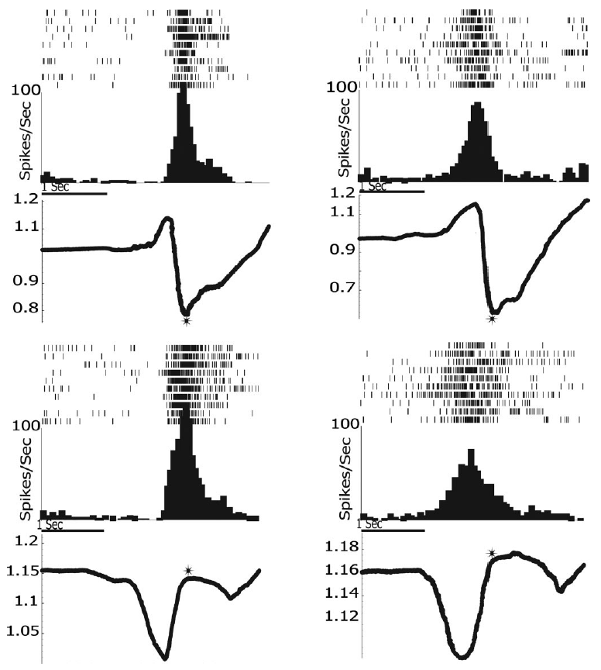
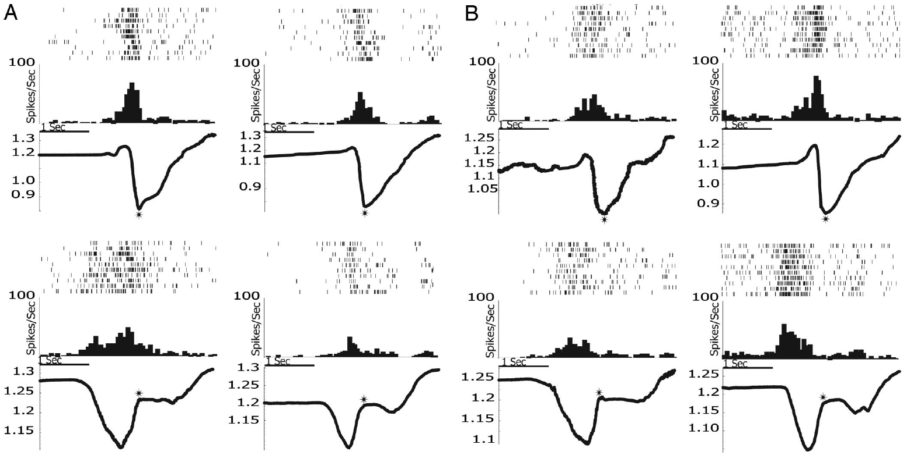
Results III
F5
F1g
F1m
S
Spikes
PETH
PETH
Normal Pliers
HOW
Hand Opening Width
Reverse Pliers
Notes:
HOW is a cross-trial average
Star is end of grasping closure phase, point of alignment for generating histograms.

Slide 10
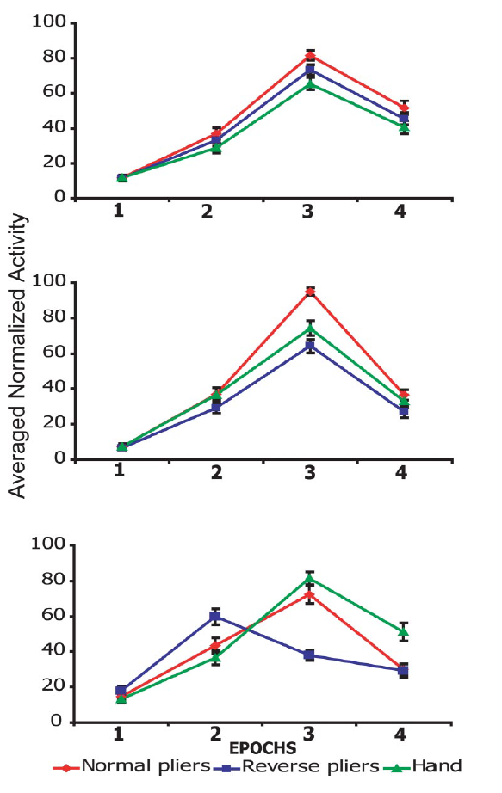
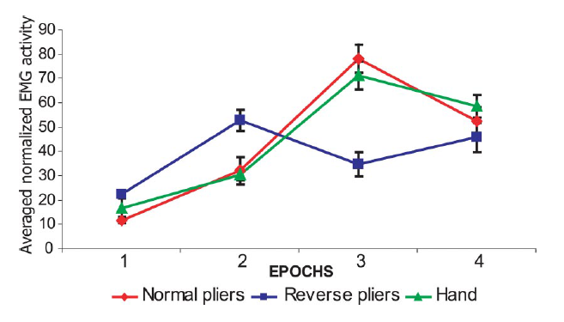
Results IV
Looked at population level too, using 3 factors:
Population (F5, F1g, F1m)
Tool Condition (normal pliers, reverse pliers, hand grasping)
Epoch (1: pre-grasp period, 2: pliers opening, 3: pliers closing, 4: post-grasp hold)
For each population, ANOVA obtained significant (P < 0.001) effects for both Tool Condition and Epoch, with significant interactions between these factors in F1g and F1m populations.
Pre Tips open Tips Close Post

Slide 11
Discussion
“The present finding shows that, in addition to being incorporated into the body schema, the tool, after learning, is coded in the motor system as if it were an artificial hand able to interact with the external objects, as the natural hand is able to do. “How can this embodiment take place? The most plausible explanation is that this occurs because both F5 and F1 contain neurons that code the goal of the motor act.”
Further suggest:
Goal-related populations are connected to two separate populations of neurons which produce the motor pattern
These connections are reinforced by trial success

Slide 12
Discussion II
The authors also argue that:
This experiment shows that activity of F5 neurons is goal-related, not execution-related
Suggest that this supports the argument that F5 neurons (mirror neurons) encode the goal of (self-executed and observed) motor acts.
However, there has since been another 5 years of mirror neuron research, including quite a bit of criticism.

Slide 13
Additional References
G. Rizzolatti & P. Strick, “Cognitive Functions of the Premotor Systems,” Chapter 19 in Kandel, Schwartz, Jessel, Siegelbaum, & Hudspeth, Principles of Neural Science (5th Edition), 2013.
G. Rizzolatti and L. Craighero, “The Mirror Neuron System,” Annual Review of Neuroscience, 2004.

