Slide 1
Variational Inference for Mahalanobis Distance Metrics in Gaussian Process Regression
Tea Talk by Thomas Desautels
Paper by M. K. Titsias and M. Lázaro-Gredilla,
NIPS 2013

Slide 2
Teaser
We’ll be discussing the guts of this paper in detail at the ML reading group on Thursday (4 PM); if you think this looks interesting, read it and join us!

Slide 3
Conclusions
Titsias and Lázaro-Gredilla present a neat method for GP regression which has some clever techniques and solves a difficult theoretical problem
Their experiments don’t convincingly show a regime where this technique is superior to all competitors.

Slide 4
Those pesky kernel hyperparameters
Gaussian process regression uses data
,
Along with a kernel function , these are used to predict values of a function, assumed to have generated the (noisy) data.
Conditioned on the kernel hyperparameters θ, we have closed forms for .
How should we choose θ? Can we integrate it out?

Slide 5
Those pesky kernel hyperparameters
Typically, use relatively few hyperparameters and fit
using the available data.
This works OK: often inexpressive as the dimensionality D of x becomes large or the dimensions have different natural scales.
Natural fix would be to use more parameters, but this can overfit and generalize poorly.

Slide 6
What would we like?
We’d really love to get
The posterior over the hyperparameters is nasty, possibly multimodal, etc.
Could use MCMC, but very expensive.

Slide 7
Variational Approximation
We’ll settle for a variational approximation.
Restriction: just square-exponential kernels.
How do we get there?

Slide 8
Key Idea #1: Standardized Representations of GPs
Define a kernel function for .
Note that has no hyperparameters.
Denote a function drawn from the corresponding GP as .
If we define the related function , then it works out that if .

Slide 9
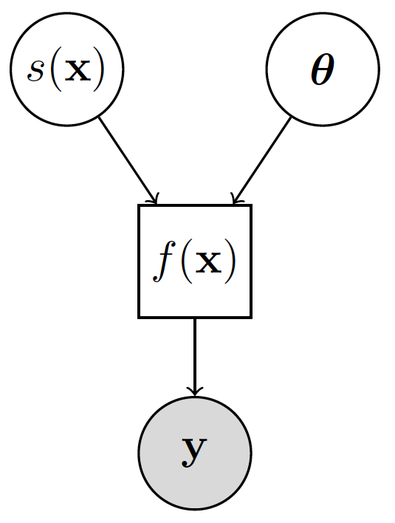
Why is this useful?
This is handy because we’ve built a model with different conditional relationships:
Now we can express the GP bit meaningfully, even without having a particular assignment for θ.

Slide 10
Key Idea #2: Variational Inference on Augmented Joint
Introduce an entirely new collection of m scalar variables and associated : let .
Then the joint over the latents f corresponding to the observed data and our newly-defined vector of u values is
And thus:

Slide 11
Why bother?
The choice of z enables us to tweak the distribution over f, since they are free parameters.
Crucially, K_{u,u} is not a function of the hyperparameters, so we can write the augmented joint as follows:
Gaussian: Last slide
Our choice
Assume Gaussian noise
Gaussian

Slide 12
Variational Approximation
Introduce:
We now have the choice of
Show q(u) should be Gaussian, choose q(W) as a factorized Gaussian with individual means and covariances μ,σ for each weight.
Minimize with respect to μ’s,σ’s,z’s, σ (noise), and σ_{f} : gradient methods.
Can also do some exact elimination.

Slide 13
Prediction
We were originally interested in predicting the value of y* at some new point x* (equivalently, f*).
Approximately marginalize over f,u,W, and f*:
This reduces to
Which is still intractable, due to the dependence on W: sample W~q(W), and approximate q(y*|y) as a mixture of Gaussians.

Slide 14
Whew! Now, Experiments
This algorithm:
VDMGP
NMSE: Normalized Mean Square Error
NLPD: Negative Log Probability Density

Slide 15
Run Time
The one that catches up for large data

Slide 16
Conclusions
Nifty!
Not demonstrated to be much/at all better than the competition.

