Slide 1
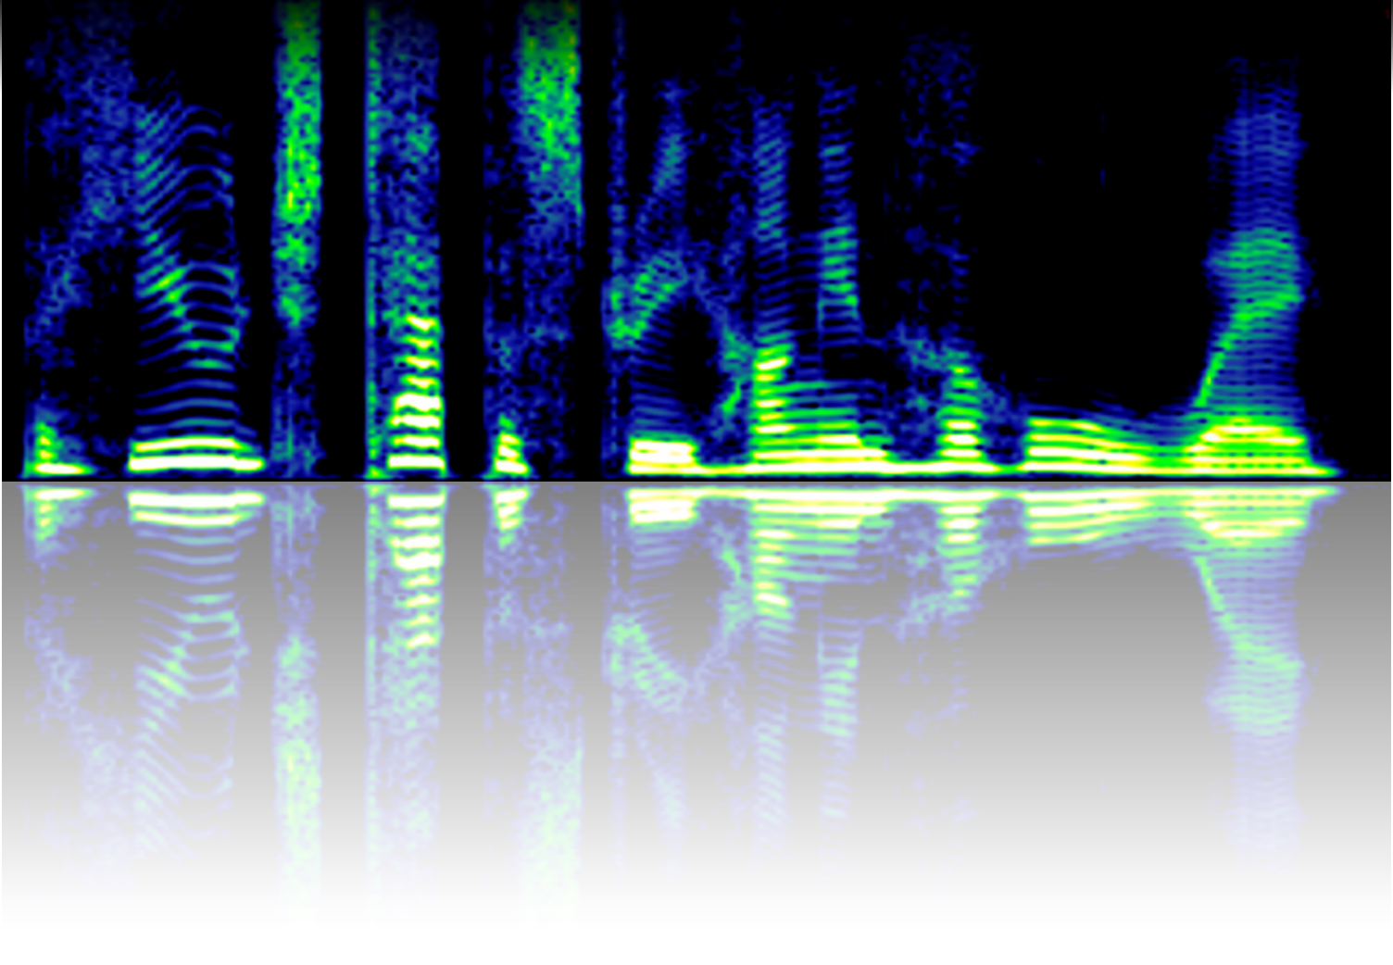
THE STRUCTURE AND FUNCTION OF THE AUDITORY SYSTEM
Nicholas A. Lesica
Ear Institute
University College London
www.lesicalab.com

Slide 2



HEARING
THE PROBLEM
Potential danger
Background noise
Source of interest
Competing sources
Key points:
Hearing is a 360° sense
Auditory objects are transparent(ish)

Slide 3
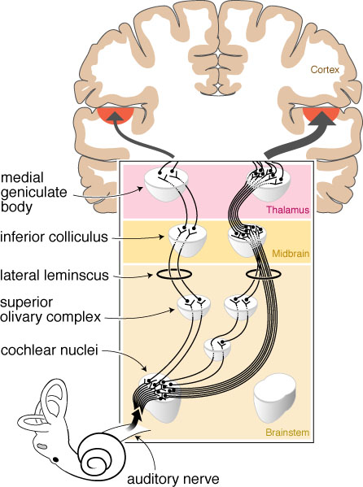
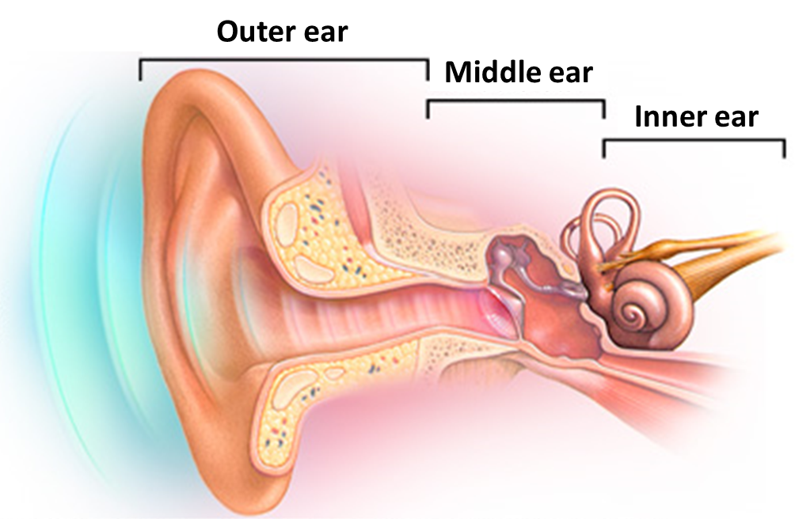
HEARING
THE SOLUTION
The ear receives, filters, and encodes acoustic information …
… and the brain analyzes it to update its internal model of the world

Slide 4



THE MAMALIAN AUDITORY PATHWAY
OVERVIEW
Ear
Brainstem
Midbrain
Thalamocortical loop
Higher cortex
Encoding
Feature extraction
Nonlinear recombination
Selective amplification
Perception
Receptive field
Low-D basis
High-D basis
High SNR basis
Classification
Intensity
help
hello
yellow
mellow
Melo
Jello
fellow
Frequency
Temporal profile
sound
Activity
Time

Slide 5
THE EAR
OVERVIEW

Slide 6
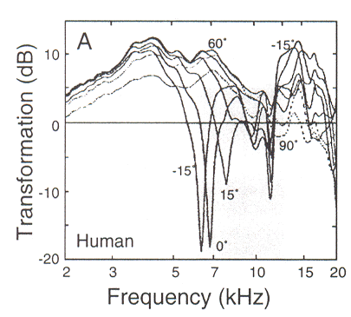
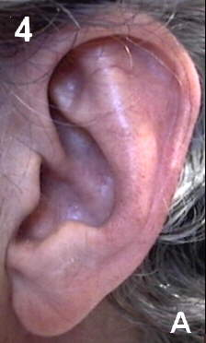
THE OUTER EAR
The outer ear collects sound and amplifies low frequencies …
+15°
0°
-15°
… and also filters high frequencies in a location-dependent manner

Slide 7
THE EAR
OVERVIEW

Slide 8
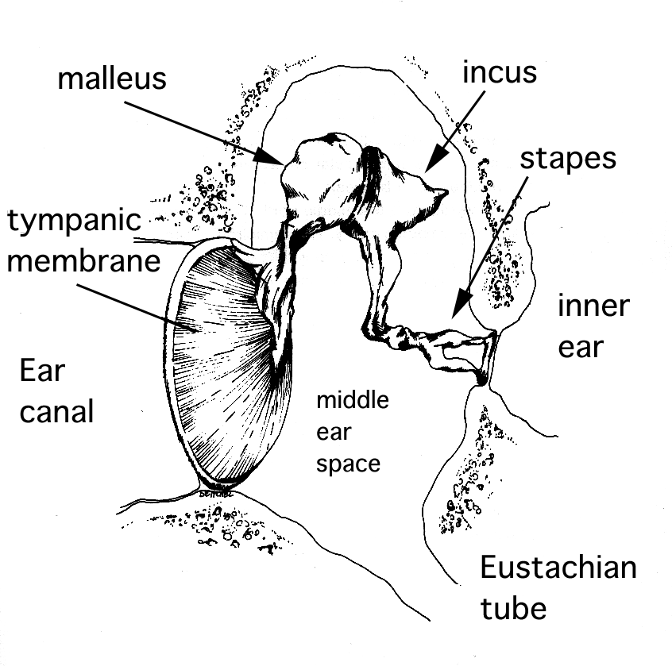
THE MIDDLE EAR
The middle ear compensates for the impedance mismatch between the air in the ear canal and the fluid in the cochlea …
ear drum
Cochlea (fluid)
Ear canal (air)

Slide 9
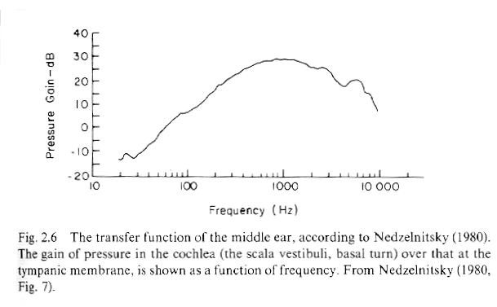
THE MIDDLE EAR
The middle ear compensates for the impedance mismatch between the air in the ear canal and the fluid in the cochlea …
Middle ear transfer function
… by amplifying behaviorally relevant frequencies …
… except for a protective reflex that attenuates very loud sounds

Slide 10
THE EAR
OVERVIEW

Slide 11
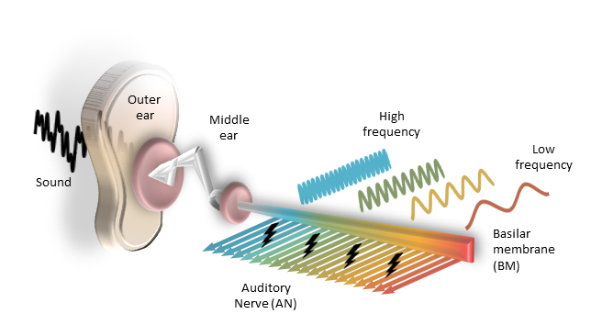
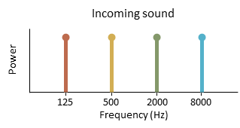
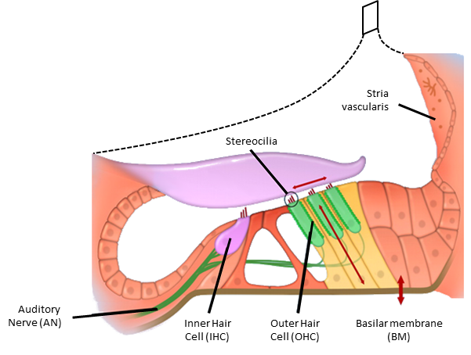
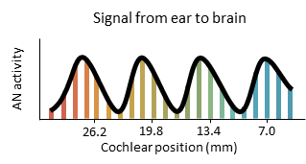
THE COCHLEA
FREQUENCY ANALYSIS
The cochlea decomposes sound into its constituent frequencies

Slide 12
THE COCHLEA
AMPLIFICATION AND COMPRESSION
Outer hair cells are critical for sensitivity to weak sounds
Outer hair cells (OHCs) amplify weak sounds
w/ OHCs
w/o OHCs
BM movement
Threshold for AN activation
Sound level
AN activity
Sound level

Slide 13
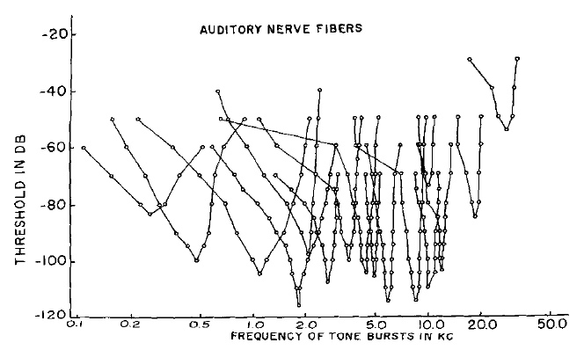
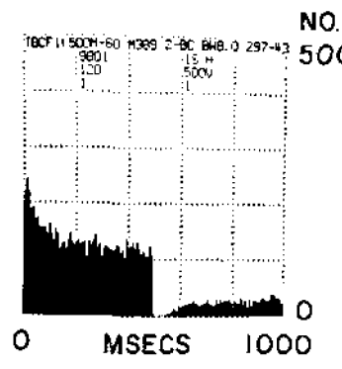
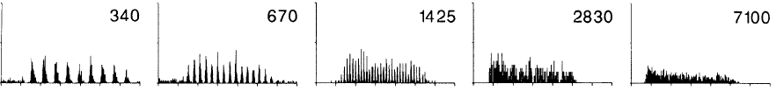

THE COCHLEA
AUDITORY NERVE FIBER ACTIVITY
Receptive fields
Temporal profile
Kiang, Acta Oto-laryng, 1968
Phase-locking at low frequencies
Freq =
Joris et al, J Neurophysiol, 1994

Slide 14
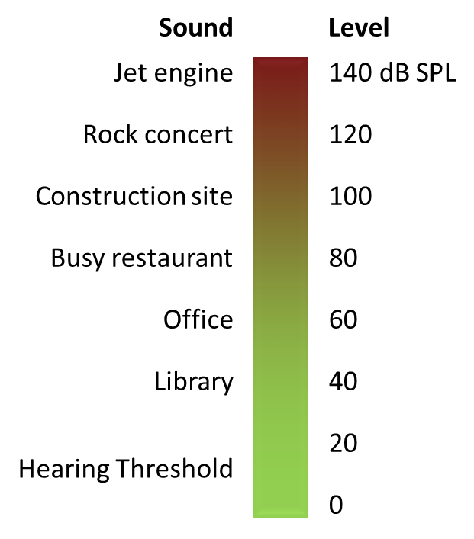
THE COCHLEA
DYNAMIC RANGE FRACTIONATION
The dynamic range of individual AN fibers is not sufficient …
Low threshold
High threshold
AN activity
Sound level
… but the collective dynamic range of the population is

Slide 15
THE COCHLEA
DYNAMIC RANGE FRACTIONATION
Sound with increasing level in quiet environment
Incoming sound
Signal from ear to brain
Sound level
AN activity
AN activity
Time
Sound level
Time
Sound in noisy environment
Incoming sound
Signal from ear to brain
Sound level
AN activity
AN activity
Time
Sound level
Time

Slide 16
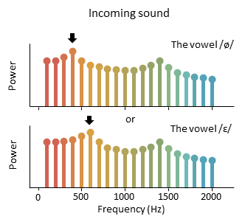
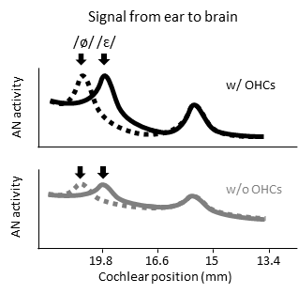
THE COCHLEA
NONLINEAR SPECTRAL PROCESSING
The cochlea is *not* just a frequency analyzer
Incoming sound
Power
500
1000
2000
4000
Frequency (Hz)
Signal from ear to brain
Distortion
Suppression
Amplification
AN activity
19.8
16.6
13.4
10.2
Cochlear position (mm)

Slide 17
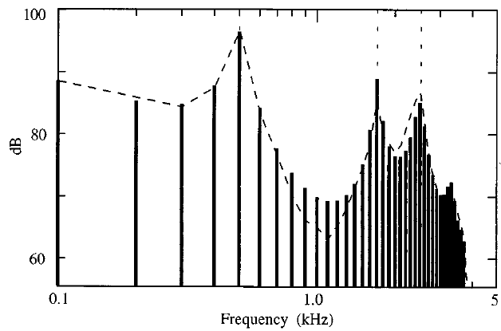
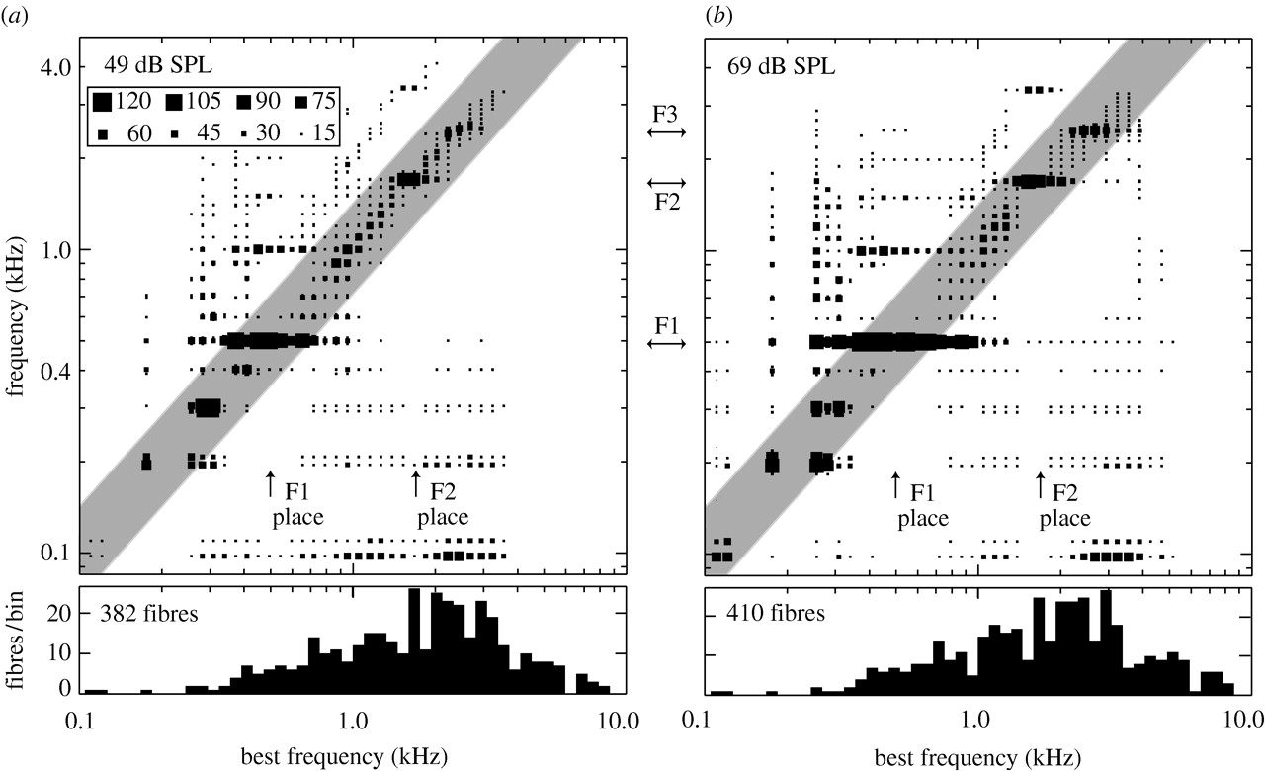
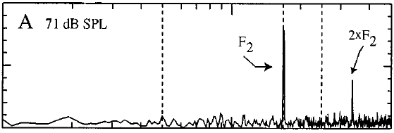
THE COCHLEA
NONLINEAR SPECTRAL PROCESSING
“Synchrony capture” of vowel formants
Power spectrum of incoming sound
Population representation
F₁
F₂
F₃
The vowel /ε/
Young, 2012
Power
0.5
1.7
2.5
Frequency (kHz)
Power spectrum of AN activity
Fiber BF ≈ F₂
Power

Slide 18
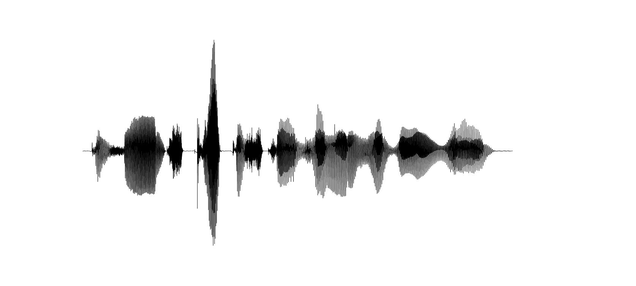
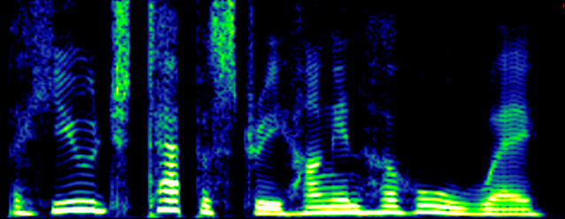
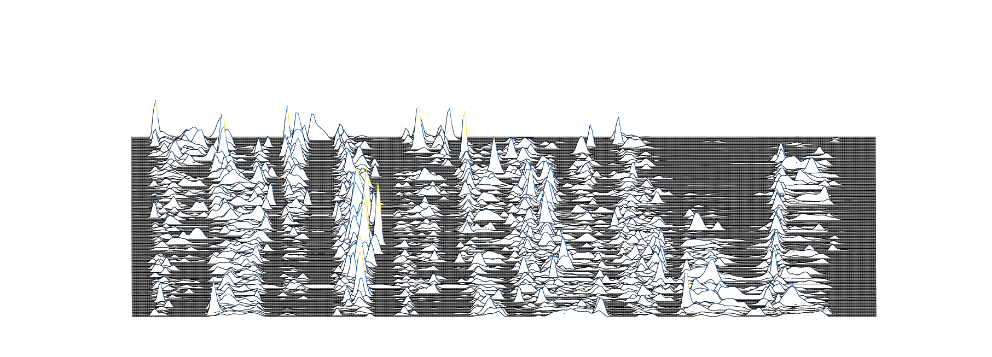
THE COCHLEA
SUMMARY
The ear encodes incoming sounds for transmission to the brain
Outer and middle ear:
Linear filtering
Cochlea:
Frequency analysis
Amplification/compression
Dynamic range fractionation
Nonlinear transformation
Phase-locking
The signal from ear to brain
is *not* just a spectrogram!
A hu ge ta pes try hung in her hall way
4
Frequency (kHz)
2
0
0
0.5
1
1.5
2
2.5
Time (s)
AN activity

Slide 19
THE MAMALIAN AUDITORY PATHWAY
OVERVIEW
Ear
Brainstem
Midbrain
Thalamocortical loop
Higher cortex
Encoding
Feature extraction
Nonlinear recombination
Selective amplification
Perception
Receptive field
Low-D basis
High-D basis
High SNR basis
Classification
Intensity
help
hello
yellow
mellow
Melo
Jello
fellow
Frequency
Temporal profile
sound
Activity
Time

Slide 20
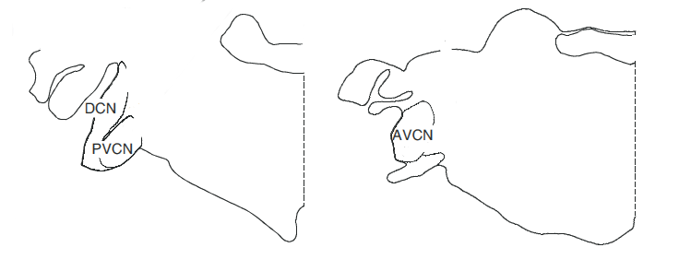
THE COCHLEAR NUCLEUS
OVERVIEW
Location:
medulla
Primary function:
feature extraction
Major inputs:
auditory nerve (E)
Major outputs:
superior olivary complex (E, from VCN)
inferior colliculus (E, from DCN)
Of note:
many different cell types
DCN has complex micro-circuit

Slide 21
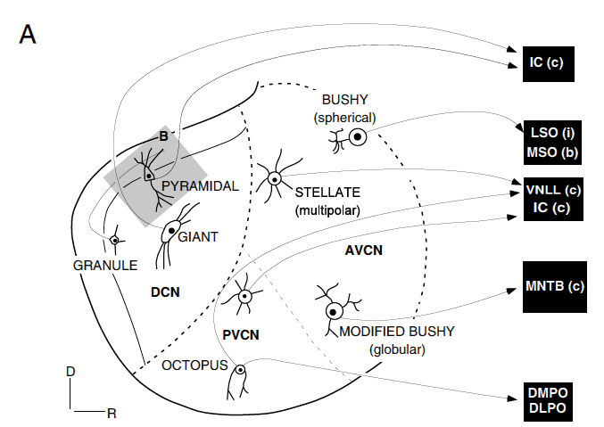
THE COCHLEAR NUCLEUS
MAJOR CELL TYPES
From AN

Slide 22
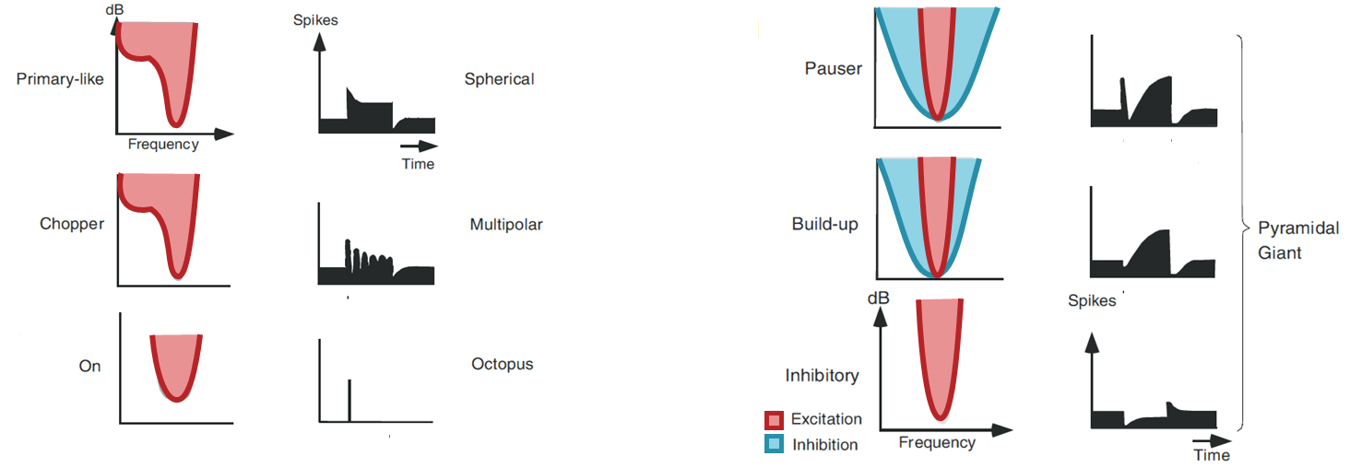
THE COCHLEAR NUCLEUS
MAJOR CELL TYPES
Different cell types have distinct response properties
Ventral cochlear nucleus
Dorsal cochlear nucleus
Receptive field
Temporal profile
Receptive field
Temporal profile
sound

Slide 23
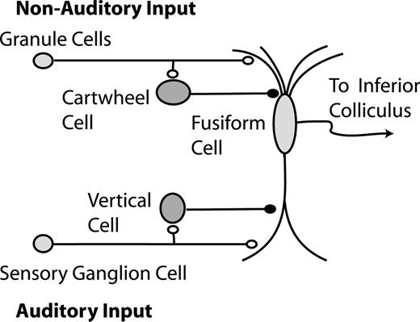
THE COCHLEAR NUCLEUS
MONOAURAL SPATIAL PROCESSING
The outer ear creates elevation-dependent spectral notches
The DCN contains cells that are sensitive to the notch …
… as well as the position of the head (and pinna)

Slide 24
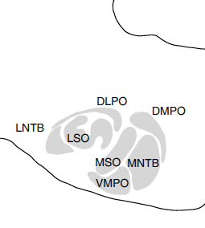
THE SUPERIOR OLIVARY COMPLEX
OVERVIEW
Location:
medulla
Primary function:
(binaural) feature extraction
Major inputs:
cochlear nucleus (E)
Major outputs:
lateral lemniscus (E)
inferior colliculus (E)
Of note:
many understudied sub-nuclei
calyx of held

Slide 25
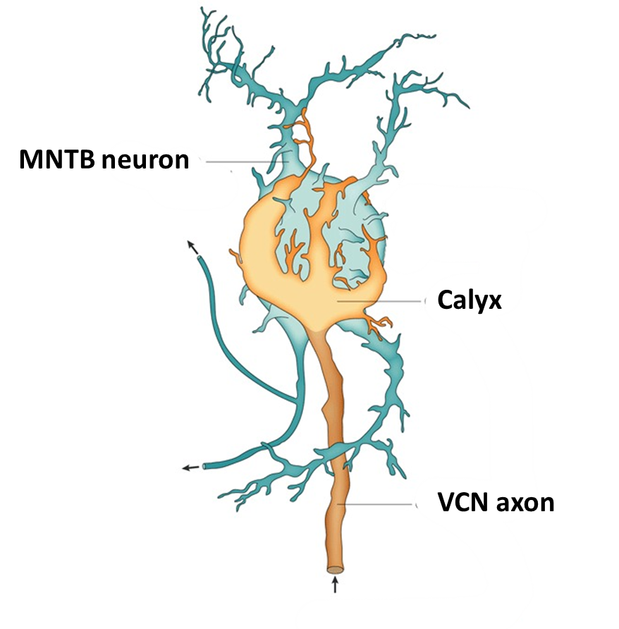
THE SUPERIOR OLIVARY COMPLEX
THE CALYX OF HELD
The MNTB provides a sign change on the way to the SOC
Hundreds of active zones allow for fast, reliable transmission even at high input rates

Slide 26
BINAURAL SPATIAL CUES
Differences between the two ears indicate the position of sounds in the horizontal plane
Interaural time difference (ITD)
Useful for frequencies < 2 kHz
Interaural level difference (ILD)
Useful for frequencies > 2 kHz
ITD
ILD

Slide 27
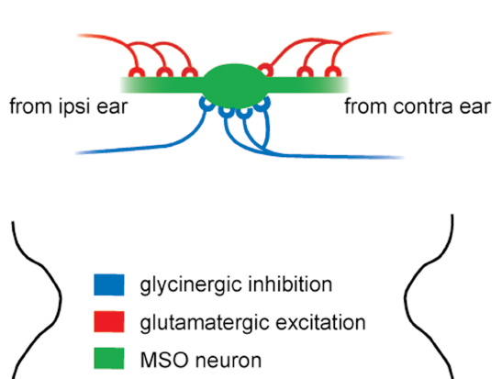
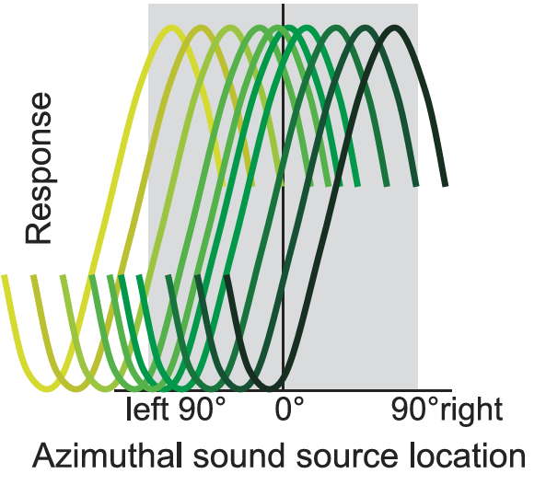
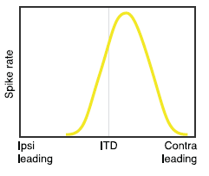
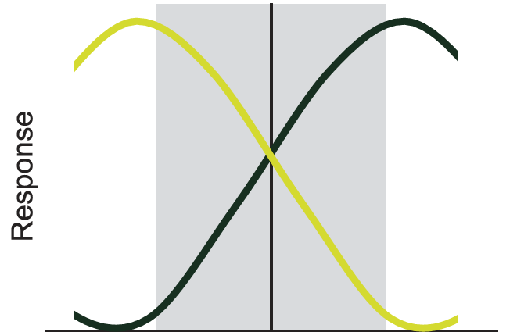
THE SUPERIOR OLIVARY COMPLEX
BINAURAL SPATIAL PROCESSING
ITDs are processed in the MSO …
“labelled line” code
birds, lizards
“two-channel” code
mammals
… and represented by activity balance across hemispheres

Slide 28
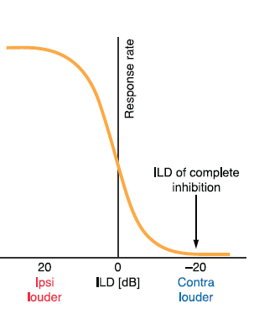
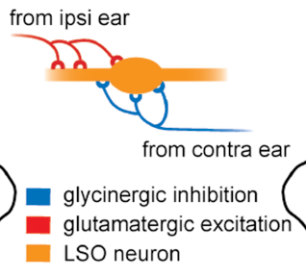
THE SUPERIOR OLIVARY COMPLEX
BINAURAL SPATIAL PROCESSING
ILDs are processed in the LSO …
… and also represented by activity balance across hemispheres
Temporal multiplexing of acoustic and spatial information

Slide 29
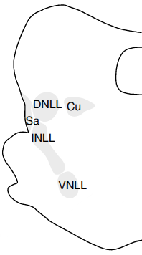
THE LATERAL LEMNISCUS
OVERVIEW
Location:
pons/midbrain border
Primary function:
sign change?
Major inputs:
cochlear nucleus (E)
superior olivary complex (E)
Major outputs:
inferior colliculus (I)
Of note:
very understudied

Slide 30
THE MAMALIAN AUDITORY PATHWAY
OVERVIEW
Ear
Brainstem
Midbrain
Thalamocortical loop
Higher cortex
Encoding
Feature extraction
Nonlinear recombination
Selective amplification
Perception
Receptive field
Low-D basis
High-D basis
High SNR basis
Classification
Intensity
help
hello
yellow
mellow
Melo
Jello
fellow
Frequency
Temporal profile
sound
Activity
Time

Slide 31
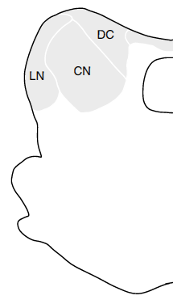
THE INFERIOR COLLICULUS
OVERVIEW
Location:
midbrain
Primary function:
integration of brainstem inputs
for relay to thalamocortical loop
Major inputs:
cochlear nucleus (E)
superior olivary complex (E)
lateral lemniscus (I)
Major outputs:
medial geniculate body (E,I)
Of note:
no structure-function relationships
no known micro-circuit

Slide 32
THE INFERIOR COLLICULUS
NONLINEAR RECOMBINATION OF BRAINSTEM INPUTS
Responses to tones
Responses to speech
Receptive field
Temporal profile
80
From left side
51.0
From right side
55.9
Intensity (dB SPL)
p (spike)
0.5
0.5
0.5
10
0
0
0
250
1
4
0
100
0
1
0
1
Frequency (kHz)
Time (ms)
Time (s)
Time (s)
0.5
58.7
59.5
0.5
0.5
0
0
0
5.5
2.0
0.2
0.2
0.2
0
0
0
0.1
0.2
0.1
0.2
0.2
0
0
0
0.5
19.8
16.0
0.5
0.5
0
0
0
0.01
10.6
4.7
0.2
0.2
0
0
0

Slide 33
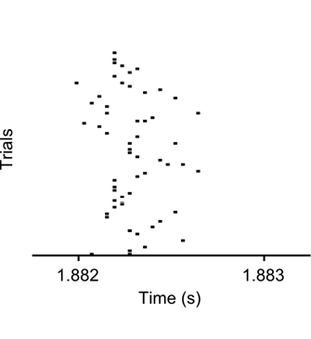
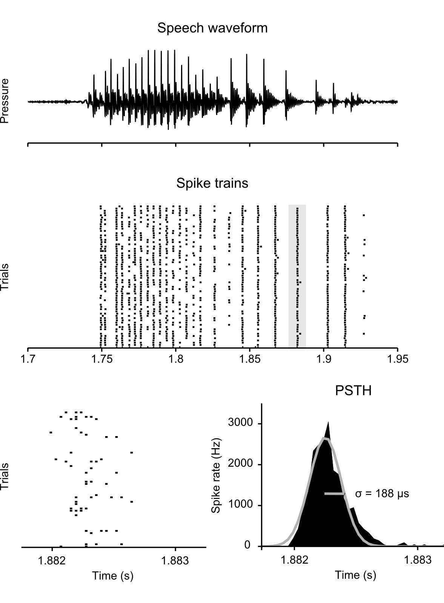
THE INFERIOR COLLICULUS
HIGH TEMPORAL PRECISION
The neural basis for scene analysis has high temporal precision

Slide 34


THE AUDITORY BRAINSTEM AND MIDBRAIN
SUMMARY
The brainstem extracts useful features and combines them to create a high-dimensional neural basis for scene analysis
Cochlear nucleus
Spectral/temporal features
Monoaural spatial cues
Superior olivary complex:
Binaural spatial cues
Inferior colliculus
Nonlinear recombination
The basis for scene analysis
is *not* just a spectrogram!
inferior colliculus
lateral lemniscus
superior olivary complex
trapezoid body
cochlear nucleus
exc
inh

Slide 35
THE MAMALIAN AUDITORY PATHWAY
OVERVIEW
Ear
Brainstem
Midbrain
Thalamocortical loop
Higher cortex
Encoding
Feature extraction
Nonlinear recombination
Selective amplification
Perception
Receptive field
Low-D basis
High-D basis
High SNR basis
Classification
Intensity
help
hello
yellow
mellow
Melo
Jello
fellow
Frequency
Temporal profile
sound
Activity
Time

Slide 36
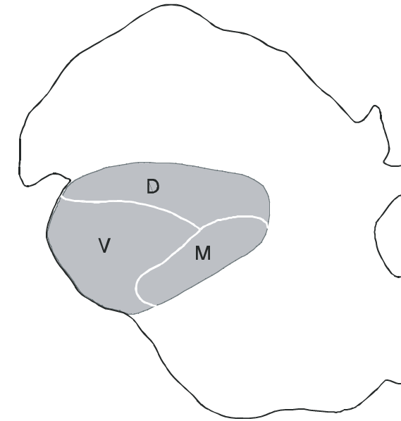
THE MEDIAL GENICULATE BODY
OVERVIEW
Location:
thalamus
Primary function:
attentional modulation?
Major inputs:
inferior colliculus (E,I)
primary auditory cortex (E)
thalamic reticular nucleus (I)
Major outputs:
primary auditory cortex (E)
Of note:
no interneurons in rodents

Slide 37
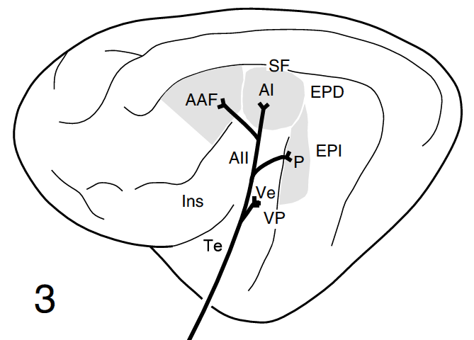
THE PRIMARY AUDITORY CORTEX
OVERVIEW
Location:
Temporal lobe
Primary functions:
attentional modulation
contextual processing
Major inputs:
medial geniculate body (E)
auditory and non-auditory (E,I?)
Major outputs:
higher-level auditory cortex (E)
thalamus (E)
Of note:
≥ 2 primary areas (A1, AAF, ?)

Slide 38
THE THALAMOCORTICAL LOOP
ATTENTIONAL MODULATION OF SPECTRAL AND TEMPORAL SELECTIVITY
Spectrotemporal filtering improves SNR
Spectral filtering
Rhythmic target
signal in noise
Enhanced representation
Frequency
Time
Power
Temporal filtering

Slide 39
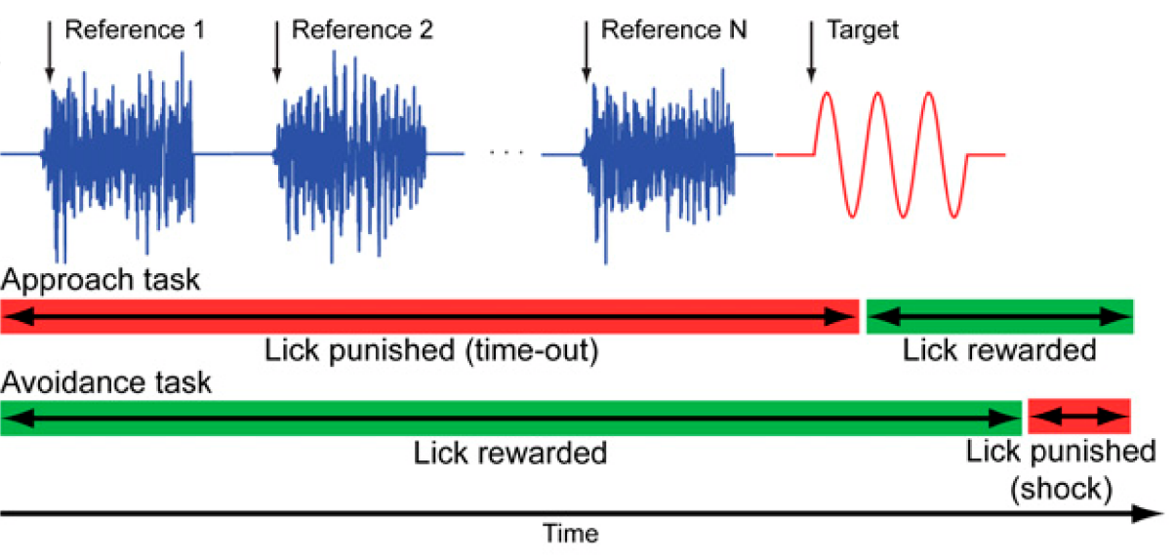
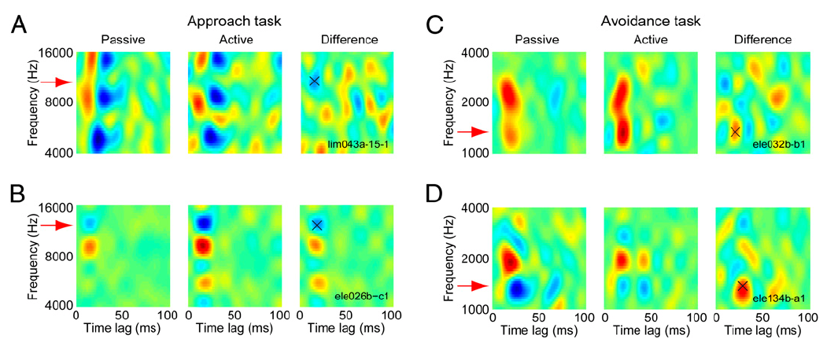
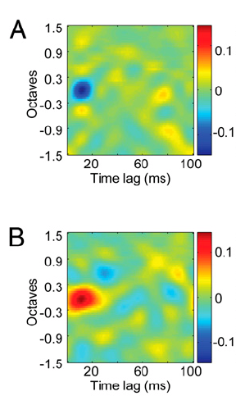
THE THALAMOCORTICAL LOOP
ATTENTIONAL MODULATION OF SPECTRAL SELECTIVITY
Sound discrimination task
David et al, 2012
Spectrotemporal receptive fields in ferret A1
Example neuron
Population average

Slide 40
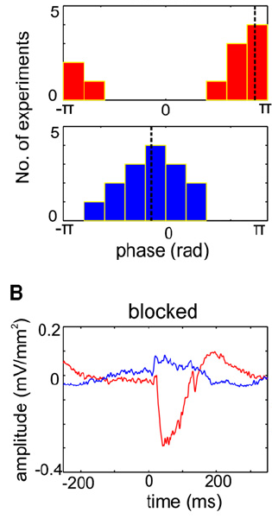
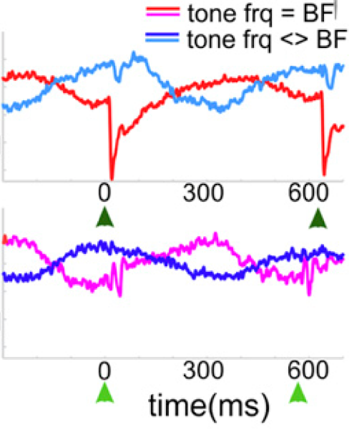
THE THALAMOCORTICAL LOOP
ATTENTIONAL MODULATION OF TEMPORAL SELECTIVITY
Single rhythmic tone stream - passive
Dual rhythmic tone streams - active
~ 1 s
~ 1 s
Freq. = BF
Freq. = BF
OR
AND
Freq. = non-BF
Freq. = non-BF
Local field potential in monkey A1
Local field potential in monkey A1
LFP amplitude (a.u.)
Tone freq. = BF
Attend BF stream
Tone freq. = non-BF
Attend non-BF stream
Time (ms re. sound onset)
Time (ms re. sound onset)
O’Connell et al., Neuron, 2011
Lakatos et al., Neuron, 2013

Slide 41
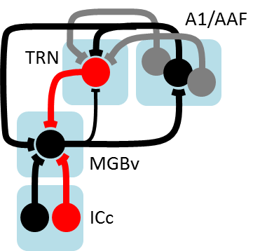

THE THALAMOCORTICAL LOOP
SUMMARY
The thalamocortical loop modifies the neural basis for scene analysis based on task-specific needs
Spectral filtering
Attention-dependent reweighting of inputs
Temporal filtering
Attention-dependent entrainment of intrinsic fluctuations in excitability
Higher-level cortex receives a modified neural basis that is suited to the current task

Slide 42
THE MAMALIAN AUDITORY PATHWAY
OVERVIEW
Ear
Brainstem
Midbrain
Thalamocortical loop
Higher cortex
Encoding
Feature extraction
Nonlinear recombination
Selective amplification
Perception
Receptive field
Low-D basis
High-D basis
High SNR basis
Classification
Intensity
help
hello
yellow
mellow
Melo
Jello
fellow
Frequency
Temporal profile
sound
Activity
Time

Slide 43
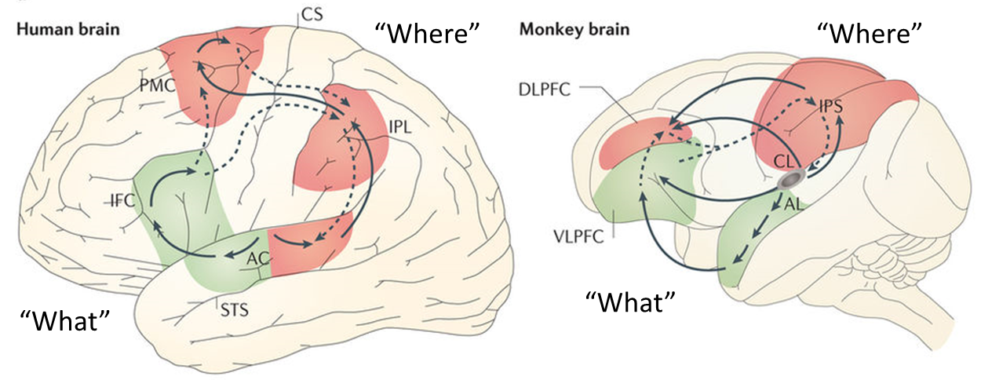
HIGHER CORTEX
OVERVIEW
The auditory cortex plays an important yet ambiguous role in hearing. When the auditory information passes into the cortex, the specifics of what exactly takes place are unclear.
- Wikipedia
Bizley and Cohen, 2013

Slide 44
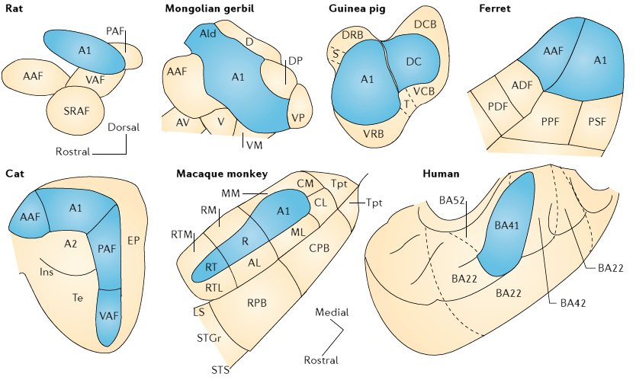
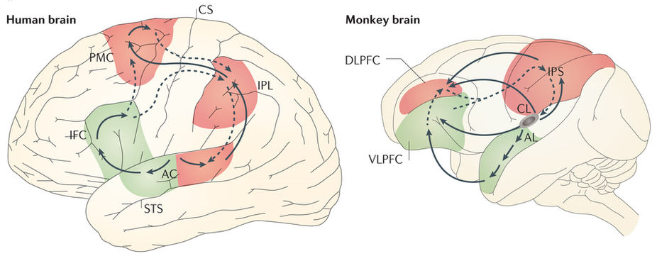
HIGHER CORTEX
OVERVIEW
“Where”
“What”
Bizley and Cohen, 2013

Slide 45



HIGHER CORTEX
NEURAL CORRELATES OF SELECTIVE ATTENTION
Selective attention enhances the SNR of the neural basis for scene analysis
+
=
Reconstruction from cortical field potentials
Mesgarani and Chang, 2012

Slide 46


HIGHER CORTEX
CATEGORICAL RESPONSES
Neurons represent sound class rather than acoustics in monkey STG
Auditory task
Example neuron
Morph (%)
0
50
Neural activity
100
Time (s)

Slide 47
THE MAMALIAN AUDITORY PATHWAY
OVERVIEW
Cochlea
Brainstem
Midbrain
Thalamocortical loop
Higher cortex
Encoding
Feature extraction
Nonlinear recombination
Selective amplification
Perception
Receptive field
Low-D basis
High-D basis
High SNR basis
Classification
Intensity
help
hello
yellow
mellow
Melo
Jello
fellow
Frequency
Temporal profile
sound
Activity
Time

Slide 48

HEARING LOSS
Death, taxes … and hearing loss

Slide 49


HEARING LOSS
Communication problems, social isolation, and more …
Hearing loss makes it difficult to understand speech
Hearing loss linked to increased:
Cognitive decline (Lin et al., 2013)
Dementia (Lin et al., 2011)
Mortality (Contrera et al., 2015)
Associated costs in the US expected to exceed $50 billion annually by 2030 (Stucky, 2010)

Slide 50




HEARING LOSS
Hearing aids help, but not in noisy environments
Two studies of speech recognition performance
% correct
100
Larson et al., 2000
w/ aid
50
w/o aid
Quiet (52 dB SPL)
Loud (74 dB SPL)
0
High Low
High Low
Background noise level
“I can hear you, but I can’t understand you”

Slide 51


THE COCHLEA
AMPLIFICATION AND COMPRESSION
Outer hair cells dysfunction decreases sensitivity
Outer hair cells (OHCs) amplify weak sounds
w/ OHCs
w/o OHCs
BM movement
Threshold for AN activation
Sound level
AN activity
Sound level

Slide 52


HIDDEN HEARING LOSS
Hearing loss also arises from changes to the changes to the AN itself
Cochlear synaptopathy
Synaptopathy in older people
Mild
AN fibers
IHC area
Severe
From Viana et al., 2015
Problem: high-threshold AN fibers are particularly vulnerable

Slide 53
THE COCHLEA
NONLINEAR SPECTRAL PROCESSING
The cochlea is *not* just a frequency analyzer
Incoming sound
Power
500
1000
2000
4000
Frequency (Hz)
Signal from ear to brain
Distortion
Suppression
Amplification
AN activity
w/ OHCs
w/o OHCs
19.8
16.6
13.4
10.2
Cochlear position (mm)

Slide 54

THE COCHLEA
NONLINEAR SPECTRAL PROCESSING
“Synchrony capture” of vowel formants
F₁
F₂
F₃
The vowel /ε/
Power spectrum
of incoming sound
Power
0.5
1.7
2.5
Frequency (kHz)
Fiber BF ≈ F₂
Power spectrum of AN activity
Power
Normal ear
Power
Impaired ear

Slide 55

THE COCHLEA
NONLINEAR SPECTRAL PROCESSING
Population representation of /ε/
Normal
Impaired
Hearing loss is a profound distortion of the signal from ear to brain

Slide 56
HIDDEN HEARING LOSS
Hearing loss also arises from changes to the AN itself
Cochlear synaptopathy
Synaptopathy in older people
Mild
AN fibers
IHC area
Severe
From Viana et al., 2015
Problem: high-threshold AN fibers are particularly vulnerable

Slide 57
THE COCHLEA
DYNAMIC RANGE FRACTIONATION
Normal
Hidden hearing loss
Low threshold
High threshold
Low threshold
High threshold
AN activity
AN activity
Sound level
Sound level
Hidden hearing loss decreases differential sensitivity at high levels

Slide 58
THE COCHLEA
DYNAMIC RANGE FRACTIONATION
Sound with increasing level in quiet environment
Incoming sound
Signal from ear to brain
Normal
HHL
Sound level
AN activity
AN activity
Time
Sound level
Time
Sound in noisy environment
Incoming sound
Signal from ear to brain
Sound level
AN activity
AN activity
Time
Sound level
Time
Hidden hearing loss impairs perception at high sound levels

Slide 59



HEARING LOSS
Hearing loss is much more than just a sensitivity problem
… it is a profound distortion of the signal from ear to brain
… that hearing aids fail to correct

Slide 60
WHY DO HEARING AIDS FAIL TO RESTORE NORMAL AUDITORY PERCEPTION?
Nicholas A. Lesica
Ear Institute
University College London
www.lesicalab.com

Slide 61
Sound
Level
Jet engine
140 dB SPL
Rock concert
120
Construction site
100
Busy restaurant
80
Office
60
Library
40
20
Hearing Threshold
0

Slide 62
THE THALAMOCORTICAL LOOP
ATTENTIONAL MODULATION OF SPECTRAL SELECTIVITY
Two different sound detection tasks
David et al, PNAS, 2012

Slide 63
THE THALAMOCORTICAL LOOP
ATTENTIONAL MODULATION OF SPECTRAL SELECTIVITY
Spectrotemporal receptive fields in ferret A1
Example neurons
Population averages
Approach task
Avoidance task
David et al, PNAS, 2012

Slide 64



TEMPORAL COHERENCE FOR AUDITORY SCENE ANALYSIS
8
Frequency (KHz)
0
Time
8
Frequency (KHz)
Frequency
0
Time
Time

Slide 65

TEMPORAL COHERENCE FOR AUDITORY SCENE ANALYSIS
The brainstem projects the signal from the ear into a high-dimensional space …
8
Frequency (KHz)
0
Time
8
Frequency (KHz)
Frequency
0
Time
Time
… in which temporal coherence indicates a common source

Slide 66


