Slide 1
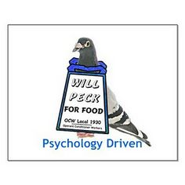
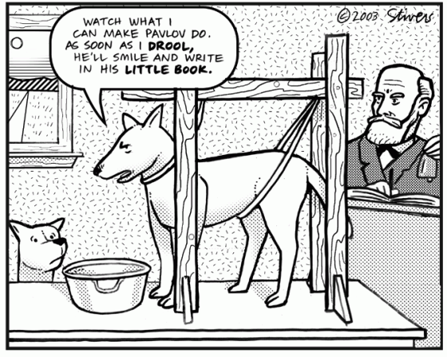

Slide 2
Marrian Conditioning
prediction: of important events
control: in the light of those predictions
Ethology
  optimality
  appropriateness
Psychology
  classical/operant
  conditioning
Computation
  dynamic progr.
  Kalman filtering
Algorithm
  TD/delta rules
  simple weights
Neurobiology
neuromodulators; midbrain; sub-cortical;
cortical structures

Slide 3
Plan
‘simple’ learning
  Rescorla-Wagner
  Pearce-Hall
  contexts and extinction
temporal difference learning and dopamine
action-learning
  model-free
  model-based
  vigour

Slide 4
Rescorla & Wagner (1972)
error-driven learning: change in value is proportional to the difference
between actual and predicted outcome
Assumptions:
learning is driven by error (formalizes notion of surprise)
summations of predictors is linear
A simple model - but very powerful!
  explains: gradual acquisition & extinction, blocking, overshadowing, conditioned inhibition, and more..
  predicted overexpectation
note: US as “special stimulus”

Slide 5
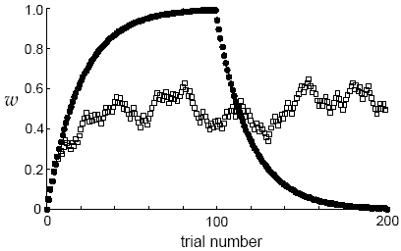
Rescorla-Wagner learning
what about 50% reinforcement?
note that extinction is not really like this – misses savings

Slide 6
Rescorla-Wagner learning
prediction on trial (t) as a function of rewards in trials (t-1), (t-2), …?
the R-W rule estimates expected reward using a weighted average of past rewards
recent rewards weigh more heavily
learning rate = forgetting rate!

Slide 7
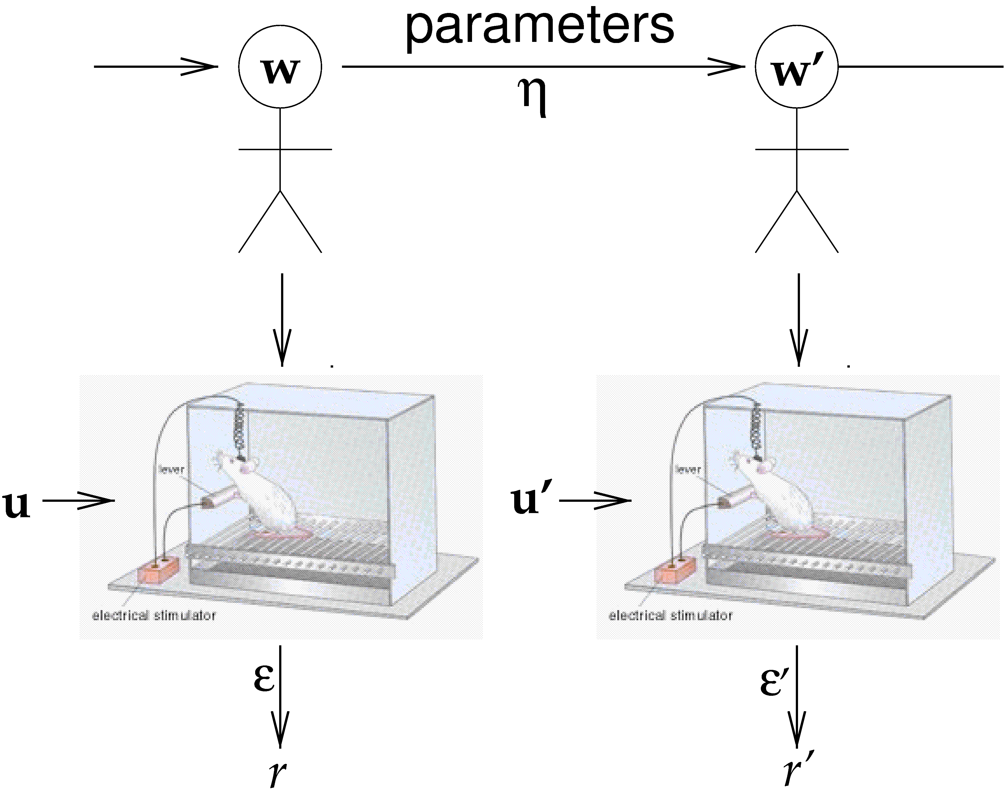
Kalman Filter
Markov random walk (or OU process)
no punctate changes
additive model of combination
forward inference

Slide 8
Kalman Posterior
^
ε
η

Slide 9
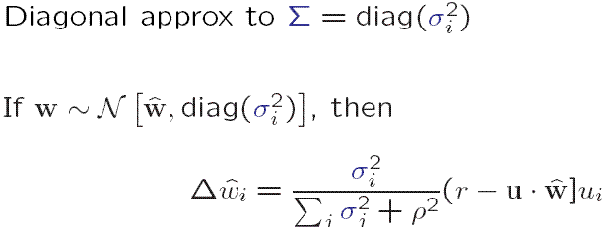
Assumed Density KF
Rescorla-Wagner error correction
competitive allocation of learning
  P&H, M

Slide 10

Blocking
forward blocking: error correction
backward blocking: -ve off-diag

Slide 11
Plan
‘simple’ learning
  Rescorla-Wagner
  Pearce-Hall
  contexts and extinction
temporal difference learning and dopamine
action-learning
  model-free
  model-based
  vigour

Slide 12
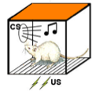
reinstatement
Test
Acquisition
Extinction
no shock
no shock
no shock
slides from Yael Niv

Slide 13
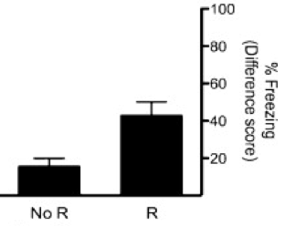
extinction ≠ unlearning
Acquisition
Extinction
Test
no shock
Storsve, McNally & Richardson, 2012
slides from Yael Niv
Notes:
also other evidence that extinction is not unlearning: spontaneous recovery, reinstatement

Slide 14

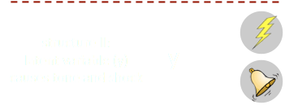
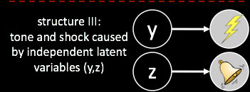
learning causal structure: Gershman & Niv
Sam Gershman
Notes:
there are many options for what the animal can be learning. maybe by modifying the learned association we can get insight regarding what was actually learned

Slide 15


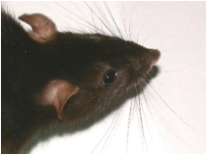
conditioning as clustering: DPM
Gershman & Niv;
Daw & Courville; Redish
Within each cluster: “learning as usual”
(Rescorla-Wagner, RL etc.)

Slide 16
associative learning versus state learning
Gershman & Niv
structural learning
(create new state)
Notes:
these two processes compete to relieve the “explanatory tension” in the animal’s internal model

Slide 17
how to erase a fear memory
hypothesis: prediction errors (dissimilar data) lead to new states
acquisition
extinction
what if we make extinction a bit more similar to acquisition?
slides from Yael Niv

Slide 18
gradual extinction
acquisition
extinction
gradual extinction
regular extinction
gradual reverse
Gershman, Jones, Norman, Monfils & Niv

Slide 19
gradual extinction
Gershman, Jones, Norman, Monfils & Niv - under review
acquisition
extinction
gradual extinction
regular extinction
gradual reverse
test one day (reinstatement) or 30 days later (spontaneous recovery)

Slide 20
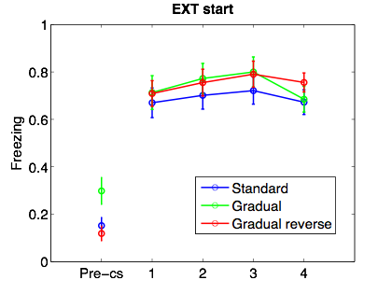
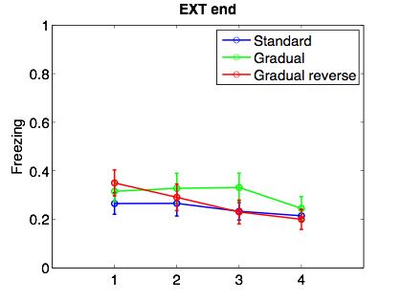
gradual extinction
Gershman, Jones, Norman, Monfils & Niv - under review
first trials of extinction
last trials of extinction
Notes:
N=16 except for group GR (15)

Slide 21
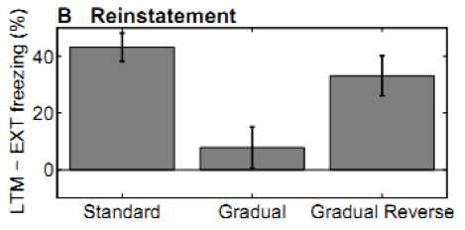
gradual extinction
Gershman, Jones, Norman, Monfils & Niv - under review
only gradual extinction group shows no reinstatement

Slide 22
Plan
‘simple’ learning
  Rescorla-Wagner
  Pearce-Hall
  contexts and extinction
temporal difference learning and dopamine
action-learning
  model-free
  model-based
  vigour

Slide 23



But: second order conditioning
phase 1:
phase 2:
?
test:
animals learn that a predictor of a predictor is also a predictor of reward!
⇒ not interested solely in predicting immediate reward

Slide 24
lets start over: this time from the top
Marr’s 3 levels:
The problem: optimal prediction of future reward
what’s the obvious prediction error?
but…
want to predict expected sum of future reward in a trial/episode
(N.B. here t indexes time within a trial)

Slide 25
lets start over: this time from the top
Marr’s 3 levels:
The problem: optimal prediction of future reward
want to predict expected sum of future reward in a trial/episode
Bellman eqn
for policy
evaluation

Slide 26
lets start over: this time from the top
Marr’s 3 levels:
The problem: optimal prediction of future reward
The algorithm: temporal difference learning
temporal difference prediction error δ_{t}
compare to:

Slide 27
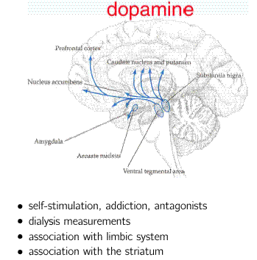
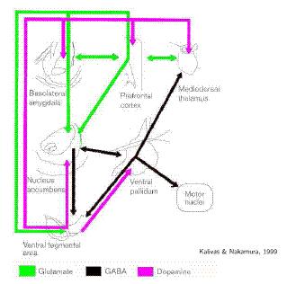
Dopamine

Slide 28
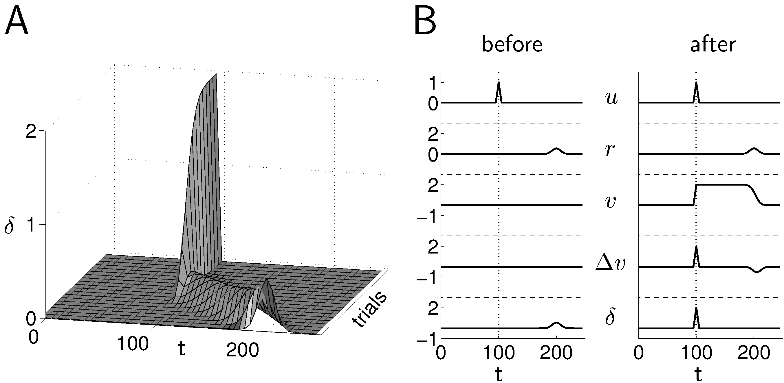
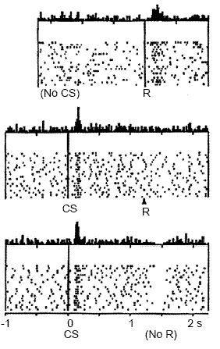
dopamine and prediction error
TD error
L
R
V_{t}
R
no prediction
prediction, reward
prediction, no reward

Slide 29










Risk Experiment
5 stimuli:
40¢
20¢
0/40¢
0¢
0¢
< 1 sec
5 sec
ISI
0.5 sec
You won
40 cents
2-5sec
ITI
19 subjects (dropped 3 non learners, N=16)
3T scanner, TR=2sec, interleaved
234 trials: 130 choice, 104 single stimulus
randomly ordered and counterbalanced

Slide 30
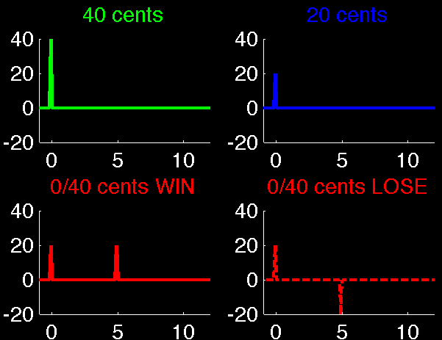
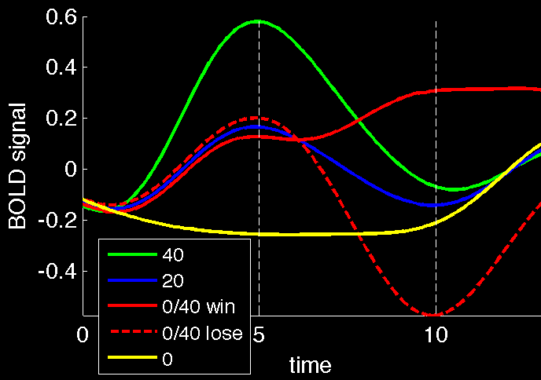
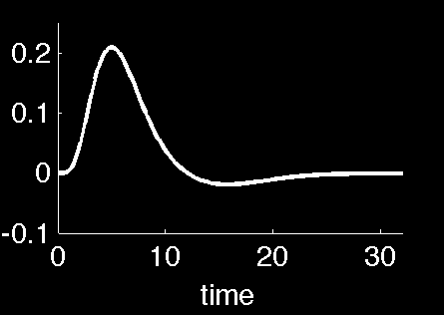
Neural results: Prediction Errors
what would a prediction error look like (in BOLD)?

Slide 31
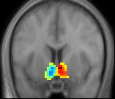
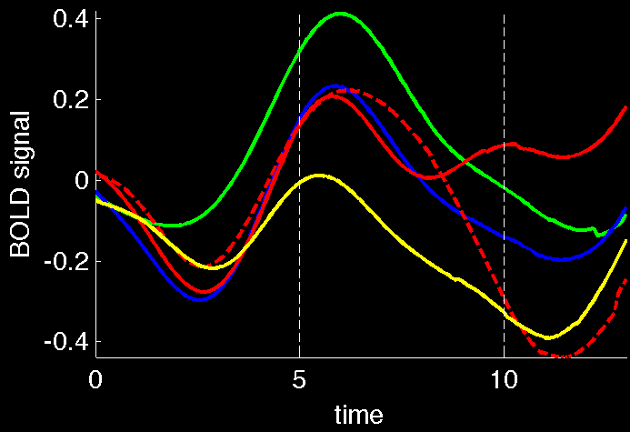
Neural results: Prediction errors in NAC
unbiased anatomical ROI in nucleus accumbens
(marked per subject*)
raw BOLD
(avg over all subjects)
can actually decide between different neuroeconomic models of risk
* thanks to Laura deSouza

Slide 32
Plan
‘simple’ learning
  Rescorla-Wagner
  Pearce-Hall
  contexts and extinction
temporal difference learning and dopamine
action-learning
  model-free
  model-based
  vigour

Slide 33
Action Selection
Immediate reinforcement:
  leg flexion
  Thorndike puzzle box
  pigeon; rat; human matching
Delayed reinforcement:
  these tasks
  mazes
  chess
Evolutionary specification

Slide 34
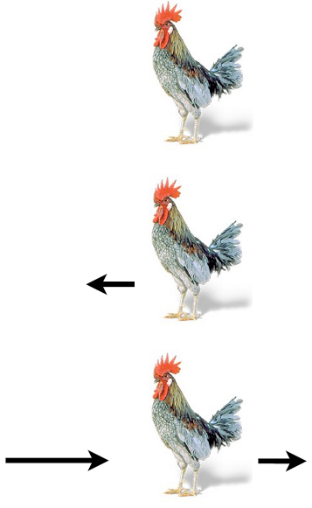
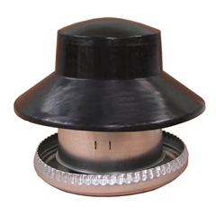
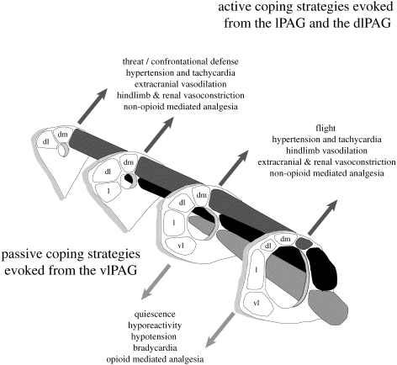

Pavlovian Control
Keay & Bandler, 2001

Slide 35
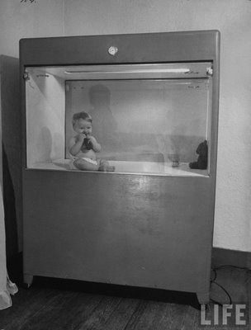

Slide 36

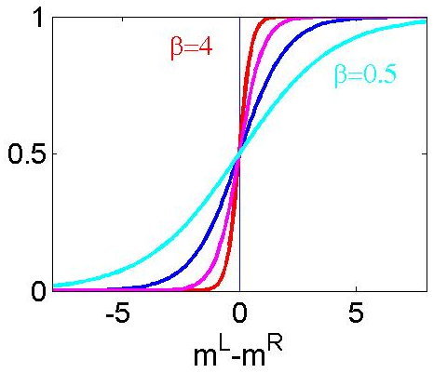




Immediate Reinforcement
stochastic policy:
based on action values:

Slide 37
Direct Actor

Slide 38


Action at a (Temporal) Distance
4
2
0
2
S₂
S₃
S₁
learning an appropriate action at S₁:
  depends on the actions at S₂ and S₃
  gains no immediate feedback
idea: use prediction as surrogate feedback

Slide 39
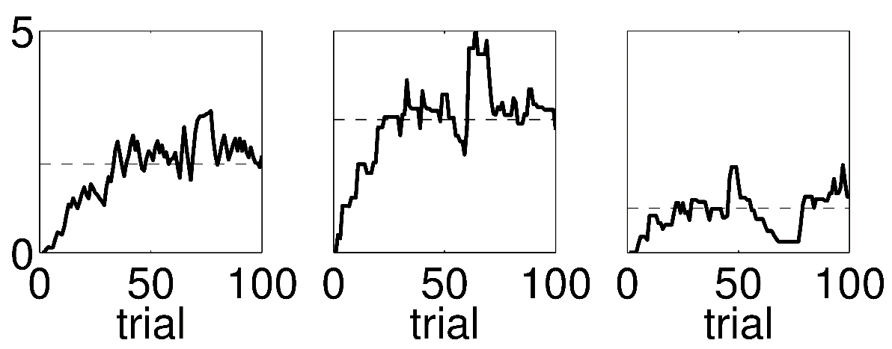
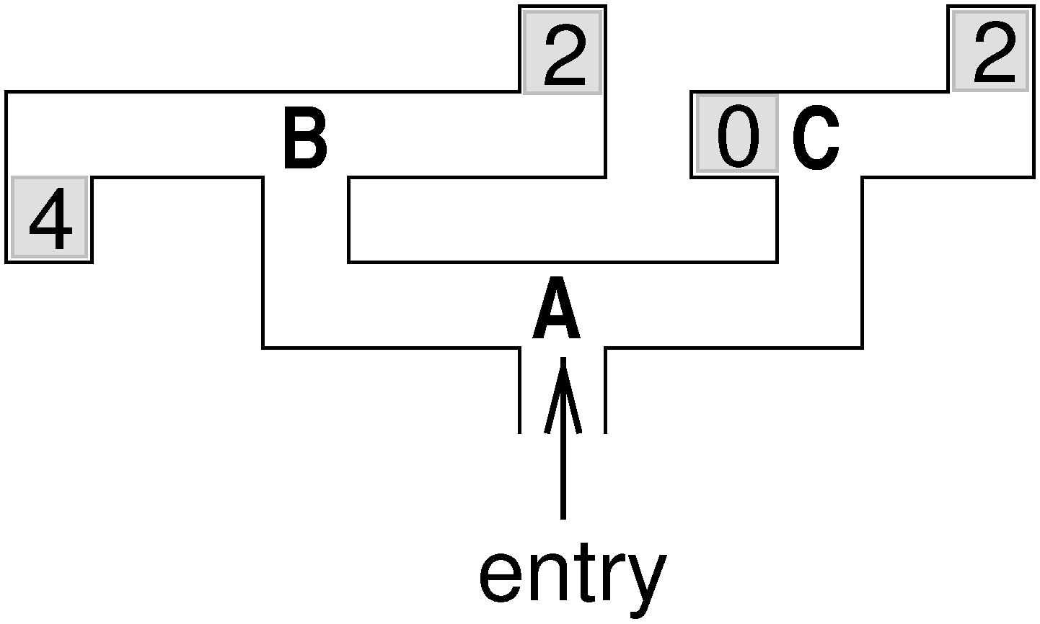
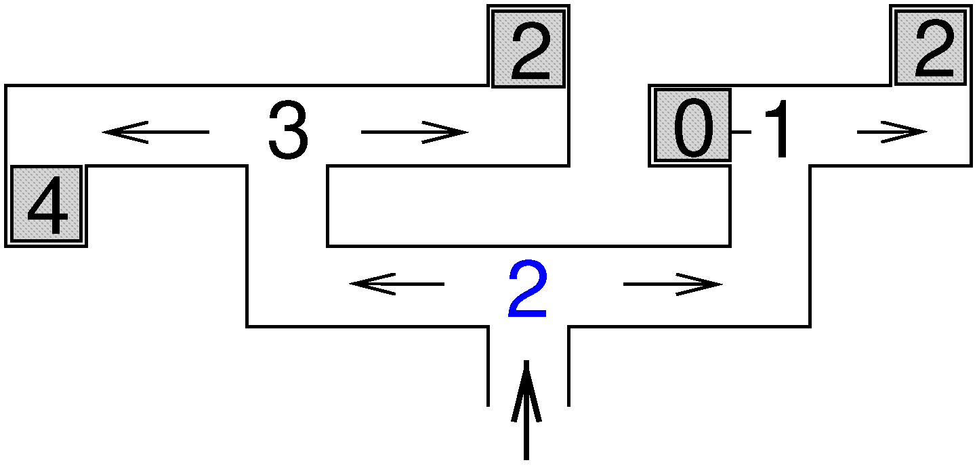



Direct Action Propensities
start with policy:
evaluate it:
S₁
S₂
S₃
$${\text{S}}_{2}$$
$${\text{S}}_{3}$$
$${\text{S}}_{1}$$
improve it:
1
-1
thus choose L more frequently than R

Slide 40
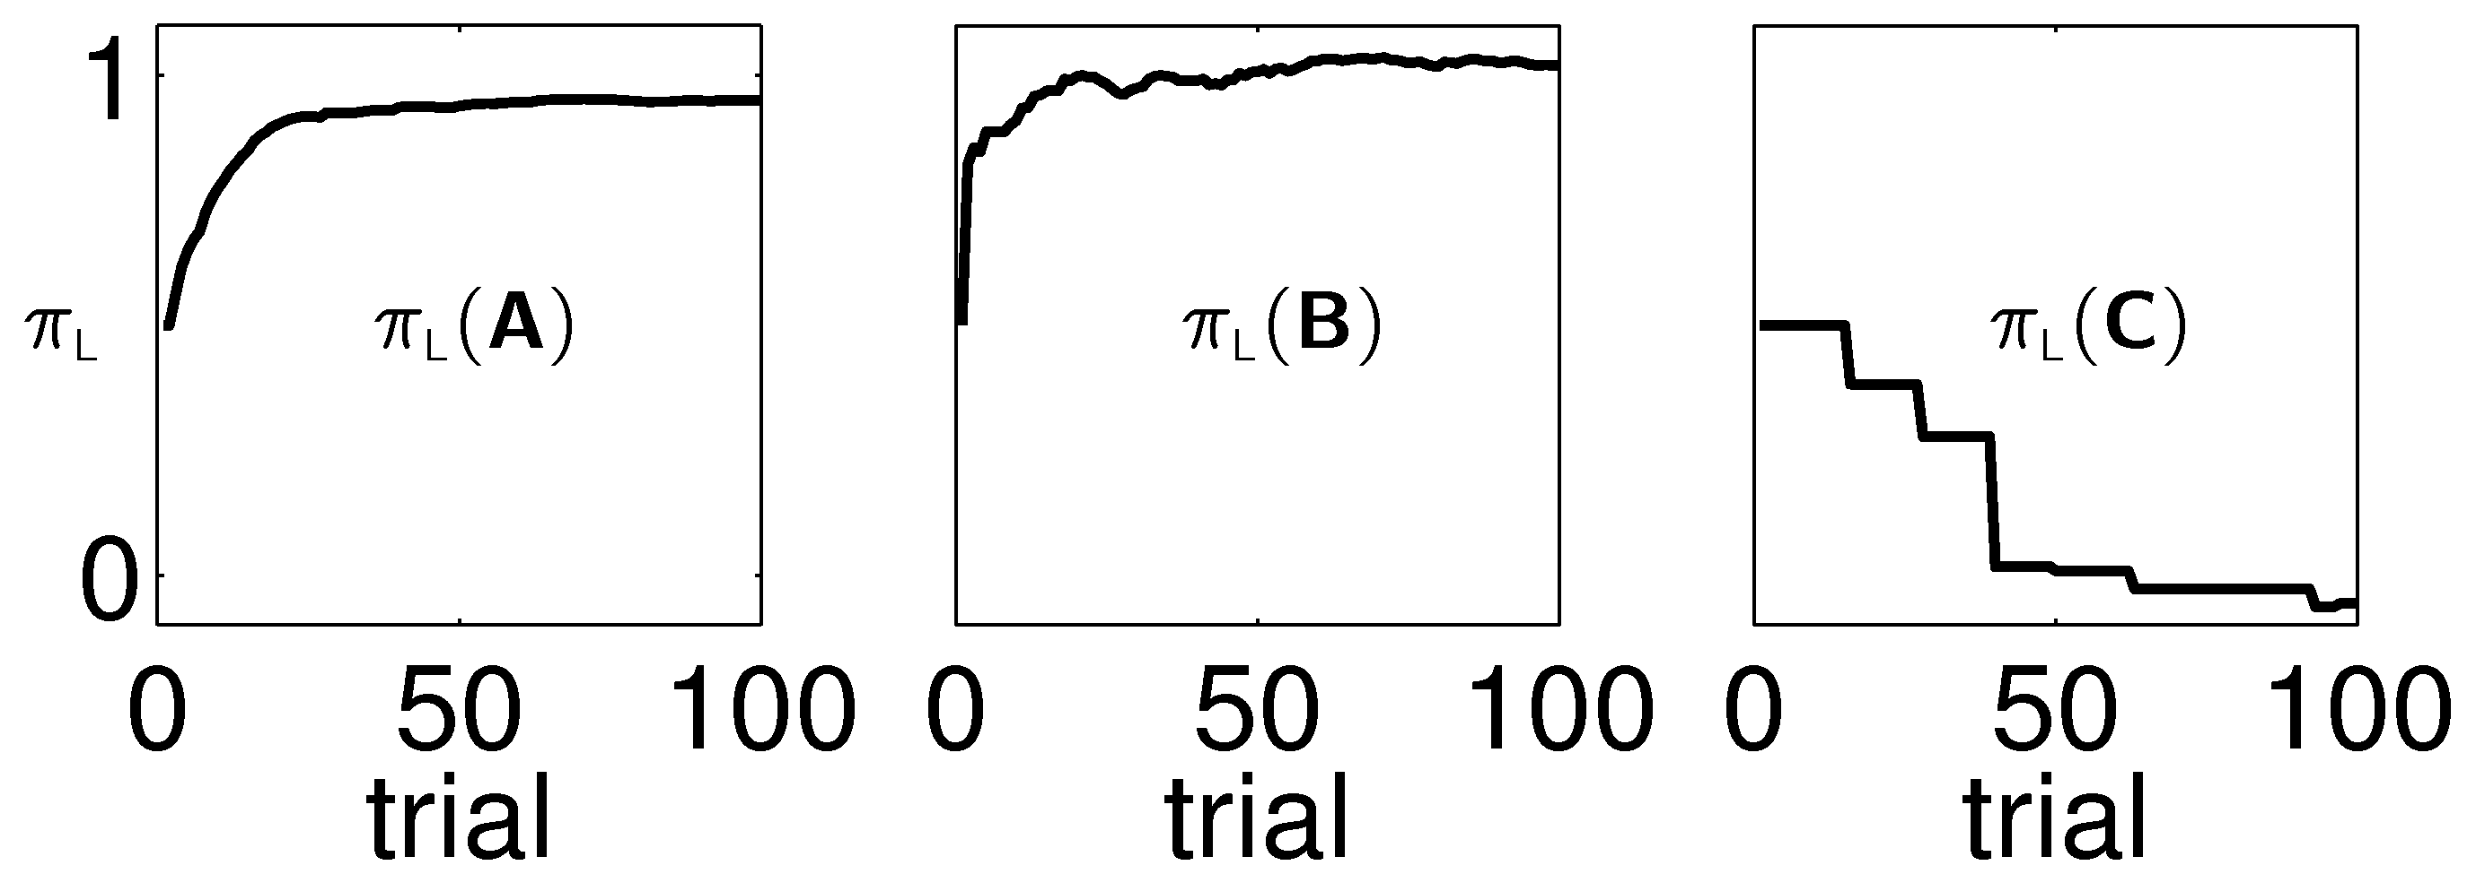
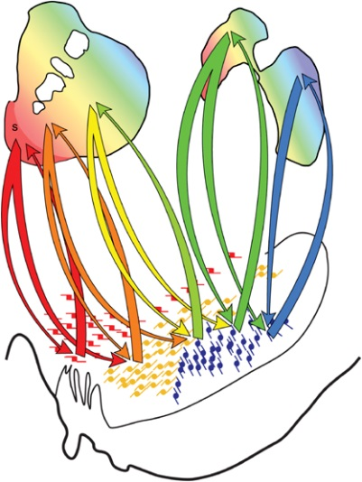



Policy
$${\text{S}}_{2}$$
$${\text{S}}_{3}$$
$${\text{S}}_{1}$$
value is too pessimistic
action is better than average
S₁
S₂
S₃
spiraling links between striatum and dopamine system: ventral to dorsal
vmPFC
OFC/dACC
dPFC
SMA
Mx

Slide 41
Plan
‘simple’ learning
  Rescorla-Wagner
  Pearce-Hall
  contexts and extinction
temporal difference learning and dopamine
action-learning
  model-free
  model-based
  vigour

Slide 42
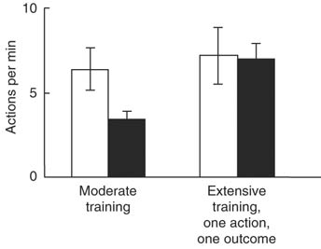
Tree-Search/Model-Based System
Tolmanian forward model
forwards/backwards tree search
motivationally flexible
OFC; dlPFC; dorsomedial striatum; BLA?
statistically efficient
computationally catastrophic

Slide 43
Or more formally….
S₂
S₃
Daw & Niv
S₁
forward model (goal directed)
caching (habitual)
Hunger
Thirst
(NB: trained hungry)
L
= 4
= 2
H;S₂,L
4
S₂
= 0
= 0
4
H;S₂,R
0
L
R
H;S₁,L
S₁
3
R
S₃
L
= 2
= 4
H;S₁,R
H;S₃,L
2
R
= 3
= 1
H;S₃,R
3
acquire with simple learning rules
perform online planning (MCTS)
but how to choose when thirsty?

Slide 44
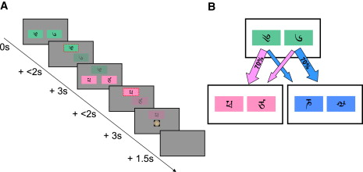
Human Canary
a
b
c
if a → c and c → £££ , then do more of a or b?
  MB: b
  MF: a (or even no effect)

Slide 45
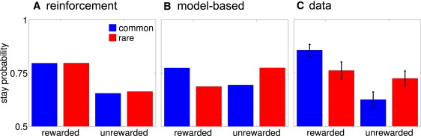
Behaviour
action values depend on both systems:
expect that will vary by subject (but be fixed)

Slide 46
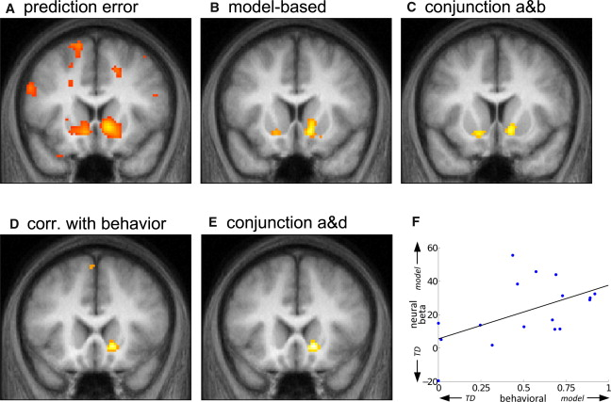
Neural Prediction Errors (1→2)
R ventral striatum
(anatomical definition)
note that MB RL does not use this prediction error – training signal?

Slide 47
Plan
‘simple’ learning
  Rescorla-Wagner
  Pearce-Hall
  contexts and extinction
temporal difference learning and dopamine
action-learning
  model-free
  model-based
  vigour

Slide 48
Vigour
Two components to choice:
  what:
    lever pressing
    direction to run
    meal to choose
  when/how fast/how vigorous
    free operant tasks
real-valued DP

Slide 49
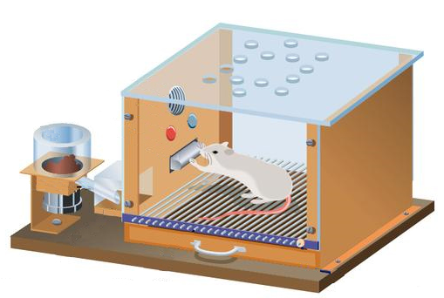
The model
cost
vigour cost
unit cost
(reward)
P_{R}
how fast
U_{R}
?
τ
LP
NP
Other
S₀
τ₁ time
S₁
τ₂ time
S₂
choose
(action,τ)
= (LP,τ₁)
Costs
Rewards
choose
(action,τ)
= (LP,τ₂)
Costs
Rewards
goal

Slide 50
The model
Goal: Choose actions and latencies to maximize
the average rate of return (rewards minus costs per time)
S₀
τ₁ time
S₁
τ₂ time
S₂
choose
(action,τ)
= (LP,τ₁)
Costs
Rewards
choose
(action,τ)
= (LP,τ₂)
Costs
Rewards
ARL

Slide 51
Average Reward RL
Compute differential values of actions
Differential value of taking action L with latency τ when in state x
ρ = average rewards minus costs, per unit time
Future Returns
Q_{L,τ}(x) = Rewards – Costs +
steady state behavior (not learning dynamics)
(Extension of Schwartz 1993)
Notes:
Mention that the model has few parameters (basically the cost constants and the reward utility) but we will not try to fit any of these, but just look at principles

Slide 52
Average Reward Cost/benefit Tradeoffs
1. Which action to take?
Choose action with largest expected reward minus cost
How fast to perform it?
slow → less costly (vigour cost)
slow → delays (all) rewards
net rate of rewards = cost of delay
(opportunity cost of time)
Choose rate that balances vigour and opportunity costs
explains faster (irrelevant) actions under hunger, etc
masochism

Slide 53
Optimal response rates
1st Nose poke
Niv, Dayan, Joel, unpublished
Experimental data
seconds
seconds since reinforcement
1st Nose poke
Model simulation
seconds
seconds since reinforcement

Slide 54
Optimal response rates
Experimental data
Model simulation
100
50
Pigeon A
Model
Pigeon B
Perfect matching
80
Perfect matching
60
% Responses on key A
% Responses on lever A
40
20
Herrnstein 1961
0
More:
# responses
interval length
amount of reward
ratio vs. interval
breaking point
temporal structure
etc.
0
20
40
60
80
100
0
50
% Reinforcements on key A
% Reinforcements on lever A

Slide 55
Effects of motivation (in the model)
RR25
low utility
high utility
energizing
effect
mean latency
LP Other

Slide 56

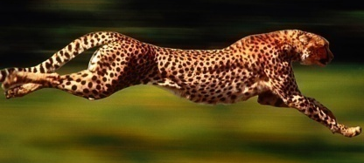
Relation to Dopamine
Phasic dopamine firing = reward prediction error
What about tonic dopamine?
less
more

Slide 57
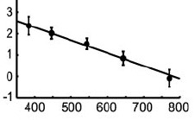
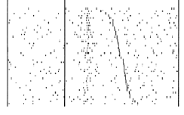
Tonic dopamine hypothesis
♫
$
♫
$
♫
$
♫
$
♫
♫
$
$
…also explains effects of phasic dopamine on response times
firing rate
reaction time
Satoh and Kimura 2003
Ljungberg, Apicella and Schultz 1992

Slide 58
Conditioning
prediction: of important events
control: in the light of those predictions
Ethology
  optimality
  appropriateness
Psychology
  classical/operant
  conditioning
Computation
  dynamic progr.
  Kalman filtering
Algorithm
  TD/delta rules
  simple weights
Neurobiology
neuromodulators; amygdala; OFC
nucleus accumbens; dorsal striatum
58

