Slide 1
TNI: Computational Neuroscience
Instructors: Peter Latham
Maneesh Sahani
Peter Dayan
TAs: Elena Zamfir <elena.zamfir07@gmail.com>
Eszter Vértes <vertes.eszter@gmail.com>
Sofy Jativa <sofypyd@gmail.com>
Website: http://www.gatsby.ucl.ac.uk/tn1/
Lectures: Tuesday and Friday, 11:00-1:00.
Review: TBA.
Homework: Assigned Friday, due Friday (1 week later).
first homework: assigned Oct. 9, due Oct. 16.
Notes:
update first homework

Slide 2
Outline
Basic facts about the brain.
What it is we really want to know about the brain.
How that relates to the course.
The math you will need to know.
Then we switch over to the white board, and the fun begins!

Slide 3
Outline
Basic facts about the brain.
What it is we really want to know about the brain.
How that relates to the course.
The math you will need to know.
Then we switch over to the white board, and the fun begins!

Slide 4
Disclaimer: this is biology.
There isn’t a single “fact” I know of that doesn’t have an exception.
Every single process in the brain (including spike generation) has lots of bells and whistles. It’s not known whether or not they’re important. I’m going to ignore them, and err on the side of simplicity.
I may or may not be throwing the baby out with the bathwater.
Notes:
update first homework

Slide 5
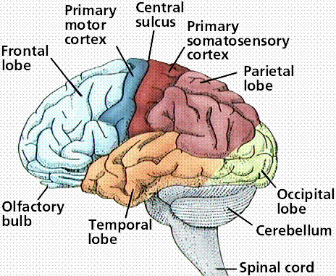
Your brain

Slide 6
Your cortex unfolded
neocortex (sensory and motor processing, cognition)
6 layers
~30 cm
~0.5 cm
subcortical structures
(emotions, reward,
homeostasis, much much
more)

Slide 7
Your cortex unfolded
1 cubic millimeter,
~10⁻³ grams

Slide 8
1 mm³ of cortex:
50,000 neurons
1000 connections/neuron
(=> 50 million connections)
4 km of axons
whole brain (2 kg):
10¹¹ neurons
10¹⁴ connections
8 million km of axons
20 watts
1 mm² of a CPU:
1 million transistors
2 connections/transistor
(=> 2 million connections)
.002 km of wire
whole CPU:
10⁹ transistors
2×10⁹ connections
2 km of wire
scaled to brain: MW

Slide 9
1 mm³ of cortex:
50,000 neurons
1000 connections/neuron
(=> 50 million connections)
4 km of axons
whole brain (2 kg):
10¹¹ neurons
10¹⁴ connections
8 million km of axons
20 watts
1 mm² of a CPU:
1 million transistors
2 connections/transistor
(=> 2 million connections)
.002 km of wire
whole CPU:
10⁹ transistors
2×10⁹ connections
2 km of wire
scaled to brain: MW

Slide 10
1 mm³ of cortex:
50,000 neurons
1000 connections/neuron
(=> 50 million connections)
4 km of axons
whole brain (2 kg):
10¹¹ neurons
10¹⁴ connections
8 million km of axons
20 watts
1 mm² of a CPU:
1 million transistors
2 connections/transistor
(=> 2 million connections)
.002 km of wire
whole CPU:
10⁹ transistors
2×10⁹ connections
2 km of wire
scaled to brain: MW

Slide 11
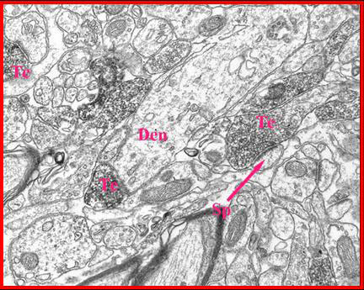
There are about 10 billion cubes of
this size in your brain!
10 microns
.01 mm
Notes:
main point: the brain is really really complicatd

Slide 12
Your brain is full of neurons
dendrites (input)
soma
spike generation
1 mm
axon (output)
(1000 μm)
20 μm
mm - meter
(1000-1,000,000 μm)
Notes:
Here through “A bigger picture view of the brain” I’m telling them basic facts about neurons and networks.

Slide 13
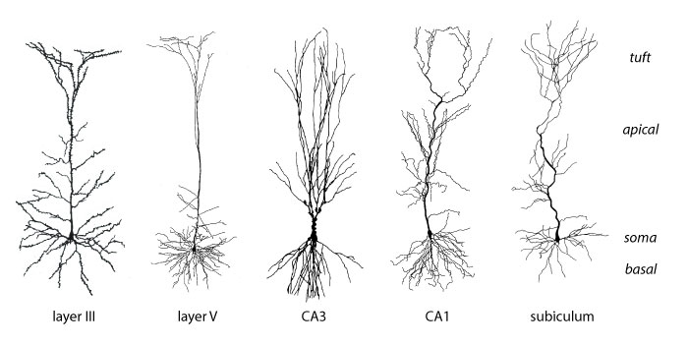
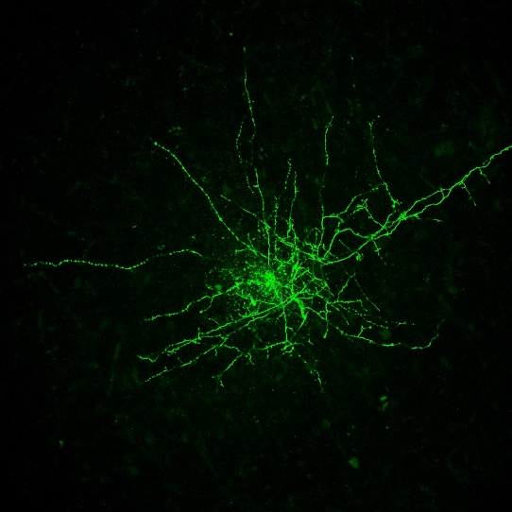
~1900 (Ramon y Cajal)
~2010 (Mandy George)
~100 μm
Notes:
Here through “A bigger picture view of the brain” I’m telling them basic facts about neurons and networks.

Slide 14
dendrites (input)
soma
spike generation
axon (output)
+20 mV
1 ms
voltage
-50 mV
time
100 ms
Notes:
Here through “A bigger picture view of the brain” I’m telling them basic facts about neurons and networks.

Slide 15
dendrites (input)
soma
spike generation
axon (wires)
+20 mV
1 ms
voltage
-50 mV
time
100 ms
Notes:
Here through “A bigger picture view of the brain” I’m telling them basic facts about neurons and networks.

Slide 17
synapse
current flow

Slide 18
+20 mV
voltage
-50 mV
time
100 ms

Slide 19
neuron i
neuron j
neuron j emits a spike:
EPSP (excitatory post-synaptic
potential)
0.5 mV
V on neuron i
t
10 ms

Slide 20
neuron i
neuron j
neuron j emits a spike:
IPSP (inhibitory post-synaptic
potential)
V on neuron i
t
10 ms
0.5 mV

Slide 21
neuron i
neuron j
neuron j emits a spike:
changes with
learning
IPSP
V on neuron i
t
amplitude ∝ w_{ij}
10 ms
0.5 mV

Slide 22
Simplest possible network equations:
~10 ms
dV_{i}
τ
=
–(V_{i} – V_{rest}) + Σ_{j} w_{ij} g_{j}(t)
subtheshold integration
dt
+20 mV
voltage
V_{thresh}
V_{rest}
time
100 ms
Notes:
update first homework

Slide 23
Simplest possible network equations:
~10 ms
dV_{i}
τ
=
–(V_{i} – V_{rest}) + Σ_{j} w_{ij} g_{j}(t)
subtheshold integration
dt
V_{i} reaches threshold (≈ -50 mV):
- a spike is emitted
- V_{i} is reset to V_{rest} (≈ -65 mV)
+20 mV
1 ms
voltage
-50 mV
-65 mV
time
100 ms
Notes:
update first homework

Slide 24
Simplest possible network equations:
~10 ms
dV_{i}
τ
=
–(V_{i} – V_{rest}) + Σ_{j} w_{ij} g_{j}(t)
subtheshold integration
dt
V_{i} reaches threshold (≈ -50 mV):
- a spike is emitted
- V_{i} is reset to V_{rest} (≈ -65 mV)
+20 mV
voltage
-50 mV
-65 mV
time
100 ms
Notes:
update first homework

Slide 25
Simplest possible network equations:
each neuron receives
about 1,000 inputs.
about 1,000 nonzero
terms in this sum.
~10 ms
dV_{i}
τ
=
–(V_{i} – V_{rest}) + Σ_{j} w_{ij} g_{j}(t)
dt
~5 ms
V_{i} reaches threshold (≈ -50 mV):
t
- a spike is emitted
- V_{i} is reset to V_{rest} (≈ -65 mV)
spike times,
neuron j
+20 mV
voltage
-50 mV
-65 mV
time
100 ms
Notes:
update first homework

Slide 26
Simplest possible network equations:
dV_{i}
τ
=
–(V_{i} – V_{rest}) + Σ_{j} w_{ij} g_{j}(t)
dt
w is 10¹¹ × 10¹¹
w is very sparse: each neuron contacts ~10³ other neurons.
w evolves in time (learning):
dw_{ij}
τ_{s}
=
F_{ij} (V_{i} ,V_{j}; global signal)
dt
>> τ
we think
spikes on neuron j
Notes:
update first homework

Slide 27
Notes:
update first homework

Slide 28
Simplest possible network equations:
dV_{i}
τ
=
–(V_{i} – V_{rest}) + Σ_{j} w_{ij} g_{j}(t)
dt
w is 10¹¹ × 10¹¹
w is very sparse: each neuron contacts ~10³ other neurons.
w evolves in time (learning):
dw_{ij}
τ_{s}
=
F_{ij} (V_{i} ,V_{j}; global signal)
dt
>> τ
we think
spikes on neuron j
Notes:
update first homework

Slide 29
your brain
~10¹¹ neurons
excitatory
neuron (80%)
~1,000 connections
~90% short range
~10% long range
Notes:
update first homework

Slide 30
your brain
~10¹¹ neurons
excitatory
neuron (80%)
inhibitory
neuron (20%)
~1,000 connections
~100% short range
Notes:
update first homework

Slide 31
What you need to remember:
When a neurons spikes, that causes a small change in the voltage of its target neurons:
- if the neuron is excitatory, the voltage goes up on
about half of its 1,000 target neurons
on the other half, nothing happens
- if the neuron is inhibitory, the voltage goes down on
about half if its 1,000 target neurons
on the other half, nothing happens
a different half every time there’s a spike!
why nothing happens is one of the biggest
mysteries in neuroscience
along with why we sleep – another huge mystery
Notes:
update first homework

Slide 32
your brain at a microscopic level
~10¹¹ neurons
excitatory
neuron (80%)
inhibitory
neuron (20%)
Notes:
update first homework

Slide 33
there is lots of structure at the macroscopic level
sensory
processing
(input)
action
selection
motor
processing
(output)
memory
Notes:
update first homework

Slide 34
there is lots of structure at the macroscopic level
lots of
visual areas
action
selection
motor
processing
(output)
auditory areas
memory
Notes:
update first homework

Slide 35
Outline
Basic facts about the brain.
What it is we really want to know about the brain.
How that relates to the course.
The math you will need to know.
Then we switch over to the white board, and the fun begins!

Slide 36
In neuroscience, unlike most of the hard sciences, it’s
not clear what we want to know.
The really hard part in this field is identifying a question that’s both answerable and brings us closer to understanding how the brain works.

Slide 37
For instance, the question
how does the brain works?
is not answerable (at least not directly, or any time soon) but it will bring us (a lot!) closer to understanding how the brain works.
On the other hand, the question
what’s the activation curve for the Kv1.1
voltage-gated potassium channels?
is answerable, but it will bring us (almost) no closer to understanding how the brain works.

Slide 38
Most questions fall into one of these two categories:
- interesting but not answerable
- not interesting but answerable

Slide 39
I’m not going to tell you what the right questions are.
But in the next several slides, I’m going to give you a highly biased view of how we might go about identifying the right questions.

Slide 40
Simplest possible network equations:
dV_{i}
τ
=
–(V_{i} – V_{rest}) + Σ_{j} w_{ij} g_{j}(t)
dt
dw_{ij}
τ_{s}
=
F_{ij} (V_{i} ,V_{j}; global signal)
dt
This might be a reasonably good model of the brain.
If it is, we just have to solve these equations!
Notes:
update first homework

Slide 41
Simplest possible network equations:
dV_{i}
τ
=
–(V_{i} – V_{rest}) + Σ_{j} w_{ij} g_{j}(t)
dt
dw_{ij}
τ_{s}
=
F_{ij} (V_{i} ,V_{j}; global signal)
dt
Techniques physicists use:
look for symmetries/conserved quantities
look for optimization principles
look at toy models that can illuminate general principles
perform simulations
These have not been all that useful in neuroscience!
Notes:
update first homework

Slide 42
Simplest possible network equations:
dV_{i}
τ
=
–(V_{i} – V_{rest}) + Σ_{j} w_{ij} g_{j}(t)
dt
dw_{ij}
τ_{s}
=
F_{ij} (V_{i} ,V_{j}; global signal)
dt
Things physicists like to compute:
averages
correlations
critical points
These have not been all that useful in neuroscience!
Notes:
update first homework

Slide 43
Simplest possible network equations:
dV_{i}
τ
=
–(V_{i} – V_{rest}) + Σ_{j} w_{ij} g_{j}(t)
dt
dw_{ij}
τ_{s}
=
F_{ij} (V_{i} ,V_{j}; global signal)
dt
That’s because these equations depend on about 10¹⁴
parameters (10¹¹ neurons × 10³ connections/neuron).
It’s likely that the region of parameter space in which
these equations behave anything like the brain is small.
small = really really small
Notes:
update first homework

Slide 44
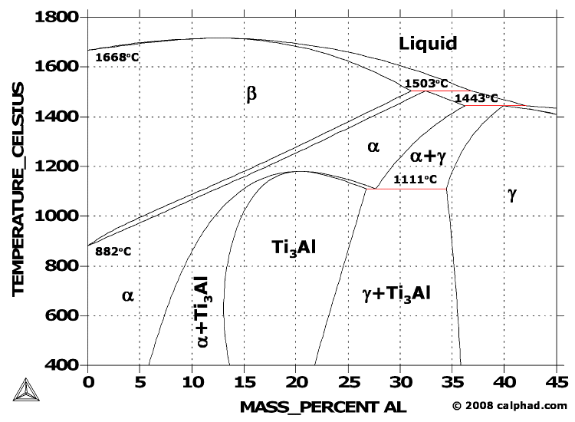
Titanium-Aluminum (Ti-Al) Phase Diagram
Notes:
update first homework

Slide 45
The brain’s parameter space
~10¹⁴ dimensional
region of brain-
like behavior
size = 10^{-really big number}
Notes:
update first homework

Slide 46
The brain’s parameter space
~10¹⁴ dimensional
region of brain-
like behavior
size = 10^{-really big number}
nobody knows how big the number is.
my guess: much much larger than 1,000.
the Human Brain Project’s guess: less than 5.
Notes:
update first homework

Slide 47
Possibly the biggest problem faced by neuroscientists
working at the circuit level is finding the very small set
of parameters that tell us something about how the
brain works.
One strategy for finding the right parameters:
try to find parameters such that the equations mimic
the kinds of computations that animals perform.
Notes:
update first homework

Slide 48
What the brain computes
Notes:
update first homework

Slide 49
your brain
sensory
processing
(input)
action
selection
motor
processing
(output)
Notes:
update first homework

Slide 50
x
latent variables
r
peripheral spikes
sensory processing
^
r
“direct” code for
latent variables
cognition
memory
action selection
brain
^
r'
“direct” code for
motor actions
motor processing
r'
peripheral spikes
x'
motor actions

Slide 51


Slide 52


Slide 54
x
latent variables
r
peripheral spikes
sensory processing
^
r
“direct” code for
latent variables
cognition
memory
action selection
brain
^
r'
“direct” code for
motor actions
motor processing
r'
peripheral spikes
x'
motor actions

Slide 55

what your brain sees
spike trains change
kid on a bike
urban environment
probably bad parents
…

Slide 56

spike trains change again
exactly the same kid
two years later

Slide 57
x
latent variables
r
peripheral spikes
sensory processing
^
r
“direct” code for
latent variables
cognition
memory
action selection
brain
^
r'
“direct” code for
motor actions
motor processing
r'
peripheral spikes
x'
motor actions

Slide 58
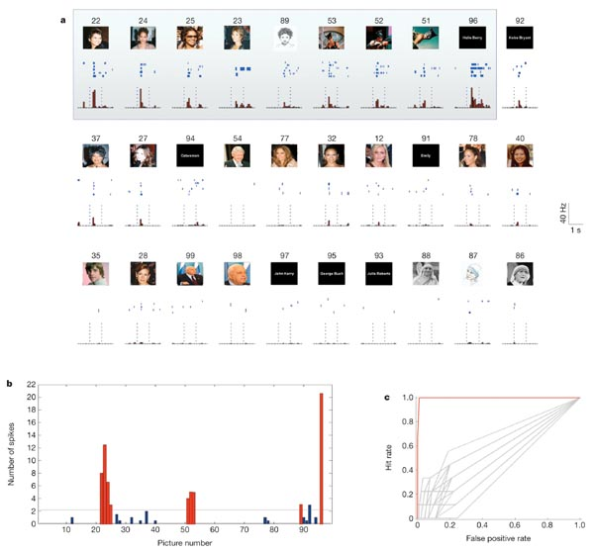
R. Quian Quiroga, L. Reddy, G. Kreiman, C. Koch & I. Fried
Nature 435, 1102-1107 (2005)

Slide 59
To make matters worse, sensory processing is fundamentally
probabilistic:
Given sensory input, the best we can do is construct a
probability distribution over the state of the world.
Those distributions are critical for accurate decision-making.

Slide 60
Do you jump, or take the long way around?

Slide 61
Do you jump, or take the long way around?

Slide 62
The current best strategy for understanding sensory processing:
choose a sensory modality
figure out an algorithm for translating spike trains to latent variables
map it onto the sensory modality of interest
do experiments to see if the mapping is correct
this has not
This isn’t so far from what goes on in physics:
make a set of observations
guess a set of equations
do experiments to see if the guess is correct
this has been
hugely successful

Slide 63
That’s because we haven’t been able to figure out the algorithms.
We do not, for instance, know how to go from an image to the latent variables.
We don’t know how to go from
to
kid on a bike
urban environment
probably bad parents
…

Slide 64
and after we solve sensory processing,
action selection is still hard
sensory
processing
(input)
action
selection
motor
processing
(output)
Notes:
update first homework

Slide 65
$

Slide 66
$

Slide 67
$

Slide 68
$

Slide 69
$

Slide 70
In any particular situation, deciding what is relevant and what is irrelevant is a combinatorially hard problem.
The current best strategy for solving this problem:
figure out an algorithm for translating latent variables into actions
map it onto the brain
do experiments to see if the mapping is correct
No good algorithms exist.
Although we may be getting close (hierarchical reinforcement learning).

Slide 71
and let’s not forget motor processing
I won’t go into detail, but it’s hard too
sensory
processing
(input)
action
selection
motor
processing
(output)
Notes:
update first homework

Slide 72
Summary so far:
We have a fairly good understanding of how neurons interact with each other
We have a less good understanding about how connection strengths evolve
Even if we knew both perfectly, that would be only the tip of the iceberg
The brain is fundamentally a computational device, and we’re never going to understand it until we understand:
what computations it performs
how those computations could be carried out

Slide 73
Does this mean we just have to march through the brain computation by computation?
Or are there are general principles?
There might be …

Slide 74
The brain is a very efficient learning machine.
If there are general principles, they may be associated
with learning.
Why is a bit of a story.
And a bit speculative.

Slide 75
Importantly, most learning is unsupervised:
the brain has to extract structure from incoming spike
trains with virtually no teaching signal.

Slide 76
You can see that from the numbers:
You have about 10¹⁴ synapses.
Let’s say it takes 1 bit of information to set a synapse,
and you want to set 1/10 of them in 30 years.
30 years ≈ 10⁹ seconds.
To set 10¹³ synapses in 10⁹ seconds,
you must absorb 10,000 bits/second!

Slide 77
The teaching signal looks like:
look both ways before you cross the street
or
that’s a cat
At most, that’s about 1 bit/second.
The rest of the bits come from finding structure in
incoming spike trains.

Slide 78
An artificial example:
neuron 2
neuron 1
Notes:
I think lots of people haven’t thought much about unsupervised learning, so I spend a fair amount of time on this.

Slide 79
An artificial example:
dog
neuron 2
cat
neuron 1

Slide 80
Structure in spike trains comes from structure in the world.
If the bran can discover structure in spike trains,
it can discover structure in the world.
If we can figure out how the brain does this,
we’ll understand sensory processing.

Slide 81
The picture:
information flows into a network.
the network extracts structure from those spike trains, and modifies its own connectivity to retain that structure.
network

Slide 82
The algorithms for learning have to be fast, robust, and simple.
If there are any general principles, we’ll probably find them
in learning algorithms.
So far we haven’t.

Slide 83
Summary
We have a fairly good understanding of how neurons interact with each other
We might even know the underlying equations

Slide 84
Simplest possible network equations:
dV_{i}
τ
=
–(V_{i} – V_{rest}) + Σ_{j} w_{ij} g_{j}(t)
dt
dw_{ij}
τ_{s}
=
F_{ij} (V_{i} ,V_{j}; global signal)
dt
w is 10¹¹ × 10¹¹
w is very sparse: each neuron contacts ~10³ other neurons.
Notes:
update first homework

Slide 85
Summary
We have a fairly good understanding of how neurons interact with each other
We might even know the underlying equations
However, we don’t know what the weights are, so solving the equations isn’t so useful
The brain is fundamentally a computational device, and we’re never going to understand it until we understand what computations it performs and how those computations could be carried out
But, in my opinion, the big advances are going to come when we understand why and how the brain learns efficiently

Slide 86
Outline
Basic facts about the brain.
What it is we really want to know about the brain.
How that relates to the course.
The math you will need to know.
Then we switch over to the white board, and the fun begins!

Slide 87
Topics:
Biophysics of single neurons and synapses
Systems neuroscience
Neural coding
Learning at the level of synapses
Information theory
Reinforcement learning
Network dynamics

Slide 88
Biophysics of single neurons and synapses
To make experimentally testable predictions, we often (but not always) have to turn ideas about how the brain works into network equations.
To be able to do that, we need to understand how neurons and synapses (and, sometimes, axons and dendrites) work.

Slide 89
Systems neuroscience
This section largely consists of facts you need to know about how the brain works at a “systems” level (somewhere between low level networks and behavior).
Unfortunately, there are a lot of facts in neuroscience, some of which are actually true. You need to know them.

Slide 90
Neural coding
To interpret neural spike trains, which we need to do if we’re going to use experiments to shed light on how the brain works, we need to understand what the spike trains are telling us.
This is where neural coding comes in. It basically asks the questions:
- what aspects of spike trains carry information?
- how do we extract that information?

Slide 91
Learning at the level of synapses
This is partly a continuation of biophysics. But we’re also going to look at what learning rules can actually do something useful at the network level.

Slide 92
Information theory
We include this partly because it’s a really cool theory; everybody should understand information theory!
The possibly more important reason is that it’s used a lot in neuroscience.

Slide 93
Reinforcement learning
We are constantly faced with the problem of what action to take.
Sometimes that’s easy (right now, it’s “don’t fall asleep”).
Sometimes it’s really hard (“what graduate school do I go to”).
hard = hard to make an optimal decision
Reinforcement learning is a theory about how to learn to make good, if not optimal, decisions.
It is probably the most successful theory in neuroscience!

Slide 94
Network dynamics
If we’re ever going to understand how networks of neurons compute things, we’re going to have to understand how networks of neurons work.
The very last section of the course is on network dynamics.
It’s short (three lectures), because not much is known.
But it’s important, because future theories of network dynamics are likely to build on this work.

Slide 95
Topics:
Biophysics of single neurons and synapses
Systems neuroscience
Neural coding
Learning at the level of synapses
Information theory
Reinforcement learning
Network dynamics

Slide 96
Outline
Basic facts about the brain.
What it is we really want to know about the brain.
How that relates to the course.
The math you will need to know.
Then we switch over to the white board, and the fun begins!

Slide 97
A (partial) list
linear algebra
ordinary differential equations (ODEs)
- mainly linear, some nonlinear, some stochastic
- bifurcation theory!
(very little) partial differential equations (PDEs)
Fourier (and Laplace) transforms
The central limit theorem
Taylor expansions
Integrals: Gaussian, exponential, Gamma (at least)
Distributions:
Gaussian Exponential
Bernoulli Binomial and Multinomial
Gamma Beta
Delta Poisson
See the website for a lot more information on math!
(although it’s only partially finished)

Slide 98
Outline
Basic facts about the brain.
What it is we really want to know about the brain.
How that relates to the course.
The math you will need to know.
Now we switch over to the white board, and the fun begins!

