Slide 1
Noise, correlations and computing
Peter Latham
Gatsby Computational Neuroscience Unit, UCL
Theoretical Neuroscience
March 6, 2017

Slide 2
sensory
stimulus
processing by the brain
motor
output
noise
noise
noise
noise
We’re going to try to get at the question:
how big is the noise?

Slide 3
Why do we care?
We want to understand the transformation from sensory
input to motor output.
It’s complicated!
How we think about it depends on where we think the
brain is putting its efforts.
- If it’s constantly battling noise, we would think
about noise resistant algorithms.
- If it’s not constantly battling noise, we wouldn’t.
(How the brain works.)

Slide 4
x
z = g(x, y)
network
y
g(x, y) could be a simple function
g(x, y) = angle relative to head
= x+y
x
y

Slide 5
x
z = g(x, y)
network
y
or a complicated one
x = visual stream of a movie
y = auditory stream of the movie
g(x, y) = plot

Slide 6
x
z = g(x, y)
network
y
here we’ll focus on simple functions

Slide 7
x
Var[x] = σ²
z = g(x, y)
_{x}
network
y
optimal Var[z] = σ²
_{z}
Var[y] = σ²
_{y}
z = x + y
σ_{z} = σ_{x} + σ_{y}
2
2
2

Slide 8
x
Var[x] = σ²
z = g(x, y)
_{x}
network
y
optimal Var[z] = σ²
+ σ²
_{noise}
+ σ²
_{z}
_{approx}
Var[y] = σ²
_{y}
There is additional variability in z, for two reasons:
Neurons are noisy.
Computations are always approximate.

Slide 9
x
Var[x] = σ²
z = g(x, y)
_{x}
network
y
optimal Var[z] = σ²
+ σ²
_{noise}
+ σ²
_{z}
_{z}
_{approx}
Var[y] = σ²
_{y}
If σ² is small, the brain will spend a lot of effort making
computations near-optimal.
If σ² is large, it will focus on reducing noise as much as possible.
_{noise}
_{noise}

Slide 10
x
Var[x] = σ²
z = g(x, y)
_{x}
network
y
optimal Var[z] = σ²
+ σ²
_{noise}
+ σ²
_{z}
_{z}
_{approx}
Var[y] = σ²
_{y}
We want to compute σ² , but how do we define it?
_{noise}

Slide 11
x
The true story
z = g(x, y)
network
y
noise in the internal
population code
noise in the output
population code

Slide 12
x
The approximate story
z = g(x, y)
network
y
only
noise in the output
population code

Slide 13
x
z = g(x, y)
network
y
only
noise in the output
population code
We’re going to calculate how
much information we can
pack into a population code.
intuition: if it’s a lot, we can ignore noise.
that’s not quite correct, but it’s close.

Slide 14
x
Var[x] = σ²
z = g(x, y)
_{x}
network
y
optimal Var[z] = σ²
+ σ²
_{noise}
+ σ²
_{z}
_{z}
_{approx}
Var[y] = σ²
_{y}
1
σ² ≡
_{noise}
information
definition!

Slide 15
The question for the day:
How much information can we pack into a
population of neurons?
The short answer:
It’s complicated.

Slide 16
The longer answer:
When noise is independent across neurons, we can
pack a lot of information into a population code.
That’s because the independence allows us to average
away the noise.
But noise is not independent; experimentally,
noise across neurons is correlated.

Slide 17
Correlated:
r₂
uncorrelated
θ
r₁

Slide 18
Correlated:
r₂
correlated
θ
r₁

Slide 19
Correlated:
r₂
correlated
θ
r₁
uncorrelated: p(r₁, r₂|θ) = p(r₁|θ) p(r₂|θ)
correlated: p(r₁, r₂|θ) ≠ p(r₁|θ) p(r₂|θ)

Slide 20
The longer answer:
When noise is independent across neurons, we can
pack a lot of information into a population code.
That’s because the independence allows us to average
away the noise.
But noise is not independent; experimentally,
noise across neurons is correlated.

Slide 21
A brief history lesson

Slide 22
Flash back to 1994:
Zohary, Shadlen and Newsome, Nature (1994)
Their result: correlations reduce the amount
of information that you can pack into a network.
They reduce the capacity.

Slide 23
noise
aka trial-trial
variability
r_{i}
r_{i} = x + ξ_{i}
x

Slide 24
r_{i}
r_{i} = x + ξ_{i}
^
^
x
x
x
^
1
x = ∑_{i} r_{i}
N

Slide 25
r_{i}
r_{i} = x + ξ_{i}
^
^
x
x
x
^
1
1
x = ∑_{i} r_{i}
= x + ∑_{i} ξ_{i}
N
N
^
1
1
Var[x] = ∑_{i} Var[ξ_{i}] + ∑_{i≠j} Covar[ξ_{i} , ξ_{j}]
N²
N²
N terms: scales
as 1/N
~N² terms: constant
in the large N limit.

Slide 26
r_{i}
r_{i} = x + ξ_{i}
^
^
x
x
x
^
1
1
x = ∑_{i} r_{i}
= x + ∑_{i} ξ_{i}
N
N
^
1
1
Var[x] = ∑_{i} Var[ξ_{i}] + ∑_{i≠j} Covar[ξ_{i} , ξ_{j}]
N²
N²
σ²
σ²ρ

Slide 27
r_{i}
r_{i} = x + ξ_{i}
^
^
x
x
x
^
1
1
x = ∑_{i} r_{i}
= x + ∑_{i} ξ_{i}
N
N
^
1
1
Var[x] = ∑_{i} Var[ξ_{i}] + ∑_{i≠j} Covar[ξ_{i} , ξ_{j}]
N²
N²
Nσ²
N(N-1)σ²ρ

Slide 28
r_{i}
r_{i} = x + ξ_{i}
^
^
x
x
x
^
1
1
x = ∑_{i} r_{i}
= x + ∑_{i} ξ_{i}
N
N
^
σ²
(N-1)σ²ρ
Var[x] = +
N
N

Slide 29
r_{i}
r_{i} = x + ξ_{i}
^
^
x
x
x
^
1
1
x = ∑_{i} r_{i}
= x + ∑_{i} ξ_{i}
N
N
^
σ²(1 – ρ)
σ²ρ
Var[x] = +
N

Slide 30
Flash back to 1994:
Zohary, Shadlen and Newsome, Nature (1994)
Their result: correlations reduce the amount
of information that you can pack into a network.
Correlations reduce the capacity.
^
σ²(1 – ρ)
σ²ρ
Var[x] = +
N

Slide 31
Flash back to 1994:
Zohary, Shadlen and Newsome, Nature (1994)
Their result: correlations reduce the amount
of information that you can pack into a network.
Positive correlations reduce the capacity.
^
σ²(1 – ρ)
σ²ρ
Var[x] = +
N

Slide 32
Flash back to 1994:
Zohary, Shadlen and Newsome, Nature (1994)
Their result: correlations reduce the amount
of information that you can pack into a network.
Negative correlations increase the capacity.
^
σ²(1 – ρ)
σ²ρ
Var[x] = +
N

Slide 33
Flash back to 1994:
Zohary, Shadlen and Newsome, Nature (1994)
Their result: correlations reduce the amount
of information that you can pack into a network.
Negative correlations increase the capacity.
^
σ²(1 + |ρ|)
σ²|ρ|
Var[x] = –
N

Slide 34
The next 23 years was devoted to pointing out that ρ
could be effectively negative (Abbott, Dayan, Sompolinsky)
^
σ²(1 – ρ)
σ²ρ
Var[x] = +
N

Slide 35
The next 23 years was devoted to pointing out that ρ
could be effectively negative (Abbott, Dayan, Sompolinsky)
Now correlations increase capacity!
^
σ²(1 + |ρ|)
σ²|ρ|
Var[x] = –
N

Slide 36
There were two* interesting studies:
Shamir and Sompolinsky, Neural Comp. 2006
Ecker, Berens, Tolias, Bethge, J. Neurosci. 2011
The conclusion:
in realistic situations, correlations have very little
effect on capacity: it’s big
^
σ²(1 – ρ)
σ²ρ
Var[x] = +
N

Slide 37
There were two* interesting studies:
Shamir and Sompolinsky, Neural Comp. 2006
Ecker, Berens, Tolias, Bethge, J. Neurosci. 2011
The conclusion:
in realistic situations, correlations have very little
effect on capacity: it’s big
^
σ²
Var[x] =
N

Slide 38
There were two* interesting studies:
Shamir and Sompolinsky, Neural Comp. 2006
Ecker, Berens, Tolias, Bethge, J. Neurosci. 2011
The conclusion:
in realistic situations, correlations have very little
effect on capacity: it’s big
^
σ²
× corrections
Var[x] =
N
*See also Peter Dayan, practice qualifier test question, 2004.

Slide 39
the statement
“in realistic situations, correlations have very little
effect on capacity: it’s big”
seems to imply
“in realistic situations, we can pack lots of
information into population codes”
which implies
“we can forget about noise in the brain”

Slide 40
x
z = g(x, y)
network
y
noise in the internal
population code
noise in the output
population code

Slide 41
the statement
“in realistic situations, correlations have very little
effect on capacity: it’s big”
seems to imply
“in realistic situations, we can pack lots of
information into population codes”
which implies
“we can forget about noise in the brain”
wrong
open
question

Slide 42
My talk:
Part 1: Why doesn’t the statement
“in realistic situations, correlations have very little
effect on capacity: it’s big”
imply
“in realistic situations, we can pack lots of
information into population codes”?
Part 2: Can we forget about noise in the brain?

Slide 43
x
A brief preview
z = g(x, y)
network
y

Slide 44
r_{x}
A brief preview
r_{z} = G(r_{x}, r_{y})
network
r_{y}

Slide 45
r_{x}
A brief preview
r_{z} = G(r_{x}, r_{y}) + noise
network
r_{y}
depends on
network dynamics
inherits the noise
properties of r_{x} and r_{y}
r_{z} = G(f_{x} + ξ_{x}, f_{y} + ξ_{y})

Slide 46
r_{x}
A brief preview
r_{z} = G(r_{x}, r_{y}) + noise
network
r_{y}
depends on
network dynamics
inherits the noise
properties of r_{x} and r_{y}
These terms interact.
It’s not enough to know how small the
noise is; you have to know its properties.

Slide 47
My talk:
Part 1: Why doesn’t the statement
“in realistic situations, correlations have very little
effect on capacity: it’s big”
imply
“in realistic situations, we can pack lots of information
into population codes”?
Part 2: Can we forget about noise in the brain?

Slide 48
For both parts of this talk, we need a relatively deep understanding of information.
If all goes well, the next few slides will provide that understanding.

Slide 49
The usual situation: variables are represented by noisy
population activity.
often written f(x - x_{i})
f_{i}(x)
r_{i}
x

Slide 50
The usual situation: variables are represented by noisy
population activity.
f_{i}(x)
r_{i}
r_{i} = f_{i}(x) + ξ_{i}
x

Slide 51
The usual situation: variables are represented by noisy
population activity.
f_{i}(x)
r_{i}
r_{i} = f_{i}(x) + ξ_{i}
x
Given the r_{i}, how much information do we have about x?
How much Fisher information is there in the population?
linear

Slide 52
The usual situation: variables are represented by noisy
population activity.
f_{i}(x)
r_{i}
r_{i} = f_{i}(x) + ξ_{i}
x
If the neurons have covariance matrix
R_{ij} = <ξ_{i} ξ_{j}>
I = linear Fisher information = ∑_{ij} f_{i}(x) R_{ij} f_{j}(x) = f′⋅R⁻¹⋅f′
′
⁻¹
′

Slide 53
We’re looking for a local decoder, w, of the form
x-x₀ = w⋅(r – f(x₀))
<x-x₀ > = w⋅(f(x) – f(x₀)) ≈ w⋅f′(x₀) (x-x₀)
^
^
f(x₀) + f′(x₀) (x-x₀)

Slide 54
We’re looking for a local decoder, w, of the form
x-x₀ = w⋅(r – f(x₀))
<x-x₀ > = w⋅(f(x) – f(x₀)) ≈ w⋅f′(x₀) (x-x₀)
unbiased: <x-x₀ > = x-x₀
Var[x-x₀] = w⋅<(r – f(x₀)) (r – f(x₀))>⋅w = w⋅R⋅w
minimize w⋅R⋅w with w⋅f′(x₀) = 1:
w =
^
^
^
=> w⋅f′(x₀) = 1
^
f′⋅R⁻¹
1
1
^
=
Var[x-x₀] =
f′⋅R⁻¹⋅f′
f′⋅R⁻¹⋅f′
I

Slide 55
r₂
w
^
x
f(x) = (f₁(x), f₂(x))
r₁

Slide 56
r₂
R⁻¹ ∝ identity
f′⋅R⁻¹
w
=
f′⋅R⁻¹⋅f′
^
^
x
x
f(x) = (f₁(x), f₂(x))
r₁

Slide 57
r₂
noise covariance
ellipse
f′⋅R⁻¹
w
=
f′⋅R⁻¹⋅f′
f′(x)
f(x) = (f₁(x), f₂(x))
r₁

Slide 58
- Information goes up as σ₁ and σ₂ go down.
- How much depends on the angles.
For instance, suppose θ₂ = 90°.
r₂
f′⋅R⁻¹
σ₁
w
=
θ₂
f′⋅R⁻¹⋅f′
θ₁
f′(x)
σ₂
r₁

Slide 59
- Information goes up as σ₁ and σ₂ go down.
- How much depends on the angles.
For instance, suppose θ₂ = 90°.
r₂
σ₁
θ₂
f′(x)
σ₂
r₁

Slide 60
- Information goes up as σ₁ and σ₂ go down.
- How much depends on the angles.
For instance, suppose θ₂ = 90°.
r₂
σ₁
θ₂
σ₂
f′(x)
r₁

Slide 61
- Information goes up as σ₁ and σ₂ go down.
- How much depends on the angles.
r₂
σ₁
θ₂
θ₁
f′(x)
σ₂
r₁

Slide 62
Guess:
I ∝
cos²θ₁
cos²θ₂
+
²
²
r₂
σ₁
σ₂
σ₁
θ₂
θ₁
f′(x)
σ₂
r₁

Slide 63
Guess:
I =
[
]
cos²θ₁
cos²θ₂
+
× f′⋅f′
²
²
r₂
σ₁
σ₂
σ₁
θ₂
θ₁
f′(x)
σ₂
r₁

Slide 64
number of neurons
In general,
I = f′⋅f′ ∑
_{N}
cos²θ_{k}
_{k =1}
²
σ_{k}
∑_{k} cos²θ_{k} =1
_{N}
′
∑ f_{i}(x)²
∝ N
_{i =1}

Slide 65
number of neurons
In general,
I = f′⋅f′ ∑
_{N}
cos²θ_{k}
_{k =1}
²
σ_{k}
∑_{k} cos²θ_{k} =1
_{N}
′
∑ f_{i}(x)²
∝ N = big
_{i =1}

Slide 66
In general,
I = f′⋅f′ ∑
_{N}
cos²θ_{k}
_{k =1}
= f′⋅R⁻¹⋅f′
²
σ_{k}

Slide 67
The usual eigenvector/eigenvalue expansion:
R⋅v_{k} = σ_{k} v_{k} , v_{k}⋅v_{l} = δ_{kl}
=> R = Σ _{k} σ_{k} v_{k} v_{k}
²
²
v₂
σ₁
²
R =
σ₂
v₁
²

Slide 68
The usual eigenvector/eigenvalue expansion:
R⋅v_{k} = σ_{k} v_{k} , v_{k}⋅v_{l} = δ_{kl}
=> R = Σ _{k} σ_{k} v_{k} v_{k}
f′⋅R⁻¹⋅f′ = Σ_{k}
(f′⋅v_{k} )² = |f′|² |v_{k}|² cos²θ_{k} = f′⋅f′ cos²θ_{k}
=> f′⋅R⁻¹⋅f′ = f′⋅f′ Σ_{k}
²
²
v_{k} v_{k}
=> R⁻¹ = Σ_{k}
²
σ_{k}
(f′⋅v_{k})²
²
σ_{k}
cos²θ_{k}
²
σ_{k}

Slide 69
In general,
I = f′⋅f′ ∑
_{N}
cos²θ_{k}
_{k =1}
²
σ_{k}
σ₁
θ₂
θ₁
f′(x)
σ₂

Slide 70
In general,
I = f′⋅f′ ∑
Essentially all studies of Fisher information have
looked at the relative behavior of cos²θ_{k} and σ_{k} .
_{N}
cos²θ_{k}
_{k =1}
²
σ_{k}
²

Slide 71
In general,
I = f′⋅f′ ∑
_{N}
cos²θ_{k}
_{k =1}
²
σ_{k}
?
f′(x)

Slide 72
In general,
I = f′⋅f′ ∑
_{N}
cos²θ_{k}
_{k =1}
²
σ_{k}
?
f′(x)

Slide 73
In general,
I = f′⋅f′ ∑
_{N}
cos²θ_{k}
_{k =1}
²
σ_{k}
?
f′(x)

Slide 74
How does the shape of the covariance
ellipse relative to f′ affect information?

Slide 75
_{N}
cos²θ_{k}
I = f′⋅f′ ∑
_{k =1}
²
σ_{k}
σ₁
θ₂
θ₁
f′(x)
σ₂

Slide 76
_{N}
cos²θ_{k}
I = f′⋅f′ ∑
_{k =1}
²
σ_{k}
_{N}
_{N}
f′⋅f′ ∝ N = big
∑ cos²θ_{k} =1
²
∑ σ_{k} ∝ N
_{k =1}
_{k =1}
If noise is independent, information is big.
That’s because all the σ_{k} are about the same size.
²
_{N}
cos²θ_{k}
∑
²
= approximately independent of N.
= <1/σ_{k} >
_{k =1}
²
σ_{k}
I ∝ f′⋅f′ ∝ N

Slide 77
_{N}
cos²θ_{k}
I = f′⋅f′ ∑
_{k =1}
²
σ_{k}
_{N}
_{N}
f′⋅f′ ∝ N = big
∑ cos²θ_{k} =1
²
∑ σ_{k} ∝ N
_{k =1}
_{k =1}
If noise is independent, information is big.
′
⁻¹
′
I = ∑_{ij} f_{i}(x) R_{ij} f_{j}(x)
_{N}
′
f_{i}(x)²
= ∑
∝ N
_{i =1}
²
σ_{i}

Slide 78
_{N}
cos²θ_{k}
I = f′⋅f′ ∑
_{k =1}
²
σ_{k}
_{N}
_{N}
f′⋅f′ ∝ N = big
∑ cos²θ_{k} =1
²
∑ σ_{k} ∝ N
_{k =1}
_{k =1}
If noise is independent, information is big.
That’s because all the σ_{k} are about the same size.
²
cos²θ_{k}
²
= approximately independent of N.
= <1/σ_{k} >
²
σ_{k}
I ∝ f′⋅f′ ∝ N

Slide 79
_{N}
cos²θ_{k}
I = f′⋅f′ ∑
_{k =1}
²
σ_{k}
_{N}
_{N}
f′⋅f′ ∝ N = big
∑ cos²θ_{k} =1
²
∑ σ_{k} ∝ N
_{k =1}
_{k =1}
²
If noise is weakly correlated, such that all the σ_{k} are
about the same size, information is still big.
cos²θ_{k}
²
= approximately independent of N.
= <1/σ_{k} >
²
σ_{k}
I ∝ f′⋅f′ ∝ N

Slide 80
_{N}
cos²θ_{k}
I = f′⋅f′ ∑
_{k =1}
²
σ_{k}
_{N}
_{N}
f′⋅f′ ∝ N = big
∑ cos²θ_{k} =1
²
∑ σ_{k} ∝ N
_{k =1}
_{k =1}
What happens when noise is not independent?
The main observation:
Some of the σ_{k} are proportional to N.
²

Slide 81
_{N}
cos²θ_{k}
I = f′⋅f′ ∑
_{k =1}
²
σ_{k}
_{N}
_{N}
f′⋅f′ ∝ N = big
∑ cos²θ_{k} =1
²
∑ σ_{k} ∝ N
_{k =1}
_{k =1}
_{N}
cos²θ_{k}
cos²θ₁
cos²θ₂
cos²θ₃
cos²θ₄
∑
=
+
+
+
+ …
_{k =1}
²
²
²
²
²
σ_{k}
σ₁
σ₂
σ₃
σ₄
~N
~N
~1
~1
~1
If cos²θ₃, cos²θ₄, … are all near zero, information will
be finite even when N is large.

Slide 82
_{N}
cos²θ_{k}
I = f′⋅f′ ∑
_{k =1}
²
σ_{k}
_{N}
_{N}
f′⋅f′ ∝ N = big
∑ cos²θ_{k} =1
²
∑ σ_{k} ∝ N
_{k =1}
_{k =1}
_{N}
cos²θ_{k}
cos²θ₁
cos²θ₂
cos²θ₃
cos²θ₄
∑
=
+
+
+
+ …
_{k =1}
²
²
²
²
²
σ_{k}
σ₁
σ₂
σ₃
σ₄
~N
~N
~1
~1
~1
[
]
~N
cos²θ₁
cos²θ₂
I
f′⋅f′ ×
+
²
²
σ₁
σ₂
~N

Slide 83
_{N}
cos²θ_{k}
I = f′⋅f′ ∑
_{k =1}
²
σ_{k}
_{N}
_{N}
f′⋅f′ ∝ N = big
∑ cos²θ_{k} =1
²
∑ σ_{k} ∝ N
_{k =1}
_{k =1}
_{N}
cos²θ_{k}
cos²θ₁
cos²θ₂
cos²θ₃
cos²θ₄
∑
=
+
+
+
+ …
_{k =1}
²
²
²
²
²
σ_{k}
σ₁
σ₂
σ₃
σ₄
~N
~N
~1
~1
~1
In this case, noise can not be averaged away simply
by having lots of neurons.

Slide 84
Geometrically, this has a simple interpretation
Noise can’t be averaged away
if the covariance ellipse lines up
almost perfectly with f′(x).
There are a small number
of long directions.
f′(x)
There are approximately
N short directions.

Slide 85
_{N}
cos²θ_{k}
I = f′⋅f′ ∑
_{k =1}
²
σ_{k}
_{N}
_{N}
f′⋅f′ ∝ N = big
∑ cos²θ_{k} =1
²
∑ σ_{k} ∝ N
_{k =1}
_{k =1}
_{N}
cos²θ_{k}
cos²θ₁
cos²θ₂
cos²θ₃
cos²θ₄
∑
=
+
+
+
+ …
_{k =1}
²
²
²
²
²
σ_{k}
σ₁
σ₂
σ₃
σ₄
~N
~N
~1
~1
~1
If cos²θ₃, cos²θ₄, … are all near zero, information will
be finite even when N is large.

Slide 86
Geometrically, this has a simple interpretation
Noise can’t be averaged away
if the covariance ellipse lines up
almost perfectly with f′(x).
There are a small number
of long directions.
f′(x)
There are approximately
N short directions.
This does not seem likely!

Slide 87
Geometrically, this has a simple interpretation
Noise can be averaged away!
f′(x)
Shamir and Sompolinsky, Neural Comp. 2006
Ecker, Berens, Tolias, Bethge, J. Neurosci. 2011
This seems much more likely!

Slide 88
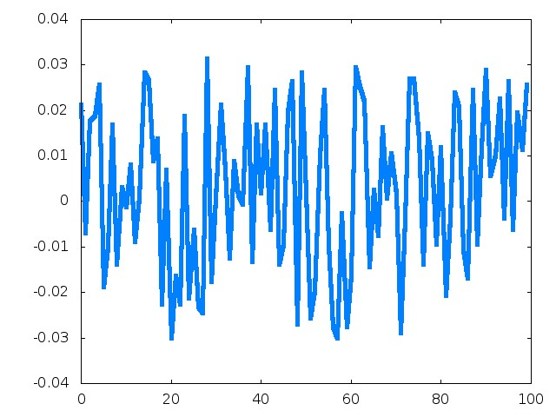
^
Locally Optimal Linear Estimator: x-x₀ = w⋅(r – f(x₀))
What does w look like?
f′(x)
weight, w_{i}
neuron number

Slide 89
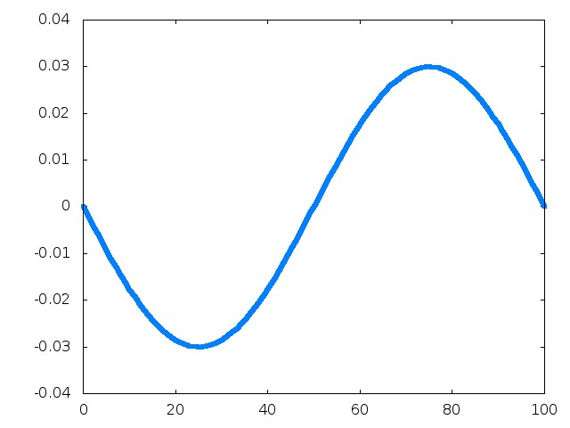
^
Locally Optimal Linear Estimator: x-x₀ = w⋅(r – f(x₀))
What does w look like?
f′(x)
weight, w_{i}
neuron number

Slide 90
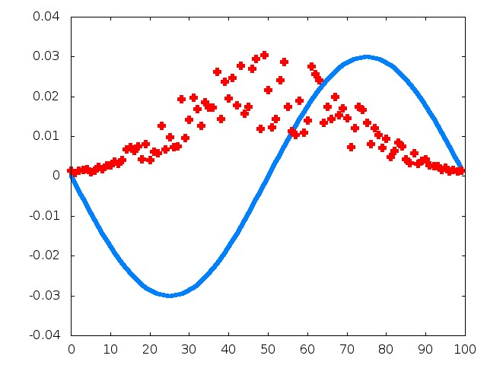
^
Locally Optimal Linear Estimator: x-x₀ = w⋅(r – f(x₀))
What does w look like?
f′(x)
weight, w_{i}
neuron number

Slide 91
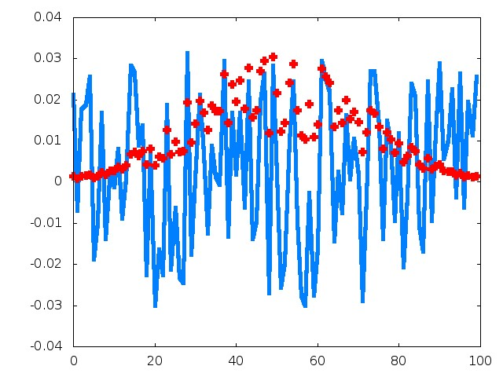
^
Locally Optimal Linear Estimator: x-x₀ = w⋅(r – f(x₀))
What does w look like?
f′(x)
weight, w_{i}
neuron number

Slide 92
Summary so far:
When neurons are correlated (which they always are),
the capacity of a population may or may not be big.
big
∝ N
not big
f′(x)
f′(x)
the brain can make the noise arbitrarily
small simply by adding more neurons

Slide 93
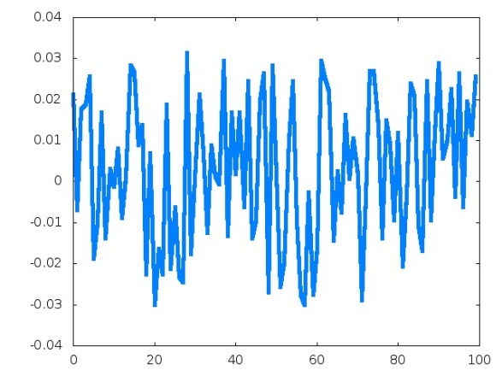
Summary so far:
But, the decoder is problematic.
But, that’s not necessarily relevant: we care about
computing, not decoding.
big
∝ N
not big
f′(x)
f′(x)

Slide 94
A little math: differential correlations,
R ∝ f′f′

Slide 95
trial 1
15
10
r
5
0
0
90
180
s

Slide 96
trial 2
15
10
r
5
0
0
90
180
s

Slide 97
trial 3
15
10
r
5
0
0
90
180
s

Slide 98
trial 4
15
10
r
5
0
0
90
180
s

Slide 99
no matter how many
neurons there are, the
standard deviation of θ
is determined by how much
the neurons shift from one
trial to the next
15
10
r
5
0
0
90
180
s
in the large N limit, the only correlations that make information independent of N are ones that shift the hill of activity
Nature Neurosci. 17:1410-1417 (2014)

Slide 100
pause and do some math!

Slide 101
x
z = g(x, y)
network
y

Slide 102
r_{x}
r_{z} = G(r_{x}, r_{y})
network
r_{y}

Slide 103
r_{x}
r_{z} = G(r_{x}, r_{y}) + noise
network
r_{y}
now we want to see
how it interacts with this
so far we’ve been
talking about this

Slide 104
r_{x}
r_{z} = G(r_{x}, r_{y}) + noise
network
r_{y}
inherits the noise
properties of r_{x} and r_{y}
so far we’ve been
talking about this
r_{z} = G(f_{x} + ξ_{x}, f_{y} + ξ_{y})

Slide 105
r_{z} = G(r_{x}, r_{y})
z = g(x, y)
r_{y} = f_{y}(y) + ξ_{y}
r_{x} = f_{x}(x) + ξ_{x}
′
f_{y}(y)
Critical observation: there is finite information
coming into the population, so the covariance
ellipses and f′ must line up!
If N, the number of neurons, is large.
′
f_{x}(x)

Slide 106
r_{z} = G(r_{x}, r_{y})
z = g(x, y)
r_{y} = f_{y}(y) + ξ_{y}
r_{x} = f_{x}(x) + ξ_{x}
′
f_{y}(y)
Our question: what do the covariance
matrices and tuning curves for x and y
tell us about the covariance matrix and
tuning curves for z?
′
f_{x}(x)

Slide 107
r_{z} = G(r_{x}, r_{y})
z = g(x, y)
r_{y} = f_{y}(y) + ξ_{y}
r_{x} = f_{x}(x) + ξ_{x}
Our question: what do the covariance
matrices and tuning curves for x and y
tell us about the covariance matrix and
tuning curves for z?

Slide 108
r_{z} = G(f_{x} + ξ_{x}, f_{y} + ξ_{y})
z = g(x, y)
r_{y} = f_{y}(y) + ξ_{y}
r_{x} = f_{x}(x) + ξ_{x}
Our question: what do the covariance
matrices and tuning curves for x and y
tell us about the covariance matrix and
tuning curves for z?

Slide 109
r_{z} = G(f_{x} + ξ_{x}, f_{y} + ξ_{y})
f_{x}(x + δx)
Our question: what do the covariance
matrices and tuning curves for x and y
tell us about the covariance matrix and
tuning curves for z?

Slide 110
r_{z} = G(f_{x} + ξ_{x}, f_{y} + ξ_{y})
′
f_{x}(x + δx) = f_{x}(x) + f_{x}(x)δx

Slide 111
′
r_{z} = G(f_{x}(x) + f_{x}(x)δx + ξ_{x}, f_{y} + ξ_{y})
′
f_{x}(x + δx) = f_{x}(x) + f_{x}(x)δx

Slide 112
′
r_{z} = G(f_{x}(x) + f_{x}(x)δx + ξ_{x}, f_{y} + ξ_{y})
′
f_{y}(y + δy) = f_{y}(y) + f_{y}(y)δy

Slide 113
′
′
r_{z} = G(f_{x}(x) + f_{x}(x)δx + ξ_{x}, f_{y}(y) + f_{y}(y)δy + ξ_{y})
′
f_{y}(y + δy) = f_{y}(y) + f_{y}(y)δy

Slide 114
′
′
r_{z} = G(f_{x}(x) + f_{x}(x)δx + ξ_{x}, f_{y}(y) + f_{y}(y)δy + ξ_{y})
′
f_{z}(z) + f_{z}(z)δz + ξ_{z}

Slide 115
′
f_{z}(z) + f_{z}(z)δz + ξ_{z}
= G(f_{x}(x) + f_{x}(x)δx + ξ_{x}, f_{y}(y) + f_{y}(y)δy + ξ_{y})
= G(f_{x}(x), f_{y}(y))
+ G_{x}⋅(f_{x}(x)δx + ξ_{x}) + G_{y}⋅(f_{y}(y)δy + ξ_{y})
′
′
′
′
∂G(f_{x}(x), f_{y}(y))
∂G(f_{x}(x), f_{y}(y))
∂f_{x}(x)
∂f_{y}(x)

Slide 116
′
f_{z}(z) + f_{z}(z)δz + ξ_{z}
= G(f_{x}(x) + f_{x}(x)δx + ξ_{x}, f_{y}(y) + f_{y}(y)δy + ξ_{y})
= G(f_{x}(x), f_{y}(y))
+ G_{x}⋅(f_{x}(x)δx + ξ_{x}) + G_{y}⋅(f_{y}(y)δy + ξ_{y})
f_{z}(z)δz + ξ_{z} = G_{x}⋅(f_{x}(x)δx + ξ_{x}) + G_{y}⋅(f_{y}(y)δy + ξ_{y})
′
′
′
′
′
′
′

Slide 117
′
′
′
f_{z}(z)δz + ξ_{z} = G_{x}⋅(f_{x}(x)δx + ξ_{x}) + G_{y}⋅(f_{y}(y)δy + ξ_{y})
′
f_{x}(x)
′
f_{y}(y)

Slide 118
′
′
′
f_{z}(z)δz + ξ_{z} = G_{x}⋅(f_{x}(x)δx + ξ_{x}) + G_{y}⋅(f_{y}(y)δy + ξ_{y})
′
f_{z}(z)
=
+
′
f_{x}(x)
′
f_{y}(y)

Slide 119
r_{x}
r_{z} = G(r_{x}, r_{y})
network
r_{y}
′
f_{z}(z)

Slide 120
x
Var[x] = σ²
z = g(x, y)
_{x}
network
y
Var[z] = σ²
_{z}
Var[y] = σ²
_{y}
Critical observation:
there is finite information coming into the population
therefore, σ_{x}, σ_{y}, and σ_{z} are fixed, and independent of N
2
2
2

Slide 121
If x, y and z are represented by large populations,
then the covariance matrix and f′ must line up.
′
f_{z}(z)
′
f_{x}(x)
′
f_{y}(y)

Slide 122
x
Var[x] = σ²
z = g(x, y)
_{x}
network
y
Var[z] = σ²
_{z}
Var[y] = σ²
_{y}

Slide 123
r_{x}
r_{z} = G(r_{x}, r_{y})
network
r_{y}

Slide 124
r_{x}
r_{z} = G(r_{x}, r_{y}) + noise
network
r_{y}
′
f_{z}(z)
+

Slide 125
If we want to understand the role of noise in the
brain, we need to understand what happens to
information when covariance ellipses add.
I(R) = f′⋅(Q + R)⁻¹⋅f′
′
f_{z}(z)
R
Q
+

Slide 126
_{N}
cos²θ_{k}
∑
I(0) = f′⋅Q⁻¹⋅f′ = f′⋅f′
_{k =1}
²
σ_{k}
I(R) = f′⋅(Q + R)⁻¹⋅f′ = ?
The easiest case: white noise.
Q
R
q_{k} = q₀

Slide 127
_{N}
cos²θ_{k}
∑
I(0) = f′⋅Q⁻¹⋅f′ = f′⋅f′
_{k =1}
²
σ_{k}
_{N}
cos²θ_{k}
∑
I(R) = f′⋅(Q + R)⁻¹⋅f′ = f′⋅f′
_{k =1}
²
²
σ_{k} + q₀
The easiest case: white noise.
Q
R
q_{k} = q₀

Slide 128
_{N}
cos²θ_{k}
∑
I(0) = f′⋅Q⁻¹⋅f′ = f′⋅f′
_{k =1}
²
σ_{k}
_{N}
cos²θ_{k}
∑
I(R) = f′⋅(Q + R)⁻¹⋅f′ = f′⋅f′
_{k =1}
²
²
σ_{k} + q₀
Information in each direction goes down by a factor of
²
σ_{k}
ΔI_{k} ∝
²
²
σ_{k} + q₀
²
Negligible if σ_{k} ∝ N.

Slide 129
_{N}
cos²θ_{k}
∑
I(0) = f′⋅Q⁻¹⋅f′ = f′⋅f′
_{k =1}
²
σ_{k}
_{N}
cos²θ_{k}
∑
I(R) = f′⋅(Q + R)⁻¹⋅f′ = f′⋅f′
_{k =1}
²
²
σ_{k} + q₀
Information in each direction goes down by a factor of
²
σ_{k}
ΔI_{k} ∝
²
²
σ_{k} + q₀
If all the noise is in the high variance directions, and
the added noise is white, the noise is effectively negligible.

Slide 130
_{N}
cos²θ_{k}
∑
I(0) = f′⋅Q⁻¹⋅f′ = f′⋅f′
_{k =1}
²
σ_{k}
_{N}
cos²θ_{k}
∑
I(R) = f′⋅(Q + R)⁻¹⋅f′ = f′⋅f′
_{k =1}
²
²
σ_{k} + q₀
_{N}
cos²θ_{k}
cos²θ₁
cos²θ₂
cos²θ₃
cos²θ₄
∑
=
+
+
+
+ …
_{k =1}
²
²
²
²
²
σ_{k}
σ₁
σ₂
σ₃
σ₄
~N
~N
~1
~1
~1
In this case, adding white noise reduces information.

Slide 131
_{N}
cos²θ_{k}
∑
I(0) = f′⋅Q⁻¹⋅f′ = f′⋅f′
_{k =1}
²
σ_{k}
_{N}
cos²θ_{k}
∑
I(R) = f′⋅(Q + R)⁻¹⋅f′ = f′⋅f′
_{k =1}
²
²
σ_{k} + q₀
_{N}
cos²θ_{k}
cos²θ₁
cos²θ₂
cos²θ₃
cos²θ₄
∑
=
+
+
+
+ …
_{k =1}
²
²
²
²
²
²
²
σ_{k}
σ₁
+q₀
σ₂
+q₀
σ₃
σ₄
~N
~N
~1
~1
~1
The noise is effectively negligible (in the large N limit).

Slide 132
_{N}
cos²θ_{k}
∑
I(0) = f′⋅Q⁻¹⋅f′ = f′⋅f′
_{k =1}
²
σ_{k}
_{N}
cos²θ_{k}
∑
I(R) = f′⋅(Q + R)⁻¹⋅f′ = f′⋅f′
_{k =1}
²
²
σ_{k} + q₀
This also holds if all the q_{k} are about the same size.
Q
R
q₁
q₂

Slide 133
_{N}
cos²θ_{k}
∑
I(0) = f′⋅Q⁻¹⋅f′ = f′⋅f′
_{k =1}
²
σ_{k}
_{N}
cos²θ_{k}
∑
I(R) = f′⋅(Q + R)⁻¹⋅f′ ≈ f′⋅f′
_{k =1}
²
²
σ_{k} + q₀
This also holds if all the q_{k} are about the same size.
Q
R
q₁
q₂

Slide 134
_{N}
cos²θ_{k}
∑
I(0) = f′⋅Q⁻¹⋅f′ = f′⋅f′
_{k =1}
²
σ_{k}
_{N}
cos²θ_{k}
∑
I(R) = f′⋅(Q + R)⁻¹⋅f′ ≈ f′⋅f′
_{k =1}
²
²
σ_{k} + q₀
This also holds if all the q_{k} are about the same size.
Important result #1:
Spreading information over lots of small variance
directions makes the system highly susceptible to
weakly correlated noise.

Slide 135
_{N}
cos²θ_{k}
∑
I(0) = f′⋅Q⁻¹⋅f′ = f′⋅f′
_{k =1}
²
σ_{k}
The more interesting case.
If the long direction of the ellipses are not perpendicular,
information will be lost due to noise.
Q
R

Slide 136
Recap

Slide 137
x
z = g(x, y)
network
y

Slide 138
r_{x}
r_{z} = G(r_{x}, r_{y})
network
r_{y}

Slide 139
r_{x}
r_{z} = G(r_{x}, r_{y}) + noise
network
r_{y}
inherits the noise
properties of r_{x} and r_{y}.

Slide 140
r_{x}
r_{z} = G(r_{x}, r_{y}) + noise
network
r_{y}
′
f_{z}(z)
R
+
Q

Slide 141
The £1M question: what does R look like in real networks?
f′
R
Q
q₁
q₂
Information is unaffected by noise (R) if f′ lines up
almost perfectly with the long direction of Q.
Otherwise, noise reduces information.
Noise reduces information.

Slide 142
We don’t know
- networks of neurons are complicated dynamical
systems.
- correlations are caused by shared input (and let’s
face it – we really don’t even know the connectivity).
But there are hints.

Slide 143
1. Renart, de la Rocha, Bartho, Hollender, Parga, Reyes,
and Harris, Science (2010).
- Reduced network model; random connectivity.
- No computation.
They found that correlations are weak.
Information loss can be small.
Q
R
q₁
q₂

Slide 144
_{N}
cos²θ_{k}
∑
I(0) = f′⋅Q⁻¹⋅f′ = f′⋅f′
_{k =1}
²
σ_{k}
_{N}
cos²θ_{k}
∑
I(R) = f′⋅(Q + R)⁻¹⋅f′ ≈ f′⋅f′
_{k =1}
²
²
σ_{k} + q₀
_{N}
cos²θ_{k}
cos²θ₁
cos²θ₂
cos²θ₃
cos²θ₄
∑
=
+
+
+
+ …
_{k =1}
²
²
²
²
²
σ_{k}
σ₁
σ₂
σ₃
σ₄
~N
~N
~1
~1
~1
most of the
information is here
Information loss is small

Slide 145
2. Beck, Bejjanki and Pouget Neural Computation (2011)
- Network of weakly coupled LNP neurons.
- Fisher information was computed explicitly.
Information loss was small.
Q
R
q₁
q₂

Slide 146
3. Networks have been evolving for 100s or millions of
years, so they probably know what they’re doing.
Probably we’re in this regime,
Q
R
q₁
q₂

Slide 147
4. Finally, recall the studies by
Shamir and Sompolinsky, Neural Comp. 2006
Ecker, Berens, Tolias, Bethge, J. Neurosci. 2011
They showed that in realistic situations, correlations
have very little effect on capacity.
However, they used a correlation structure that was
particularly susceptible to weakly correlated noise.

Slide 148
^
Locally Optimal Linear Estimator: x-x₀ = w⋅(r – f(x₀))
What does w look like?
f′(x)
weight, w_{i}
neuron number

Slide 149
4. Finally, recall the studies by
Shamir and Sompolinsky, Neural Comp. 2006
Ecker, Berens, Tolias, Bethge, J. Neurosci. 2011
They showed that in realistic situations, correlations
have very little effect on capacity.
However, they used a correlation structure that was
particularly susceptible to weakly correlated noise.
So that’s probably not a scheme used by the brain.

Slide 150
So is noise important in the brain?
When quantities are encoded using a large number of neurons.
And the information is in the high-variance modes.
And the additional noise associated with noisy neurons is weakly
correlated.
Then, noise can be ignored – computations are effectively lossless.
Otherwise, noise adds variability – and ultimately, behavioral
variability.
q₁
R
q₂

Slide 151
For additional information, see
Information-limiting correlations.
Moreno-Bote et al.
Nature Neurosci. 17:1410-1417 (2014)

