Slide 1
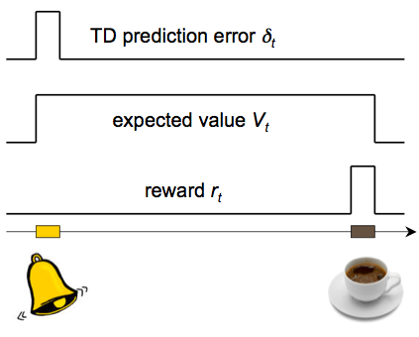
Summary of part I: prediction and RL
Prediction is important for action selection
The problem: prediction of future reward
The algorithm: temporal difference learning
Neural implementation: dopamine dependent learning in BG
A precise computational model of learning allows one to look in the brain for “hidden variables” postulated by the model
Precise (normative!) theory for generation of dopamine firing patterns
Explains anticipatory dopaminergic responding, second order conditioning
Compelling account for the role of dopamine in classical conditioning: prediction error acts as signal driving learning in prediction areas

Slide 2
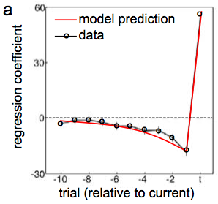
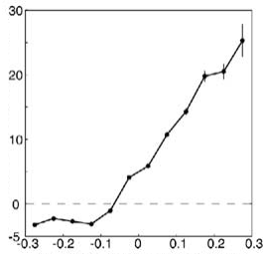
prediction error hypothesis of dopamine
measured firing rate
model prediction error
at end of trial: δ_{t} = r_{t} - V_{t} (just like R-W)
Bayer & Glimcher (2005)

Slide 3
Global plan
Reinforcement learning I:
  prediction
  classical conditioning
  dopamine
Reinforcement learning II:
  dynamic programming; action selection
  Pavlovian misbehaviour
  vigor
Chapter 9 of Theoretical Neuroscience

Slide 4
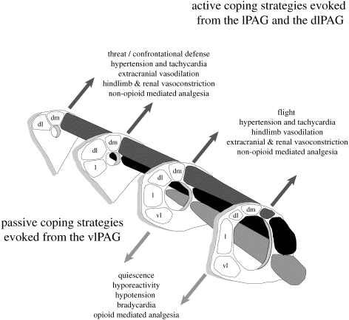
Action Selection
Evolutionary specification
Immediate reinforcement:
  leg flexion
  Thorndike puzzle box
  pigeon; rat; human matching
Delayed reinforcement:
  these tasks
  mazes
  chess
Bandler;
Blanchard

Slide 5

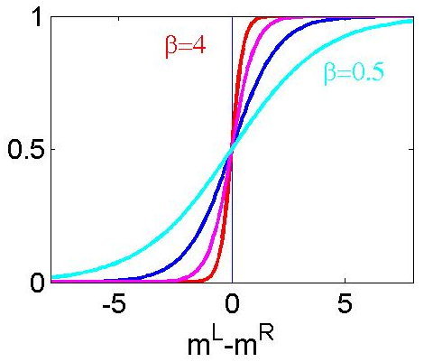




Immediate Reinforcement
stochastic policy:
based on action values:

Slide 6

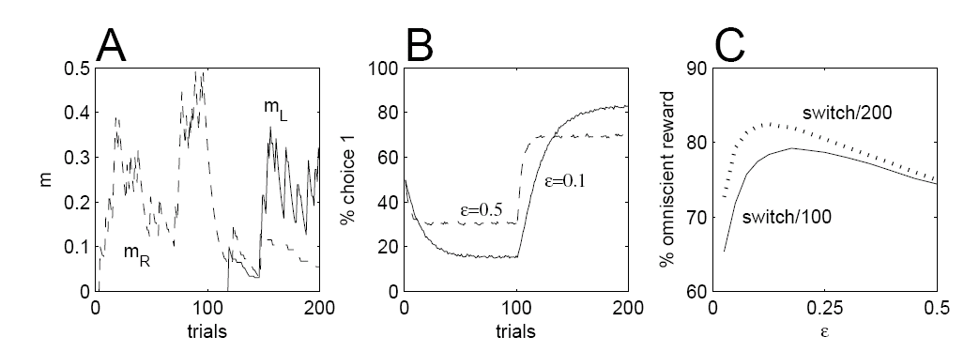
Indirect Actor
use RW rule:
switch every 100 trials

Slide 7
Direct Actor

Slide 8
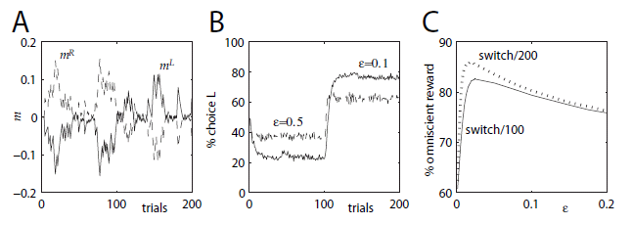
Direct Actor

Slide 9
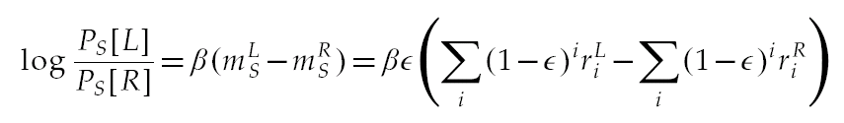
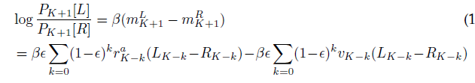
Could we Tell?
correlate past rewards, actions with present choice
indirect actor (separate clocks):
direct actor (single clock):

Slide 10
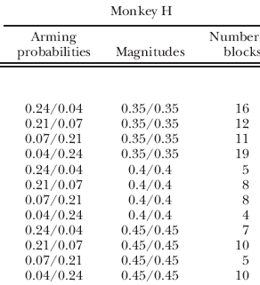
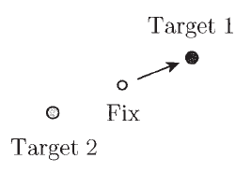
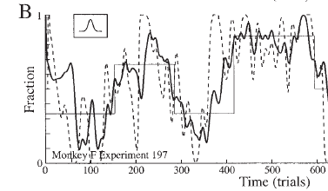
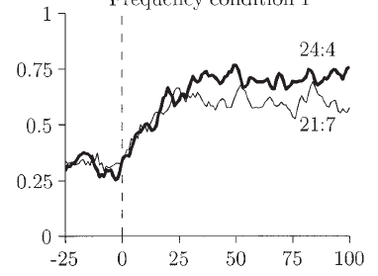
Matching: Concurrent VI-VI
Lau, Glimcher, Corrado,
Sugrue, Newsome

Slide 11
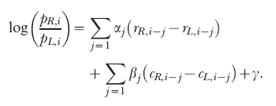
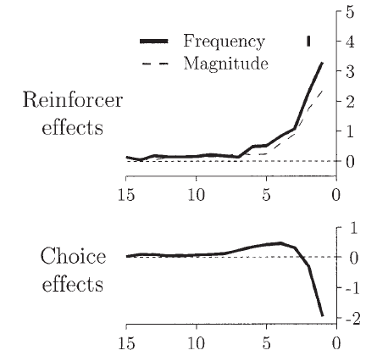
Matching
income not return
approximately exponential in r
alternation choice kernel

Slide 12
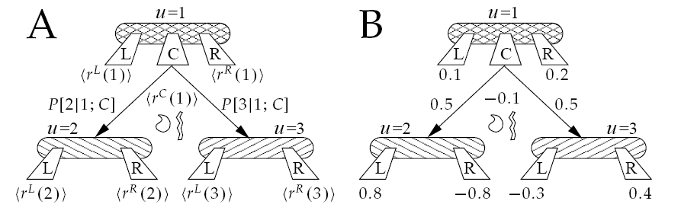
Action at a (Temporal) Distance
x=1
x=1
x=2
x=3
x=2
x=3
learning an appropriate action at x=1:
  depends on the actions at x=2 and x=3
  gains no immediate feedback
idea: use prediction as surrogate feedback

Slide 13
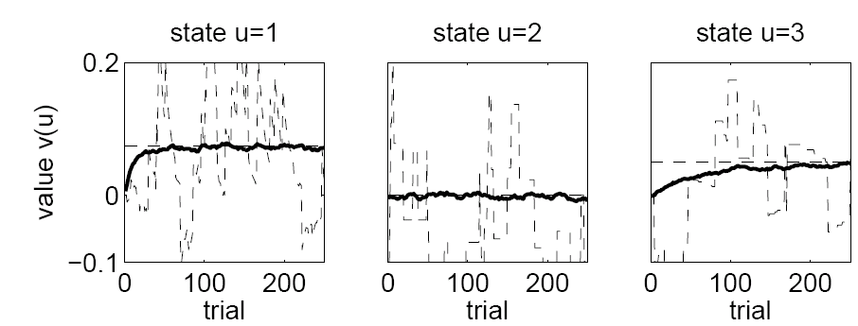
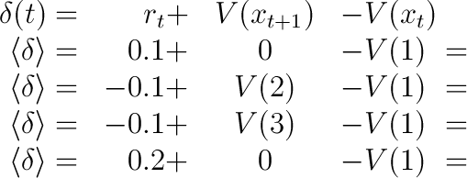
Action Selection
x=1
x=2
x=3
start with policy:
x=1
x=2
x=3
evaluate it:
improve it:
x=1
0.025
x=2
x=3
-0.175
-0.125
0.125
thus choose R more frequently than L;C

Slide 14
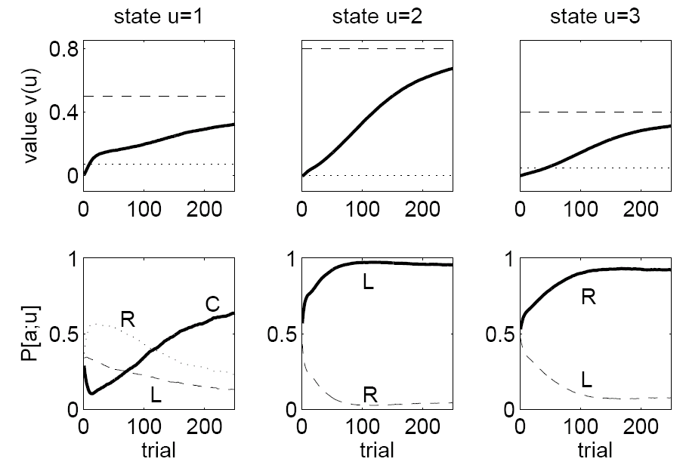
Policy
value is too pessimistic
action is better than average
x=1
x=2
x=3

Slide 15
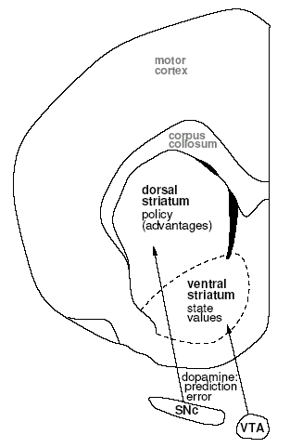
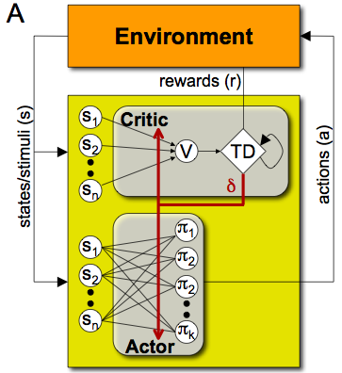
actor/critic
m₁
m₂
m₃
m_{n}
dopamine signals to both motivational & motor striatum appear, surprisingly the same
suggestion: training both values & policies

Slide 16
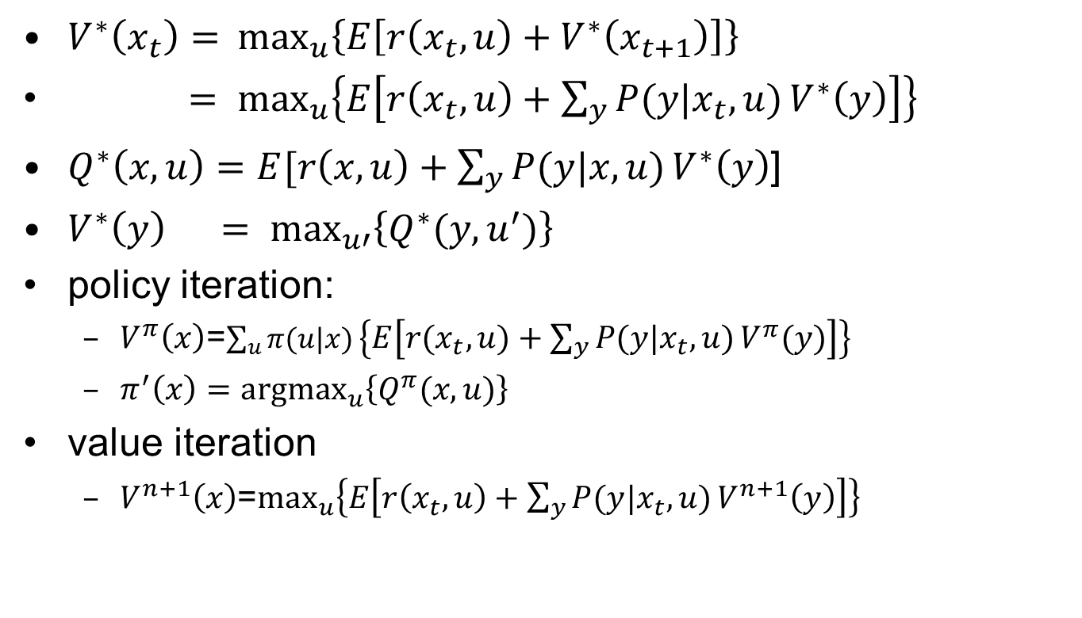
Formally: Dynamic Programming
$V^{∗}\left(x_{t}\right)=⁡\max_{u}\left\{E\left[r\left(x_{t},u\right)+V^{∗}\left(x_{t+1}\right)\right]\right\}$
$= {\max_{u}\left\{E\left[r\left(x_{t},u\right)+{\sum_{y}{P(y|x_{t},u)}V}^{∗}\left(y\right)\right]\right\}}_{}$
$Q^{∗}\left(x,u\right)=E[r\left(x,u\right)+{\sum_{y}{P(y|x,u)}V}^{∗}\left(y\right)$]
$V^{∗}\left(y\right) = {\text{max}}_{u′}\left\{Q^{∗}(y,u^{′})\right\}$
policy iteration:
  $V^{π}\left(x\right)$=$\sum_{u}{π(u|x)}\left\{E\left[r\left(x_{t},u\right)+{\sum_{y}{P(y|x_{t},u)}V}^{π}\left(y\right)\right]\right\}$
  $π^{′}\left(x\right)={\text{argmax}}_{u}\left\{Q^{π}(x,u)\right\}$
value iteration
  $V^{n+1}\left(x\right)$=${\text{max}}_{u}\left\{E\left[r\left(x_{t},u\right)+{\sum_{y}{P(y|x_{t},u)}V}^{n+1}\left(y\right)\right]\right\}$

Slide 17
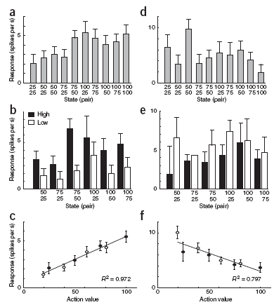
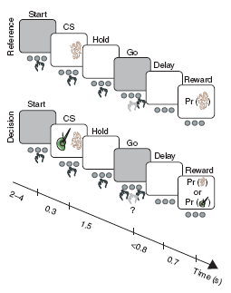
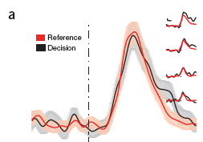
Variants: SARSA
Morris et al, 2006

Slide 18
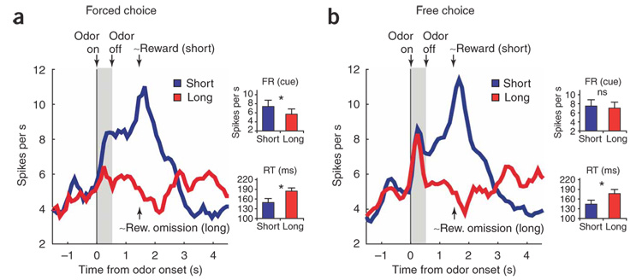
Variants: Q learning
Roesch et al, 2007

Slide 19
Summary
prediction learning
  Bellman evaluation
actor-critic
  asynchronous policy iteration
indirect method (Q learning)
  asynchronous value iteration

Slide 20
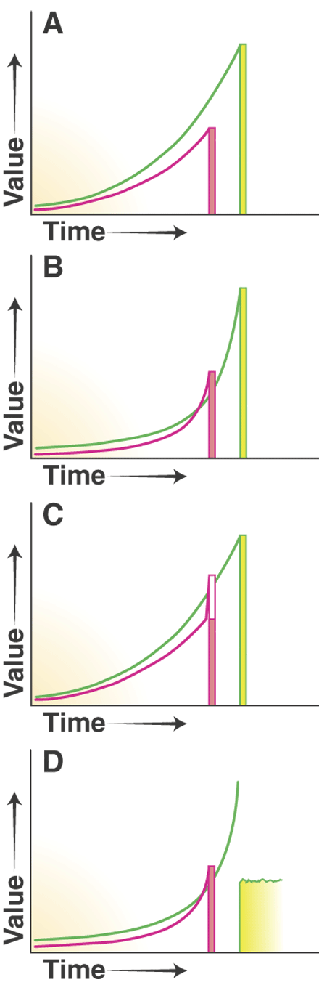
Impulsivity & Hyperbolic Discounting
humans (and animals) show impulsivity in:
  diets
  addiction
  spending, …
intertemporal conflict between short and long term choices
often explained via hyperbolic discount functions
alternative is Pavlovian imperative to an immediate reinforcer
framing, trolley dilemmas, etc

Slide 21
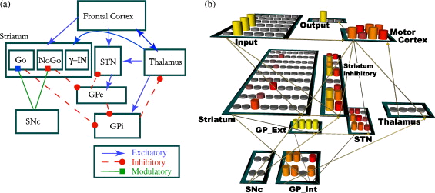
Direct/Indirect Pathways
Frank
direct: D1: GO; learn from DA increase
indirect: D2: noGO; learn from DA decrease
hyperdirect (STN) delay actions given strongly attractive choices

Slide 22
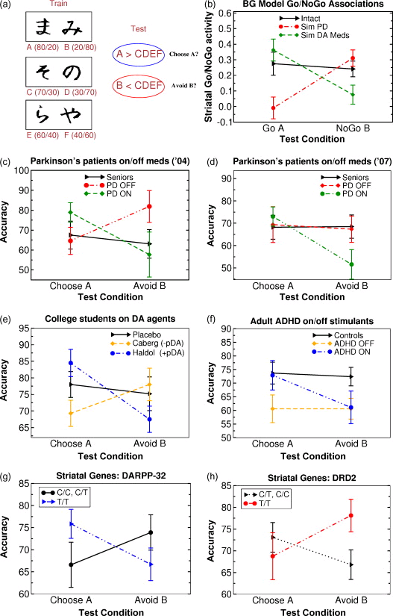
Frank
DARPP-32: D1 effect
DRD2: D2 effect

Slide 23
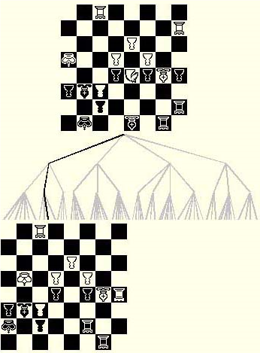
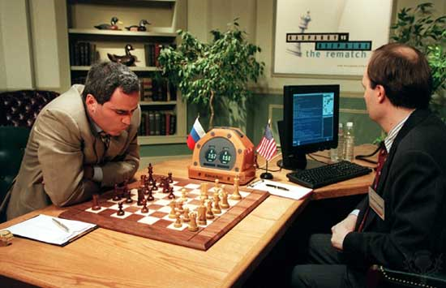
Three Decision Makers
tree search
position evaluation
situation memory

Slide 24
Multiple Systems in RL
model-based RL
  build a forward model of the task, outcomes
  search in the forward model (online DP)
    optimal use of information
    computationally ruinous
cached-based RL
  learn Q values, which summarize future worth
    computationally trivial
    bootstrap-based; so statistically inefficient
learn both – select according to uncertainty

Slide 25
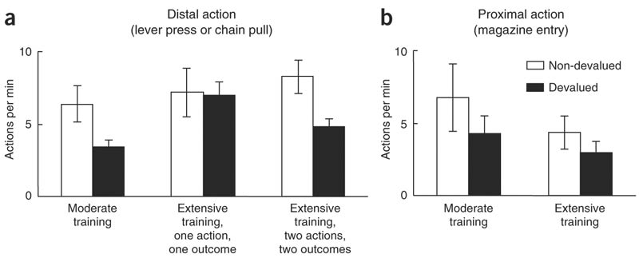
Animal Canary
OFC; dlPFC; dorsomedial striatum; BLA?
dosolateral striatum, amygdala

Slide 26
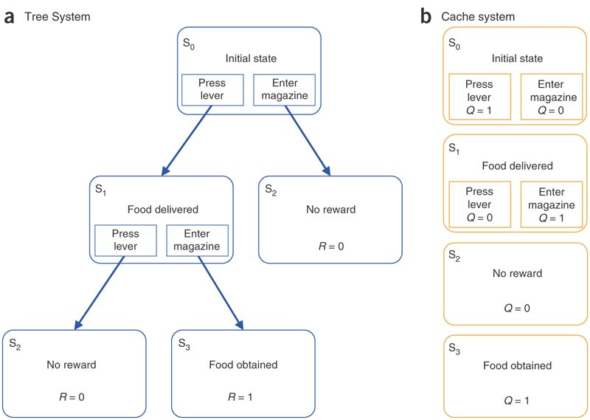
Two Systems:

Slide 27
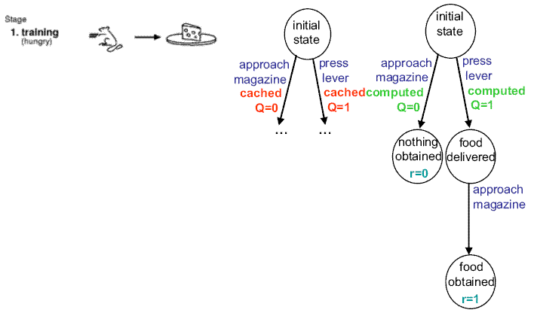
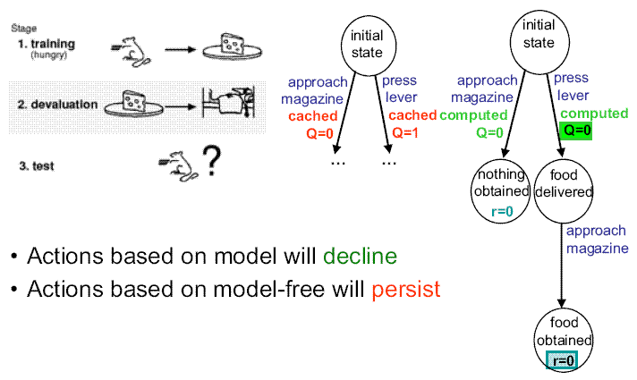
Behavioural Effects

Slide 28
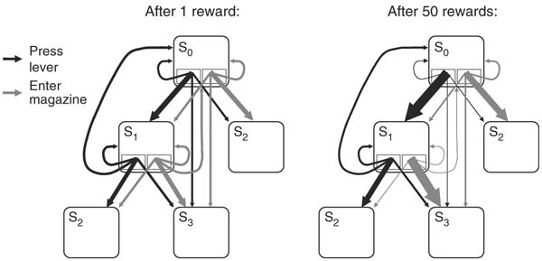
Effects of Learning
distributional value iteration
  (Bayesian Q learning)
fixed additional uncertainty per step

Slide 29
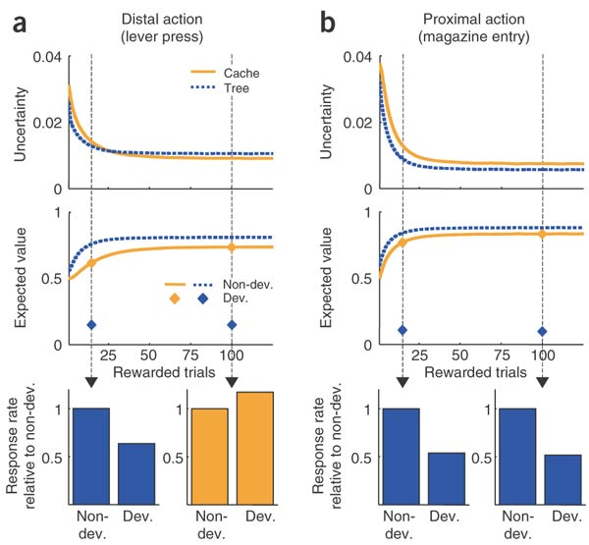
One Outcome
shallow tree
implies
goal-directed
control
wins

Slide 30
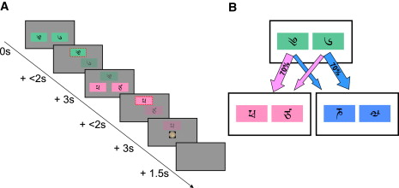
Human Canary...
a
b
c
if a → c and c → £££ , then do more of a or b?
  MB: b
  MF: a (or even no effect)

Slide 31
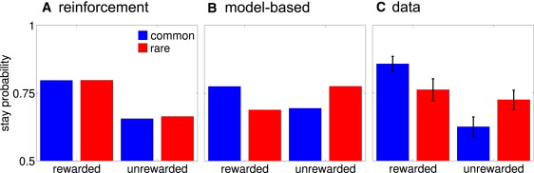
Behaviour
action values depend on both systems:
expect that will vary by subject (but be fixed)

Slide 32
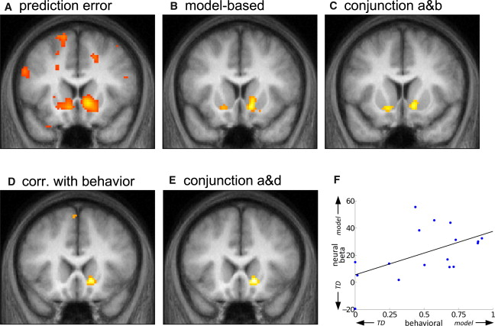
Neural Prediction Errors (1→2)
R ventral striatum
(anatomical definition)
note that MB RL does not use this prediction error – training signal?

Slide 33
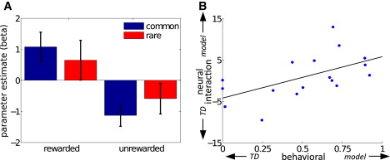
Neural Prediction Errors (1)
right nucleus accumbens
behaviour
1-2, not 1

Slide 34
Vigour
Two components to choice:
  what:
    lever pressing
    direction to run
    meal to choose
  when/how fast/how vigorous
    free operant tasks
real-valued DP

Slide 35
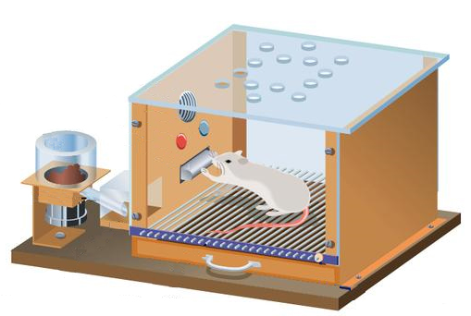
The model
cost
vigour cost
unit cost
(reward)
P_{R}
how fast
U_{R}
?
τ
LP
NP
Other
S₀
τ₁ time
S₁
τ₂ time
S₂
choose
(action,τ)
= (LP,τ₁)
Costs
Rewards
choose
(action,τ)
= (LP,τ₂)
Costs
Rewards
goal

Slide 36
The model
Goal: Choose actions and latencies to maximize
the average rate of return (rewards minus costs per time)
S₀
τ₁ time
S₁
τ₂ time
S₂
choose
(action,τ)
= (LP,τ₁)
Costs
Rewards
choose
(action,τ)
= (LP,τ₂)
Costs
Rewards
ARL

Slide 37
Average Reward RL
Compute differential values of actions
Differential value of taking action L with latency τ when in state x
ρ = average rewards minus costs, per unit time
Future Returns
Q_{L,τ}(x) = Rewards – Costs +
steady state behavior (not learning dynamics)
(Extension of Schwartz 1993)
Notes:
Mention that the model has few parameters (basically the cost constants and the reward utility) but we will not try to fit any of these, but just look at principles

Slide 38
Average Reward Cost/benefit Tradeoffs
1. Which action to take?
Choose action with largest expected reward minus cost
How fast to perform it?
slow → less costly (vigour cost)
slow → delays (all) rewards
net rate of rewards = cost of delay
(opportunity cost of time)
Choose rate that balances vigour and opportunity costs
explains faster (irrelevant) actions under hunger, etc
masochism

Slide 39
Optimal response rates
1st Nose poke
Niv, Dayan, Joel, unpublished
Experimental data
seconds
seconds since reinforcement
1st Nose poke
Model simulation
seconds
seconds since reinforcement

Slide 40
Optimal response rates
Experimental data
Model simulation
100
50
Pigeon A
Model
Pigeon B
Perfect matching
80
Perfect matching
60
% Responses on key A
% Responses on lever A
40
20
Herrnstein 1961
0
More:
# responses
interval length
amount of reward
ratio vs. interval
breaking point
temporal structure
etc.
0
20
40
60
80
100
0
50
% Reinforcements on key A
% Reinforcements on lever A

Slide 41
Effects of motivation (in the model)
RR25
low utility
high utility
energizing
effect
mean latency
LP Other

Slide 42
Effects of motivation (in the model)
RR25
response rate / minute
1
directing effect
response rate / minute
seconds from reinforcement
U_{R} 50%
low utility
high utility
energizing
effect
seconds from reinforcement
2
mean latency
LP Other

Slide 43
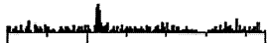

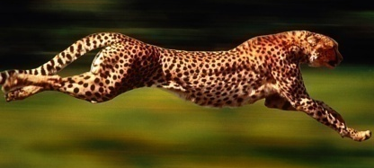
Relation to Dopamine
Phasic dopamine firing = reward prediction error
What about tonic dopamine?
less
more

Slide 44
Tonic dopamine = Average reward rate
explains pharmacological manipulations
dopamine control of vigour through BG pathways
2500
Control
DA depleted
Control
DA depleted
2000
1500
# LPs in 30 minutes
# LPs in 30 minutes
1000
500
1
4
16
64
Aberman and Salamone 1999
Model simulation
eating time confound
context/state dependence (motivation & drugs?)
less switching=perseveration
NB. phasic signal RPE for choice/value learning

Slide 45
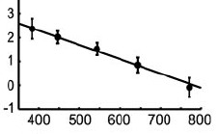
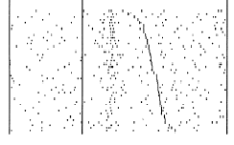
Tonic dopamine hypothesis
♫
$
♫
$
♫
$
♫
$
♫
♫
$
$
…also explains effects of phasic dopamine on response times
firing rate
reaction time
Satoh and Kimura 2003
Ljungberg, Apicella and Schultz 1992

Slide 46
Sensory Decisions as Optimal Stopping
consider listening to:
decision: choose, or sample

Slide 47


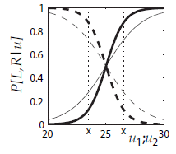


Optimal Stopping
equivalent of state u=1 is
and states u=2,3 is

Slide 48
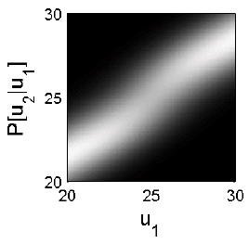
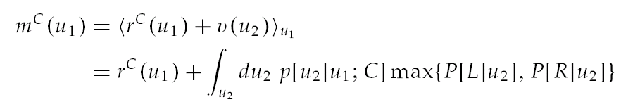
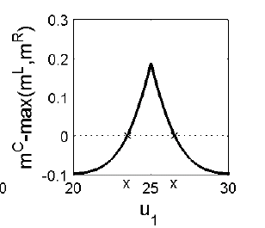
Transition Probabilities

Slide 49
Computational Neuromodulation
dopamine
  phasic: prediction error for reward
  tonic: average reward (vigour)
serotonin
  phasic: prediction error for punishment?
acetylcholine:
  expected uncertainty?
norepinephrine
  unexpected uncertainty; neural interrupt?

Slide 50
Conditioning
prediction: of important events
control: in the light of those predictions
Ethology
  optimality
  appropriateness
Psychology
  classical/operant
  conditioning
Computation
  dynamic progr.
  Kalman filtering
Algorithm
  TD/delta rules
  simple weights
Neurobiology
neuromodulators; amygdala; OFC
nucleus accumbens; dorsal striatum

Slide 51



Markov Decision Process
class of stylized tasks with
states, actions & rewards
  at each timestep t the world takes on state s_{t} and delivers reward r_{t}, and the agent chooses an action a_{t}

Slide 52
Markov Decision Process
World: You are in state 34.
Your immediate reward is 3. You have 3 actions.
Robot: I’ll take action 2.
World: You are in state 77.
Your immediate reward is -7. You have 2 actions.
Robot: I’ll take action 1.
World: You’re in state 34 (again).
Your immediate reward is 3. You have 3 actions.

Slide 53

Markov Decision Process
Stochastic process defined by:
  reward function:
  r_{t} ~ P(r_{t} | s_{t})
  transition function:
  s_{t} ~ P(s_{t+1} | s_{t}, a_{t})

Slide 54
Markov Decision Process
Stochastic process defined by:
  reward function:
  r_{t} ~ P(r_{t} | s_{t})
  transition function:
  s_{t} ~ P(s_{t+1} | s_{t}, a_{t})
Markov property
  future conditionally independent of past, given s_{t}

Slide 55
The optimal policy
Definition: a policy such that at every state, its expected value is better than (or equal to) that of all other policies
Theorem: For every MDP there exists (at least) one deterministic optimal policy.
  → by the way, why is the optimal policy just a mapping from states to actions? couldn’t you earn more reward by choosing a different action depending on last 2 states?

Slide 56
Pavlovian & Instrumental Conditioning
Pavlovian
  learning values and predictions
  using TD error
Instrumental
  learning actions:
    by reinforcement (leg flexion)
    by (TD) critic
  (actually different forms: goal directed & habitual)

Slide 57
Pavlovian-Instrumental Interactions
synergistic
  conditioned reinforcement
  Pavlovian-instrumental transfer
    Pavlovian cue predicts the instrumental outcome
    behavioural inhibition to avoid aversive outcomes
neutral
  Pavlovian-instrumental transfer
    Pavlovian cue predicts outcome with same motivational valence
opponent
  Pavlovian-instrumental transfer
    Pavlovian cue predicts opposite motivational valence
  negative automaintenance

Slide 58


-ve Automaintenance in Autoshaping
simple choice task
  N: nogo gives reward r=1
  G: go gives reward r=0
learn three quantities
  average value
  Q value for N
  Q value for G
instrumental propensity is

Slide 59
-ve Automaintenance in Autoshaping
Pavlovian action
  assert: Pavlovian impetus towards G is v(t)
  weight Pavlovian and instrumental advantages by ω – competitive reliability of Pavlov
new propensities
new action choice

Slide 60


-ve Automaintenance in Autoshaping
basic –ve automaintenance effect (μ=5)
lines are theoretical asymptotes
equilibrium probabilities of action

