Slide 1
Uncertainty and the Bayesian Brain
sources:
  sensory/processing noise
  ignorance
  change
consequences:
  inference
  learning
coding:
  distributional/probabilistic population codes
  neuromodulators

Slide 2
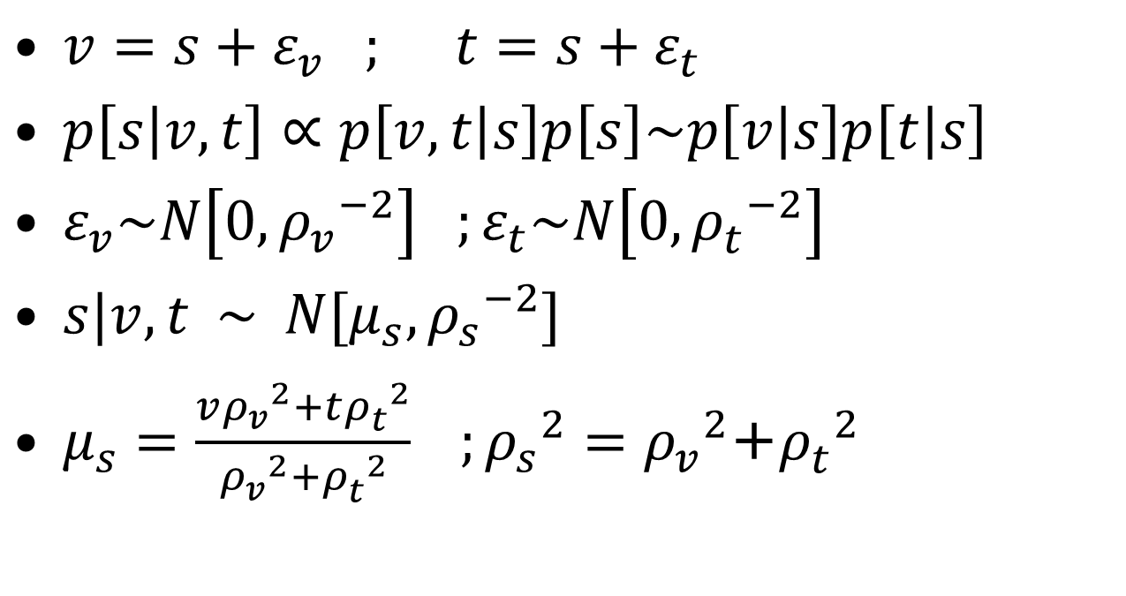
Multisensory Integration
$v=s+ε_{v} ; t=s+ε_{t}$
$p\left[s | v,t\right]∝p\left[v,t | s\right]p\left[s\right]\sim p\left[v | s\right]p\left[t | s\right]$
$ε_{v}\sim N\left[0,{ρ_{v}^{}}_{}^{−2}\right] ;ε_{t}\sim N\left[0,{ρ_{t}^{}}_{}^{−2}\right]$
$s|v,t \sim N[μ_{s},{ρ_{s}^{}}^{−2}]$
$μ_{s}=\frac{v{ρ_{v}^{}}_{}^{2}+t{ρ_{t}^{}}_{}^{2}}{{ρ_{v}^{}}_{}^{2}+{ρ_{t}^{}}_{}^{2}} ;{ρ_{s}^{}}_{}^{2}={ρ_{v}^{}}_{}^{2}$+${ρ_{t}^{}}_{}^{2}$

Slide 3


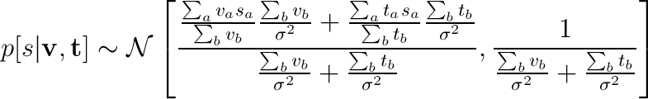

apply the previous analysis:
so if:
everything will work out

Slide 4
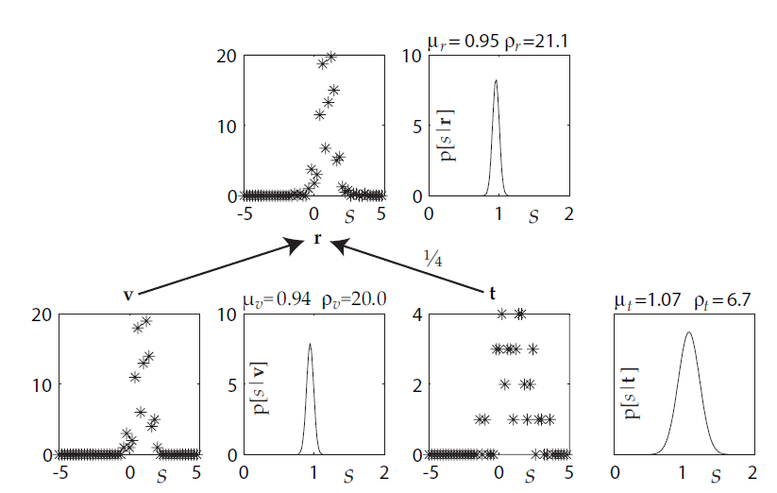
Explicit and Implicit Spaces

Slide 5
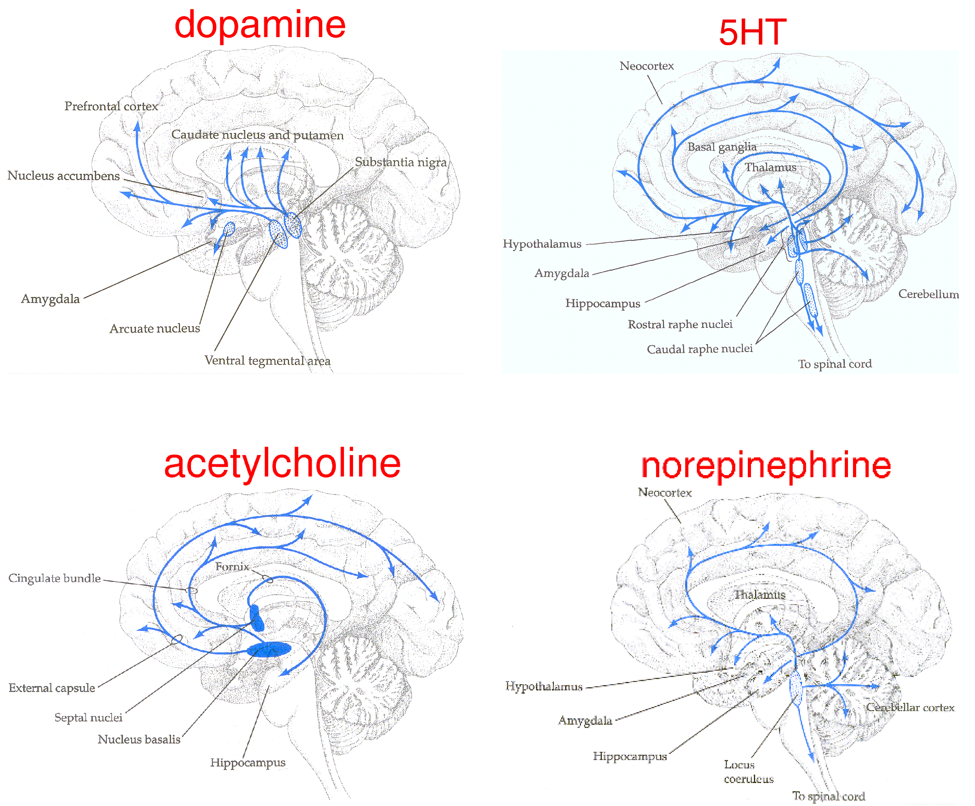
Computational Neuromodulation
general: excitability, signal/noise ratios
specific: prediction errors, uncertainty signals

Slide 6
Uncertainty
Computational functions of neuromodulatory uncertainty:
weaken top-down influence over sensory processing
promote learning about the relevant representations
We focus on two different kinds of uncertainties:
ACh
expected uncertainty from known variability or ignorance
NE
unexpected uncertainty due to gross mismatch between prediction and observation

Slide 7
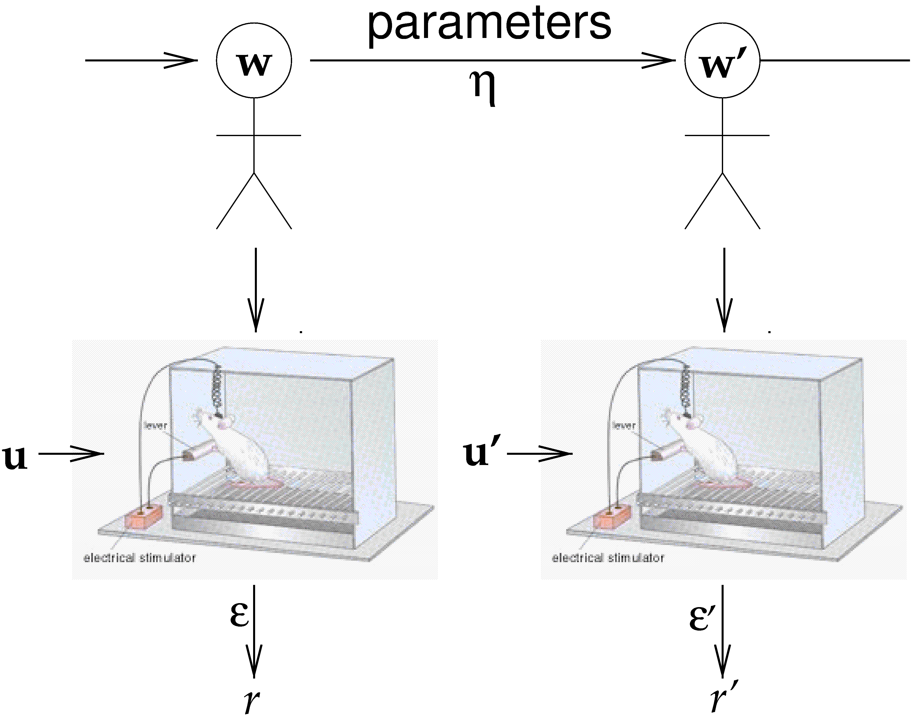
Kalman Filter
Markov random walk (or OU process)
no punctate changes
additive model of combination
forward inference

Slide 8
Kalman Posterior
^
ε
η

Slide 9
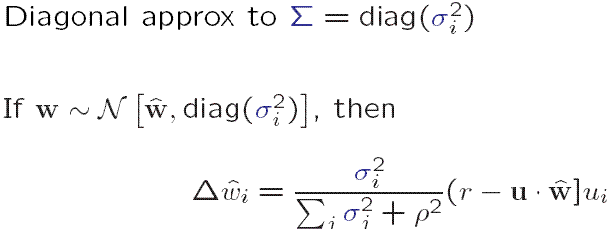
Assumed Density KF
Rescorla-Wagner error correction
competitive allocation of learning
  P&H, M

Slide 10

Blocking
forward blocking: error correction
backward blocking: -ve off-diag

Slide 11
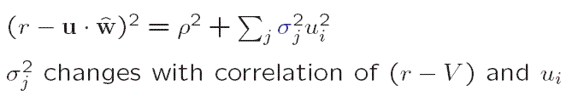
Mackintosh vs P&H
under diagonal approximation:
for slow learning,
  effect like Mackintosh
E

Slide 12
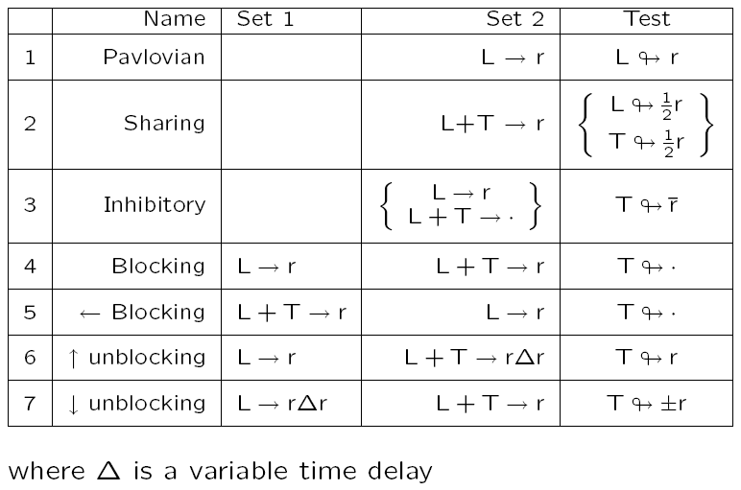
Summary
Kalman filter models many standard conditioning paradigms
elements of RW, Mackintosh, P&H
but:
  downwards unblocking
  negative patterning L→r; T→r; L+T→·
  recency vs primacy (Kruschke)
predictor competition
stimulus/correlation rerepresentation (Daw)

Slide 13
Experimental Data
ACh & NE have similar physiological effects
suppress recurrent & feedback processing
enhance thalamocortical transmission
boost experience-dependent plasticity
(e.g. Kimura et al, 1995; Kobayashi et al, 2000)
(e.g. Gil et al, 1997)
(e.g. Bear & Singer, 1986; Kilgard & Merzenich, 1998)
ACh & NE have distinct behavioral effects:
ACh boosts learning to stimuli with uncertain
consequences
NE boosts learning upon encountering global
changes in the environment
(e.g. Bucci, Holland, & Gallagher, 1998)
(e.g. Devauges & Sara, 1990)

Slide 14
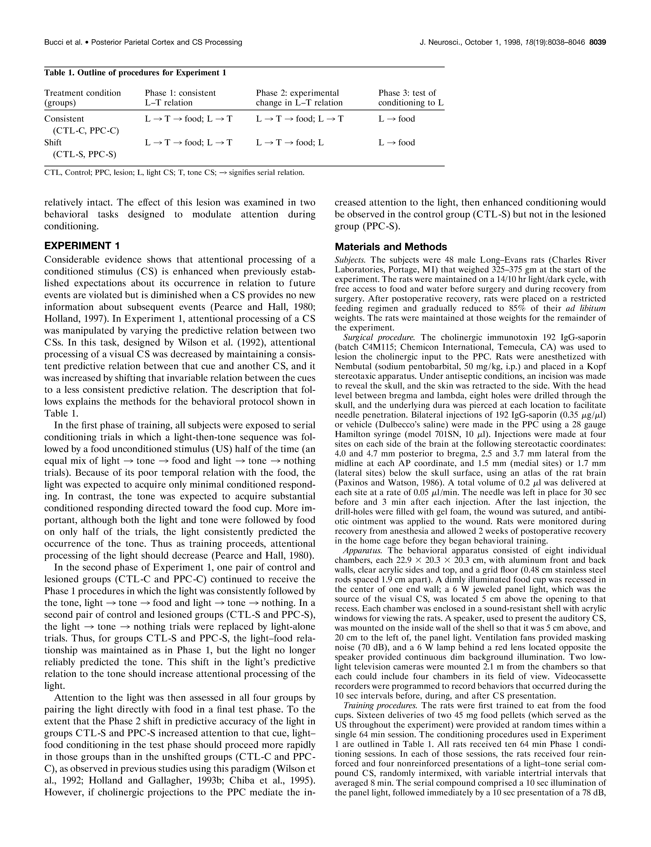
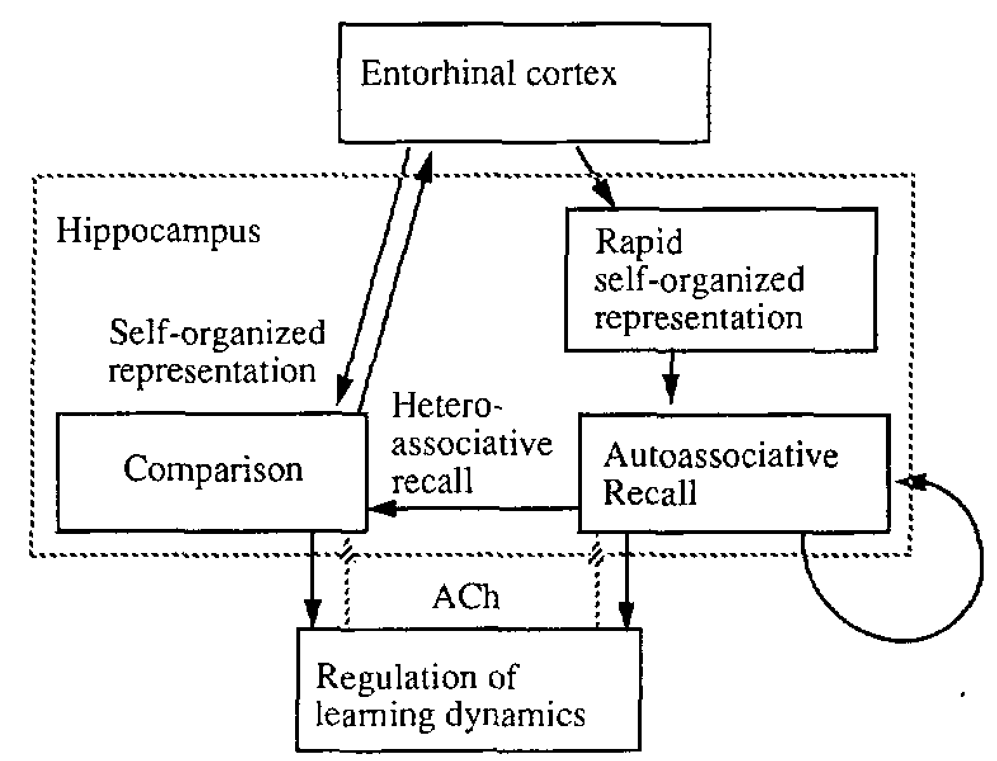
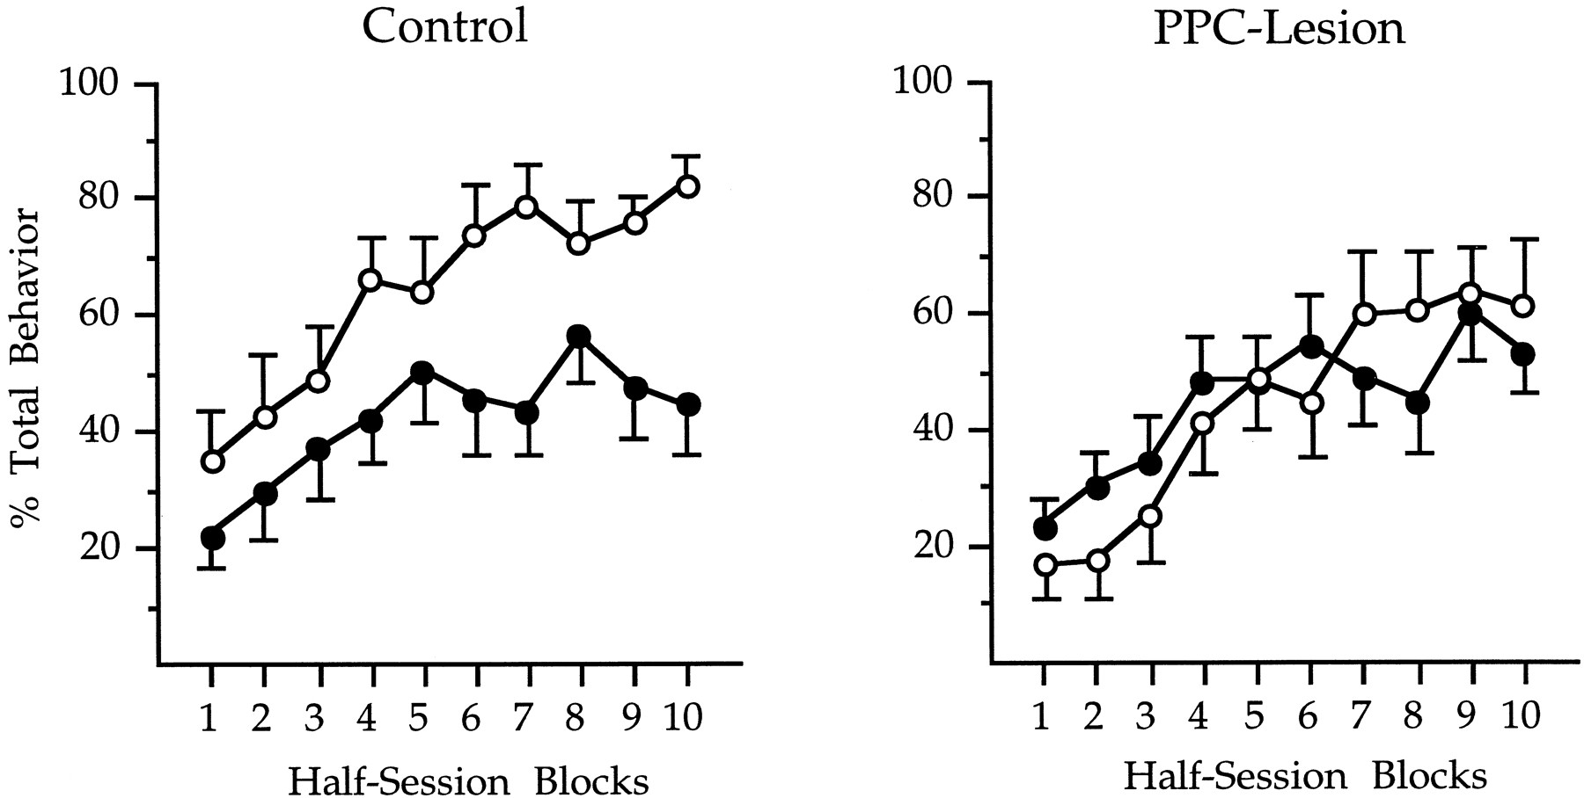
ACh in Hippocampus
ACh in Conditioning
Given unfamiliarity, ACh:
boosts bottom-up, suppresses
recurrent processing
boosts recurrent plasticity
Given uncertainty, ACh:
boosts learning to stimuli of
uncertain consequences
(DG)
(CA1)
(CA3)
(MS)
(Hasselmo, 1995)
(Bucci, Holland, & Galllagher, 1998)

Slide 15
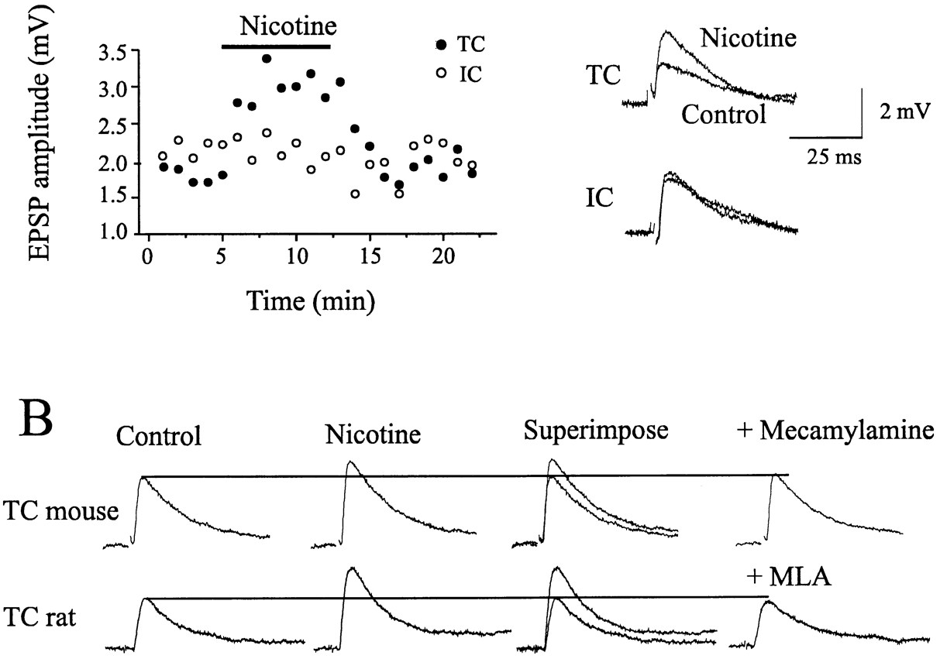
Cholinergic Modulation in the Cortex
Electrophysiology Data
Examples of Hallucinations Induced by Anticholinergic Chemicals
Scopolamine in normal volunteers | Integrated, realistic hallucinations with familiar objects and faces | Ketchum et al. (1973)
Intravenous atropine in bradycardia | Intense visual hallucinations on eye closure | Fisher (1991)
Local application of scopolamine or atropine eyedrops | Prolonged anticholinergic delirium in normal adults | Tune et al. (1992)
Side effects of motion-sickness drugs (scopolamine) | Adolescents hallucinating and unable to recognize relatives | Wilkinson (1987) Holland (1992)
(Gil, Conners, & Amitai, 1997)
(Perry & Perry, 1995)
ACh agonists:
facilitate TC transmission
enhance stimulus-specific
activity
ACh antagonists:
induce hallucinations
interfere with stimulus processing
effects enhanced by eye closure

Slide 16
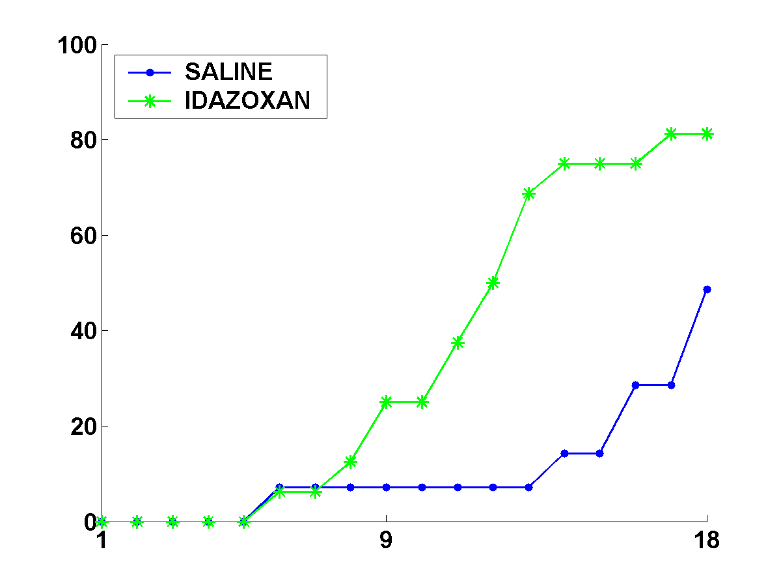
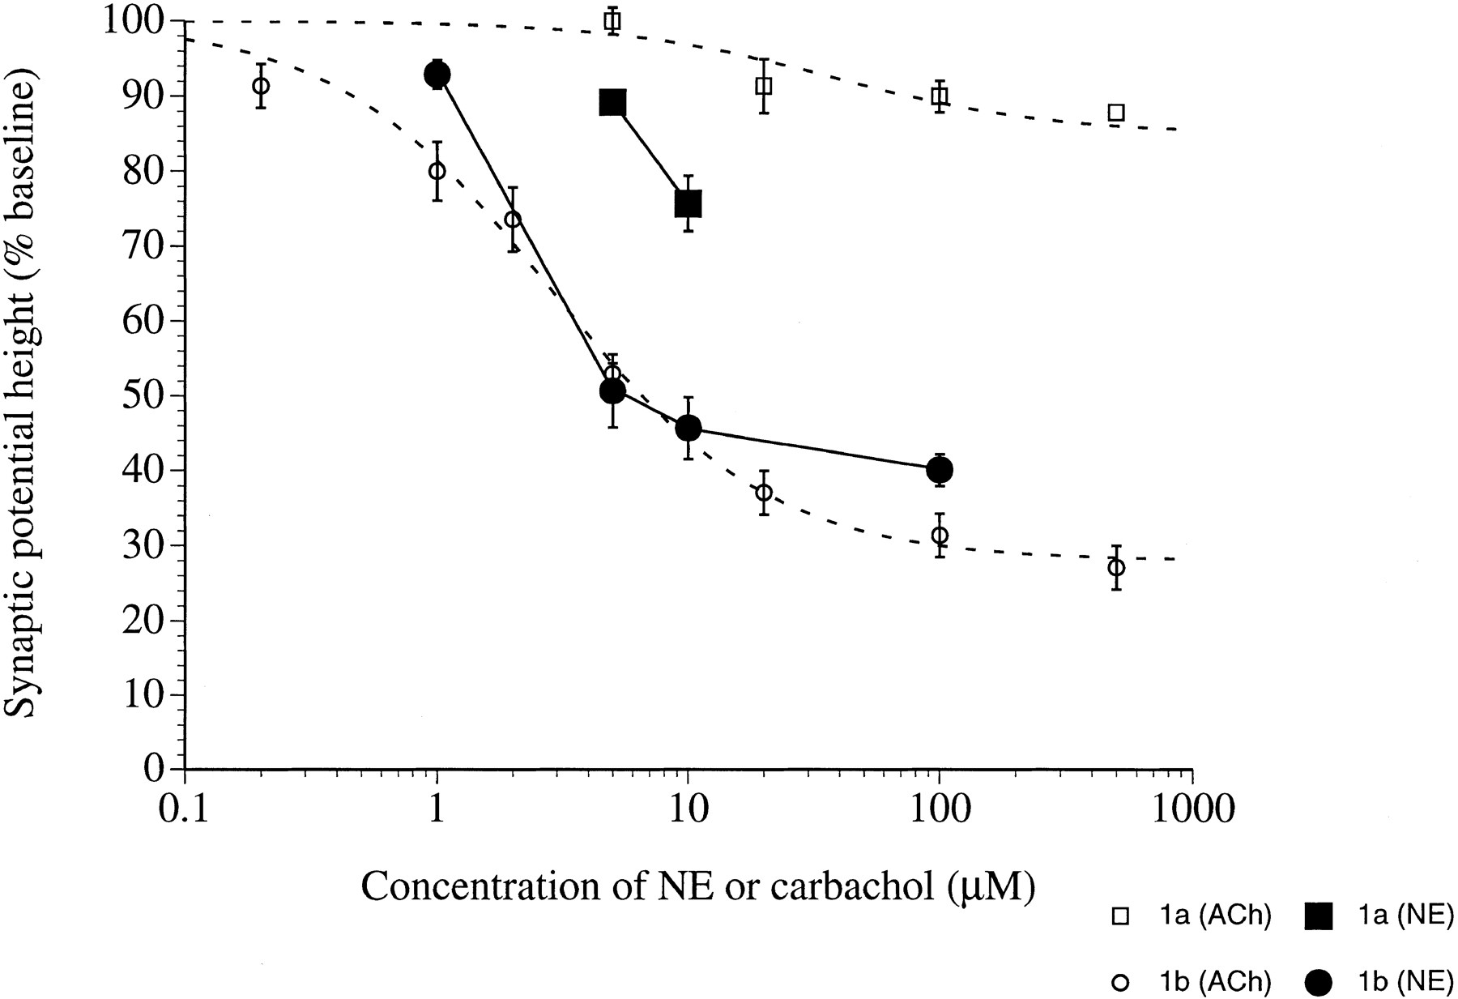
Norepinephrine
Something similar may be true for NE (Kasamatsu et al, 1981)
# Days after task shift
(Devauges & Sara, 1990)
(Hasselmo et al, 1997)
NE specially involved in novelty, confusing association with attention, vigilance

Slide 17
Model Schematics
Context
Unexpected
Uncertainty
Expected
Uncertainty
Top-down
Processing
NE
ACh
Cortical Processing
Prediction, learning, ...
Bottom-up
Processing
Sensory Inputs

Slide 18
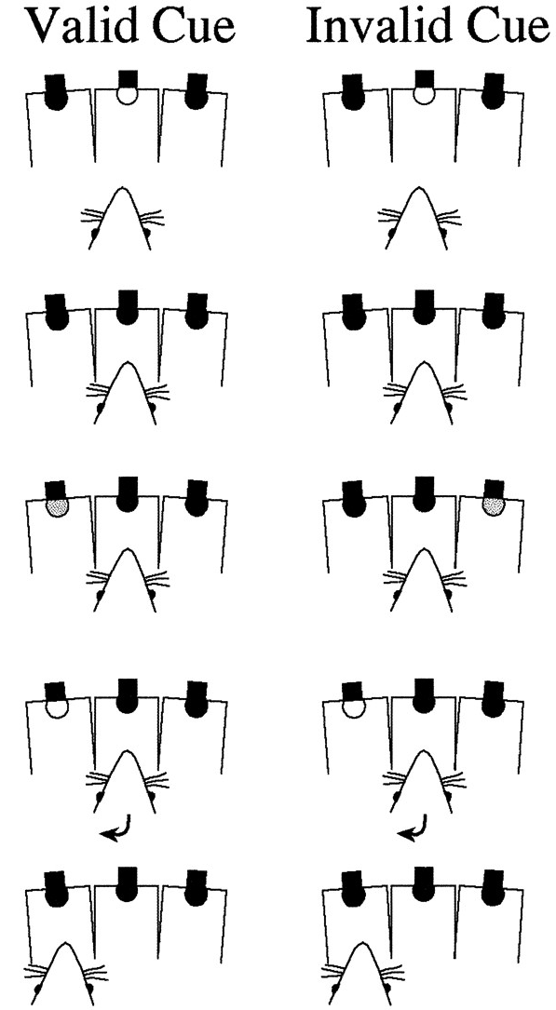
Attention
Attentional selection for (statistically) optimal processing,
above and beyond the traditional view of resource constraint
Example 1: Posner’s Task
cue
cue
high
validity
low
validity
0.1s
stimulus location
stimulus location
cue
0.1s
0.2-0.5s
target
0.15s
sensory
input
sensory
input
response
(Phillips, McAlonan, Robb, & Brown, 2000)
Uncertainty-driven bias in cortical processing

Slide 19
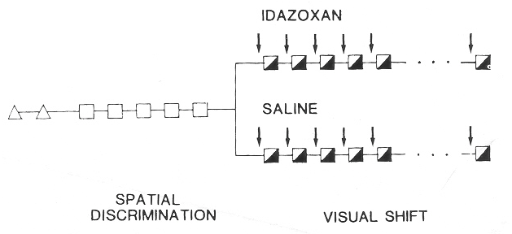
Attention
Attentional selection for (statistically) optimal processing,
above and beyond the traditional view of resource constraint
Example 2: Attentional Shift
cue 1
cue 2
relevant
irrelevant
reward
cue 1
cue 2
(Devauges & Sara, 1990)
irrelevant
relevant
reward
Uncertainty-driven bias in cortical processing

Slide 20
A Common Framework
NE
ACh
Variability in identity of relevant cue
Variability in quality of relevant cue
Cues: vestibular, visual, ...
Target: stimulus location, exit direction...
avoid representing
full uncertainty
Sensory Information

Slide 21
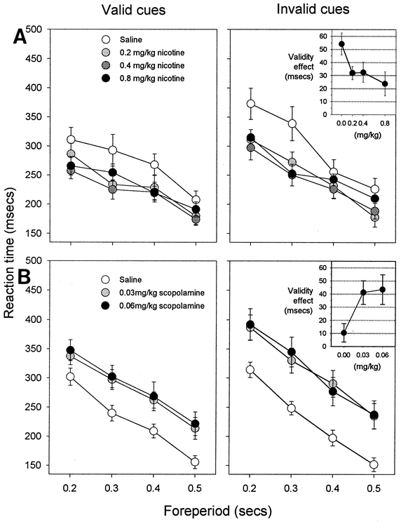
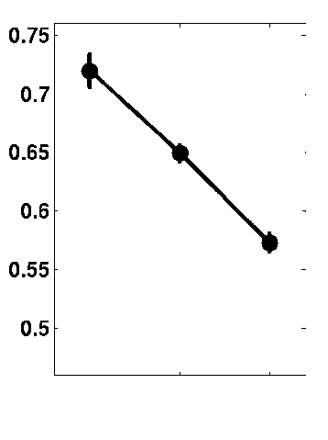
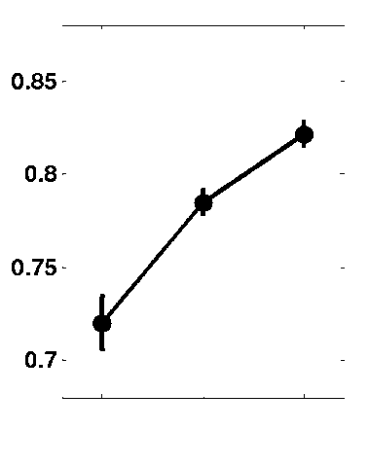
Simulation Results: Posner’s Task
Nicotine
Scopolamine
Vary cue validity ➔ Vary ACh
Validity Effect
Concentration
Concentration
Fix relevant cue ➔ low NE
(Phillips, McAlonan, Robb, & Brown, 2000)
Increase ACh
Decrease ACh
Validity Effect
100
120
140
100
80
60
% normal level
% normal level

Slide 22
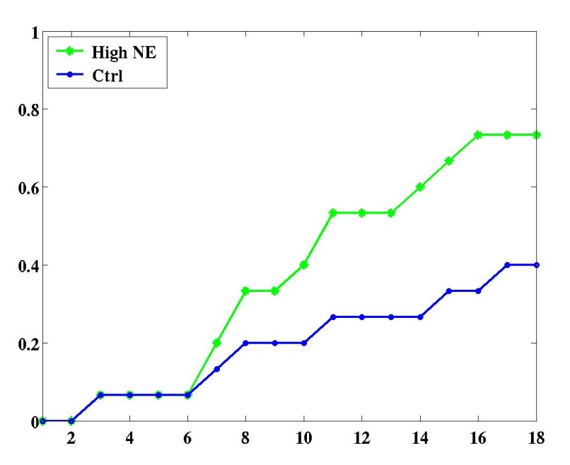
Simulation Results: Maze Navigation
Fix cue validity ➔ no explicit manipulation of ACh
Change relevant cue ➔ NE
Experimental Data
Model Data
% Rats reaching criterion
% Rats reaching criterion
No. days after shift from spatial to visual task
No. days after shift from spatial to visual task
(Devauges & Sara, 1990)

Slide 23
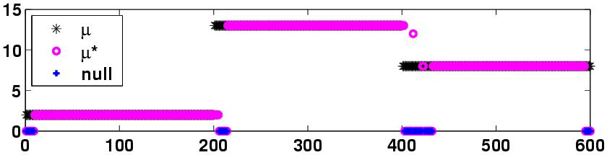
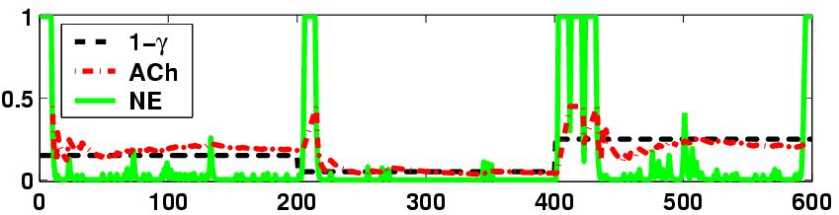
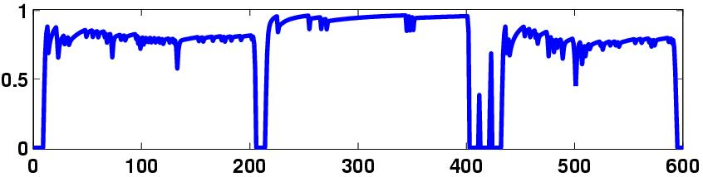
Simulation Results: Full Model
True & Estimated Relevant Stimuli
Neuromodulation in Action
Validity Effect (VE)
Trials

Slide 24
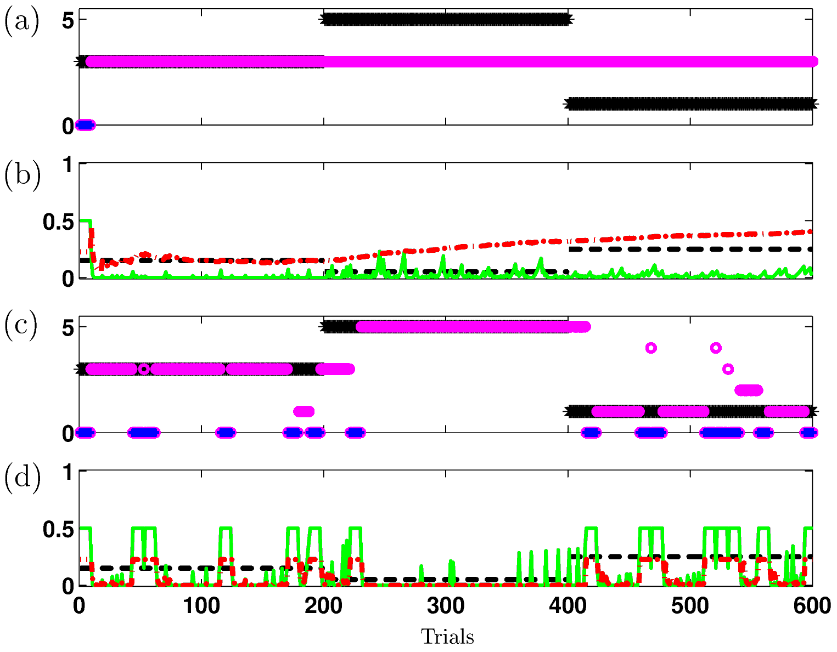
Simulated Psychopharmacology
50% NE
ACh
compensation
50% ACh/NE
NE can
nearly catch
up

Slide 25
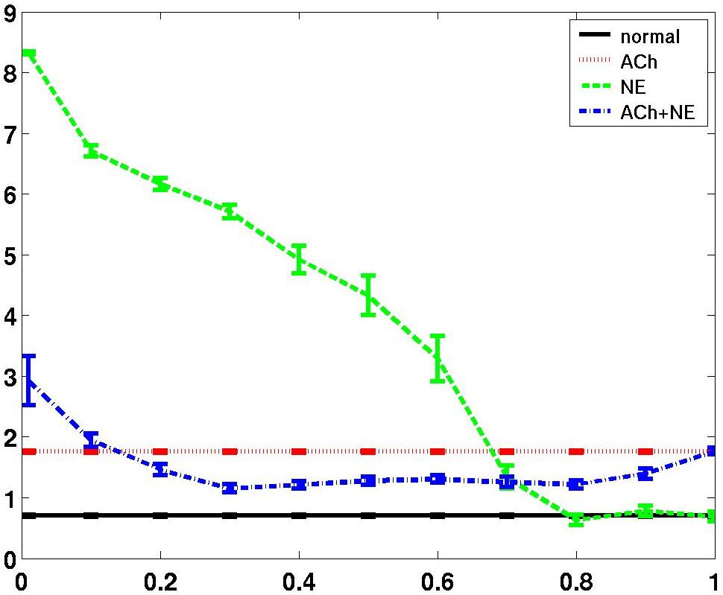
Simulation Results: Psychopharmacology
NE depletion can alleviate ACh depletion revealing underlying
opponency (implication for neurological diseases such as Alzheimers)
ACh level determines a
threshold for NE-mediated
context change:
Mean error rate
0.001% ACh
high expected uncertainty
makes a high bar for
unexpected uncertainty
% of Normal NE Level

Slide 26
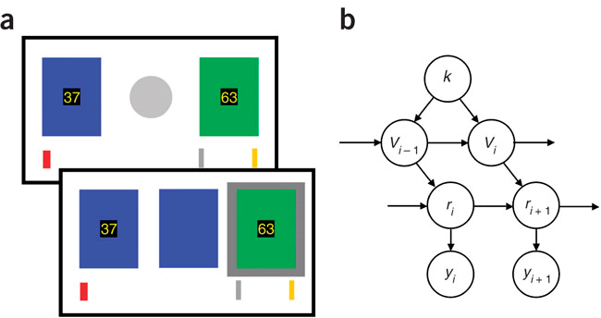
Behrens et al
£10
£20

Slide 27
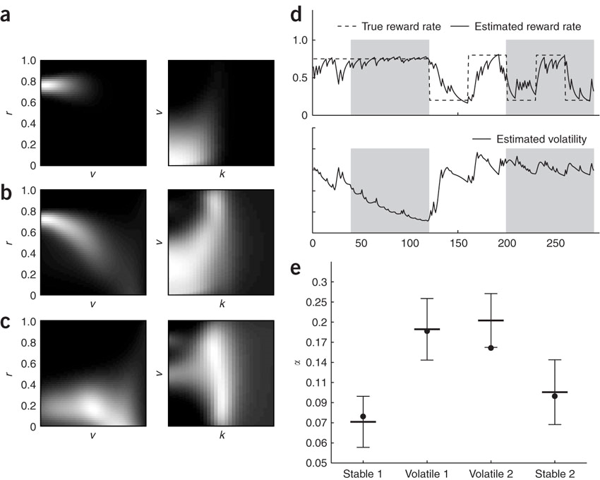
Behrens et al
stable 120
change 15
stable 25

Slide 28
Summary
Single framework for understanding ACh, NE and some
aspects of attention
ACh/NE as expected/unexpected uncertainty signals
Experimental psychopharmacological data replicated by model simulations
Implications from complex interactions between ACh & NE
Predictions at the cellular, systems, and behavioral levels
Consider loss functions
Activity vs weight vs neuromodulatory vs population representations of uncertainty (ACC in Behrens)

Slide 29
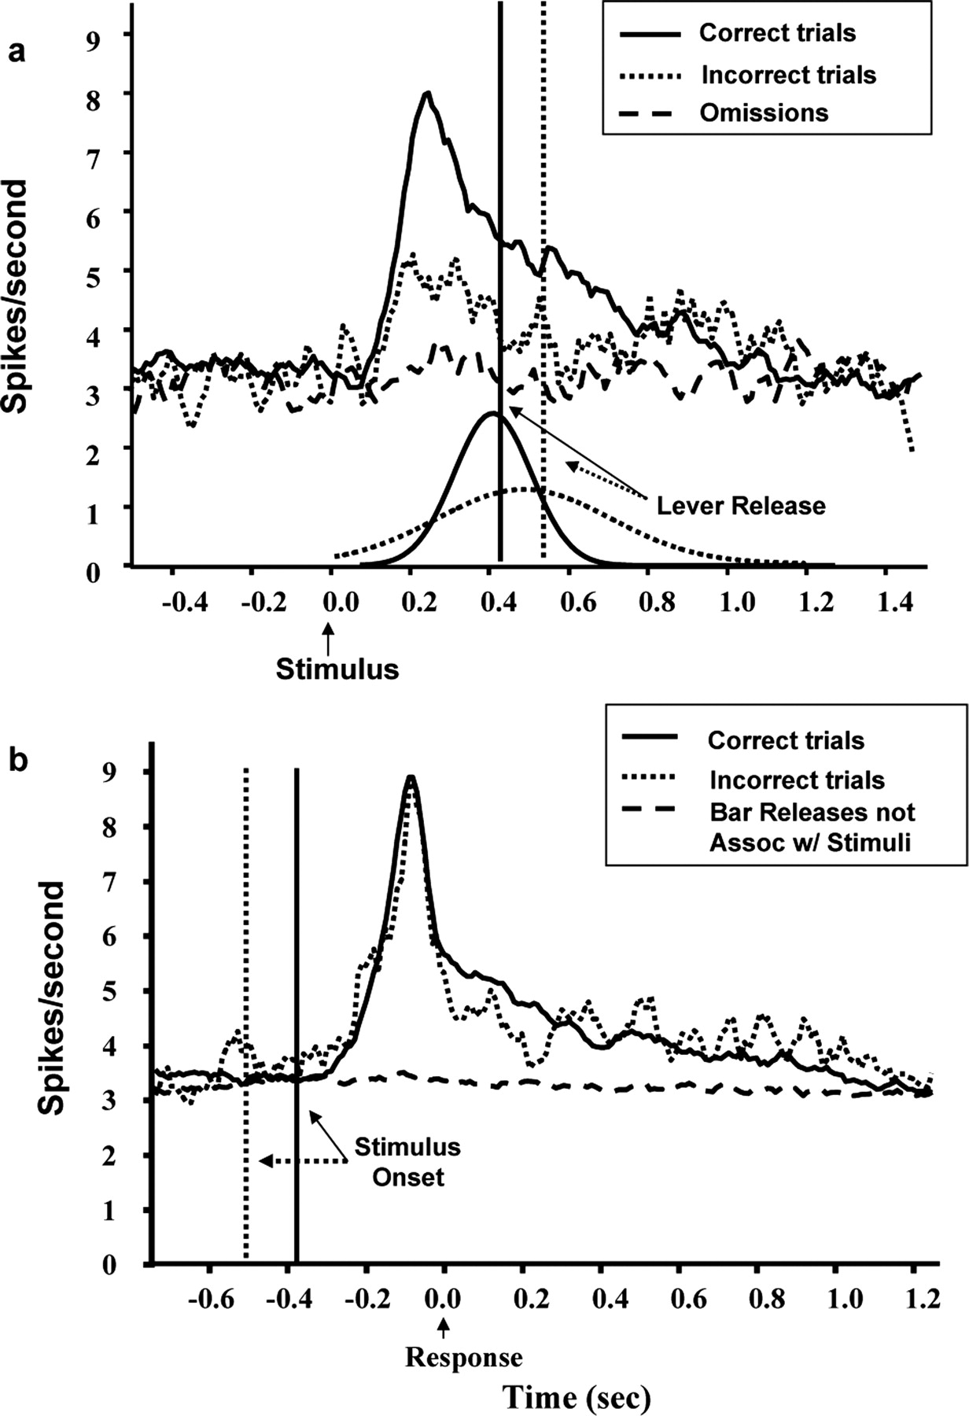
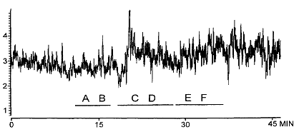
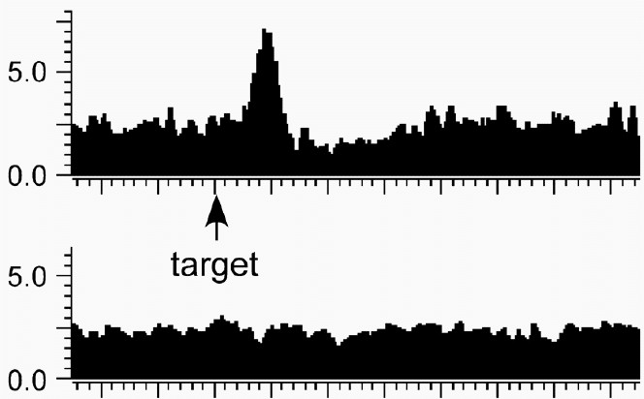
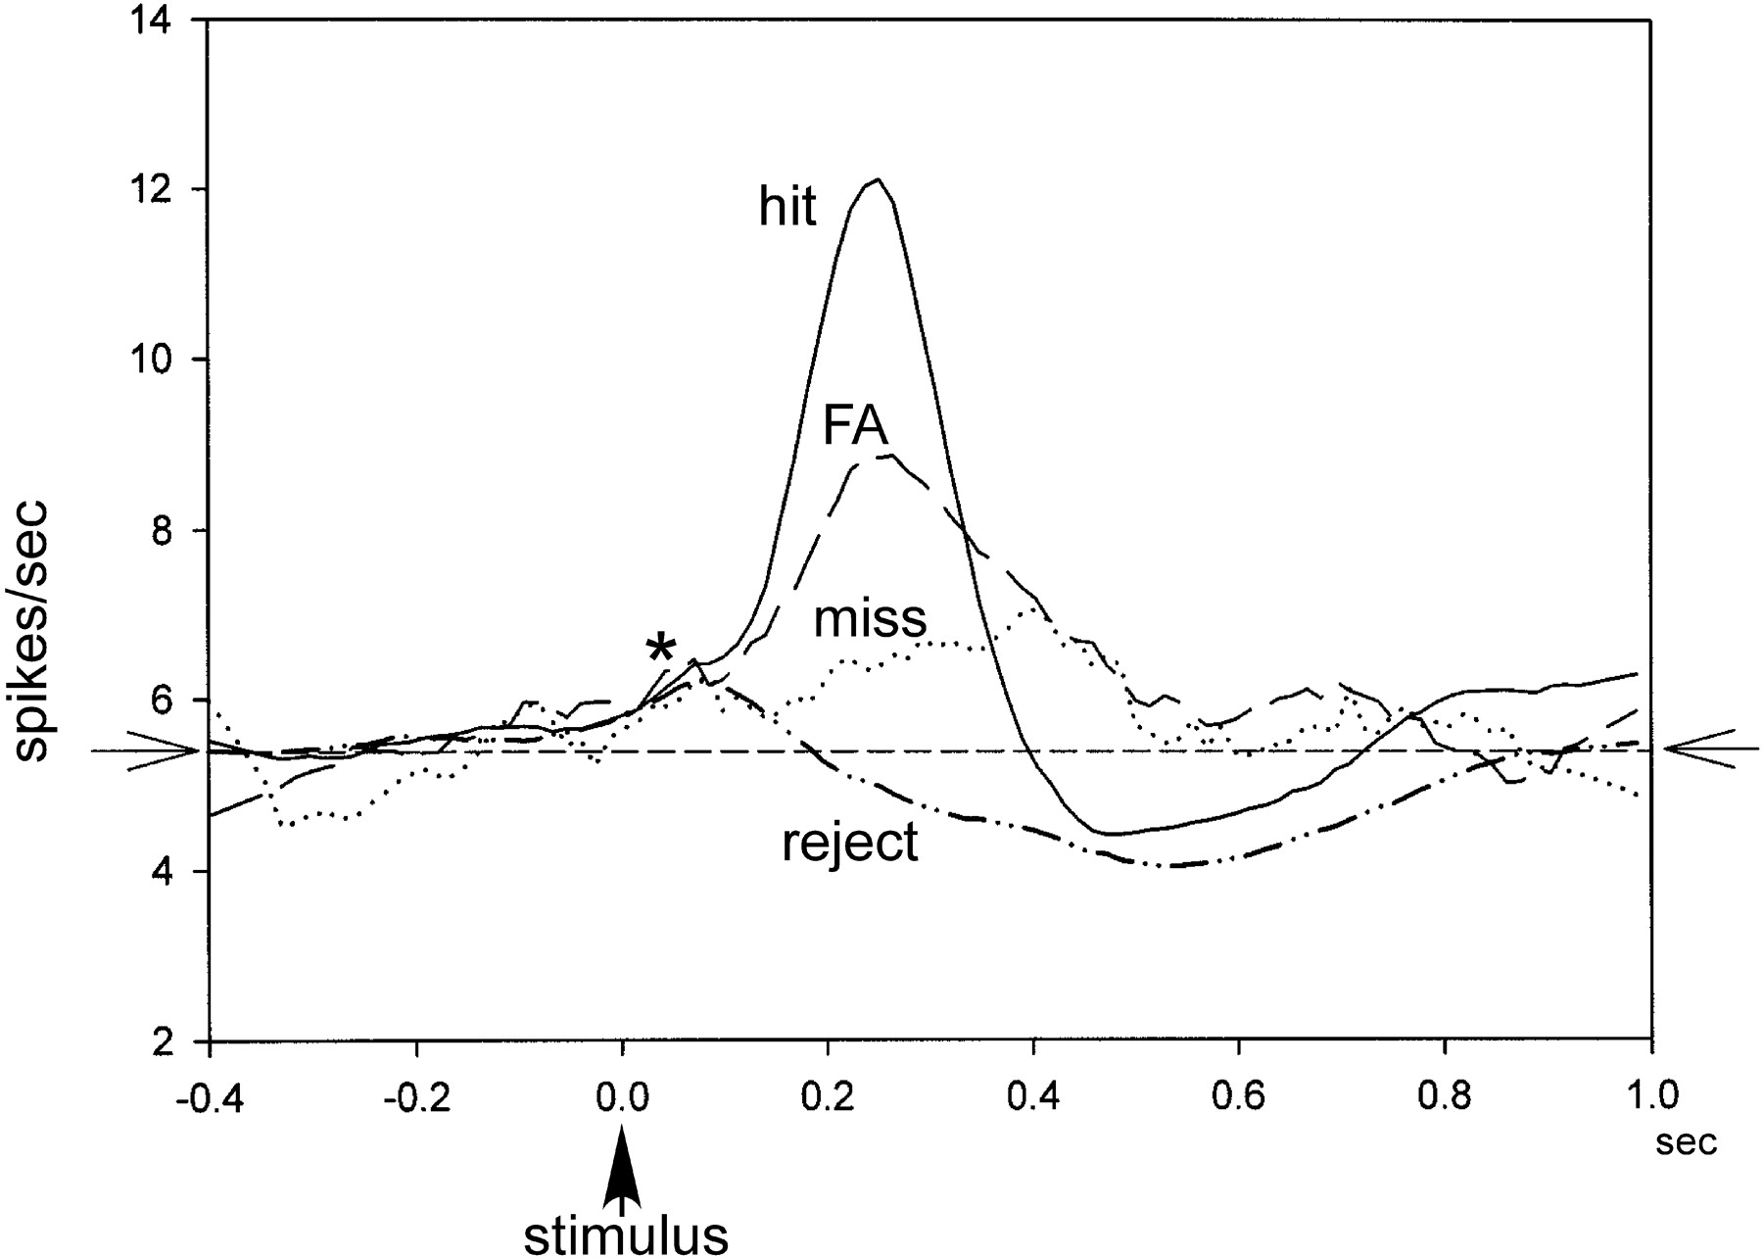
Aston-Jones: Target Detection
detect and react to a rare target amongst common distractors
elevated tonic activity for reversal
activated by rare target (and reverses)
not reward/stimulus related? more response related?
no reason to persist as hardly unexpected
Clayton, et al

Slide 30
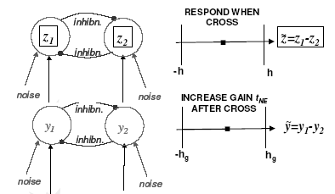
Phasic NE activity
no reason to persist under our tonic model
quantitative phasic theory (Brown, Cohen, Aston-Jones): gain change
  NE controls balance of
  recurrence/bottom-up
  implements changed
  S/N ratio with target
  or perhaps decision
  (through instability)
  detect to detect
  why only for targets?
  already detected
  (early bump)
NE reports unexpected state changes within the task

Slide 31
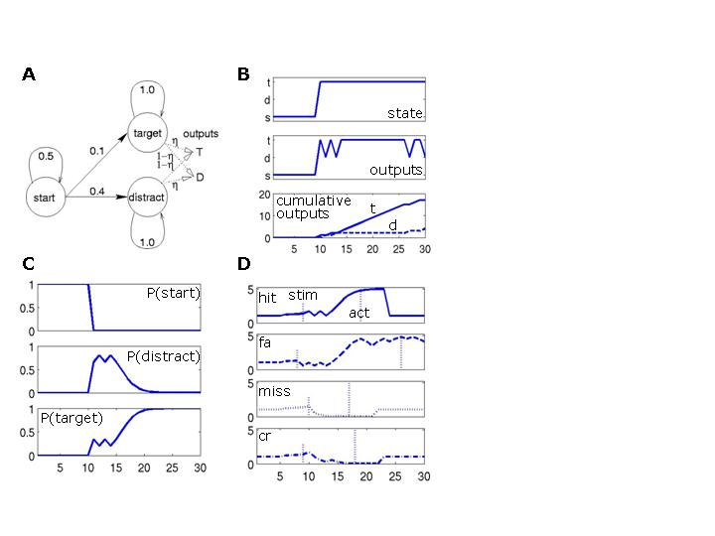
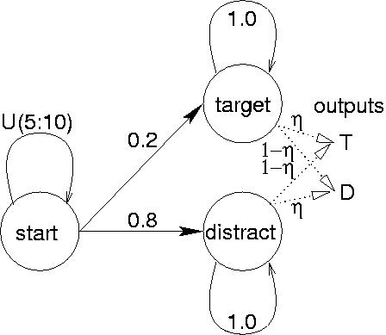
Vigilance Model
variable time in start
η controls confusability
one single run
cumulative is clearer
exact inference
effect of 80% prior

Slide 32
Phasic NE
NE reports uncertainty about current state
  state in the model, not state of the model
  divisively related to prior probability of that state
NE measured relative to default state sequence
    start → distractor
temporal aspect - start → distractor
structural aspect target versus distractor

Slide 33
Phasic NE
onset response from timing
uncertainty (SET)
growth as P(target)/0.2 rises
act when P(target)=0.95
stop if P(target)=0.01
arbitrarily set NE=0 after
5 timesteps
(small prob of reflexive action)

Slide 34
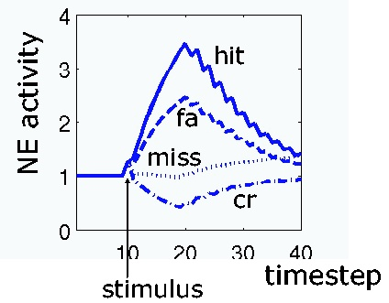
Four Types of Trial
19%
1.5%
1%
77%
fall is rather arbitrary

Slide 35
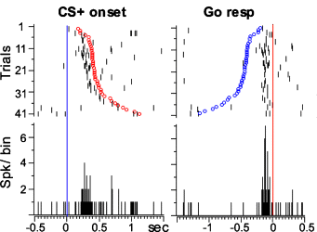
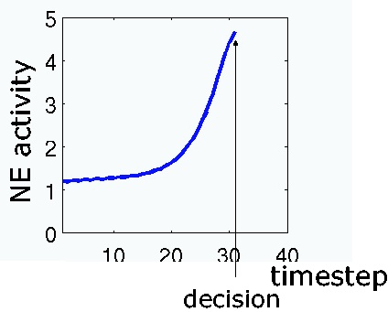
Response Locking
slightly flatters the model – since no further
response variability

Slide 36
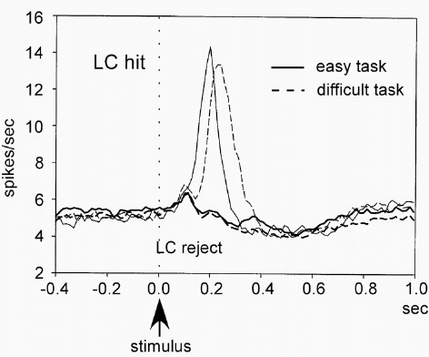
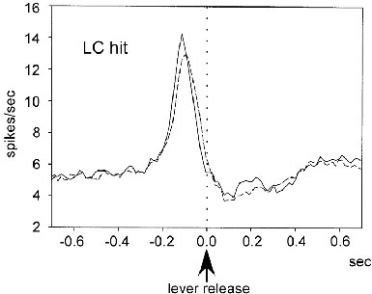
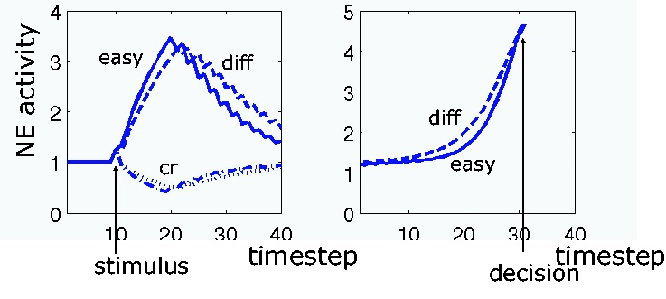
Task Difficulty
set η=0.65 rather than 0.675
information accumulates over a longer period
hits more affected than cr’s
timing not quite right

Slide 37
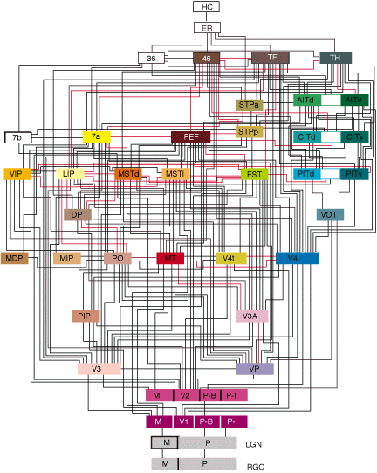
Interrupts
PFC/ACC
LC

Slide 38
Discusssion
phasic NE as unexpected state change within a model
relative to prior probability; against default
interrupts ongoing processing
tie to ADHD?
close to alerting – but not necessarily tied to behavioral output (onset rise)
close to behavioural switching – but not DA
phasic ACh: aspects of known variability within a state?

Slide 39
Computational Neuromodulation
general: excitability, signal/noise ratios
specific: prediction errors, uncertainty signals

Slide 40
Computational Neuromodulation
∆ weight α (learning rate) x (error) x (stimulus)
precise, falsifiable, roles for DA/5HT; NE/ACh
only part of the story:
  5HT: median raphe
  ACh: TANs, septum, etc
  huge diversity of receptors; regional specificity
psychological disagreement about many facets:
  attention: over-extended
  reward: reinforcement, liking, wanting, etc
interesting role for imaging:
  it didn’t have to be that simple!

