Slide 1
Learning
computation
making predictions
choosing actions
acquiring episodes
statistics
algorithm
gradient ascent (eg of the likelihood)
correlation
Kalman filtering
implementation
flavours of Hebbian synaptic plasticity
neuromodulation

Slide 2
Forms of Learning
always inputs, plus:
supervised learning
outputs provided
reinforcement learning
evaluative information, but not exact output
unsupervised learning
no outputs – look for statistical structure
not so cleanly distinguished – eg prediction

Slide 3
Preface
adaptation = short-term learning?
structure vs parameter learning?
development vs adult learning
systems:
hippocampus – multiple sub-areas
neocortex – layer and area differences
cerebellum – LTD is the norm

Slide 4
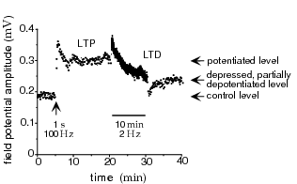
Neural Rules

Slide 5
Hebb
famously suggested: “if cell A consistently contributes to the activity of cell B, then the synapse from A to B should be strengthened”
strong element of causality
what about weakening (LTD)?
multiple timescales – STP to protein synthesis
multiple biochemical mechanisms

Slide 6
Stability and Competition
Hebbian learning involves positive feedback
LTD: usually not enough -- covariance versus correlation
saturation: prevent synaptic weights from getting too big (or too small) - triviality beckons
competition: spike-time dependent learning rules
normalization over pre-synaptic or post-synaptic arbors:
subtractive: decrease all synapses by the same amount whether large or small
divisive: decrease large synapses by more than small synapses

Slide 7
Preamble
linear firing rate model
assume that τ_{r} is small compared with learning rate, so
then have
supervised rules need targets for v

Slide 8
The Basic Hebb Rule
averaged over input statistics gives
is the input correlation matrix
positive feedback instability:
also discretised version

Slide 9
Covariance Rule
what about LTD?
if or then
with covariance
still unstable:
averages to the (+ve) covariance of v

Slide 10
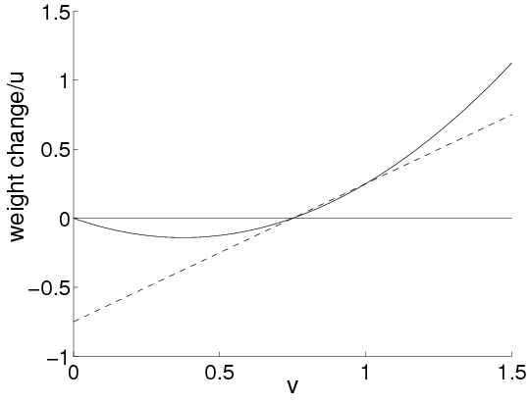
BCM Rule
odd to have LTD with v=0; u=0
evidence for
competitive, if slides to match a high power of v

Slide 11
Subtractive Normalization
could normalize or
for subtractive normalization of
with dynamic subtraction, since
highly competitive: all bar one weight

Slide 12
The Oja Rule
a multiplicative way to ensure is appropriate
gives
so
dynamic normalization: could enforce always

Slide 13
Timing-based Rules

Slide 14
Timing-based Rules
window of 50ms
gets Hebbian causality right
(original) rate-based description
but need spikes if measurable impact
overall integral: LTP + LTD
partially self-stabilizing

Slide 15
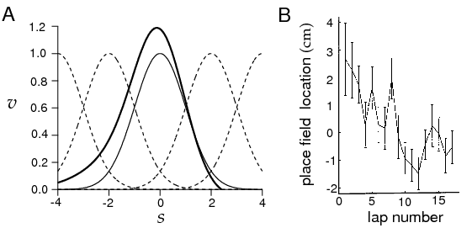
Rate-based Correlations
for place cells (Blum & Abbott)

Slide 16
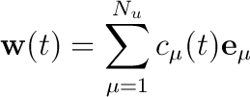
Single Postsynaptic Neuron
basic Hebb rule:
use eigendecomp of
symmetric and positive semi-definite:
complete set of real orthonormal evecs
with non-negative eigenvalues
whose growth is decoupled
so

Slide 17
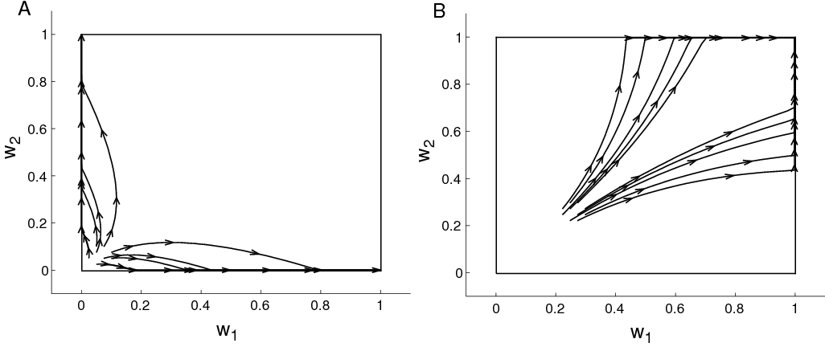
Constraints
Oja makes
saturation can disturb
subtractive constraint
if :
its growth is stunted

Slide 18
Translation Invariance
particularly important case for development has
write

Slide 19
PCA
what is the significance of
optimal linear reconstr, min:
linear infomax:

Slide 20
Linear Reconstruction
is quadratic in w with a min at
making
look for evec soln
has so PCA!

Slide 21
Infomax (Linsker)
need noise in v to be well-defined
for a Gaussian:
if then
and we have to max:
same problem as before, implies
if non-Gaussian, only maximizing an upper bound on

Slide 22
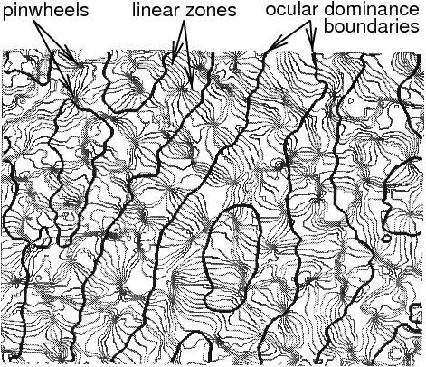
Statistics and Development

Slide 23
Barrel Cortex

Slide 24
Modelling Development
two strategies:
mathematical: understand the selectivities and the patterns of selectivities from the perspective of pattern formation and Hebb
reaction diffusion equations
symmetry breaking
computational: understand the selectivities and their adaptation from basic principles of processing:
extraction; representation of statistical structure
patterns from other principles (minimal wiring)

Slide 25
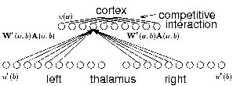
Ocular Dominance
retina-thalamus-cortex
OD develops around eye-opening
interaction with refinement of topography
interaction with orientation
interaction with ipsi/contra-innervation
effect of manipulations to input

Slide 26
OD
one input from each eye:
correlation matrix:
write
but
implies and so one eye dominates

Slide 27
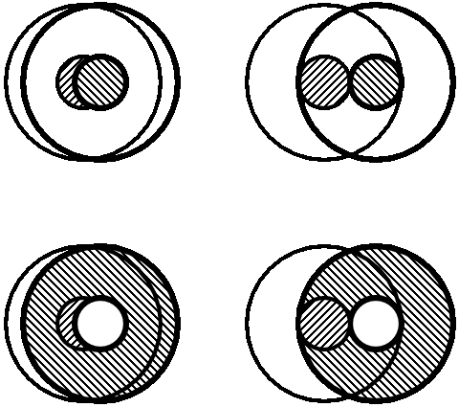
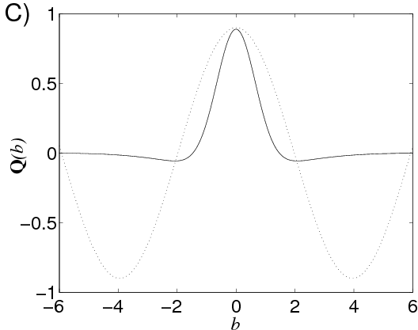
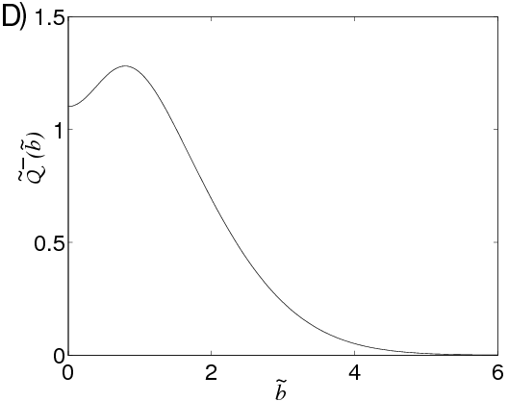
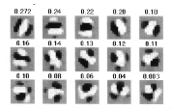
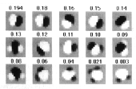
Orientation Selectivity
same model, but correlations from ON/OFF cells:
dominant mode of has spatial structure
centre-surround non-linearly disfavoured

Slide 28
Multiple Output Neurons
fixed recurrence:
implies
so with Hebbian learning:
so we study the eigeneffect of K

Slide 29
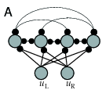
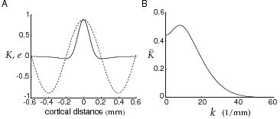
More OD
vector S;D modes:
but is clamped by normalization: so
K is Toplitz; evecs are waves; evals, from FT

Slide 30
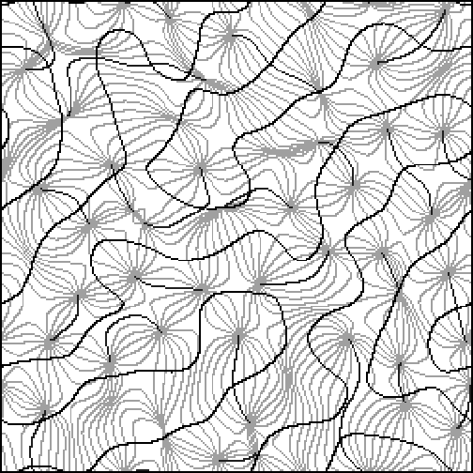
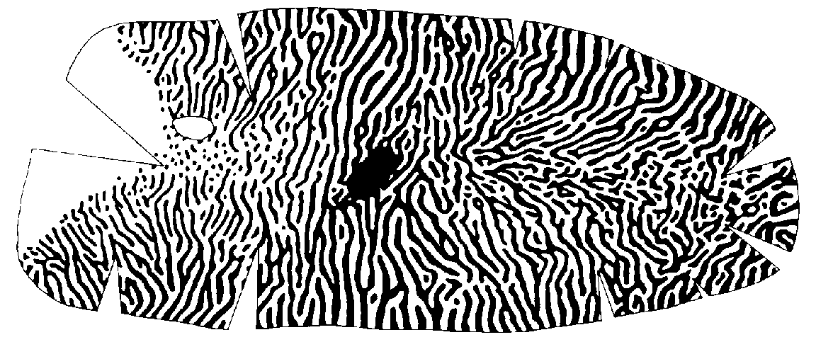
Large-Scale Results
simulation

Slide 31
Redundancy
multiple units are redundant:
Hebbian learning has all units the same
fixed output connections are inadequate
decorrelation: (indep for Gaussians)
Atick& Redlich: force ; use anti-Hebb
Foldiak: Hebbian/anti-Hebb for feedforward; recurrent connections
Sanger: explicitly subtract off previous components
Williams: subtract off predicted portion

Slide 32
Goodall
anti-Hebb learning for
if
make negative
which reduces the correlation
Goodall:
learning rule:
at
so
$$\left\langle vv\right\rangle =\left\langle K∙uu∙K\right\rangle =I$$

Slide 33
Spikes and Rates
spike trains:
change from presynaptic spike:
integrated:
three assumptions:
only rate correlations;
only rate correlations;
spike correlations too

Slide 34
Rate-based Correlations; Sloth
rate-based correlations:
sloth: where
leaves (anti-) Hebb:

Slide 35
Full Rule
pre- to post spikes: inhomogeneous PP:
can show:
for identical rates:
subtractive normalization, stabilizes at:
firing-rate
covariance
spikes
mean

Slide 36
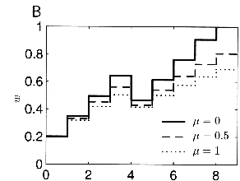
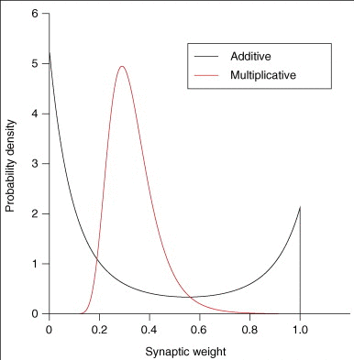
Normalization
manipulate increases/decreases

Slide 37
Supervised Learning
given pairs:
classification:
regression
tasks:
storage: learn relationships in data
generalization: infer functional relationship
two methods:
Hebbian plasticity:
error correction from mistakes

Slide 38
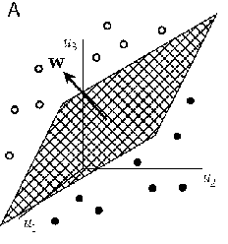
Classification & the Perceptron
classify:
Cover:
supervised Hebbian learning
works rather poorly

Slide 39
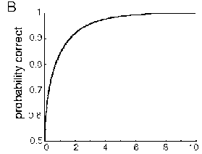
The Hebbian Perceptron
single pattern:
with noise
the sum of so Gaussian:
correct if:

Slide 40
Error Correction
Hebb ignores what the perceptron does:
if
then modify
discrete delta rule:
has:
guaranteed to converge

Slide 41
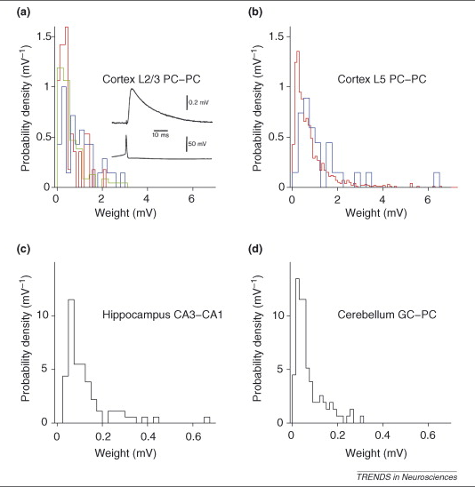
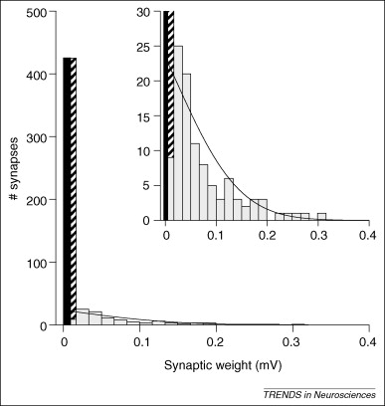
Weight Statistics (Brunel)

Slide 42
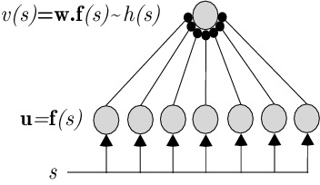
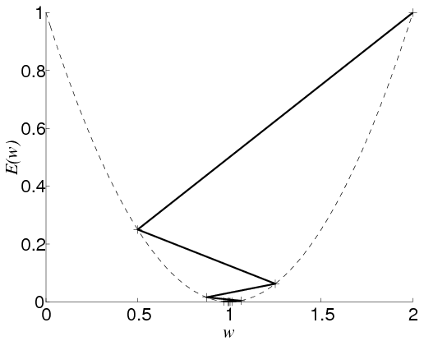
Function Approximation
basis function network
error:
min at the normal equations:
gradient descent:
since

Slide 43
Stochastic Gradient Descent
average error:
or use random input-output pairs
Hebb and anti-Hebb

Slide 44
Modelling Development
two strategies:
mathematical: understand the selectivities and the patterns of selectivities from the perspective of pattern formation and Hebb
reaction diffusion equations
symmetry breaking
computational: understand the selectivities and their adaptation from basic principles of processing:
extraction; representation of statistical structure
patterns from other principles (minimal wiring)

Slide 45
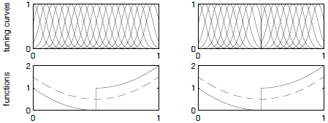
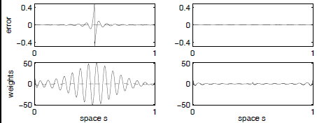
What Makes a Good Representation?

Slide 46
Tasks are the Exception
desiderata:
smoothness
invariance (face cells; place cells)
computational uniformity (wavelets)
compactness/coding efficiency
priors:
sloth (objects)
independent ‘pieces’

Slide 47
Statistical Structure
misty eyed: natural inputs lie on low dimensional `manifolds’ in high-d spaces
find the manifolds
parameterize them with coordinate systems (cortical neurons)
report the coordinates for particular stimuli (inference)
hope that structure carves stimuli at natural joints for actions/decisions

Slide 48
Two Classes of Methods
density estimation: fit using a model with hidden structure or causes
implies
too stringent: texture
too lax: look-up table
FA; MoG; sparse coding; ICA; HM; HMM; directed Graphical models; energy models
or: structure search: eg projection pursuit

Slide 49
ML Density Estimation
make:
to model how u is created: vision = graphics⁻¹
key quantity is the analytical model:
here parameterizes the manifold, coords v
captures the locations for u

Slide 50
Fitting the Parameters
find:
ML density
estimation

Slide 51
Analysis Optimises Synthesis
if we can calculate or sample from
particularly handy for exponential family distrs

Slide 52
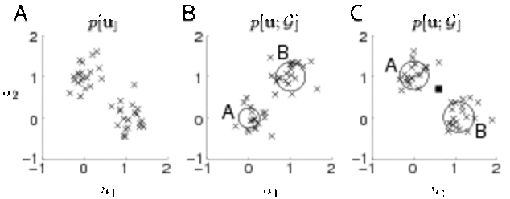
Mixture of Gaussians
E: responsibilities
M: synthesis

Slide 53
Free Energy
what if you can only approximate
Jensen’s inequality:
with equality iff
so min wrt
EM is coordinatewise descent in

Slide 54
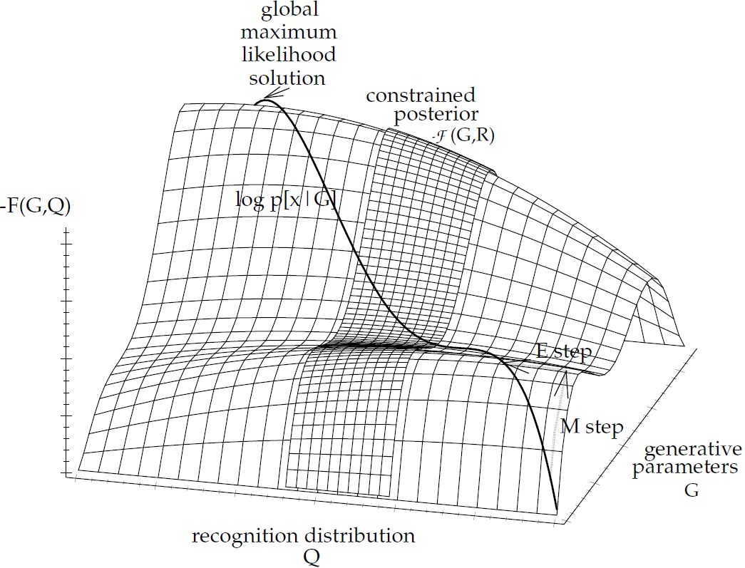
Graphically

Slide 55
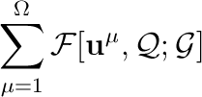
Unsupervised Learning
stochastic gradient descent on
with
exact: mixture of Gaussians, factor analysis
iterative approximation: mean field BM, sparse coding (O&F), infomax ICA
learned: Helmholtz machine
stochastic: wake-sleep

Slide 56
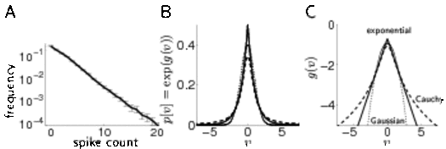
Nonlinear FA
sparsity prior
exact analysis is intractable:

Slide 57
Recognition
non-convex (not unique)
two architectures:

Slide 58
Learning the Generative Model
normalization constraints so
prior of independence and sparsity: PCA gives non-localized patches
posterior over v is a distributed population code (with bowtie dependencies)
really need hierarchical version – so prior might interfere
normalization to stop

Slide 59
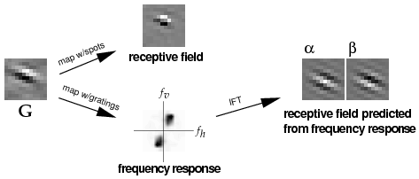
Olshausen & Field

Slide 60
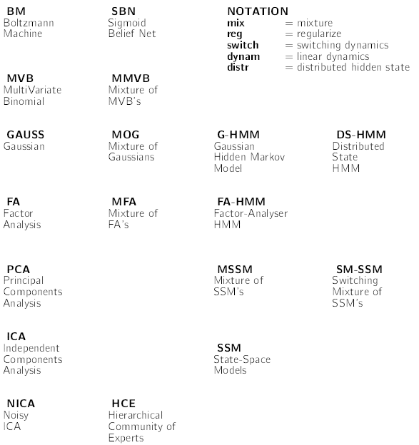
Generative Models

