Slide 1
Learning
computation
  making predictions
  choosing actions
  acquiring episodes
  statistics
algorithm
  gradient ascent (eg of the likelihood)
  correlation
  Kalman filtering
implementation
  flavours of Hebbian synaptic plasticity
  neuromodulation

Slide 2
Forms of Learning
always inputs, plus:
supervised learning
  outputs provided
reinforcement learning
  evaluative information, but not exact output
unsupervised learning
  no outputs – look for statistical structure
not so cleanly distinguished – eg prediction

Slide 3
Preface
adaptation = short-term learning?
adjust learning rate:
  uncertainty from initial ignorance/rate of change?
structure vs parameter learning?
development vs adult learning
systems:
  hippocampus – multiple sub-areas
  neocortex – layer and area differences
  cerebellum – LTD is the norm

Slide 4
Hebb
famously suggested: “if cell A consistently contributes to the activity of cell B, then the synapse from A to B should be strengthened”
strong element of causality
what about weakening (LTD)?
multiple timescales – STP to protein synthesis
multiple biochemical mechanisms

Slide 5
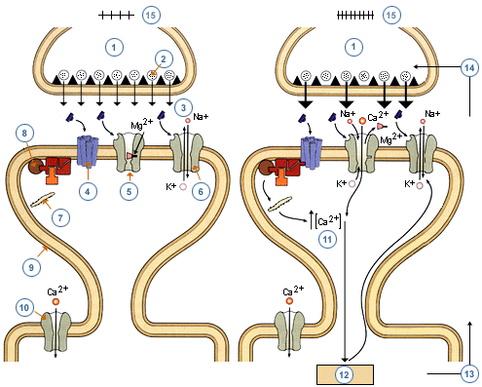
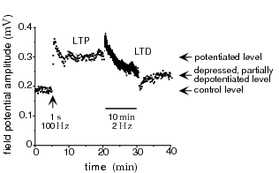
Neural Rules

Slide 6
Stability and Competition
Hebbian learning involves positive feedback
  LTD: usually not enough -- covariance versus correlation
  saturation: prevent synaptic weights from getting too big (or too small) - triviality beckons
  competition: spike-time dependent learning rules
  normalization over pre-synaptic or post-synaptic arbors:
    subtractive: decrease all synapses by the same amount whether large or small
    divisive: decrease large synapses by more than small synapses

Slide 7


Preamble
linear firing rate model
assume that τ_{r} is small compared with learning rate, so
then have
supervised rules need targets for v

Slide 8




The Basic Hebb Rule
averaged over input statistics gives
is the input correlation matrix
positive feedback instability:
also discretised version

Slide 9






Covariance Rule
what about LTD?
if or then
with covariance
still unstable:
averages to the (+ve) covariance of v

Slide 10
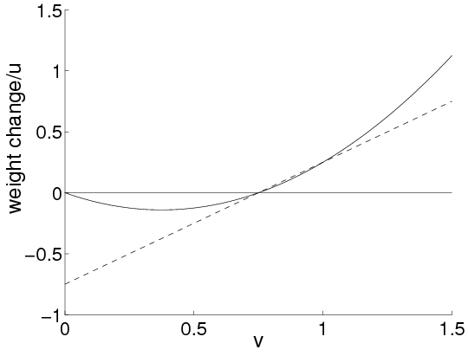


BCM Rule
odd to have LTD with v=0; u=0
evidence for
competitive, if slides to match a high power of v

Slide 11




Subtractive Normalization
could normalize or
for subtractive normalization of
with dynamic subtraction, since
highly competitive: all bar one weight

Slide 12



The Oja Rule
a multiplicative way to ensure is appropriate
gives
so
dynamic normalization: could enforce always

Slide 13
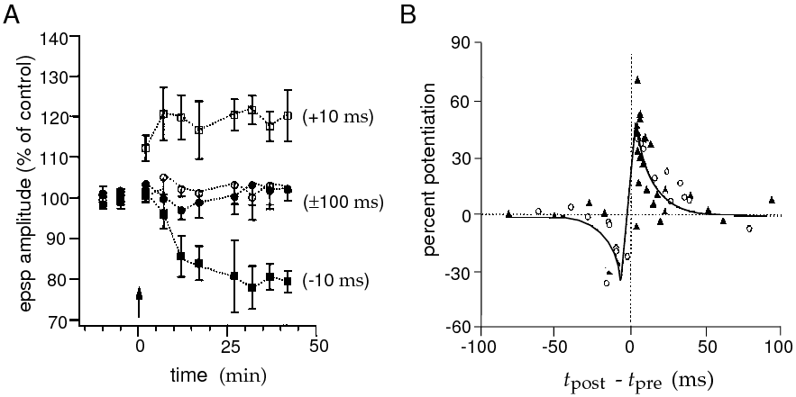
Timing-based Rules

Slide 14
Timing-based Rules
window of 50ms
gets Hebbian causality right
(original) rate-based description
but need spikes if measurable impact
overall integral: LTP + LTD
partially self-stabilizing

Slide 15


Spikes and Rates
spike trains:
change from presynaptic spike:
integrated:
three assumptions:
  only rate correlations;
  only rate correlations;
  spike correlations too

Slide 16



Rate-based Correlations; Sloth
rate-based correlations:
sloth: where
leaves (anti-) Hebb:

Slide 17

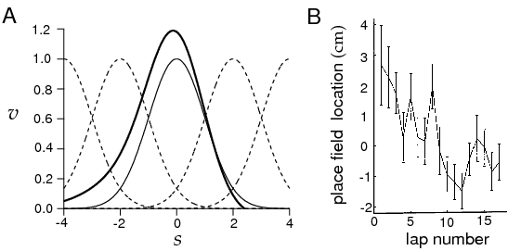
Rate-based Correlations
can’t simplify

Slide 18





Full Rule
pre- to post spikes: inhomogeneous PP:
can show:
for identical rates:
subtractive normalization, stabilizes at:
firing-rate
covariance
spikes
mean

Slide 19


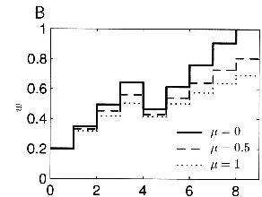
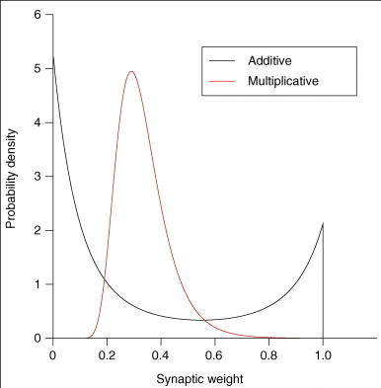
Normalization
manipulate increases/decreases

Slide 20

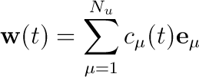


Single Postsynaptic Neuron
basic Hebb rule:
use eigendecomp of
symmetric and positive semi-definite:
  complete set of real orthonormal evecs
  with non-negative eigenvalues
  whose growth is decoupled
  so

Slide 21
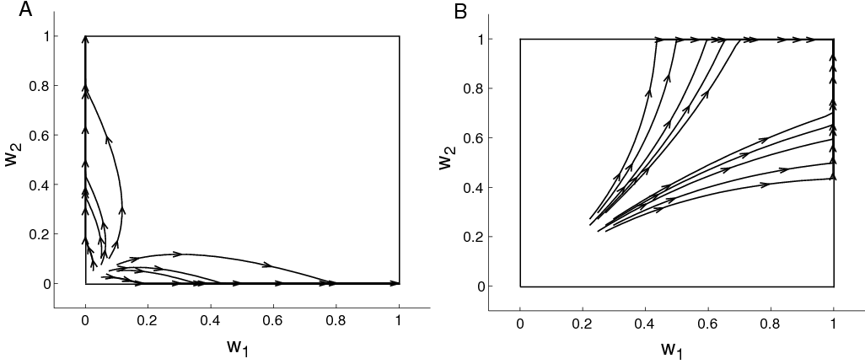



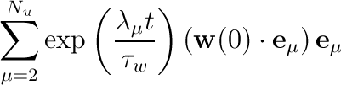

Constraints
Oja makes
saturation can disturb
subtractive constraint
if :
  its growth is stunted

Slide 22
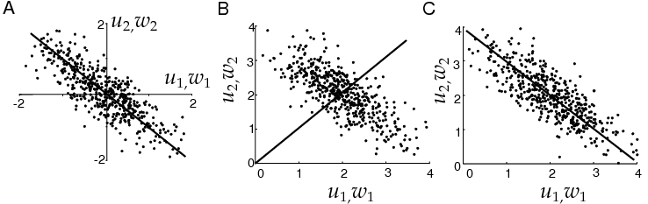


PCA
what is the significance of
optimal linear reconstr, min:
linear infomax:

Slide 23




Linear Reconstruction
is quadratic in w with a min at
making
look for evec soln
has so PCA!

Slide 24




Infomax (Linsker)
need noise in v to be well-defined
for a Gaussian:
if then
and we have to max:
same problem as before, implies
if non-Gaussian, only maximizing an upper bound on

Slide 25

Translation Invariance
particularly important case for development has
write

Slide 26
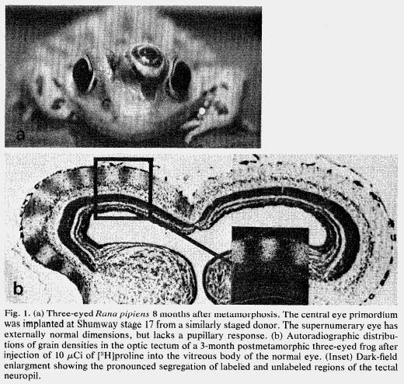
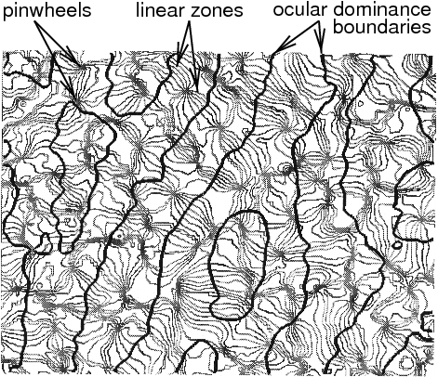
Statistics and Development

Slide 27
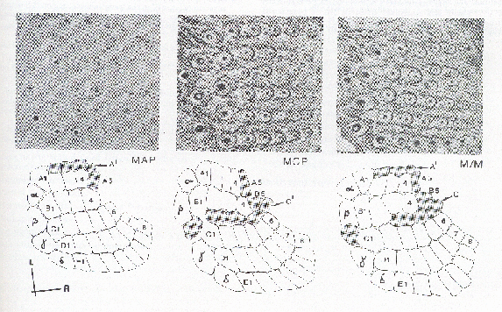
Barrel Cortex

Slide 28
Modelling Development
two strategies:
  mathematical: understand the selectivities and the patterns of selectivities from the perspective of pattern formation and Hebb
    reaction diffusion equations
    symmetry breaking
  computational: understand the selectivities and their adaptation from basic principles of processing:
    extraction; representation of statistical structure
    patterns from other principles (minimal wiring)

Slide 29
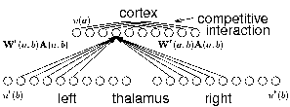

Ocular Dominance
retina-thalamus-cortex
OD develops around eye-opening
interaction with refinement of topography
interaction with orientation
interaction with ipsi/contra-innervation
effect of manipulations to input

Slide 30



OD
one input from each eye:
correlation matrix:
write
but
implies and so one eye dominates

Slide 31
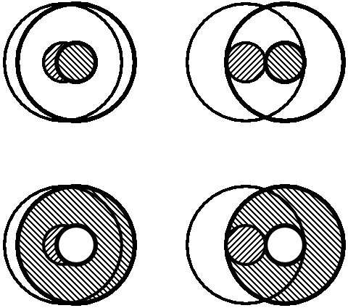
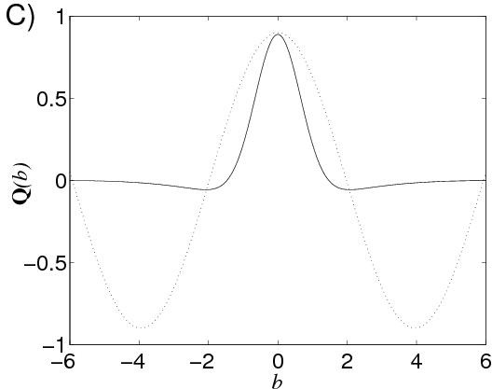
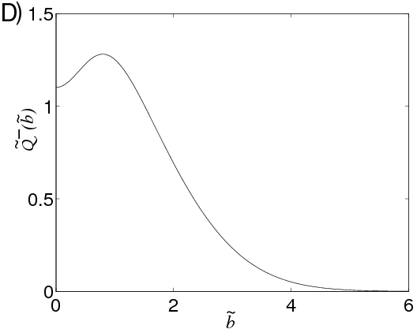
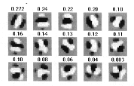
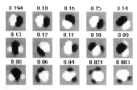
Orientation Selectivity
same model, but correlations from ON/OFF cells:
dominant mode of has spatial structure
centre-surround non-linearly disfavoured

Slide 32




Multiple Output Neurons
fixed recurrence:
implies
so with Hebbian learning:
so we study the eigeneffect of K

Slide 33
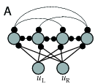
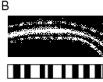
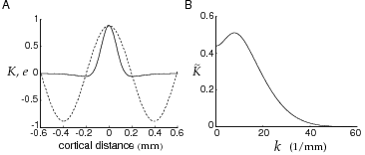
More OD
vector S;D modes:
but is clamped by normalization: so
K is Toplitz; evecs are waves; evals, from FT

Slide 34
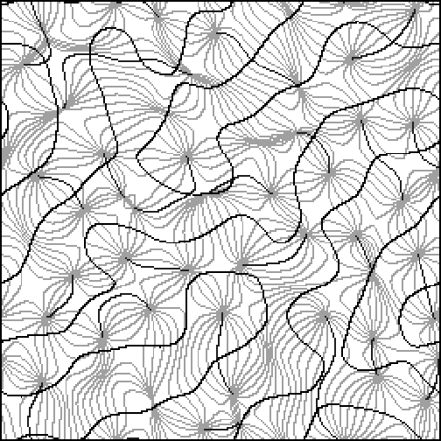
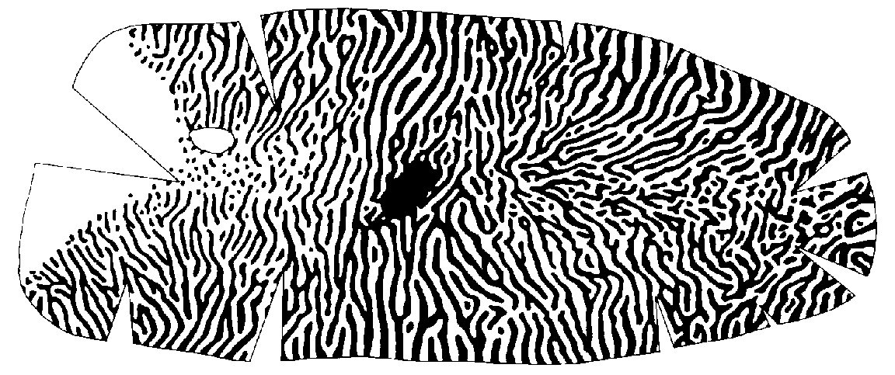
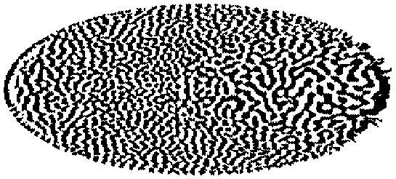
Large-Scale Results
simulation

Slide 35

Redundancy
multiple units are redundant:
  Hebbian learning has all units the same
  fixed output connections are inadequate
decorrelation: (indep for Gaussians)
  Atick& Redlich: force ; use anti-Hebb
  Foldiak: Hebbian/anti-Hebb for feedforward; recurrent connections
  Sanger: explicitly subtract off previous components
  Williams: subtract off predicted portion

Slide 36




Goodall
anti-Hebb learning for
  if
  make negative
  which reduces the correlation
Goodall:
  learning rule:
  at
  so

Slide 37


Supervised Learning
given pairs:
  classification:
  regression
tasks:
  storage: learn relationships in data
  generalization: infer functional relationship
two methods:
  Hebbian plasticity:
  error correction from mistakes

Slide 38
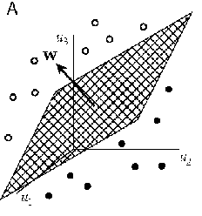


Classification & the Perceptron
classify:
Cover:
supervised Hebbian learning
works rather poorly

Slide 39


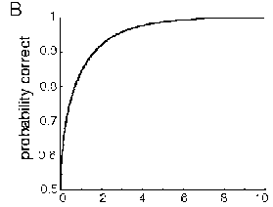

The Hebbian Perceptron
single pattern:
with noise
the sum of so Gaussian:
correct if:

Slide 40

Error Correction
Hebb ignores what the perceptron does:
  if
  then modify
discrete delta rule:
  has:
  guaranteed to converge

Slide 41
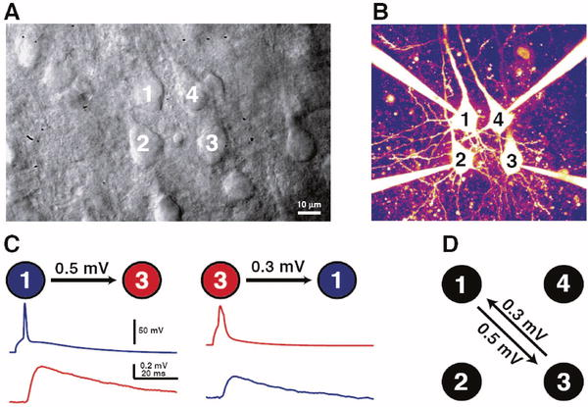
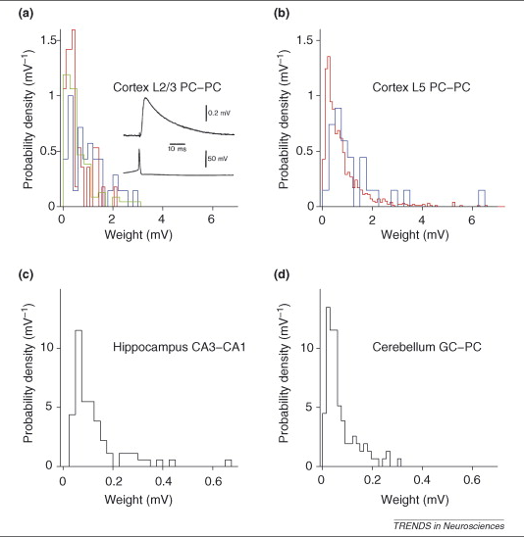
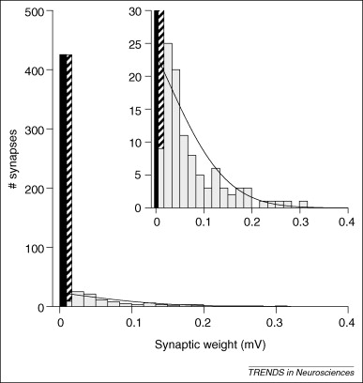
Weight Statistics (Brunel)

Slide 42
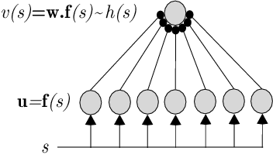

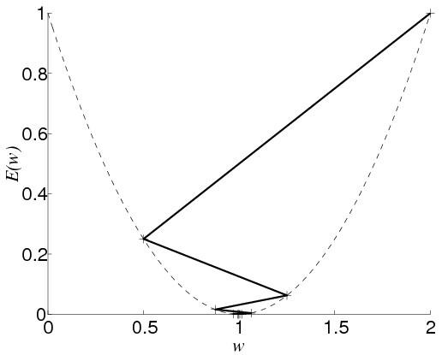

Function Approximation
basis function network
error:
min at the normal equations:
gradient descent:
since

Slide 43


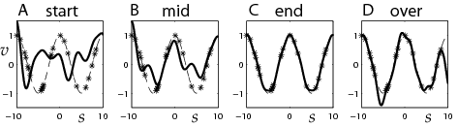
Stochastic Gradient Descent
average error:
or use random input-output pairs
Hebb and anti-Hebb

Slide 44
Modelling Development
two strategies:
  mathematical: understand the selectivities and the patterns of selectivities from the perspective of pattern formation and Hebb
    reaction diffusion equations
    symmetry breaking
  computational: understand the selectivities and their adaptation from basic principles of processing:
    extraction; representation of statistical structure
    patterns from other principles (minimal wiring)

Slide 45
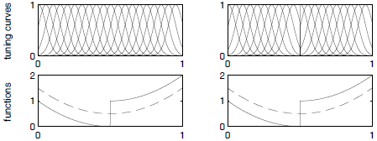
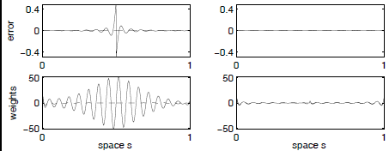
What Makes a Good Representation?

Slide 46
Tasks are the Exception
desiderata:
  smoothness
  invariance (face cells; place cells)
  computational uniformity (wavelets)
  compactness/coding efficiency
priors:
  sloth (objects)
  independent ‘pieces’

Slide 47
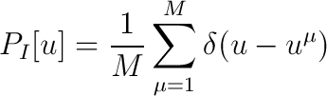
Statistical Structure
misty eyed: natural inputs lie on low dimensional `manifolds’ in high-d spaces
  find the manifolds
  parameterize them with coordinate systems (cortical neurons)
  report the coordinates for particular stimuli (inference)
  hope that structure carves stimuli at natural joints for actions/decisions

Slide 48



Two Classes of Methods
density estimation: fit using a model with hidden structure or causes
implies
  too stringent: texture
  too lax: look-up table
FA; MoG; sparse coding; ICA; HM; HMM; directed Graphical models; energy models
or: structure search: eg projection pursuit

Slide 49



ML Density Estimation
make:
to model how u is created: vision = graphics⁻¹
key quantity is the analytical model:
here parameterizes the manifold, coords v
captures the locations for u

Slide 50




Fitting the Parameters
find:
ML density
estimation

Slide 51




Analysis Optimises Synthesis
if we can calculate or sample from
particularly handy for exponential family distrs

Slide 52
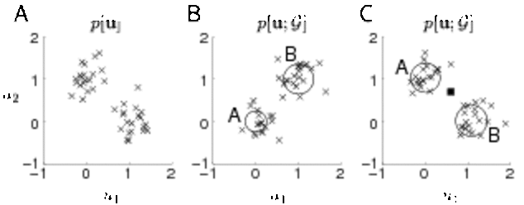


Mixture of Gaussians
E: responsibilities
M: synthesis

Slide 53




Free Energy
what if you can only approximate
Jensen’s inequality:
with equality iff
so min wrt
EM is coordinatewise descent in

Slide 54
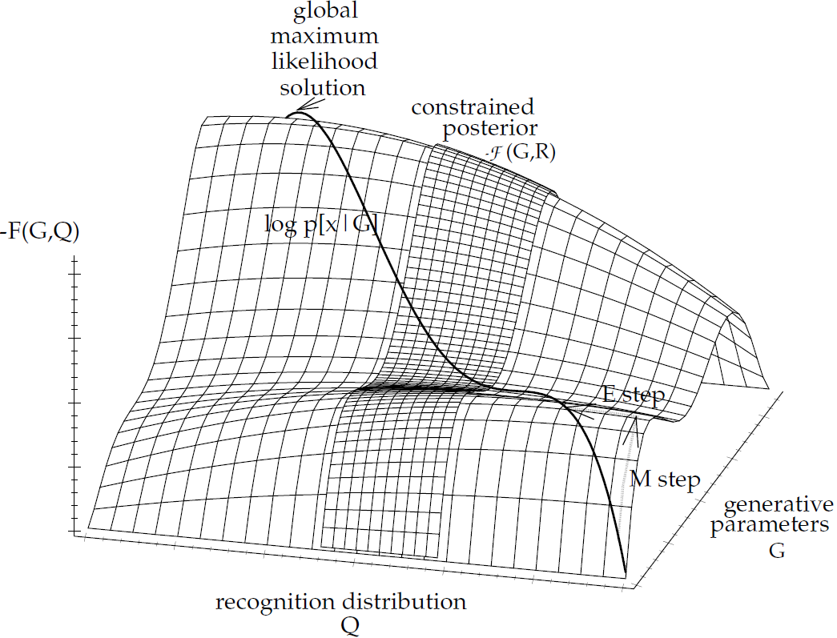
Graphically

Slide 55
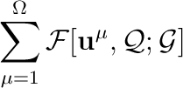


Unsupervised Learning
stochastic gradient descent on
with
  exact: mixture of Gaussians, factor analysis
  iterative approximation: mean field BM, sparse coding (O&F), infomax ICA
  learned: Helmholtz machine
  stochastic: wake-sleep

Slide 56

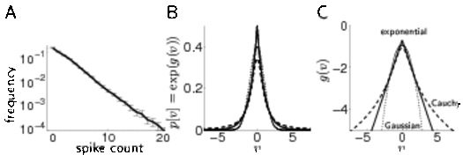


Nonlinear FA
sparsity prior
exact analysis is intractable:

Slide 57

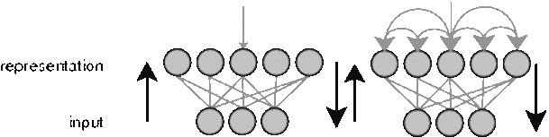
Recognition
non-convex (not unique)
two architectures:

Slide 58

Learning the Generative Model
normalization constraints so
prior of independence and sparsity: PCA gives non-localized patches
posterior over v is a distributed population code (with bowtie dependencies)
really need hierarchical version – so prior might interfere
normalization to stop

Slide 59
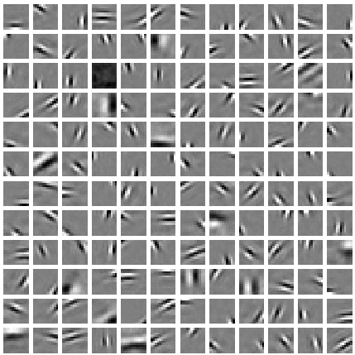
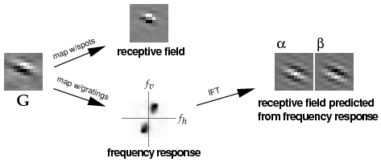
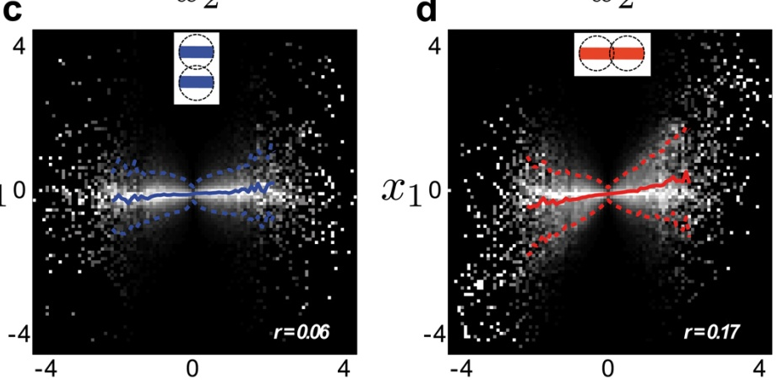
Olshausen & Field

Slide 60
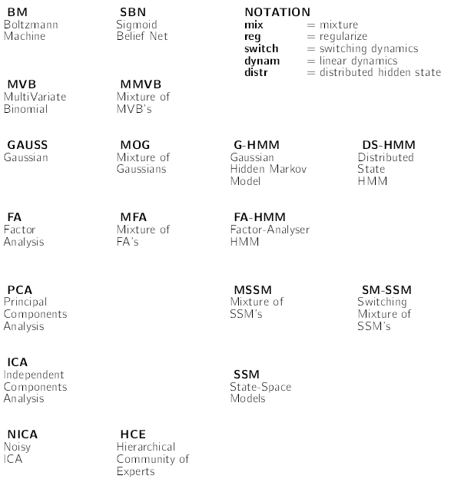
Generative Models

