Slide 1
Global plan
Reinforcement learning I:
  prediction
  classical conditioning
  dopamine
Reinforcement learning II:
  dynamic programming; action selection
  Pavlovian misbehaviour
  vigor
Chapter 9 of Theoretical Neuroscience
(thanks to Yael Niv)

Slide 2
Conditioning
prediction: of important events
control: in the light of those predictions
Ethology
  optimality
  appropriateness
Psychology
  classical/operant
  conditioning
Computation
  dynamic progr.
  Kalman filtering
Algorithm
  TD/delta rules
  simple weights
Neurobiology
neuromodulators; amygdala; OFC
nucleus accumbens; dorsal striatum

Slide 3
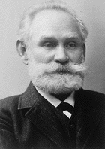
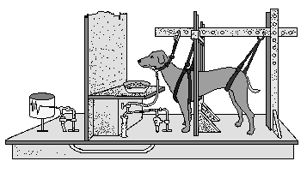


Animals learn predictions
Ivan Pavlov
= Unconditioned Stimulus
= Conditioned Stimulus
= Unconditioned Response (reflex);
Conditioned Response (reflex)

Slide 4
Animals learn predictions
Ivan Pavlov
very general across species, stimuli, behaviors

Slide 5
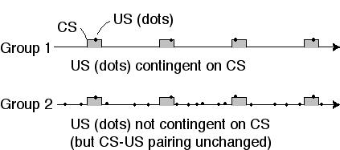
But do they really?
1. Rescorla’s control
temporal contiguity is not enough - need contingency
P(food | light) > P(food | no light)

Slide 6
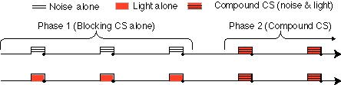
But do they really?
2. Kamin’s blocking
contingency is not enough either… need surprise

Slide 7
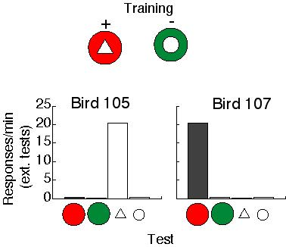
But do they really?
3. Reynold’s overshadowing
seems like stimuli compete for learning

Slide 8
Theories of prediction learning: Goals
Explain how the CS acquires “value”
When (under what conditions) does this happen?
Basic phenomena: gradual learning and extinction curves
More elaborate behavioral phenomena
(Neural data)
P.S. Why are we looking at old-fashioned Pavlovian conditioning?
→ it is the perfect uncontaminated test case for examining prediction learning on its own

Slide 9
Rescorla & Wagner (1972)
error-driven learning: change in value is proportional to the difference
between actual and predicted outcome
Assumptions:
learning is driven by error (formalizes notion of surprise)
summations of predictors is linear
A simple model - but very powerful!
  explains: gradual acquisition & extinction, blocking, overshadowing, conditioned inhibition, and more..
  predicted overexpectation
note: US as “special stimulus”

Slide 10
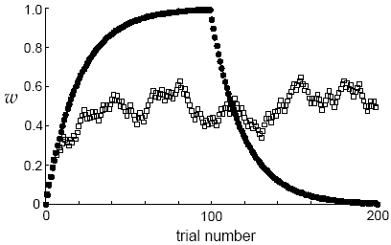
Rescorla-Wagner learning
how does this explain acquisition and extinction?
what would V look like with 50% reinforcement? eg. 1 1 0 1 0 0 1 1 1 0 0
  what would V be on average after learning?
  what would the error term be on average after learning?

Slide 11
Rescorla-Wagner learning
how is the prediction on trial (t) influenced by rewards at times (t-1), (t-2), …?
the R-W rule estimates expected reward using a weighted average of past rewards
recent rewards weigh more heavily
why is this sensible?
learning rate = forgetting rate!

Slide 12
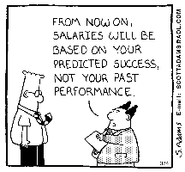
Summary so far
Predictions are useful for behavior
Animals (and people) learn predictions (Pavlovian conditioning = prediction learning)
Prediction learning can be explained by an error-correcting learning rule (Rescorla-Wagner): predictions are learned from experiencing the world and comparing predictions to reality
Marr:

Slide 13

But: second order conditioning
phase 1:
phase 2:
?
test:
what do you think will happen?
what would Rescorla-Wagner learning predict here?
animals learn that a predictor of a predictor is also a predictor of reward!
⇒ not interested solely in predicting immediate reward

Slide 14
lets start over: this time from the top
Marr’s 3 levels:
The problem: optimal prediction of future reward
what’s the obvious prediction error?
what’s the obvious problem with this?
want to predict expected sum of future reward in a trial/episode
(N.B. here t indexes time within a trial)

Slide 15
lets start over: this time from the top
Marr’s 3 levels:
The problem: optimal prediction of future reward
want to predict expected sum of future reward in a trial/episode
Bellman eqn
for policy
evaluation

Slide 16
lets start over: this time from the top
Marr’s 3 levels:
The problem: optimal prediction of future reward
The algorithm: temporal difference learning
temporal difference prediction error δ_{t}
compare to:

Slide 17
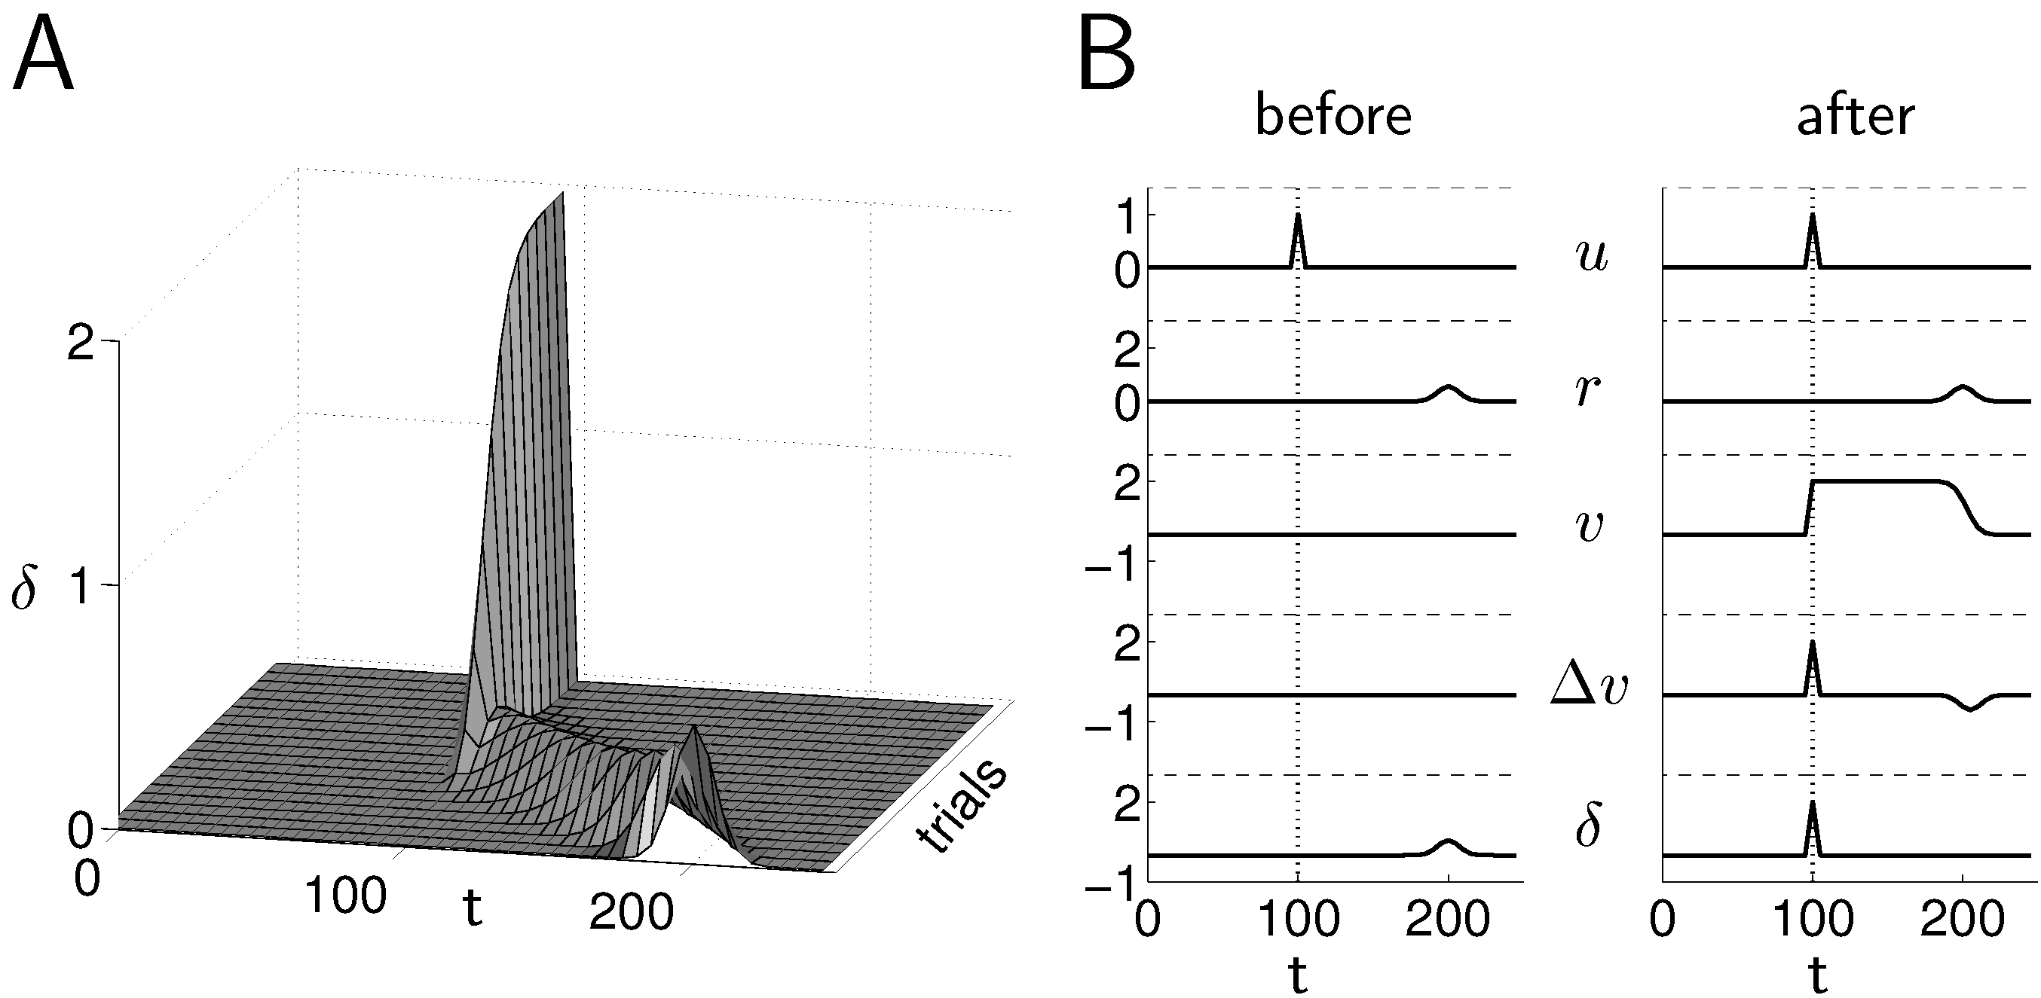
prediction error
TD error
L
R
V_{t}
R
no prediction
prediction, reward
prediction, no reward

Slide 18
Summary so far
Temporal difference learning versus Rescorla-Wagner
derived from first principles about the future
explains everything that R-W does, and more (eg. 2nd order conditioning)
a generalization of R-W to real time

Slide 19
Back to Marr’s 3 levels
The problem: optimal prediction of future reward
The algorithm: temporal difference learning
Neural implementation: does the brain use TD learning?

Slide 20
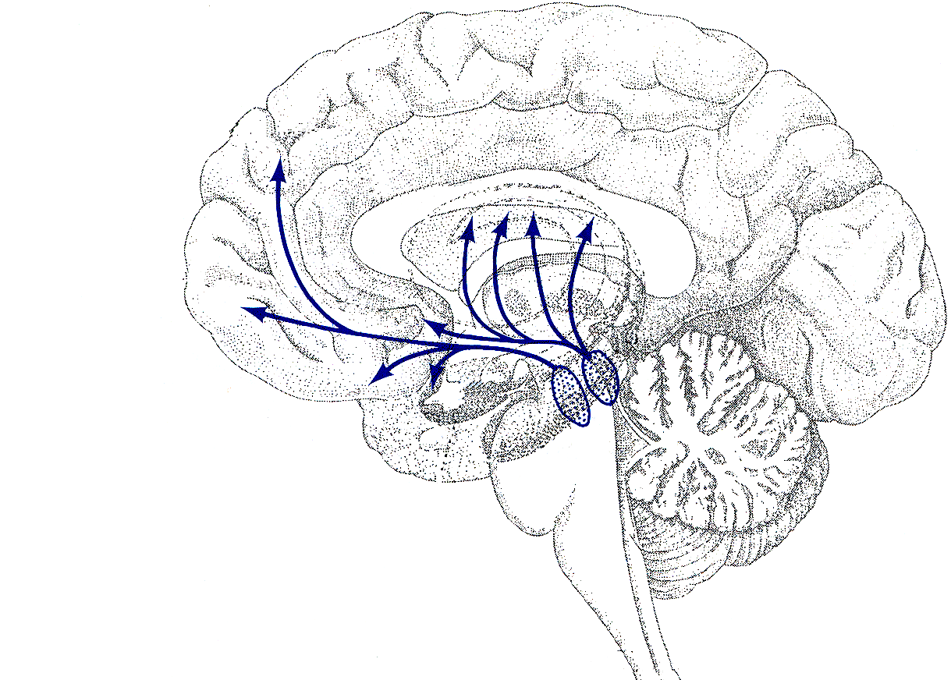
Dopamine
Parkinson’s Disease
→ Motor control + initiation?
Intracranial self-stimulation;
Drug addiction;
Natural rewards
→ Reward pathway?
→ Learning?
Also involved in:
Working memory
Novel situations
ADHD
Schizophrenia
…
Dorsal Striatum (Caudate,
Dorsal Striatum (Caudate,
Dorsal Striatum (Caudate,
Dorsal Striatum (Caudate,
Putamen
Putamen
Putamen
Putamen
)
)
)
)
Prefrontal Cortex
Prefrontal Cortex
Prefrontal Cortex
Prefrontal Cortex
Nucleus
Nucleus
Nucleus
Nucleus
Accumbens
Accumbens
Accumbens
Accumbens
(Ventral Striatum)
(Ventral Striatum)
(Ventral Striatum)
(Ventral Striatum)
Amygdala
Amygdala
Amygdala
Amygdala
Substantia
Substantia
Substantia
Substantia
Nigra
Nigra
Nigra
Ventral
Nigra
Ventral
Ventral
Ventral
Tegmental
Tegmental
Tegmental
Tegmental
Area
Area
Area
Area

Slide 21
Role of dopamine: Many hypotheses
Anhedonia hypothesis
Prediction error (learning, action selection)
Salience/attention
Incentive salience
Uncertainty
Cost/benefit computation
Energizing/motivating behavior

Slide 22
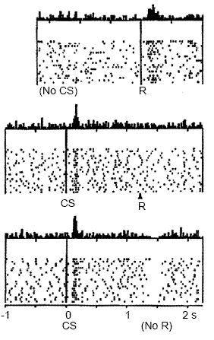
dopamine and prediction error
TD error
L
R
V_{t}
R
no prediction
prediction, reward
prediction, no reward

Slide 23
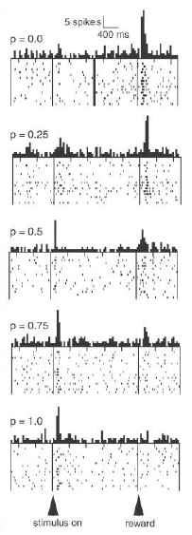
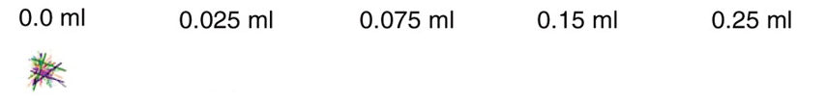
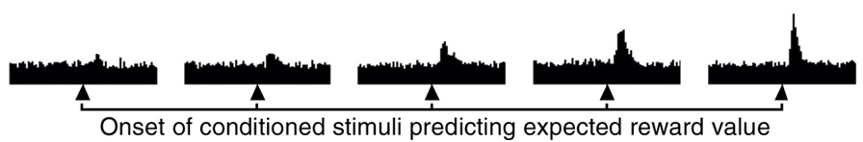

prediction error hypothesis of dopamine
The idea: Dopamine encodes a reward prediction error
Tobler et al, 2005
Fiorillo et al, 2003

Slide 24
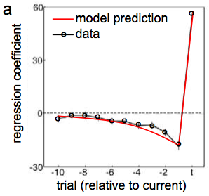
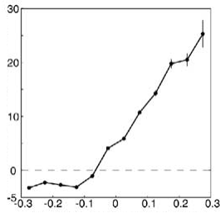
prediction error hypothesis of dopamine
measured firing rate
model prediction error
at end of trial: δ_{t} = r_{t} - V_{t} (just like R-W)
Bayer & Glimcher (2005)

Slide 25
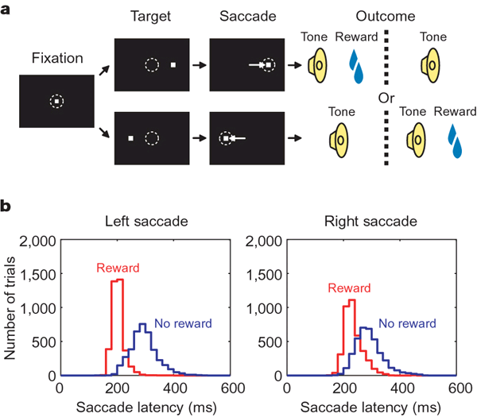
what drives the dips?
Matsumoto & Hikosaka (2007)

Slide 26
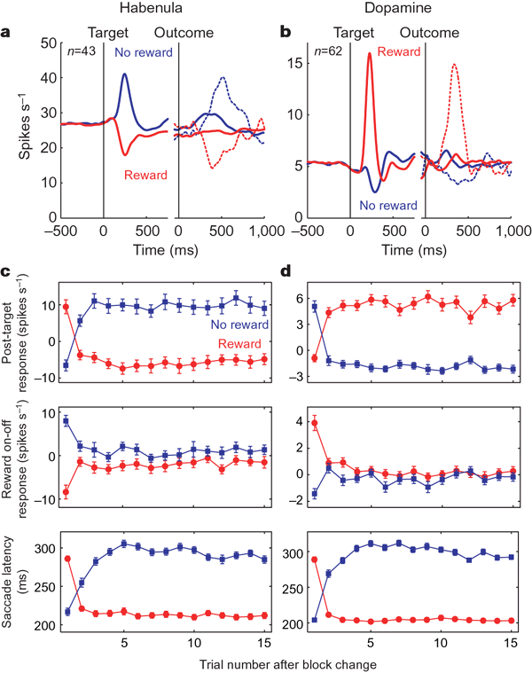
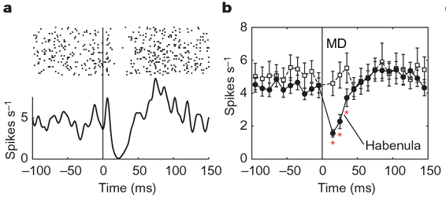
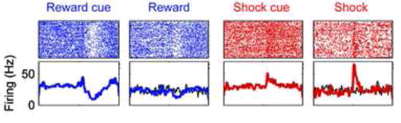
what drives the dips?
Matsumoto & Hikosaka (2007)
Jhou et al, 2009

Slide 27
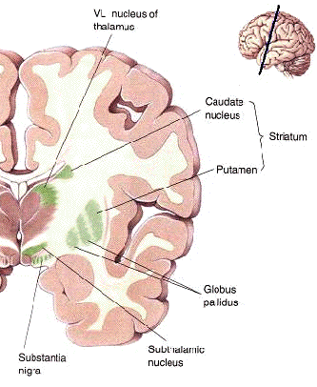
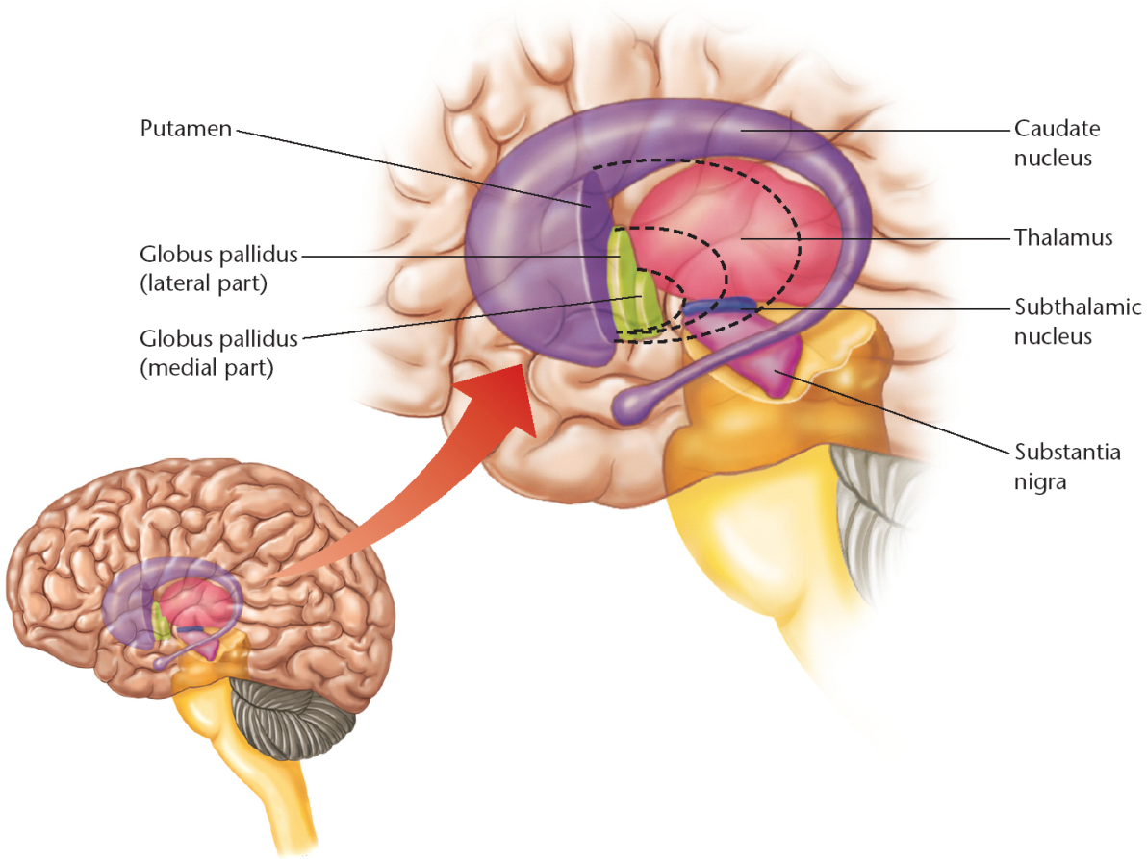
Where does dopamine project to? Basal ganglia
Several large subcortical nuclei
(unfortunate anatomical names follow structure rather than function, eg caudate + putamen + nucleus accumbens are all relatively similar pieces of striatum;
but globus pallidus & substantia nigra each comprise two different things)

Slide 28
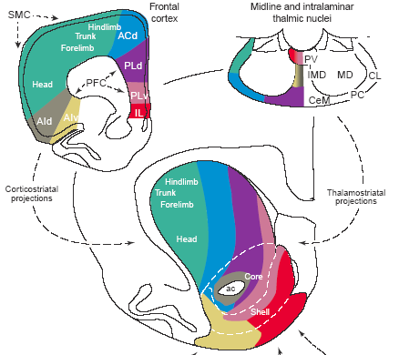
Where does dopamine project to? Basal ganglia
inputs to BG are from all over the cortex (and topographically mapped)
Voorn et al, 2004

Slide 29
Corticostriatal synapses: 3 factor learning
Cortex
Stimulus
Representation
X₁
X₂
X₃
X_{N}
adjustable
synapses
Striatum
learned values
V₁
V₂
V₃
V_{N}
PPTN, habenula etc
Prediction
Error (Dopamine)
R
δ
VTA, SNc
but also amygdala; orbitofrontal cortex; ...
Notes:
Explain 3 factor learning rule and contrast to normal Hebbian learning

Slide 30
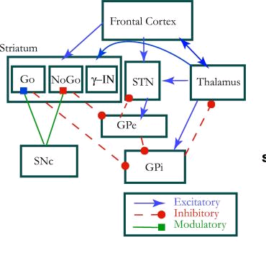
striatal complexities
Cohen & Frank, 2009

Slide 31
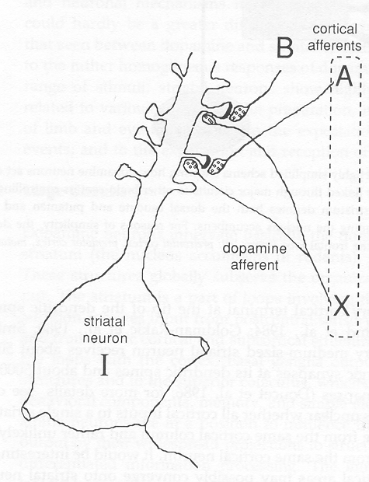
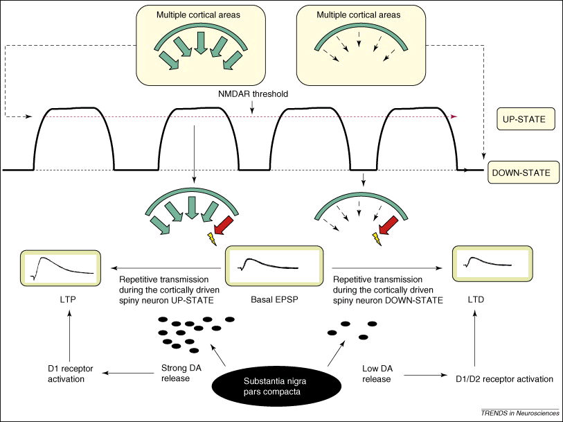
Dopamine and plasticity
Prediction errors are for learning…
Cortico-striatal synapses show complex dopamine-dependent plasticity
Wickens et al, 1996

Slide 32








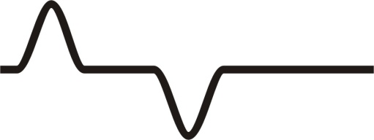

punishment prediction error
TD error
Value
Prediction error
0.8
1.0
High
Pain
0.2
0.2
Low
Pain
0.8
1.0

Slide 33
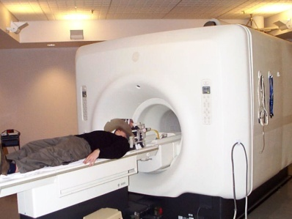
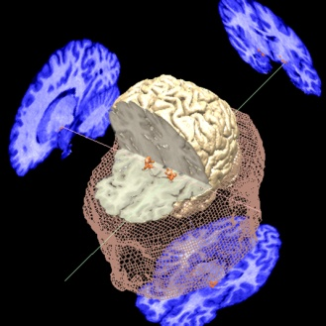
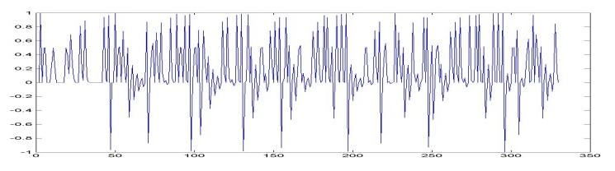
punishment prediction error
experimental sequence…..
A – B – HIGH C – D – LOW C – B – HIGH A – B – HIGH A – D – LOW C – D – LOW A – B – HIGH A – B – HIGH C – D – LOW C – B – HIGH
MR scanner
TD model
Brain responses
Prediction error
?
Ben Seymour; John O’Doherty

Slide 34
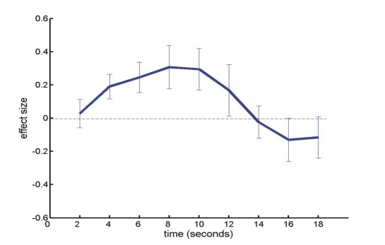
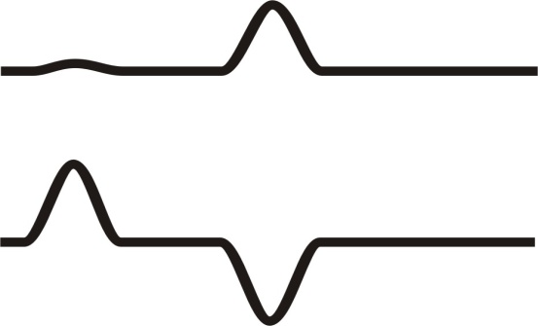
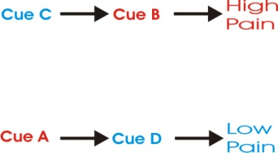
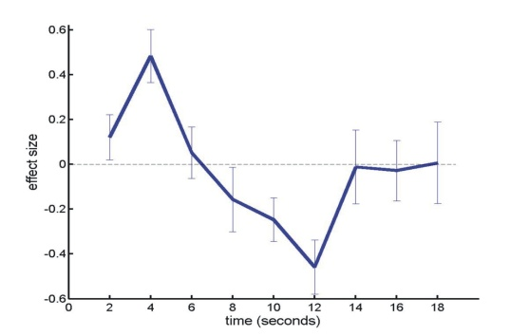
punishment prediction error
TD prediction error:
ventral striatum
Z=-4
R

Slide 35
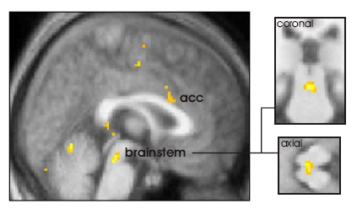
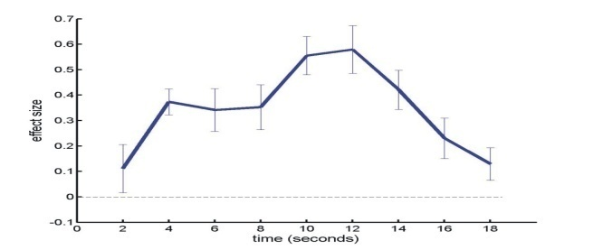
punishment prediction
dorsal raphe (5HT)?
right anterior insula

Slide 36
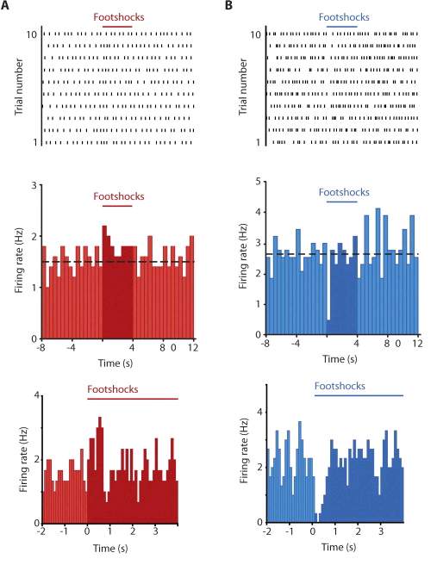
punishment
dips below baseline in dopamine
  Frank: D2 receptors particularly sensitive
  Bayer & Glimcher: length of pause related to size of negative prediction error
but:
  can’t afford to wait that long
  negative signal for such an important event
  opponency a more conventional solution:
    serotonin…

Slide 37
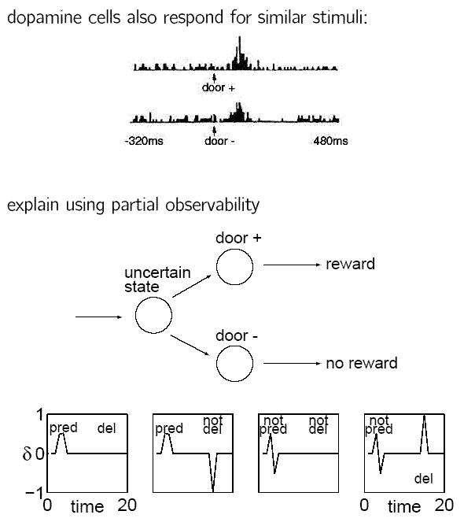
generalization

Slide 38
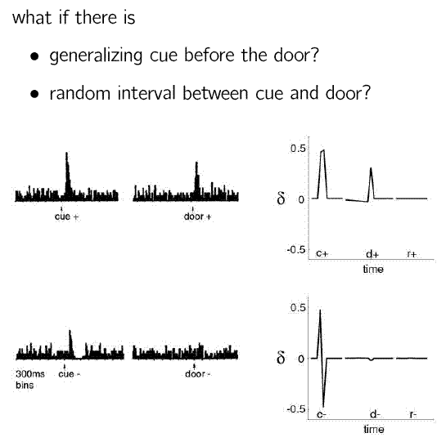
generalization

Slide 39
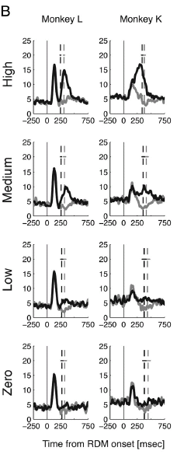
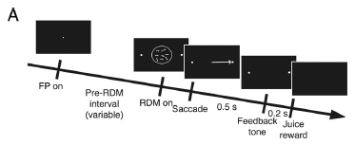
random-dot discrimination
differential reward (0.16ml; 0.38ml)
Sakagami (2010)

Slide 40
other paradigms
inhibitory conditioning
transreinforcer blocking
motivational sensitivities
backwards blocking
  Kalman filtering
downwards unblocking
primacy as well as recency (highlighting)
  assumed density filtering

Slide 41
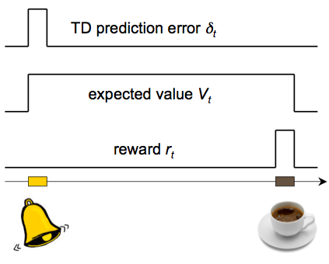
Summary of this part: prediction and RL
Prediction is important for action selection
The problem: prediction of future reward
The algorithm: temporal difference learning
Neural implementation: dopamine dependent learning in BG
A precise computational model of learning allows one to look in the brain for “hidden variables” postulated by the model
Precise (normative!) theory for generation of dopamine firing patterns
Explains anticipatory dopaminergic responding, second order conditioning
Compelling account for the role of dopamine in classical conditioning: prediction error acts as signal driving learning in prediction areas

Slide 42
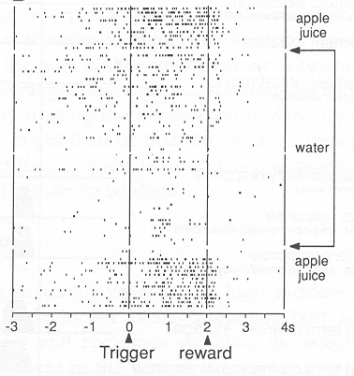
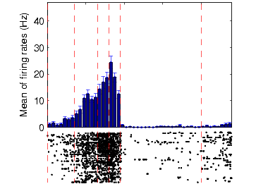
Striatum and learned values
Striatal neurons show ramping activity that precedes a reward (and changes with learning!)
start
food
(Daw)
(Schultz)

Slide 43
Phasic dopamine also responds to…
Novel stimuli
Especially salient (attention grabbing) stimuli
Aversive stimuli (??)
Reinforcers and appetitive stimuli induce approach behavior and learning, but also have attention functions (elicit orienting response) and disrupt ongoing behaviour.
→ Perhaps DA reports salience of stimuli (to attract attention; switching) and not a prediction error? (Horvitz, Redgrave)

