Slide 1

Learning the right thing with visual attributes
Kristen Grauman
Department of Computer Science
University of Texas at Austin
With Chao-Yeh Chen, Aron Yu, Fei Sha,
Dinesh Jayaraman, Adriana Kovashka
Notes:
1

Slide 2
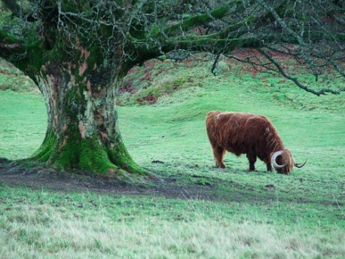
Beyond image labels
What does it mean to understand an image?
Cow
Tree
Grass
Labels
vs.
A lone cow grazes in a bright green pasture near an old tree, probably in the Scottish Highlands.
A lone cow grazes in a bright green pasture near an old tree, probably in the Scottish Highlands.
The story of an image
Kristen Grauman, UT Austin

Slide 3
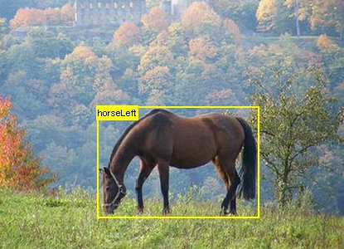
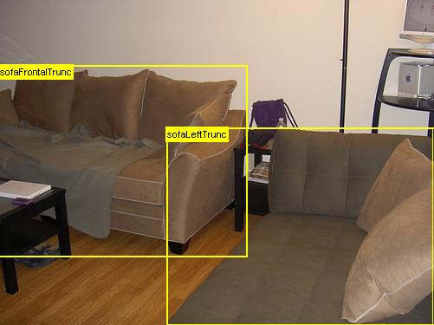
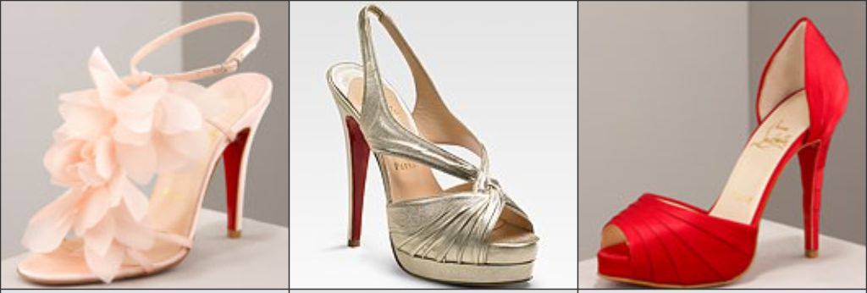
Attributes
high heel
outdoors
flat
metallic
brown
has-ornaments
red
four-legged
indoors
Mid-level semantic properties shared by objects
Human-understandable and machine-detectable
[Ferrari & Zisserman 2007, Kumar et al. 2008, Farhadi et al. 2009, Lampert et al. 2009, Endres et al. 2010, Wang & Mori 2010, Berg et al. 2010, Parikh & Grauman 2011, …]
Kristen Grauman, UT Austin

Slide 4
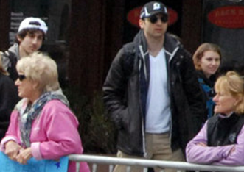
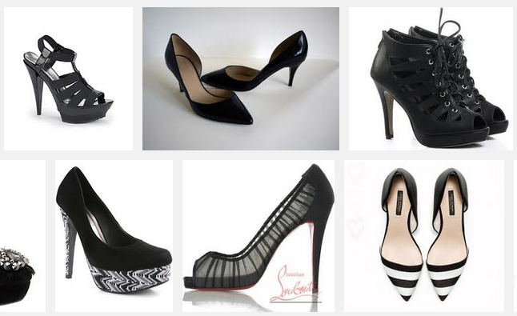
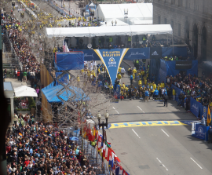
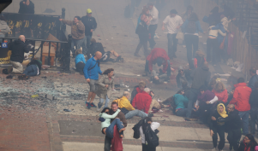
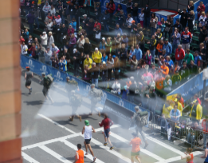
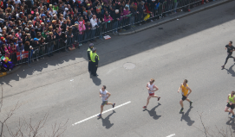
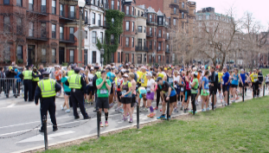
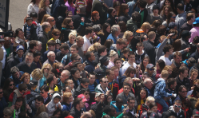
Using attributes: Visual search
Suspect #1: Male, sunglasses, black and white hat, blue shirt
“Like this…but more ornate”
Relative feedback
[Kovashka et al. 2012]
Person search
[Kumar et al. 2008, Feris et al. 2013]
Kristen Grauman, UT Austin

Slide 5
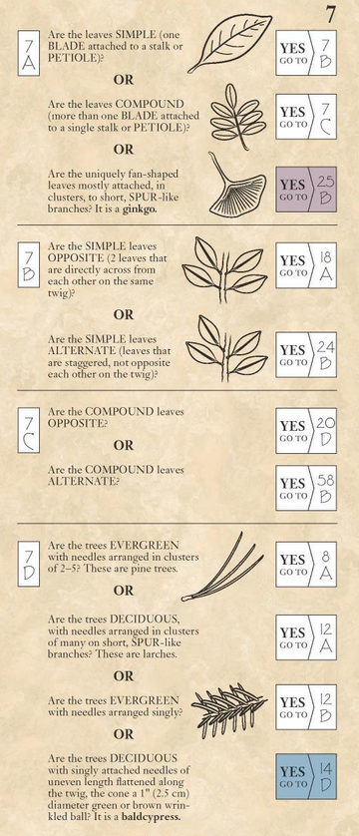
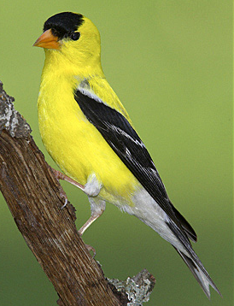

Using attributes: Interactive recognition
Computer Vision
Cone-shaped beak? yes
Computer Vision
American Goldfinch?
Kristen Grauman, UT Austin
[Branson et al. 2010, 2013]

Slide 6
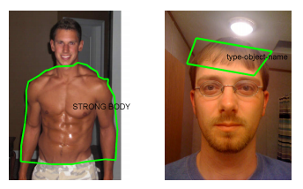
Using attributes: Semantic supervision
Band-tailed pigeons:
Mules:
White collar
Yellow feet
Shorter legs than donkeys
Yellow bill
Red breast
Shorter tails than horses
Training with relative descriptions
[Parikh & Grauman 2011,
Shrivastava & Gupta 2012]
Zero-shot learning
[Lampert et al. 2009]
Strong body
HOT
NOT HOT
Annotator rationales
[Donahue & Grauman 2011]
Kristen Grauman, UT Austin

Slide 7
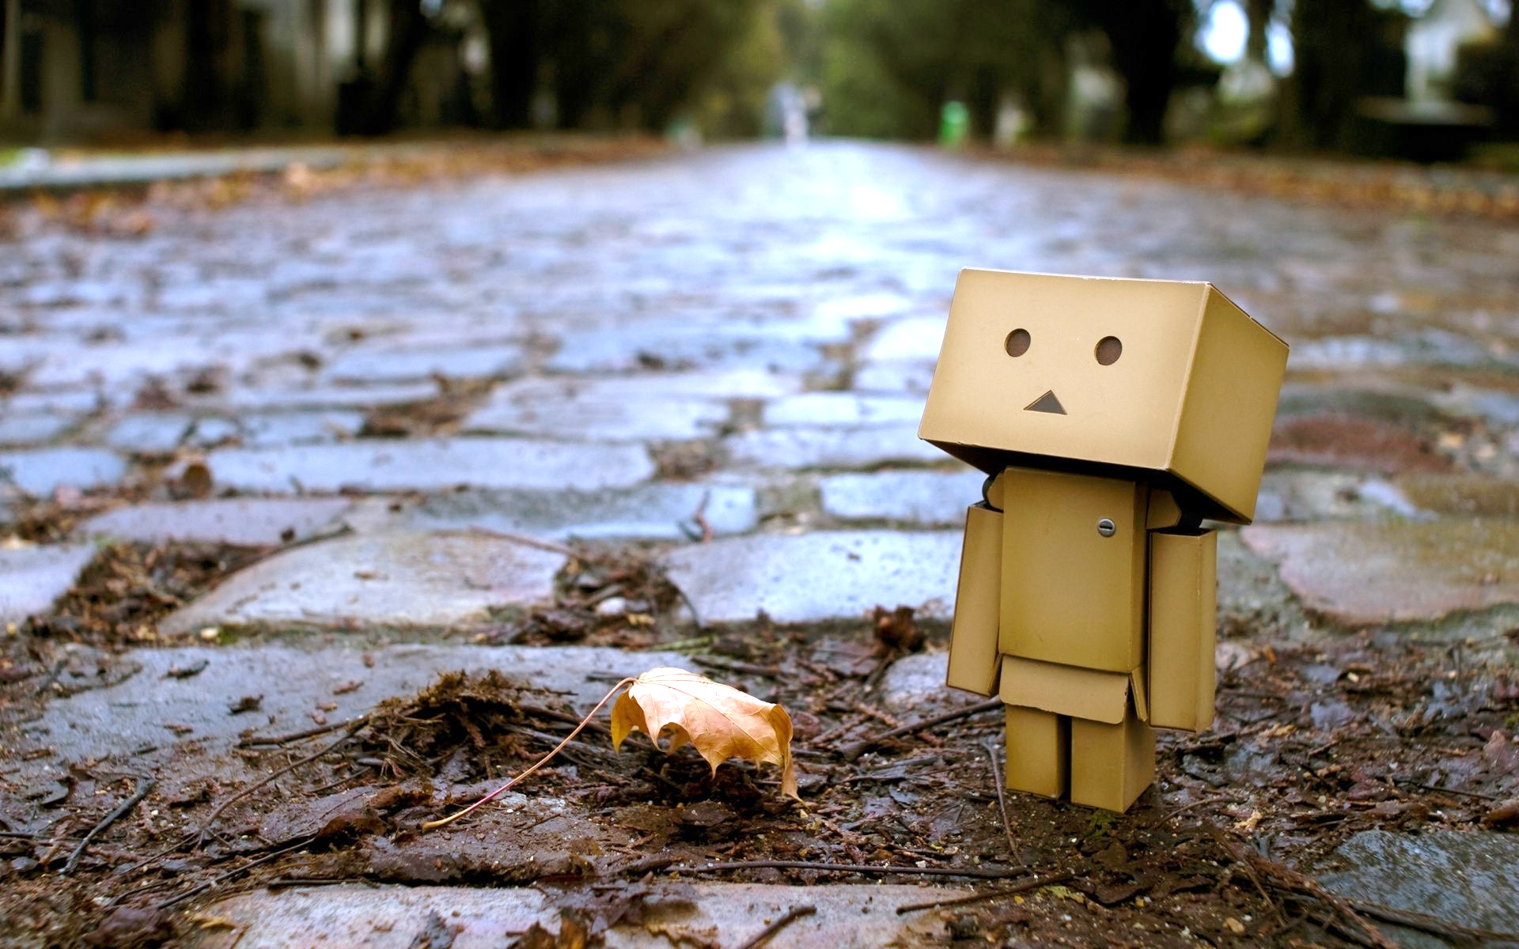
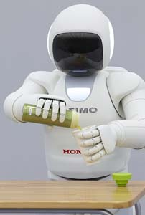
Using attributes: Affordances
Can I walk around here? Is this walkable?
How hard should I grip this? Is it brittle?
Slide credit: Devi Parikh

Slide 8
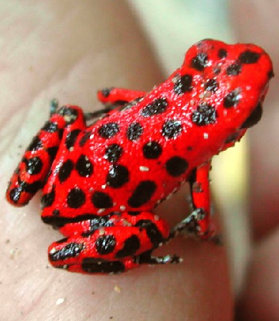
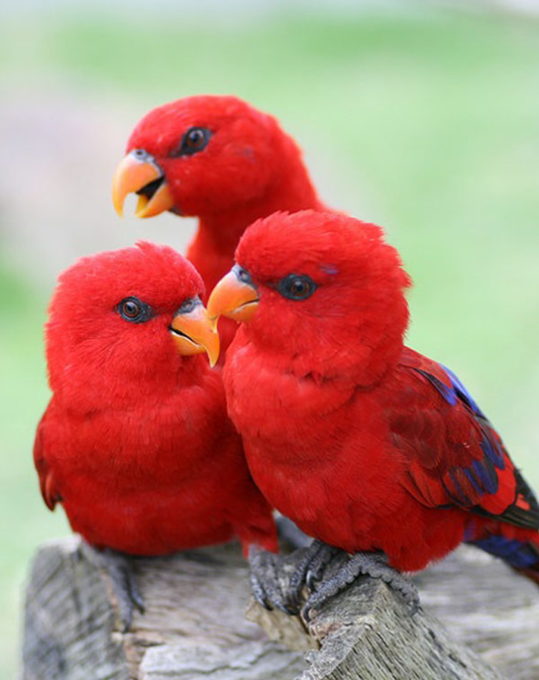
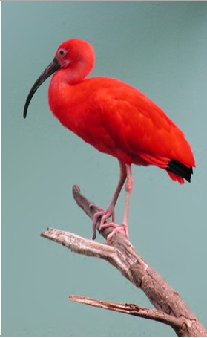
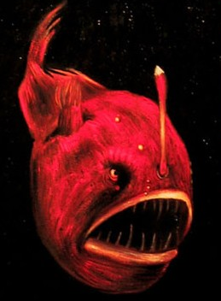
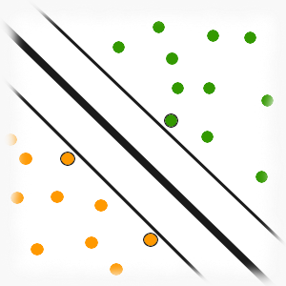
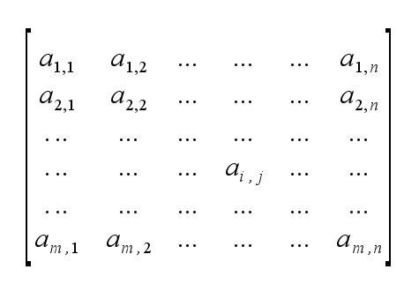
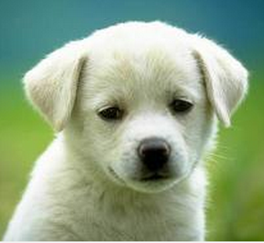
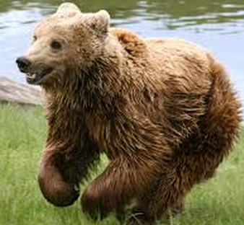
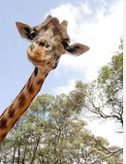
How attributes are typically learned
standard pipeline
Feature extraction
✓
Learning
✓
✓
✓
✓
✓
✓
✗
✗
✗
✗
✗
✗
Farhadi et al., CVPR 2009
Kumar et al., ECCV 2008
Kovashka et al., CVPR 2012
Lampert et al., CVPR 2009
Kumar et al., ECCV 2008
Yu et al., CVPR 2013, …
Kristen Grauman, UT Austin

Slide 9
Problem
With attributes, it’s easy to learn the wrong thing.
Incidental correlations
Spatially overlapping properties
Subtle visual differences
Partially category-dependent
Variance in human-perceived definitions
…yet applications demand that correct meaning be captured!
Kristen Grauman, UT Austin

Slide 10
Goal
Learn the right thing.
How to decorrelate attributes that often occur simultaneously?
Are attributes really class-independent?
How to detect fine-grained attribute differences?
How to account for differences in attribute perception?
Kristen Grauman, UT Austin

Slide 11
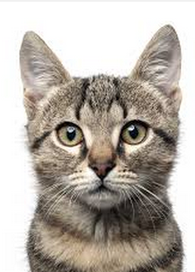

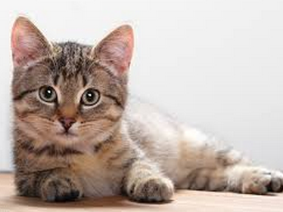
The curse of correlation
What will be learned from this training set?
Object Learning
✓
✓
✓
✗
✗
✗
Cat
Kristen Grauman, UT Austin

Slide 12
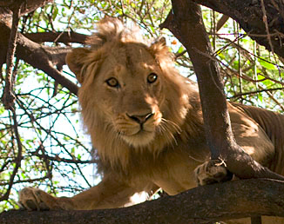
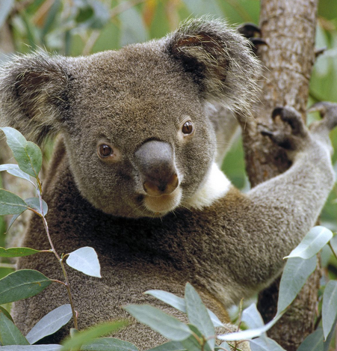
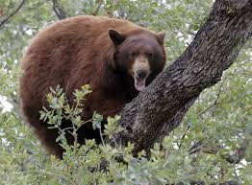
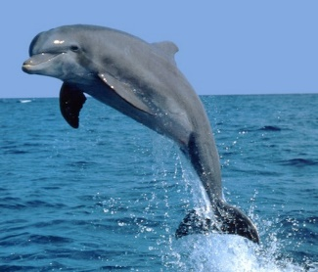
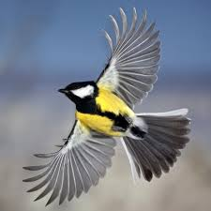
The curse of correlation
What will be learned from this training set?
Attribute Learning
✓
✓
✓
✗
✗
Forest animal?
Brown?
Has ears?
Combinations?
Problem: Attributes that often co-occur cannot be distinguished by the learner
Kristen Grauman, UT Austin

Slide 13
The curse of correlation
Forest animal
✓
✓
✓
✗
✗
Brown
✓
✓
✓
✗
✗
Problem: Attributes that often co-occur cannot be distinguished by the learner
Kristen Grauman, UT Austin

Slide 14

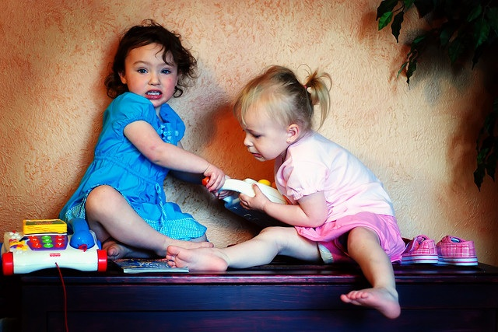
Idea: Resist the urge to share
Kristen Grauman, UT Austin

Slide 15
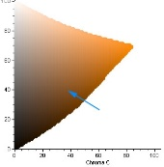
Idea: Resist the urge to share
Forest animal
“Compete” for features
✓
✓
✓
✗
✗
Brown
✓
✓
✓
✗
✗

Slide 16
Semantic attribute groups
Closely related attributes may share features
Assume attribute “groups” from external knowledge.

Slide 17
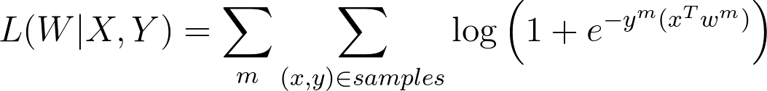
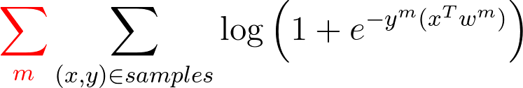
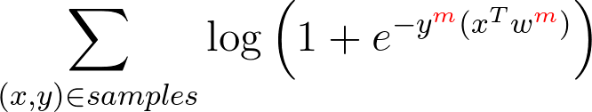
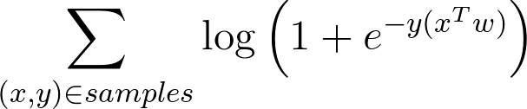







Standard approach: learning separately
Loss function:
feature dimensions
gray
hops
red
flys
furry
swims
brown
spots
patches

Slide 18


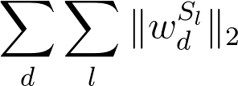

Proposed group-based formulation
S₁
motion
S₂
color
S₃
texture
Group-wise
weight matrix
Compute
row L2 norms
Penalize
row L1 norms
Penalize
row L2 norms
(inter-group competition)
(in-group sharing)
(feature sharing)
gray
hops
red
flies
furry
swims
brown
spots
patches
S₂:color
S₁:motion
S₃:texture
Jayaraman et al., CVPR 2014

Slide 19
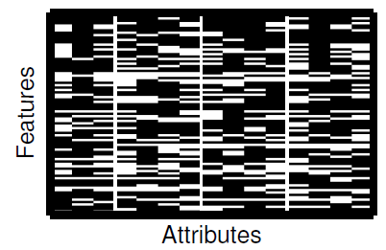
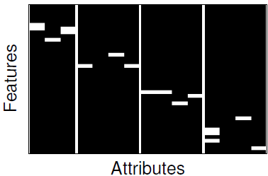
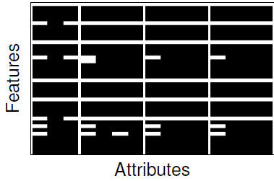
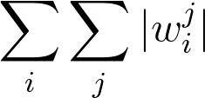
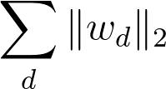

Formulation effect
Sparse features
(no relationships among attributes)
Ours
(inter-group competition,
in-group sharing)
Standard multi-task learning
(sharing and conflation
across groups)
Forest animal
Brown
Forest animal
Brown
Forest animal
Brown

Slide 20
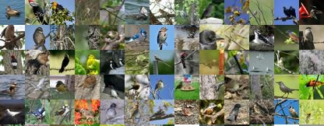
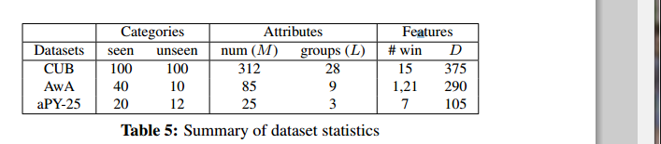
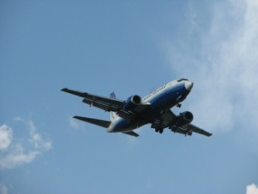
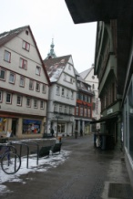
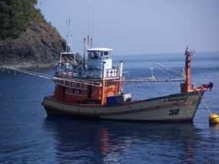


Datasets for attribute detection
Caltech-UCSD Birds 200
[Welinder et al., 2010]
6K images,
312 attributes, 28 groups
aPascal
[Farhadi et al., 2009]
12K images,
25 attributes, 3 groups
Animals with Attributes
[Lampert et al., 2009]
30K images,
85 attributes, 9 groups

Slide 21
Results – Attribute detection
By decorrelating attributes, our attribute detectors generalize much better to novel unseen categories.
(*) Argyriou et al, Multi-task Feature Learning, NIPS 2007
(~) Farhadi et al, Describing Objects by Their Attributes, CVPR 2009

Slide 22










Attribute detection example
Success cases
Not brown underparts
No eye
Not boxy
No mouth
No ear
Failure cases
No feather
Not furry
Eyeline
Black breast
Not vegetation

Slide 23








Attribute localization examples
Blue back
Brown wing
Olive back
Crested head
Standard
Our method avoids conflation to learn the correct semantic attribute.
Ours

Slide 24
Goal
Learn the right thing.
How to decorrelate attributes that often occur simultaneously?
Are attributes really class-independent?
How to detect fine-grained attribute differences?
How to account for differences in attribute perception?
Kristen Grauman, UT Austin

Slide 25


Problem
Are attributes really category-independent?
?
=
Fluffy dog
Fluffy towel
Kristen Grauman, UT Austin

Slide 26






An intuitive but impractical solution
Learn category-specific attributes?
Impractical!
Would need examples for all category-attribute combinations…
Fluffy dogs
Non-fluffy dogs
Kristen Grauman, UT Austin

Slide 27









Idea: Analogous attributes
Given sparse set of category-specific models, infer “missing” analogous attribute classifiers
1
Learned category-sensitive attributes
2
Inferred attribute
Attribute
Spotted
Striped
Brown
?? =
??
+
No training examples
+
-
Dog
-
3
Prediction
Category
No training examples
-
-
+
Equine
+
+
A striped dog? Yes.
Kristen Grauman, UT Austin
Chen & Grauman, CVPR 2014

Slide 28

Transfer via tensor completion
Construct sparse object-attribute classifier tensor
Discover low-d latent factors and infer missing classifiers (the analogous attributes)
Classifier dimension
Classifier dimension
W
W
Category
Category
Attribute
Attribute
Bayesian probabilistic tensor factorization [Xiong et al., SDM 2010].

Slide 29


Datasets
ImageNet attributes
  9600 images
  384 object categories
  25 attributes
  1498 object-attribute pairs available
SUN attributes
  14340 images
  280 object categories
  59 attributes
  6118 object-attribute pairs available
[Russakovsky & Fei-Fei 2010]
[Patterson & Hays 2012]
Kristen Grauman, UT Austin

Slide 30


Inferring class-sensitive attributes
84 total attributes, 664 object/scene classes
Our approach infers all 18K “missing” classifiers → savings of 348K labeled images
Average mAP
Category-sensitive outperforms status quo 76% of the time, average gain of 15 points in AP
Kristen Grauman, UT Austin
Chen & Grauman, CVPR 2014

Slide 31




















Which attributes are analogous?
1
Shiny, wooden, wet
White, gray, wooden
2
Brown, red, yellow
Red, long, yellow
Attribute classifiers most similar to query category’s
Gray, smooth, rough
White, gray, red
Brown, red, long
Brown, white, red
Neighboring object categories in latent space
Socializing, railing, eating
Metal, gaming, leaves
3
Tiles, metal, wire
Conducting business, carpet, foliage
4
Congregating, cleaning, socializing
Conducting business, carpet, foliage
Grass, wire, working
Working, paper, sailing/boating
Kristen Grauman, UT Austin
Chen & Grauman, CVPR 2014

Slide 32
Goal
Learn the right thing.
How to decorrelate attributes that often occur simultaneously?
Are attributes really class-independent?
How to detect fine-grained attribute differences?
How to account for differences in attribute perception?
Kristen Grauman, UT Austin

Slide 33






Relative attributes
Use ordered image pairs to train a ranking function:
Ranking function
=
…,
Image features
“smiling more than”
[Parikh & Grauman, ICCV 2011; Joachims 2002]
Kristen Grauman, UT Austin

Slide 34



Relative attributes
Rather than simply label images with their properties,
Not bright
Smiling
Not natural
Kristen Grauman, UT Austin

Slide 35


















Relative attributes
We can compare images by attribute’s “strength”
bright
smiling
natural
Kristen Grauman, UT Austin
[Parikh & Grauman, ICCV 2011]

Slide 36

Problem: Fine-grained attribute comparisons
Which is more comfortable?
Kristen Grauman, UT Austin

Slide 37










Idea: Local learning for fine-grained relative attributes
  Lazy: Train query-specific model on the fly.
  Local: Use only pairs that are similar/relevant to test case.
:
Test comparison
Relevant nearby training pairs
Kristen Grauman, UT Austin
Yu & Grauman, CVPR 2014

Slide 38
Idea: Local learning for fine-grained relative attributes
w
Global
Vs.
Local
more
2
2
?
?
1
1
more
less
w
less
Kristen Grauman, UT Austin
Yu & Grauman, CVPR 2014

Slide 39

















































Learning attribute-specific metrics
Determine neighbor pairs based on learned distance
Zap50K (pointy) |  | OSR (open) |  | PubFig (smiling)
vs. |  | vs. |  | vs.
FG-LocalPair | LocalPair | FG-LocalPair | LocalPair | FG-LocalPair | LocalPair
We use Information-Theoretic Metric Learning [Davis et al. ICML ‘07]

Slide 40












Datasets
Public Figures
[Kumar et al., ICCV 2009]
Outdoor Scenes
[Oliva & Torralba, IJCV 2001]
UT Zappos50K
[Yu & Grauman, CVPR 2014]
Kristen Grauman, UT Austin

Slide 41









UT Zappos50K Dataset
Large shoe dataset, consisting of 50,025 catalog images from Zappos.com
Coarse
  4 relative attributes
  High quality pairwise labels from mTurk workers
  6,751 ordered labels + 4,612 “equal” labels
  4,334 twice-labeled fine-grained labels (no “equal” option)
>
>
Fine-Grained
>
>
“open”
Yu & Grauman, CVPR 2014
Kristen Grauman, UT Austin

Slide 42

Results: Fine-grained attributes
Accuracy of comparisons – all attributes
Accuracy on the 30 hardest test pairs
Kristen Grauman, UT Austin
Yu & Grauman, CVPR 2014

Slide 43















Idea: Predicting useful neighborhoods
Most relevant points = most similar points?
Pose as large-scale multi-label classification problem
. . .
. . .
$$y_{n}$$
$\hat{y_{q}}$
= [0, 0, 0, 1, 1, …, 1, 0]
= [1, 0, 1, 1, 0, …, 0, 1]
$$φ$$
Reconstruct
$$f_{}$$
$$z_{n}$$
$$f_{}$$
$$x_{n}$$
$$x_{q}$$
Compressed label space
Training
Testing
Kristen Grauman, UT Austin
[Yu & Grauman NIPS 2014]

Slide 44












































Predicting useful neighborhoods
SUN Attribute Dataset: 14,340 images, 707 classes
“hiking”
“eating”
Local
Local
Ours
Ours
“exercise”
“clouds”
Local
Local
Ours
Ours
Kristen Grauman, UT Austin
Yu & Grauman, NIPS 2014

Slide 45
Goal
Learn the right thing.
How to decorrelate attributes that often occur simultaneously?
Are attributes really class-independent?
How to detect fine-grained attribute differences?
How to account for differences in attribute perception?
Kristen Grauman, UT Austin

Slide 46



Standard approach
Learn one monolithic model per attribute
Vote on labels
“formal”
Annotator A
“not formal”
Annotator B
Annotator C
Kristen Grauman, UT Austin

Slide 47


Problem
There may be valid perceptual differences within an attribute.
Formal?
User labels:
50% “yes”
50% “no”
More ornamented?
User labels:
50% “first”
20% “second”
30% “equally”
or
Binary attribute
Relative attribute
Simple consensus model is insufficient for some attributes
Kristen Grauman, UT Austin

Slide 48

Imprecision of attributes
Fine-grained meaning
Overweight?
or just
Big-boned?

Slide 49

Imprecision of attributes
Context
Is formal?
= formal wear for a conference? OR
= formal wear for a wedding?
Kristen Grauman, UT Austin

Slide 50

Imprecision of attributes
Cultural
color is…
“голубой”
(azure)
“blue”
“青”
(blue and green)
Kristen Grauman, UT Austin

Slide 51


Imprecision of attributes
Cultural
Is
fashionable?
No
No
Yes!
Kristen Grauman, UT Austin

Slide 52





Idea: Adapting attributes
Vote on labels
“formal”
Adapt
“not formal”
“formal”
“formal”
“not
formal”
“not formal”
[Kovashka and Grauman, ICCV 2013]
Kristen Grauman, UT Austin

Slide 53

Adapted attribute accuracy
3 datasets
22 attributes
75 total users
Kristen Grauman, UT Austin

Slide 54

Adapted attribute accuracy
3 datasets
22 attributes
75 total users
Kristen Grauman, UT Austin

Slide 55

Adapted attribute accuracy
3 datasets
22 attributes
75 total users
Kristen Grauman, UT Austin

Slide 56

Adapted attribute accuracy
Adaptation approach most accurately captures perceived attributes
[Kovashka and Grauman, ICCV 2013]
Kristen Grauman, UT Austin

Slide 57






















Which images most influence adaptation?
pointy
open
bright
ornamented
shiny
high-heeled
long
formal
sporty
feminine
sailing
vacationing
hiking
camping
socializing
shopping
vegetation
clouds
natural light
cold
open area
horizon far

Slide 58




























Visualizing adapted attributes
Shoes – Relative Attributes – “Formal”
generic
less
more
adapted
SUN – Binary Attributes – “Vacationing”
generic
less
more
adapted
Kristen Grauman, UT Austin

Slide 59


Personalizing image search
with adapted attributes
“white shiny heels”
“shinier than ”
Match rate
Kristen Grauman, UT Austin

Slide 60
Summary
Attribute learning is more nuanced than object learning
Essential that language and visual concepts align
Ideas:
  Explicitly decorrelate attribute classifiers
  Transfer between analogous attribute-object models
  Fine-grained comparisons via lazy local learning
  Adapting attribute models to account for individual perception
high heel
outdoors
flat
metallic
brown
has-ornaments
red
four-legged
indoors
Kristen Grauman, UT Austin

Slide 61
References
Predicting Useful Neighborhoods for Lazy Local Learning. A. Yu and K. Grauman. In Advances in Neural Information Processing Systems (NIPS), Montreal, Canada, Dec 2014.
Fine-Grained Visual Comparisons with Local Learning. A. Yu and K. Grauman. In Proceedings of the IEEE Conference on Computer Vision and Pattern Recognition (CVPR), Columbus, Ohio, June 2014
Decorrelating Semantic Visual Attributes by Resisting the Urge to Share. D. Jayaraman, F. Sha, and K. Grauman. In Proceedings of the IEEE Conference on Computer Vision and Pattern Recognition (CVPR), Columbus, Ohio, June 2014.
Inferring Analogous Attributes. C.-Y. Chen and K. Grauman. In Proceedings of the IEEE Conference on Computer Vision and Pattern Recognition (CVPR), Columbus, Ohio, June 2014.
Attribute Adaptation for Personalized Image Search. A. Kovashka and K. Grauman. In Proceedings of the IEEE International Conference on Computer Vision (ICCV), Sydney, Australia, December 2013.
WhittleSearch: Image Search with Relative Attribute Feedback. A. Kovashka, D. Parikh, and K. Grauman. In Proceedings of the IEEE Conference on Computer Vision and Pattern Recognition (CVPR), Providence, RI, June 2012.

