Slide 1


Fast Algorithms for Structured Sparsity
Piotr Indyk
Joint work with C. Hegde and L. Schmidt (MIT),
J. Kane and L. Lu and D. Hohl (Shell)

Slide 2
Sparsity in data
Data is often sparse
  In this talk, “data” means some x ∈ R^{n}
n-pixel seismic image
n-pixel Hubble image (cropped)
Data can be specified by values and locations of their k large coefficients (2k numbers)

Slide 3
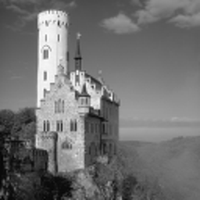
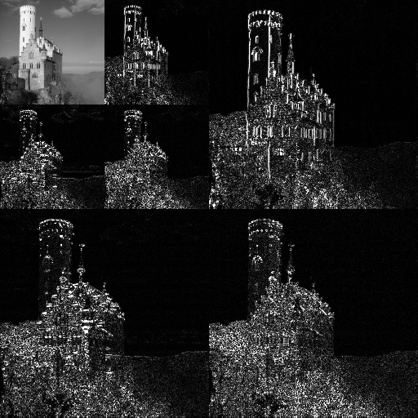
Sparsity in data
Data is often sparsely expressed using a suitable linear transformation
Wavelet transform
pixels
large wavelet coefficients
Data can be specified by values and locations of their k large wavelet coefficients (2k numbers)

Slide 4
Sparse = good
Applications:
  Compression: JPEG, JPEG 2000 and relatives
  De-noising: the “sparse” component is information, the “dense” component is noise
  Machine learning
  Compressive sensing - recovering data from few measurements (more later)
  …

Slide 5
Beyond sparsity
Notion of sparsity captures
simple primary structure
But locations of large coefficients often exhibit rich secondary structure

Slide 6
Today
Structured sparsity:
  Models
  Examples: Block sparsity,Tree sparsity, Constrained EMD, Clustered Sparsity
Efficient algorithms: how to extract structured sparse representations quickly
Applications:
  (Approximation-tolerant) model-based compressive sensing

Slide 7
Modeling sparse structure
[Blumensath-Davies’09]
Def: Specify a list of p allowable sparsity patterns
M = {Ω₁, . . . , Ω_{p} } where Ω_{i} ⊆ [n], |Ω_{i}|≤k
Then, a structured sparsity model is the space of signals supported on one of the patterns in M
M = {x ∈ R^{n} | ∃ Ω_{i} ∈ Ω : supp(x ) ⊆ Ω_{i} }
M
n = 5, k = 2
p = 4
Notes:
.

Slide 8
Model I: Block sparsity
“Large coefficients cluster together”
Parameters: k, b (block length) and l (number of blocks)
The range {1…n} is partitioned into b-length blocks B₁…B_{n/b}
M contains all combinations of l blocks, i.e.,
  M={ B_{i1}∪…∪B_{il}:i₁,..,i_{l}∈{1..n/b} }
Total sparsity: k=bl
b=3, l=1, k=3

Slide 9
Model II: Tree-sparsity
“Large coefficients cluster on a tree”
Parameters: k,t
Coefficients are nodes in a full t-ary tree
M is the set of all rooted connected subtrees of size k

Slide 10
Model III: Graph sparsity
Parameters: k, g, graph G
Coefficients are nodes in G
M contains all subgraphs with k nodes and clustered into g connected components

Slide 11
Algorithms ?
Structured sparsity model specifies a hypothesis class for signals of interest
For an arbitrary input signal x, model projection oracle extracts structure by returning the “closest” signal in model
M(x) = argmin_{Ω∈M} ||x-x_{Ω}||₂

Slide 12
Algorithms for model projection
Good news: several important models admit projection oracles with polynomial time complexity
Bad news:
  Polynomial time is not enough. E.g., consider a ‘moderate’ problem: n = 10 million, k = 5% of n. Then, nk > 5 x 10¹²
  For some models (e.g., graph sparsity), model projection is NP-hard
Blocks
Trees
Block thresholding
linear time: O(n)
Dynamic programming
rectangular time: O(nk) [Cartis-Thompson ’13]

Slide 13
Approximation to the rescue
Instead of finding an exact solution to the projection
M(x) = argmin_{Ω∈M} ||x-x_{Ω}||₂
we solve it approximately (and much faster)
What does “approximately” mean ?
  (Tail) ||x-T(x)||≤ C_{T} argmin_{Ω∈M} ||x-x_{Ω}||₂
  (Head) ||H(x)||≥ C_{H} argmax_{Ω∈M} ||x_{Ω}||₂
Choice depends on applications
  Tail: works great if approximation error is small
  Head: meaningful output even if approximation is not good
For compressive sensing application we need both !
Note: T(x) and H(x) might not report k-sparse vectors
  But in all examples in this talk they do report O(k)-sparse vectors from the (slightly larger) model

Slide 14
We will see
Tree sparsity
  Exact: O(kn) [Cartis-Thompson, SPL’13]
  Approximate (H/T): O(n log² n) [Hegde-Indyk-Schmidt, ICALP’14]
Graph sparsity
  Approximate: O(n log⁴n) [Hegde-Indyk-Schmidt,ICML’15]
  (based on Goemans-Williamson’95)

Slide 15
Tree sparsity
(Tail) ||x-T(x)||≤ C_{T} argmin_{Ω∈Tree} ||x-x_{Ω}||₂
(Head) ||H(x)||≥ C_{H} argmax_{Ω∈Tree} ||x_{Ω}||₂
 | Runtime | Guarantee
Bohanec-Bratko ‘94 | O(n²) | Exact
Cartis-Thompson ‘13 | O(nk) | Exact
Baraniuk-Jones ‘94 | O(n log n) | ?
Donoho ‘97 | O(n) | ?
Hegde-Indyk-Schmidt’14 | O(n log n + k log² n) | Approx. Head
Hegde-Indyk-Schmidt’14 | O(n log n) | Approx. Tail

Slide 16
Exact algorithm
OPT[t,i] = max_{|Ω|≤t, Ω tree rooted at i} ||x_{Ω}||₂²
Recurrence:
  If t>0 then
OPT[t,i] =max_{0≤s≤t-1}OPT[s,left(i)]+OPT[t-1-s,right(i)]+x_{i}²
  If t=0 then OPT[0,i]=0
Space:
  On level l: 2^{l} *n/2^{l} = n
  Total: n log n
Running time:
  On level l s.t. 2^{l}<k: n*2^{l}
  On level l s.t. 2^{l} ≈k: nk
  On level l+1: nk/2
  …
  Total: O(nk)

Slide 17
Approximate Algorithms
Approximate “tail” oracle:
  Idea: Lagrange relaxation + Pareto curve analysis
Approximate “head” oracle:
  Idea: Submodular maximization

Slide 18
Head approximation
Want to approximate:
Lemma: The optimal tree can be always broken up into disjoint trees of size O(log n)
Greedy approach: compute exact projections with sparsity level O(log n), assemble pieces
||H(x)||≥ C_{H} argmax_{Ω∈Tree} ||x_{Ω}||₂

Slide 19
Head approximation
Want to approximate:
Greedy approach:
  Pre-processing: execute DP for exact tree sparsity, sparsity O(log n)
  Repeat k/log n times:
    Select the best O(log n)-sparse tree
    Set the corresponding coordinates to zero
    Update the data structure
||H(x)||≥ C_{H} argmax_{Ω∈Tree} ||x_{Ω}||₂

Slide 20
Graph sparsity
Specification:
  Parameters: k, g, graph G
  Coefficients are nodes in G
  M contains all subgraphs with k nodes and clustered into g connected components
Can be generalized by adding edge weight constraints
NP-hard

Slide 21
Approximation Algorithms
Consider g=1 (single component):
min_{|Ω|≤k, Ω tree} ||x_{[n]-Ω}||₂²
Langrange relaxation:
min_{Ω tree} ||x_{[n]-Ω}||₂² +λ|Ω|
Prize-Collecting Steiner Tree!
  2-approximation algorithm
  [Goemans-Williamson’95]
  Can get nearly-linear running time using dynamic edge splitting idea [Cole, Hariharan, Lewenstein, Porat, 2001]
[Hegde-Indyk-Schmidt, ICML’15]:
  Improve the runtime
  Use to solve head/tail formulation for the weighted graph sparsity model
  Leads to measurement-optimal compressive sensing scheme for a wide collection of models

Slide 22

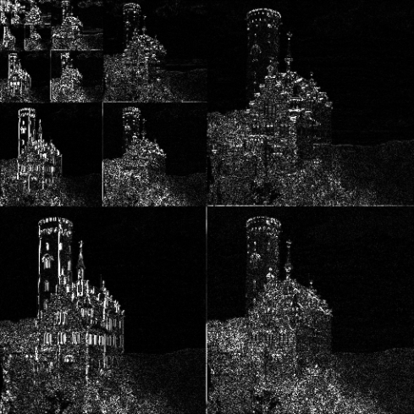
Compressive sensing
Setup:
  Data/signal in n-dimensional space : x
  E.g., x is an 256x256 image ⇒ n=65536
  Goal: compress x into Ax ,
  where A is a m x n “measurement” or “sketch” matrix, m << n
Goal: want to recover an “approximation” x* of k-sparse x from Ax+e, i.e.,
  ||x*-x||≤ C ||e||
Want:
  Good compression (small m=m(k,n))
  Efficient algorithms for encoding and recovery
A
=
Ax
m=O(k log (n/k)) [Candes-Romberg-Tao’04,….]
x
O(n log n) [Needell-Tropp’08, Indyk-Ruzic’08, …]

Slide 23
Model-based compressive sensing
Setup:
  Data/signal in n-dimensional space : x
  E.g., x is an 256x256 image ⇒ n=65536
  Goal: compress x into Ax ,
  where A is a m x n “measurement” or “sketch” matrix,
  m << n
Goal: want to recover an “approximation” x* of k-sparse x from Ax+e, i.e.,
  ||x*-x||≤ C ||e||
Want:
  Good compression (small m=m(k,n))
  m=O(k log (n/k)) [Blumensath-Davies’09]
  Efficient algorithms for encoding and recovery:
    Exact model projection [Baraniuk-Cevher-Duarte-Hegde, IT’08]
    Approximate model projection [Hegde-Indyk-Schmidt, SODA’14]
A
=
Ax
x

Slide 24
Grah sparsity: experiments
[Hegde-Indyk-Schmidt, ICML’15]

Slide 25
Running time

Slide 26
Conclusions/Open Problems
We have seen:
  Approximation algorithms for structured sparsity in near-linear time
  Applications to compressive sensing
There is more:
  “Fast Algorithms for Structured Sparsity”, EATCS Bulletin, 2015.
Some open questions:
  Structured matrices:
    Our analysis assumes matrices with i.i.d. entries
    Our experiments use partial Fourier/Hadamard
    Would be nice to extend the analysis to partial Fourier/Hadamard or sparse matrices
  Hardness: Can we prove that exact tree-sparsity requires kn time (under 3SUM, SETH etc) ?

